Slide 1
MVVM and LiveData
Info5126 :
Mobile Development Advanced

Slide 2
MVVM Advantages and Disadvantages
MVVM pattern has many advantages for apps which separates the UI from the core logic of an app
Advantages
Maintainability
Testability
Extensibility
Easy UI Edits
Disadvantages
Overhead for small apps
Harder to design
Debugging

Slide 3
History
Model-View-Controller (MVC )
Was also based off the observer design pattern
The following design patterns evolved with the evolution of UI
Model-View-Presenter (MVP)
Model-View-View Model (MVVM)

Slide 4
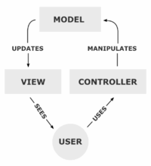
Model – View – Controller (MVC)

Slide 5
MVC
A controller can send commands to its associated view to change the view's presentation of the model (e.g., by scrolling through a document). It can also send commands to the model to update the model's state (e.g., editing a document).
A model notifies its associated views and controllers when there has been a change in its state. This notification allows the views to produce updated output, and the controllers to change the available set of commands. A passive implementation of MVC omits these notifications, because the application does not require them or the software platform does not support them.
A view requests from the model the information that it needs to generate an output representation to the user.

Slide 6
Observer Pattern
The observer pattern is a software design pattern in which an object, called the subject, maintains a list of its dependents, called observers, and notifies them automatically of any state changes, usually by calling one of their methods. It is mainly used to implement distributed event handling systems. The Observer pattern is also a key part in the familiar Model View Controller (MVC) architectural pattern.
https://docs.microsoft.com/en-us/previous-versions/msp-n-p/ee817669(v=pandp.10)?redirectedfrom=MSDN

Slide 7
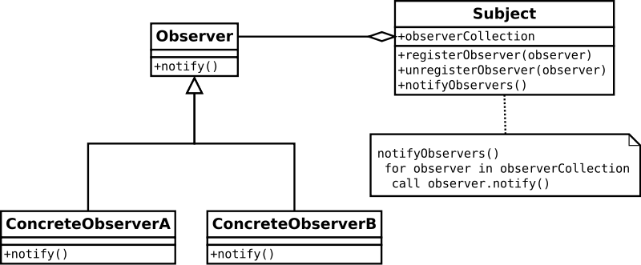
Observer Pattern

Slide 8
Model-view-presenter
Model–view–presenter (MVP) is a derivative of the model–view–controller (MVC) software pattern, also used mostly for building user interfaces.
In MVP the presenter assumes the functionality of the "middle-man" (played by the controller in MVC). In MVP, all presentation logic is pushed to the presenter. Eventually, the model becomes strictly a domain model.
The Model now does not talk directly to the view

Slide 9
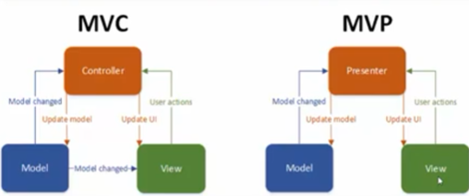
MVP

Slide 10
Model – View – View Model
MVVM stands for Model, View, ViewModel.
Model: This holds the data of the application. It cannot directly talk to the View. Generally, it’s recommended to expose the data to the ViewModel through Observables.
View: It represents the UI of the application devoid of any Application Logic. It observes the ViewModel.
ViewModel: It acts as a link between the Model and the View. It’s responsible for transforming the data from the Model. It provides data streams to the View. It also uses hooks or callbacks to update the View. It’ll ask for the data from the Model.
Notes:
WPF- Windows Presentation Framework

Slide 11
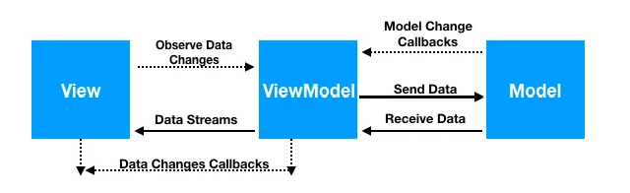
MVVM
Interaction between View – ViewModel - Model

Slide 12
ViewModel
The view classes have no idea that the model classes exist, while the ViewModel and model are unaware of the view.
Very loosely coupled design (A good thing)
The ViewModel class also allows data to survive device-configuration changes such as screen rotations and changes to keyboard availability

Slide 13
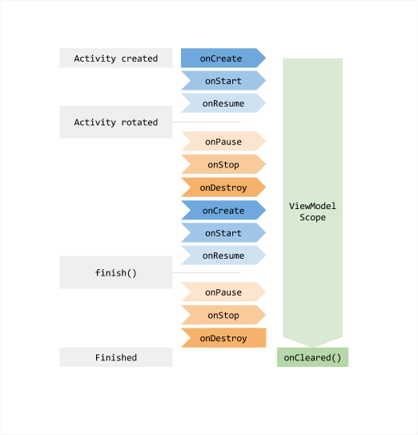
ViewModel Lifecycle

Slide 14
Create your ViewModel file
The ViewModel file should be based off the ViewModel()
class MainViewModel: ViewModel()
The ViewModel file has the following lifecycle callbacks
init : When created
onCleared() : When destroyed

Slide 15
Let your Activity file know about the ViewModel
Create an instance of your ViewModel in the Activity
Always use the ViewModelProvider to get the instance of your ViewModel
private lateinit var viewModel: MainViewModel
// initializing the viewModel
viewModel = ViewModelProvider(this).get(MainViewModel::class.java)
Use viewModel to access the elements of the ViewModel file needed

Slide 16
Live Data
LiveData is an observable data holder class
Unlike regular observables, LiveData is LifeCycle Aware
Pros
Ensures your UI matches your data state
No memory leaks
No crashes due to stopped activities
No more manual lifecycle handling
Always up to date data
Proper configuration changes
Sharing resources

Slide 17
Working with LiveData objects
Create an instance of LiveData, usually done within your ViewModel class
Create an Observer object that defines the onChanged() method that controls what happens when the LiveData object’s held data changes, usually done within your activity or fragment
Attach the Observer object to the LiveData object using the observe() method. This subscribes the Observer object to the LiveData object so that it is notified of changes.

Slide 18
Creating LiveData objects (ViewModel)
class NameViewModel : ViewModel() { // Create a LiveData with a String val currentName: MutableLiveData<String> by lazy { MutableLiveData<String>() } // Rest of the ViewModel... }

Slide 19
Observe LiveData objects
class NameActivity : AppCompatActivity() { // Use the 'by viewModels()' Kotlin property delegate // from the activity-ktx artifact private val model: NameViewModel by viewModels() override fun onCreate(savedInstanceState: Bundle?) { super.onCreate(savedInstanceState) // Other code to setup the activity... // Create the observer which updates the UI. val nameObserver = Observer<String> { newName -> // Update the UI, in this case, a TextView. nameTextView.text = newName } // Observe the LiveData, passing in this activity as the LifecycleOwner and the observer. model.currentName.observe(this, nameObserver) } }

Slide 20
Update LiveData objects
button.setOnClickListener { val anotherName = "John Doe" model.currentName.setValue(anotherName) }

