Slide 1
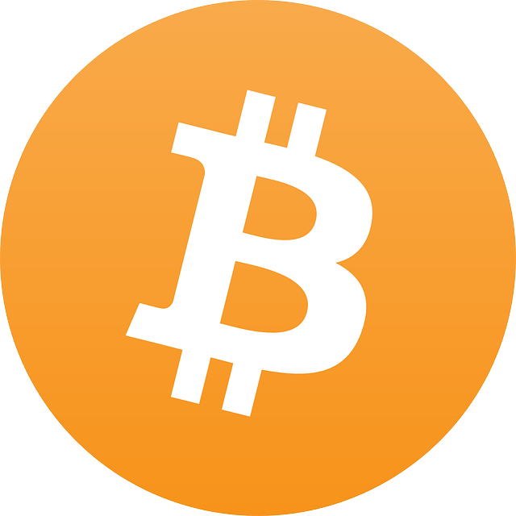
Bitcoin
Regulations and Revenue
Digital Currency, Real Revenue

Slide 2
About me
Todd Erickson-
Bitcoin Foundation, Regulatory Affairs Committee
Professional background:
Senior Vice President and COO in a Credit Union
President of a CUSO
Senior role in organizations in Government, Destination Resorts, Restaurants, Banks and also as an euntrapenuer
A Lifetime Technologist and Austrian Economics
Owns and operates a Horse Park
Digital Currency, Real Revenue

Slide 3
The Invention of Bitcoin
“Satoshi Nakamoto” https://bitcoin.org/bitcoin.pdf (2008)
Bitcoin: A Peer-to-Peer Electronic Cash System
- Abstract: A purely peer-to-peer version of electronic cash would allow online payments to be sent directly from one party to another without going through a financial institution
Solves the Byzantine General’s Problem
For decades, it was widely considered to be unsolvable among top computer scientists.

Slide 4
Bitcoin allows...
→ The publicly verifiable transfer of the ownership of an asset (or fractional portion) without requiring a trusted 3rd party
Person #1
Person #2
+1 - .00000001

Slide 5
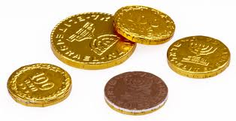
Historical Transfer Model
→ Possession was Law
→ Currency: Commodities, Metals
→ Limitations: Portability, Fungibility
Person #1
Person #2
Store of Wealth
Financial
Institution

Slide 6
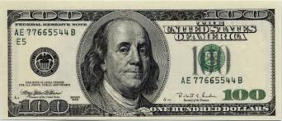
Modern Transfer Model
→ Trusted 3rd Party
→ Currency: Paper (Fiat)
→ Limitations: Durability, Fungibility, Portability
Person #1
Person #2
Method of payment
Financial
Institution
Store of Wealth

Slide 7
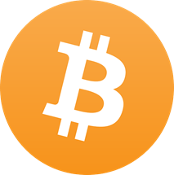
Digital Transfer Model
→ 2 party transfers
→ Currency: CryptoCurrency
→ Limitations: Intrinsic value
Method of payment
Person #1
Person #2
Store of Wealth
Financial
Institution
????

Slide 8
Bitcoin is...
→ Electronic Cash, Currency of the Internet, Money 2.0
→ The internationalization of money
→ Facilites the global commoditization of labor
Bitcoin
→ A Distributed Global Payment Network
bitcoin
→ A Digital Currency Unit

Slide 9
bitcoin the Currency
Aristotle’s Four Criteria for Money
Durability: No decay, and like the internet, there’s no single point of failure
Portability: Carry millions on a phone, thumb drive, or even in your brain
Fungibility: Divisible to 0.00000001, each one identical and interchangeable with all others
Intrinsic Value?: Useful, scarce, programmable money...or not

Slide 10
Bitcoin the Payment Network
First of its kind
Open-source code, fully transparent
Decentralized, peer-to-peer operation
Public ledger of every transaction ever made
Push transactions, private info stays private
Irreversible payments, optional fees
Send any amount anywhere instantly
Consensus in real-time on a global scale!

Slide 11
Bitcoin is NOT...
Bitcoin is not recognized by the U.S. or any foreign government as legal tender.
Bitcoin is not a check, and does not involve any document or writing.
Bitcoin is not an instrument or device for the payment or transmission of monetary value; like a dollar or a peso, it is itself the monetary value.
Bitcoin does not obligate any third party to pay its value to its holder; Bitcoin itself is the payment and value.

Slide 12
Bitcoin is NOT...
Bitcoin is not a stored value device; it is not a card or other tangible object, and no party besides the holder of bitcoin himself stores any value.
Bitcoin is a “push” system, unlike bank accounts and credit cards, which are “pull” systems that can be debited without the owner’s knowledge or permission.
Bitcoin transactions do not require providing any personally identifying information that hackers can steal or marketers can appropriate.
Bitcoin is a decentralized, peer-to-peer system where bitcoins are sent directly from one person to another over a network of computers, without requiring a third party money transmitter or bank.

Slide 13
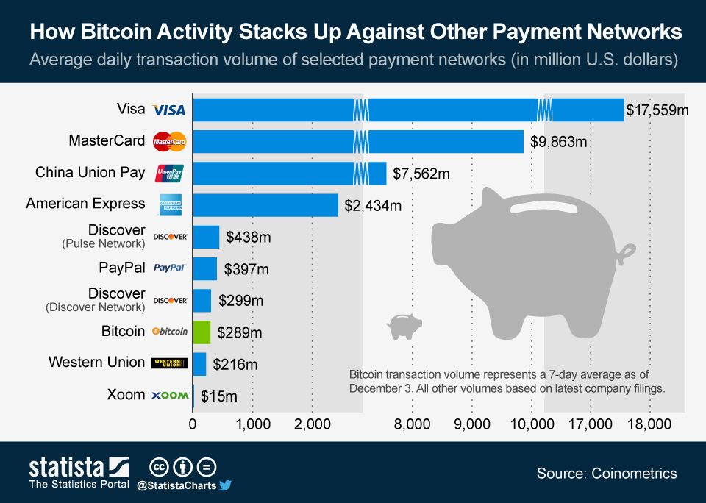

Slide 14
Demonstration...
Lets: Pay someone $10 right now
Lets: Buy something online right now

Slide 15
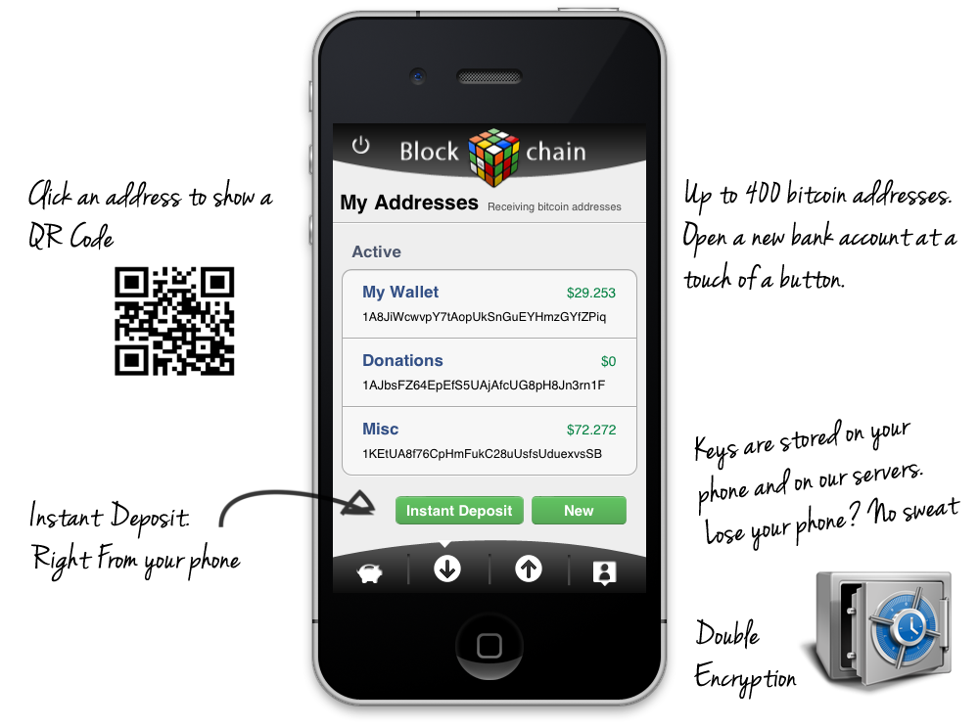

Slide 16
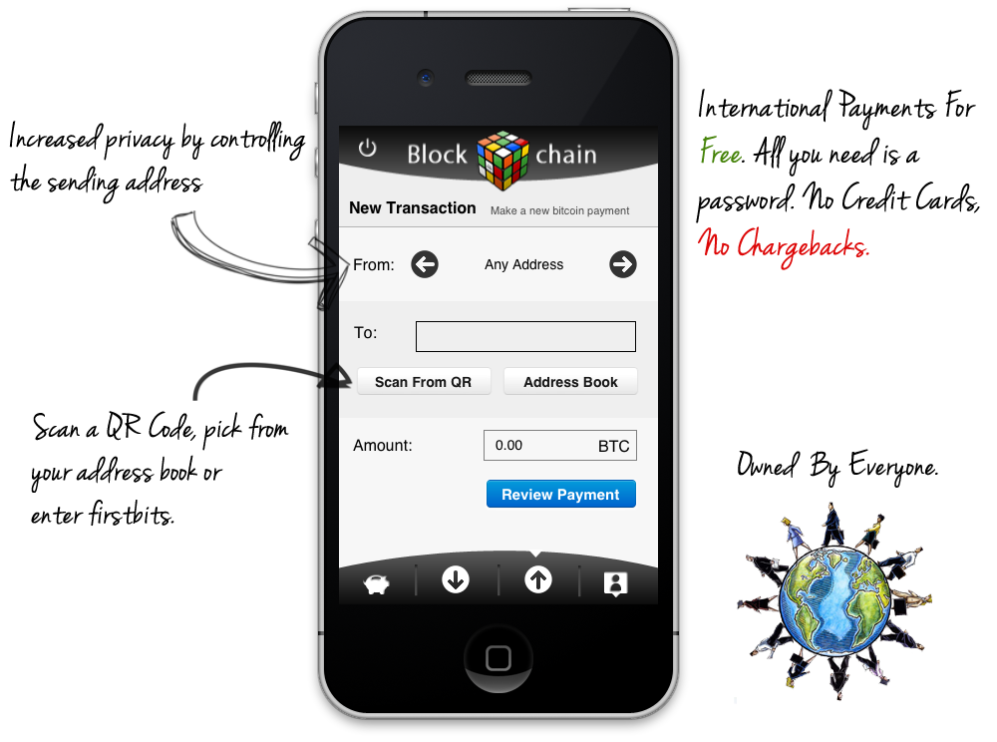

Slide 17
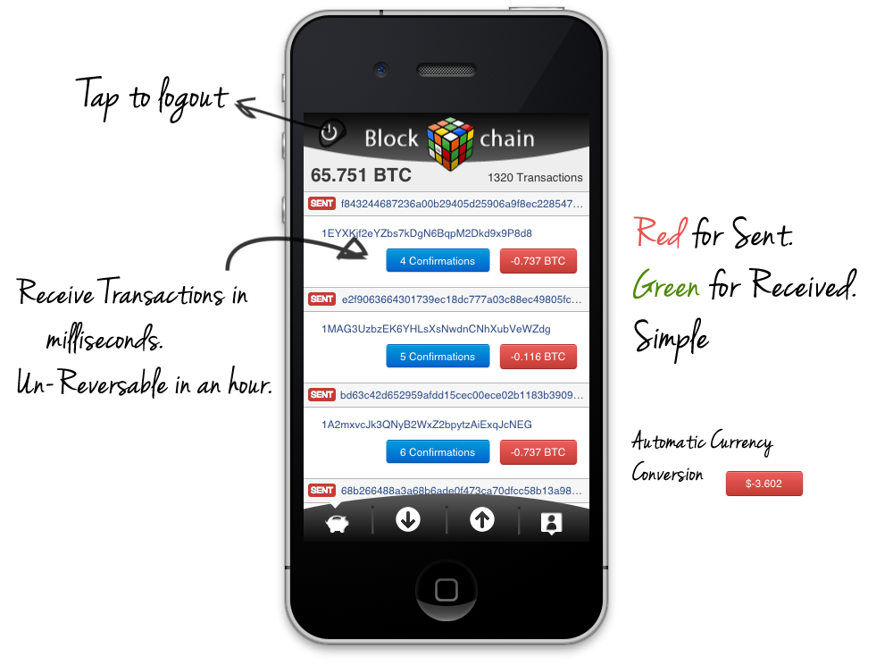

Slide 18
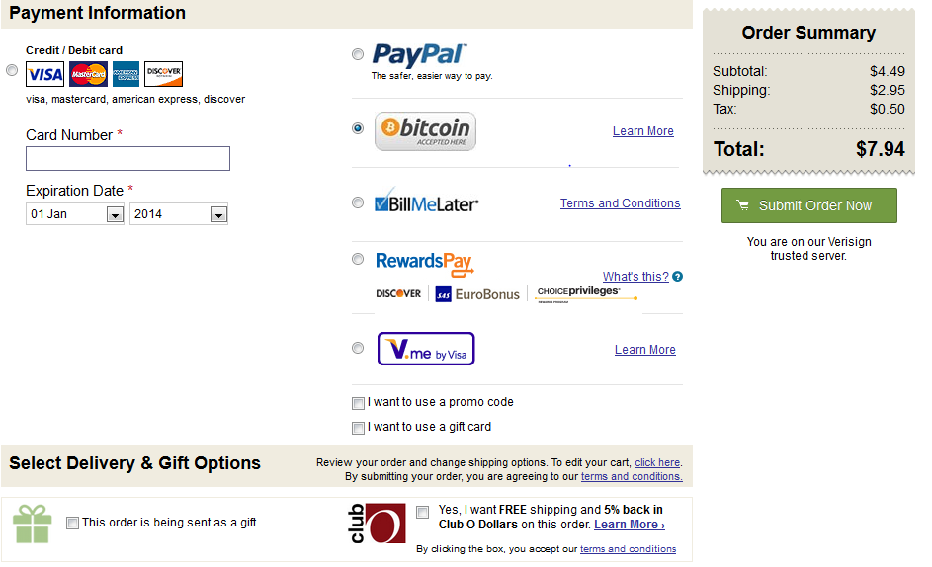

Slide 19
Credit Union & CUSO’s Role
????
Financial
Institution
Method of payment
Person #1
Person #2
Store of Wealth

Slide 20
Revenue Opportunities
What are the near term revenue opportunities
Compliance Service – AML, KYC
ATM’s and support services
Digital Currency Consulting / Education

Slide 21
Revenue Opportunities
What are the mid-term revenue opportunities
Exchange’s / Currency Services
Digital Payment services
Digital Currency Technology Consulting
Vault Services

Slide 22
Revenue Opportunities
What are the long term revenue opportunities
Core Banking integration
Mobile Wallet / Web Wallet Services
International remittances services

Slide 23
How much guidance is there?
1 – None really, I think it is illegal in many places
2 – There may be some, but very sporadic
3 – Many world economies have provided guidance
4 – Green Light! The coast is clear for Business!

Slide 24
Regulation (as of 4/8/2014)
Domestically here are the watershed documents
FINCEN - http://fincen.gov/statutes_regs/guidance/html/FIN-2013-G001.html - http://www.fincen.gov/news_room/speech/pdf/20130613.pdf
IRS - http://www.irs.gov/pub/irs-drop/n-14-21.pdf
GAO - http://www.gao.gov/assets/660/654620.pdf
Texas legal documents - http://ia600904.us.archive.org/35/items/gov.uscourts.txed.146063/gov.uscourts.txed.146063.23.0.pdf - http://www.dob.texas.gov/lg_manual/sm1037.pdf

Slide 25
Regulation (as of 4/8/2014)
Domestically here are major recognitions
Federal Reserve - http://www.chicagofed.org/digital_assets/publications/chicago_fed_letter/2013/cfldecember2013_317.pdf http://www.stlouisfed.org/dialogue-with-the-fed/assets/Bitcoin-3-31-14.pdf
Bank of America - http://cryptome.org/2013/12/boa-bitcoin.pdf
And a host of others - http://bitcoinmagazine.com/5526/regulatory-responses-to-bitcoin-2013-edition/

Slide 26
Regulation (as of 4/8/2014)
Internationally there is also A LOT of varying guidance
China, Singapore, Korea, Thailand, India, Germany, France, Denmark, Norway, Switzerland, Poland, Slovenea
ECB Guidance - http://www.ecb.europa.eu/pub/pdf/other/virtualcurrencyschemes201210en.pdf

Slide 27
Risk Factors
What are the largest risk factors
Federal Regulatory Guidance Change
Governments adopt their own flavor
Cost / Compliance burden unprofitable
https://bitcoinfoundation.org/blog/wp-content/uploads/2014/04/Bitcoin-Risk-Management-Study-Spring-2014.pdf

Slide 28
Summary
What I hope you saw today:
1- Bitcoin is new and revolutionary software
2 - Real Revenue Opportunity Exist
3 - The technology is worth becoming familiar with
4 - Risks are present but manageable

Slide 29
What else can Bitcoin do?
Gives the unbanked access to financial services
Remittances
Microtransactions
In the (very) near future
Distributed fair voting
Asset registration and notarization
Decentralized Autonomous Corporations
Programmable contracts, i.e. Law itself

Slide 30

“Bitcoin is far more important than currency. Currency is just the first app” -Andreas Antonopoulos

