Slide 1
MATLAB for GG Cycle Engine
Brendan Morgan

Slide 2
Getting Started
All files should be in the same folder
Must download CoolProp for MATLAB
Requires an installation of Anaconda for Python
Instructions here: https://www.youtube.com/watch?v=XvR10Fjph7U
Must request CEAM from NASA software catalog and download to same folder as other files
Request here: https://software.nasa.gov/software/MFS-33320-1
Run “main.m”

Slide 3
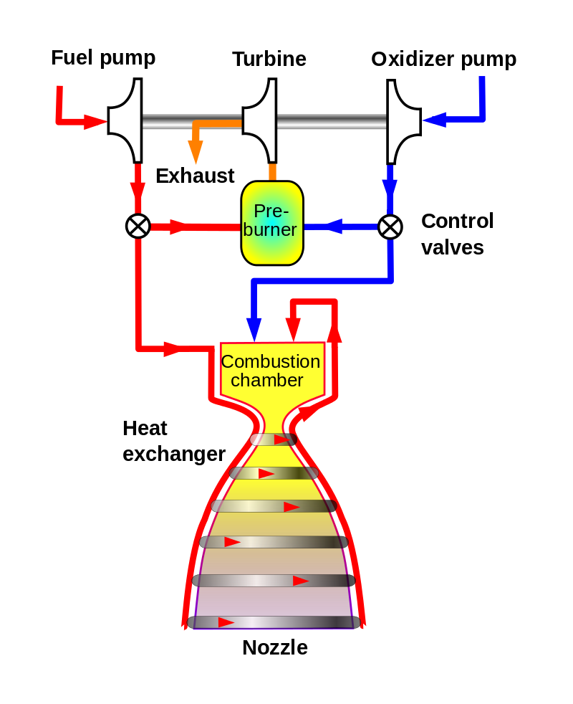
Overview and Motivation
Model a gas generator cycle engine with sufficient detail to inform CAD, FEA, and CFD models with few to no other calculations
Fuel is ethanol (proof can be varied) and liquid oxygen. Combustion chamber and gas generator are intended to run fuel-rich, however the OF ratio of both can be modified to any value.
Calculations take a “top-down” approach: the final desired results are entered as inputs (e.g. thrust, chamber pressure, OF ratio), and then the script works backwards through the system and outputs requirements to achieve the desired results (e.g. mass flow from tanks, turbopump efficiencies)

Slide 4
main.m
First section is all inputs. All these numbers can be safely modified without breaking the program; however, some configurations will not be physically possible and error messages will be thrown (e.g., requested chamber pressure is too high and needs a dangerously high contraction ratio)

Slide 5
combustion.m

Slide 6
exhaust_flow.m

Slide 7
thermal_balance.m

Slide 8
pump.m

Slide 9
gas_generator.m

Slide 10
Acknowledgements
NASA Software Catalog
CoolProp
Cryo-Rocket.com by Brian Brady

