Slide 1
r_{shaft}
r_{rms}
r_{eye}
r_{exit}
r_{inner}
Spin Axis
Flow In
p₁
p₂
w_{eye}
Shroud Curve
p₃
p₄
Impeller Curve
Flow Out
w_{exit}

Slide 2
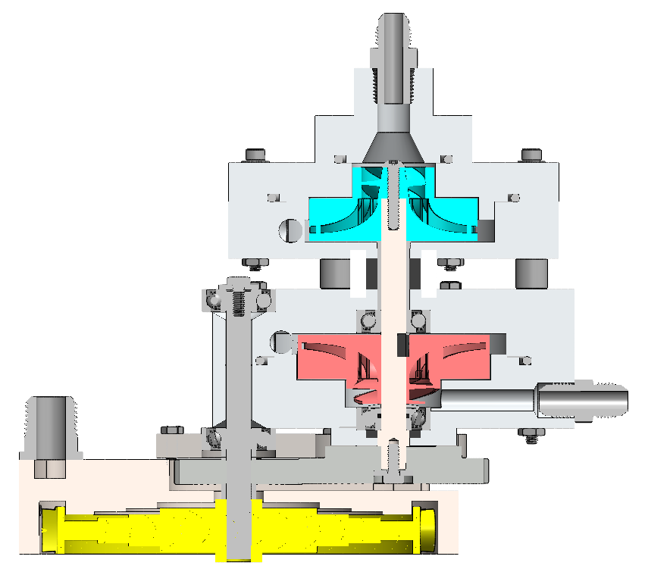
Ox Inlet
Oxidizer Pump
Bearings
Fuel Pump
Gas Inlet
Fuel Inlet
Manifold
Gears
Turbine
Rotor

Slide 3
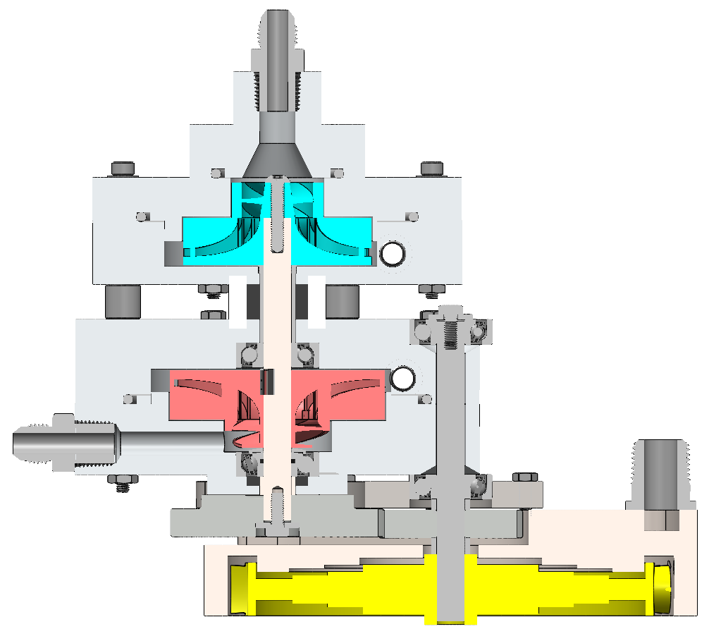
Ox Inlet
Oxidizer Pump
Outlets
Bearings
Fuel Pump
Fuel Inlet
Mounting Plate
Gas Inlet
Gears
Manifold
Turbine
Rotor

Slide 4
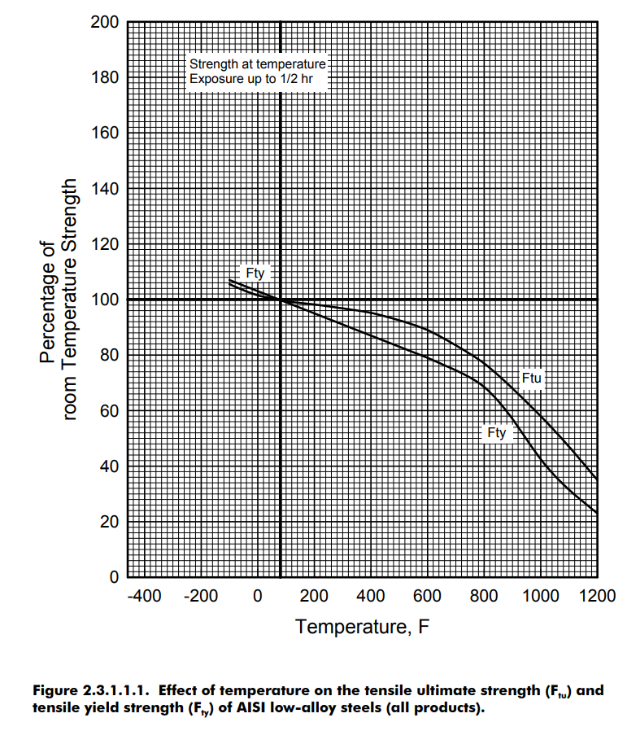
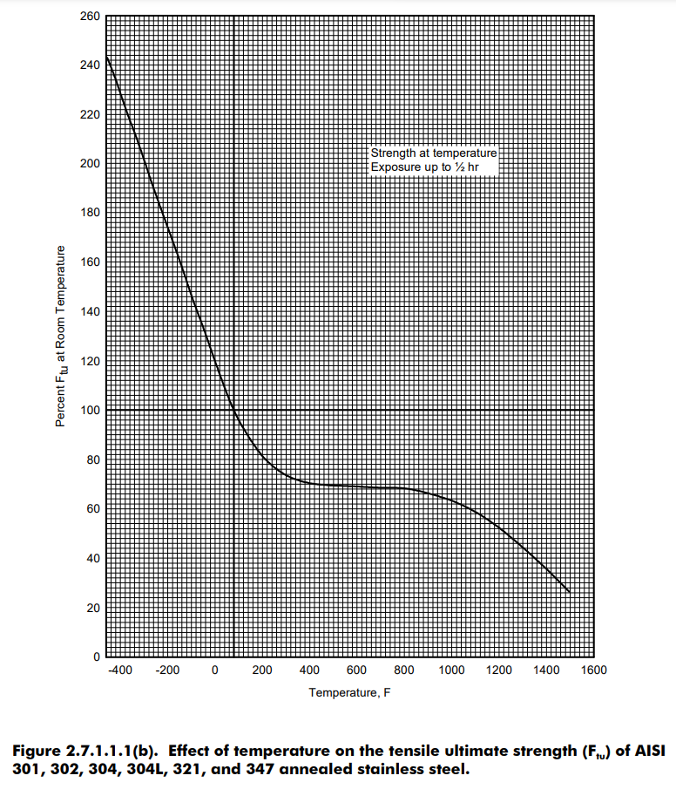
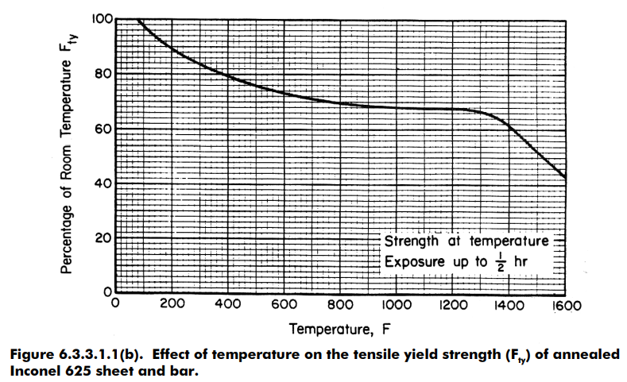
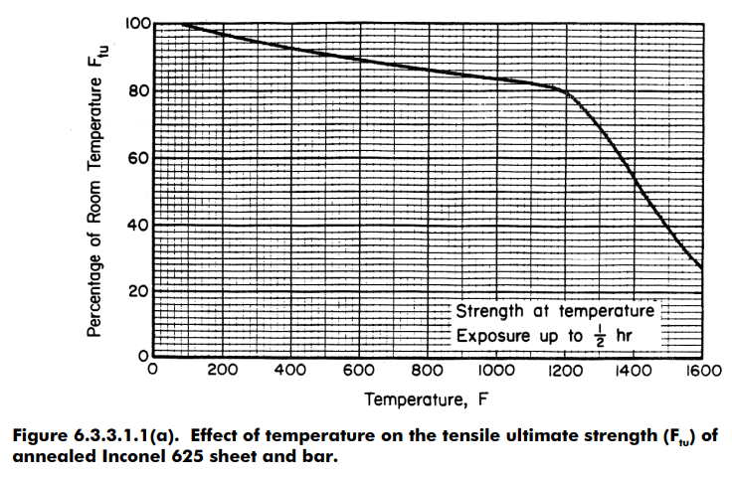

Slide 5
r_{exit}
β_{outlet}
p₄
p₃
p₂
β_{inlet}
p₁
r_{eye}

Slide 6
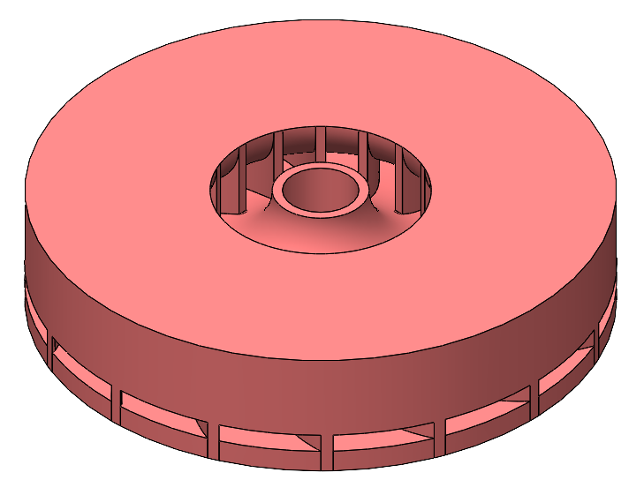
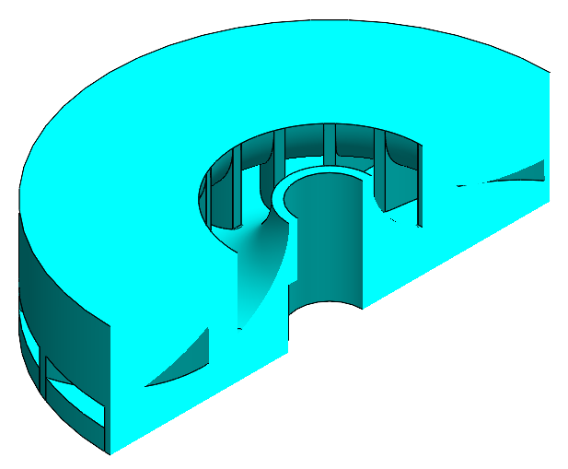

Slide 7
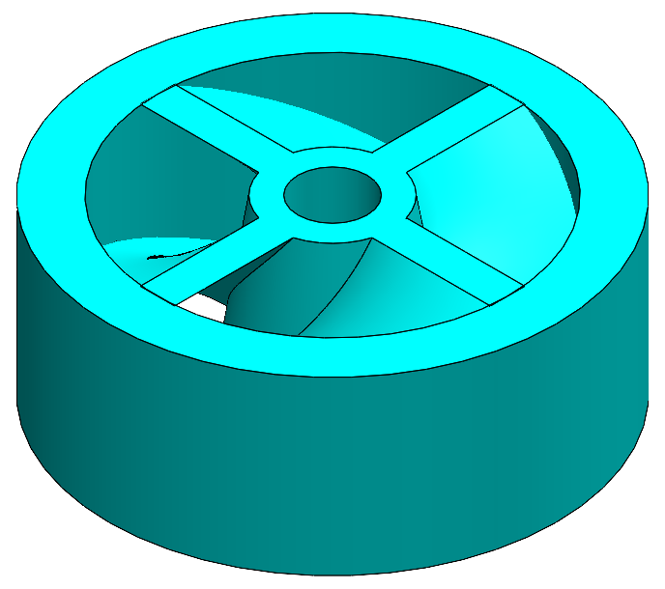
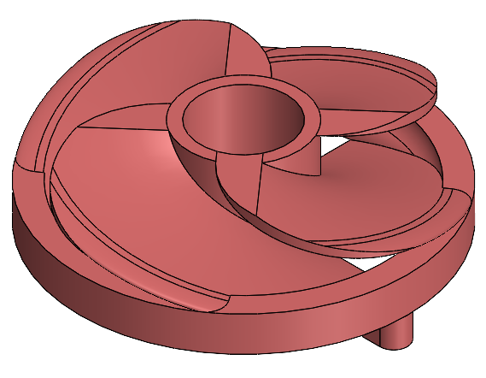
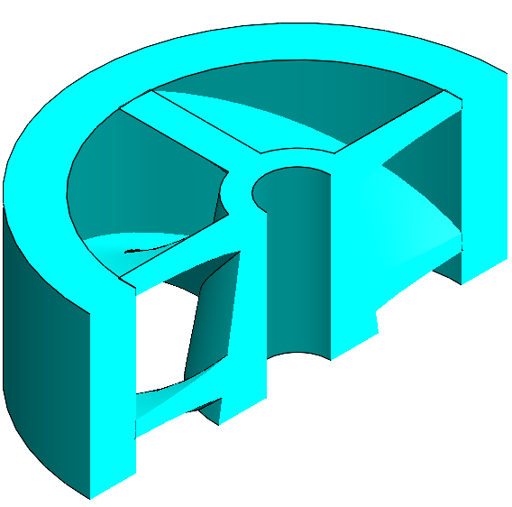
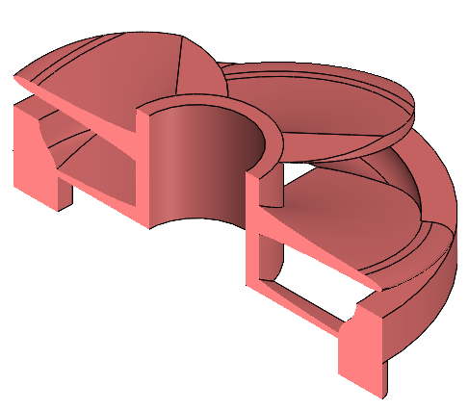

Slide 8
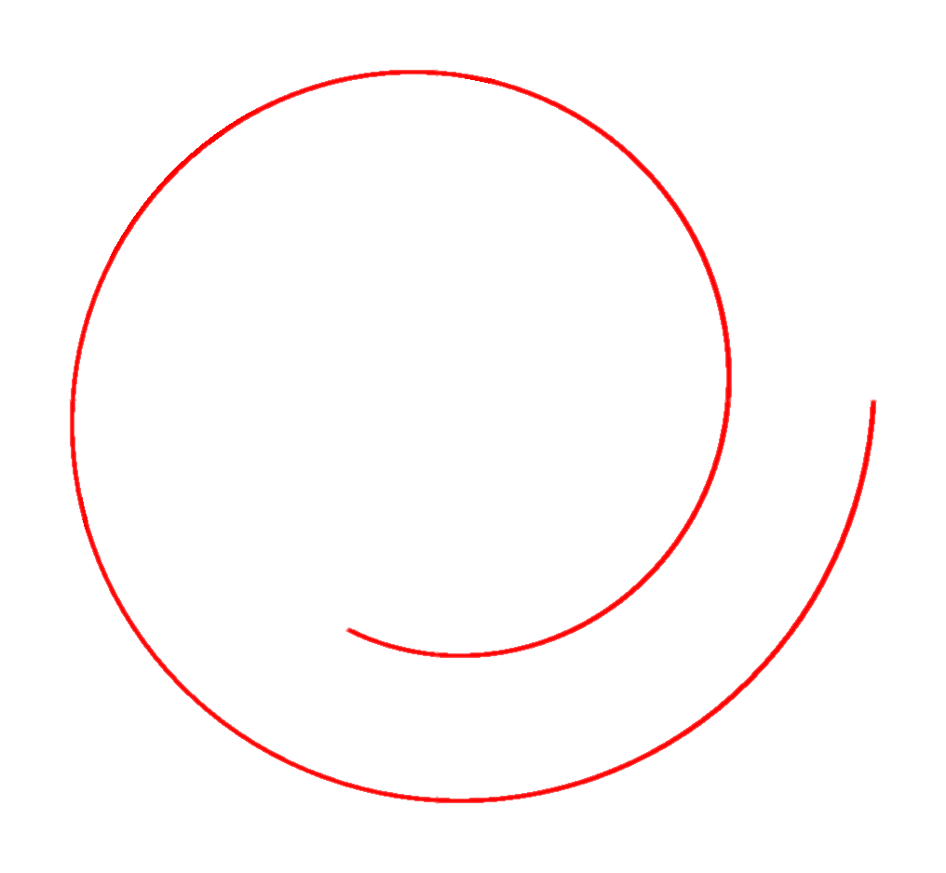
Impeller
Circular Cross Section, A_{outlet}
r_{exit}
r_{tongue}
r_{outlet}
Square Cross Section, A_{outlet}
t_{tongue}

Slide 9
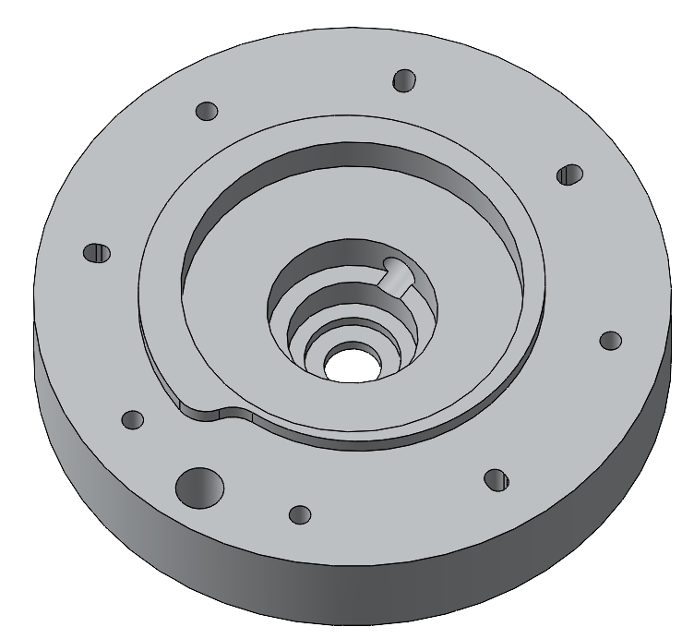
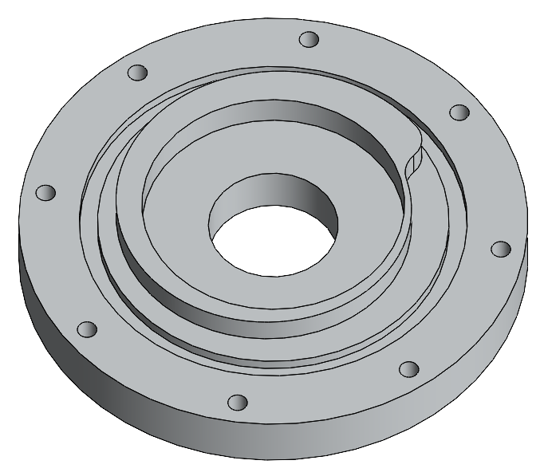
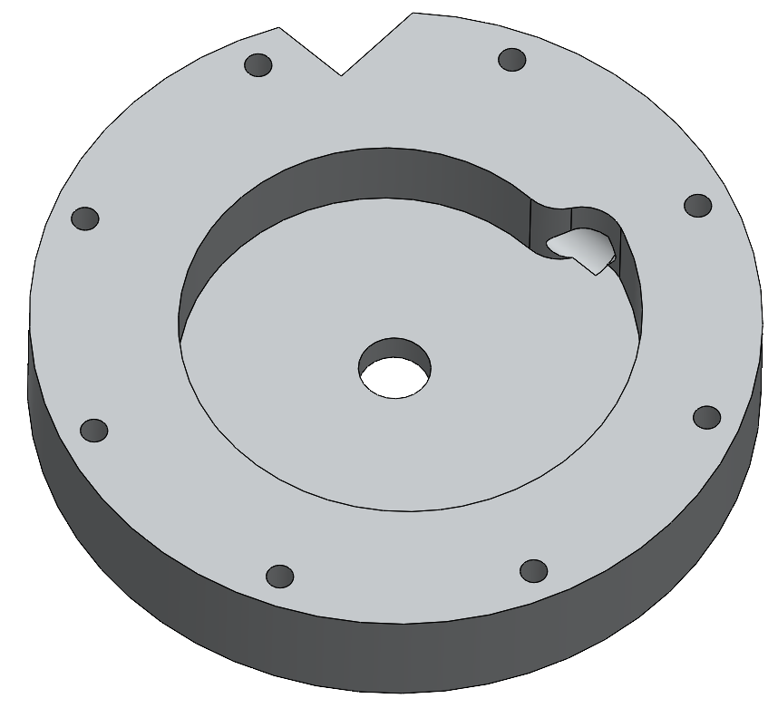
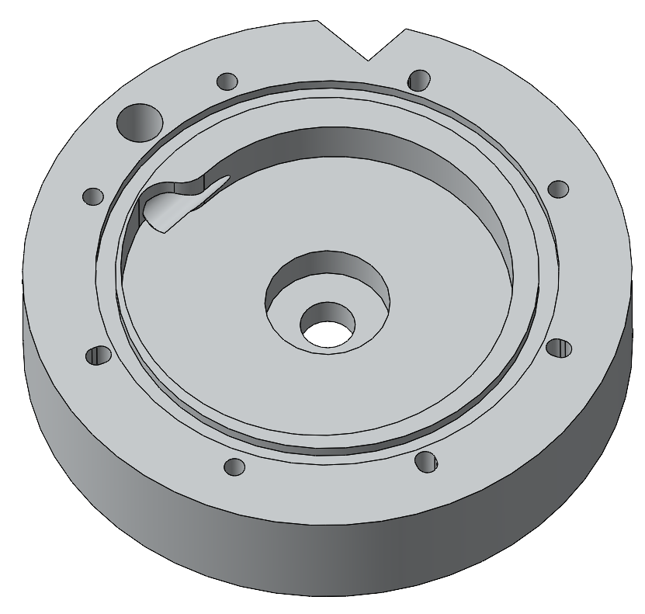

Slide 10
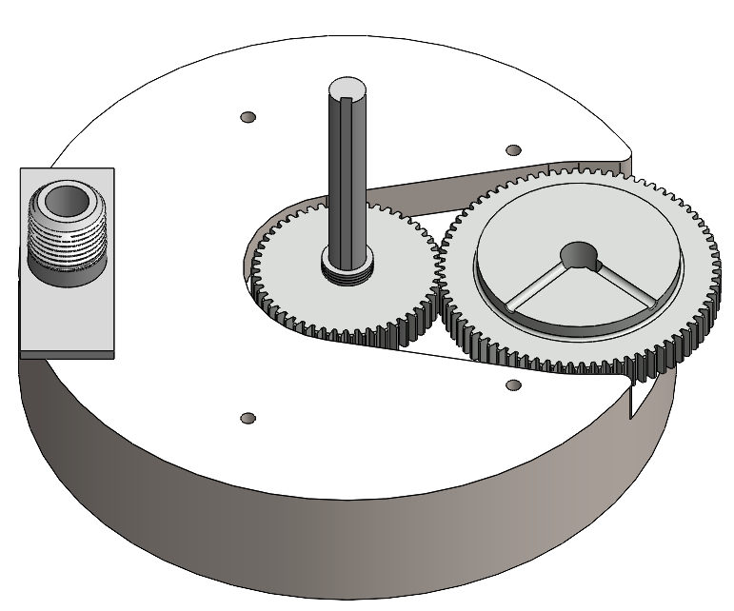
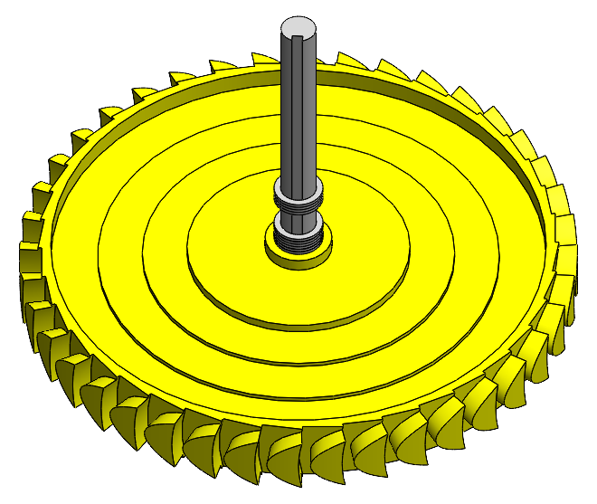
Gas inlet
Pump Gear
Turbine Gear

Slide 11
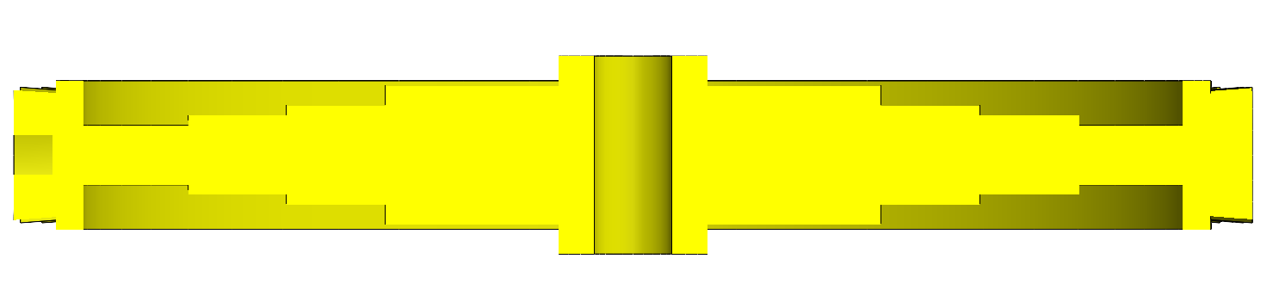
Spin Axis
r_{tip}=3.125”
r_{base}=2.875”
r_{shaft} = 5 mm
r_{pitchline}=3.00”
1.0”
0.7”
0.5”
0.4”
0.3”
0.75”

Slide 12


θ_{nozzle} = 26.0º
Gas Manifold
d_{nozzle} = 0.127”
gap ~ 0.05”
θ_{inlet} = θ_{outlet} = 13.7º
l_{chord} = 0.75”
ωr = 239.4 m/s
l_{pitch} = 0.575”

Slide 15
