Slide 1
Aircraft Identification: A Demonstration of Convolutional Neural Networks
Brendan Jenkins & Michael Reigelman
MSDS 631 - Deep Learning
June 2022

Slide 2
Project Goal
Create a Convolutional NN model that can identify the aircraft from images. We tried to classify:
Manufacturers: Boeing, Airbus, Embraer, etc.
Models: a identifier to that is unique and specific to its aircraft manufacturer.
Data Used: over 10,000 images total (2.76GB)
30 classes of manufacturers
70 classes of families (manufacturer and model)

Slide 3
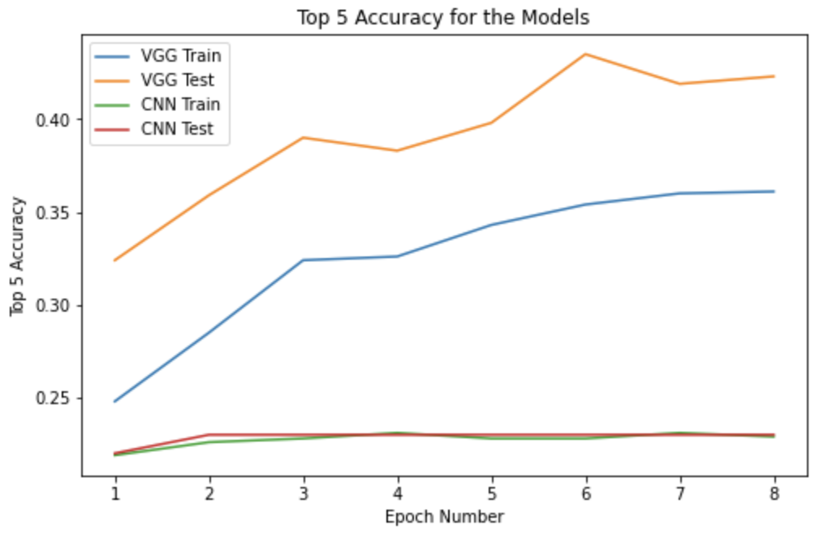
Classifying Family Models
Aircraft Family: combination of manufacturer name & model
Our Model:
CNN with Data Augmentation
Small batch sizes
4 Convolutional Layers.
2 Linear Layers with 1000 Hidden Nodes.
Results: 23% Top 5 Accuracy
VGG-16:
Pre-trained model using partially frozen weights.
Results: 42% Top 5 Accuracy

Slide 4
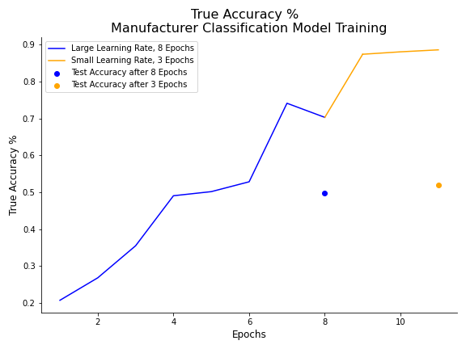
Classifying Manufacturer Model
Manufacturer: the name of the company that produces and sells the aircraft
Model Architecture:
CNN with Data Augmentation
Small batch sizes
Dynamic Learning Rate
8 epochs at .001
3 epochs at .00001
Reshuffling of Training and Validation data during training
Results: 52% True Accuracy

Slide 5
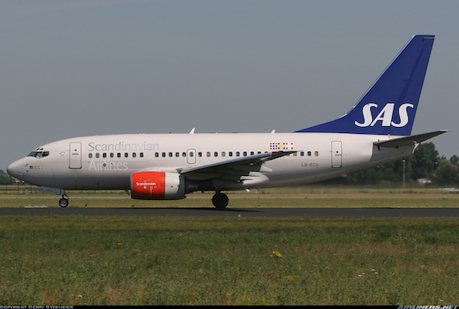
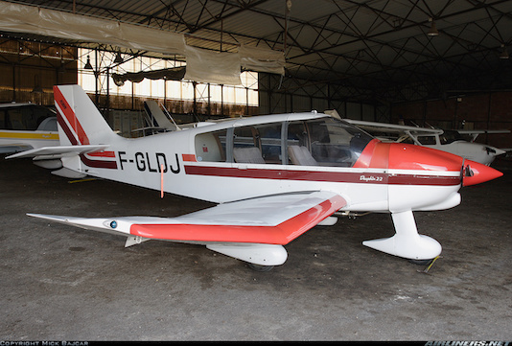
Images Our Model Classified Correctly

Slide 6
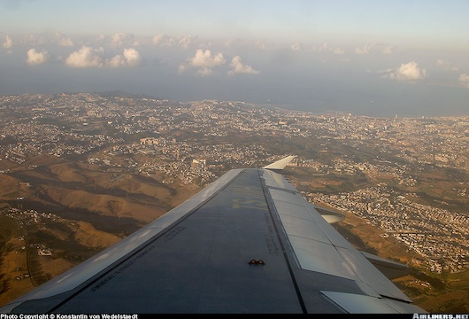
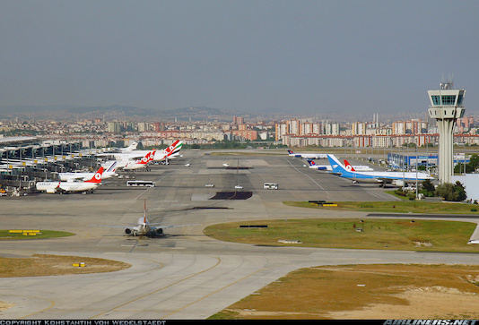
Images Our Model Classified Incorrectly

Slide 7
Thank You!

