Slide 1
Weather Forecast
By: Brendan, Steven & Ian

Slide 2
Welcome to Our Analysis
We've analyzed 16 months of weather data from 167 U.S. cities.
Our goal is to understand where and why weather forecasts struggle.
Together, we examined forecast accuracy patterns.
Multiple lead times: 12, 24, 36, and 48 hours
Key metrics: forecast vs. observed temperature

Slide 3
Our Research Questions
How many times did each forecast outlook occur?
What is the average forecast error across states and time?
Where are the minimum and maximum prediction errors?

Slide 4
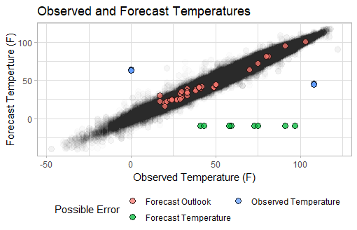
Finding 1: Temperature Patterns

Slide 5
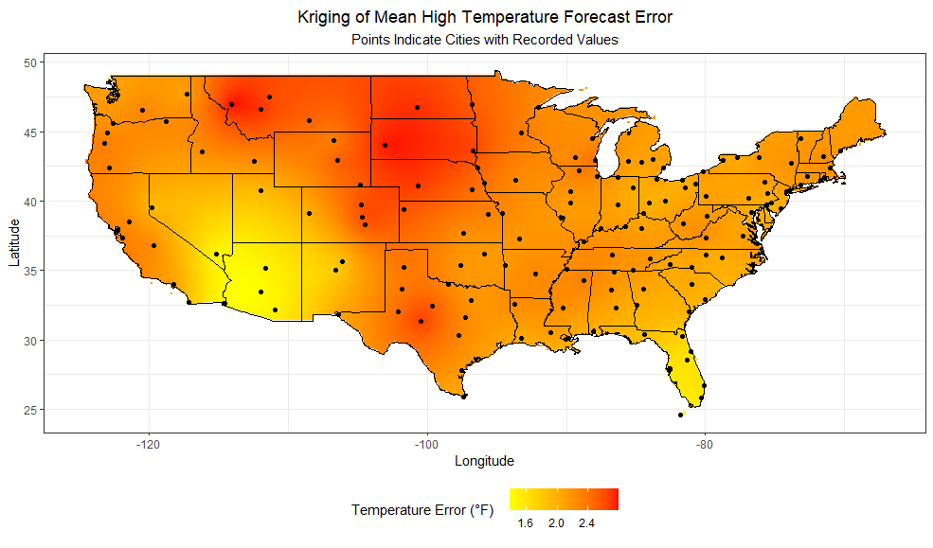
Finding 2: Geographic Patterns

Slide 6
Key Finding: Lead Time Impact
Forecast error increases dramatically with lead time (12h vs 48h)
Geographic patterns: Great Plains and Southwest show highest errors
Coastal regions demonstrate more consistent accuracy
Regional terrain complexity directly impacts prediction reliability

Slide 7
Key Finding: Weather Distribution
Dataset dominated by sunny and partly cloudy forecasts (~70%)
Rare events (storms, snow) underrepresented but harder to predict
Data imbalance may explain regional variation in forecast skill
States with frequent severe weather show higher error rates

Slide 8
Why Forecast Accuracy Matters
Planning: Citizens and businesses rely on accurate forecasts
Safety: Severe weather warnings depend on prediction reliability
Research: Understanding error patterns improves forecasting algorithms
Regional Challenges: Certain geographic areas need better modeling

Slide 9
Key Takeaways
✓ Lead time significantly impacts forecast accuracy
✓ Geographic variation suggests regional challenges in modeling
✓ Data-driven insights enable continuous improvement in weather services

