Slide 1
Hierarchical
Reinforcement Learning
Ronald Parr
Duke University
©2005 Ronald Parr
From ICML 2005 Rich Representations for Reinforcement Learning Workshop

Slide 2
Why?
Knowledge transfer/injection
Biases exploration
Faster solutions (even if model known)

Slide 3
Why Not?
Some cool ideas and algorithms, but
No killer apps or wide acceptance, yet.
Good idea that needs more refinement:
  More user friendliness
  More rigor in
    Problem specification
    Measures of progress
      Improvement = Flat – (Hierarchical + Hierarchy)
      What units?

Slide 4
Introductory Comments
∀ X: Hierarchical X nearly as old as X
Very hard to evaluate methods
  Measuring improvement
    Improvement = Flat – (Hierarchical + Hierarchy)
    What units?
  Algorithmic desiderata
    Convergence?
    Optimality?

Slide 5
Overview
Temporal Abstraction
Goal Abstraction
Challenges
Not orthogonal

Slide 6
Temporal Abstraction
What’s the issue?
  Want “macro” actions (multiple time steps)
  Advantages:
    Avoid dealing with (exploring/computing values for) less desirable states
    Reuse experience across problems/regions
What’s not obvious (except in hindsight)
  Dealing w/Markov assumption
  Getting the math right (stability)

Slide 7
Looking back
Classical planning analogs
  Macro-actions
  Chunking
  EBL
RL roots
  Maes & Brooks 90
  Singh 91
  Mahadevan & Connell 93
MDP/control roots are oldest
  Forestier & Varaiya 78
Grappling w/represenation,
Markov assumption
Got the math right
Ignored representation

Slide 8
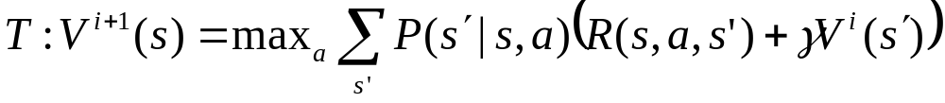
Stable Temporal Abstraction
Recall the dynamic programming operator:
T is a contraction in maximum norm
Can use to prove:
  Convergence of value iteration (& bounds)
  Convergence of policy iteration (& bounds)
  Convergence of TD, Q-learning
(Not necessarily the only way to prove these things!)

Slide 9
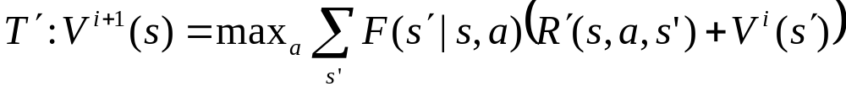
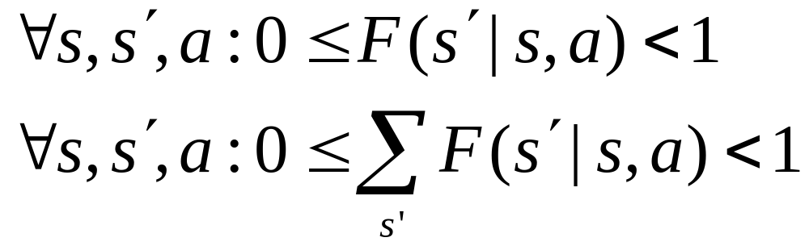
The Big(?) Insight
Replace Bellman operator:
With
Where

Slide 10
State Transitions → Macro Transitions
F plays the role of generalized transition function
More general:
  Need not be a probability
  Coefficient for value of one state in terms of others
  May be:
    P (special case)
    Arbitrary SMDP (discount varies w/state, etc.)
    Discounted probability of following a policy/running program

Slide 11
What’s so special?
Modified Bellman operator:
T ′ is also a contraction in max norm
Free goodies!
  Optimality (Hierarchical Optimality)
  Convergence & stability

Slide 12
Historical Comment
Forestier & Varaiya studied avg. reward (Recognized that macro actions implicitly defined transition functions)
Recognized informally/intuitively by many
Initially formalized by Sutton (95)
Collective forehead smack (97-98)
  Mahadevan
  Precup, Sutton & Singh: Options
  Hauskrecht et al.: Macro actions
  Parr & Russell: HAMs
  Dietterich: MAXQ (though not the most important contribution of MAXQ)

Slide 13
Using Temporal Abstraction
Accelerate convergence (usually)
Avoid uninteresting states
  Improve exploration in RL
  Avoid computing all values for MDPs
Can finesse partial observability (a little)
Simplify state space with “funnel” states

Slide 14
Funneling
Proposed by Forestier & Varaiya 78
Define “supervisor” MDP over boundary states
Selects policies at boundaries to
  Push system back into nominal states
  Keep it there
Boundary
states
Boundary
states
Nominal
Region
Control theory
version of
maze world!

Slide 15
HAMs
Teaspoon more general than some others
Partially specified finite state machines
States could conditionally (on observation):
  Output an action
  Switch to another state
  Encode a set of choices (choice point)
HAM + MDP = SMDP (cross product state space)
NB: Traditional policy = special case
Extended by Andre

Slide 16
Why this Isn’t Enough
Many problems still have too many states!
Funneling is tricky
  Doesn’t happen in some problems
  Hard to guarantee
    Controllers can get “stuck”
    Requires (extensive?) knowledge of the environment

Slide 17
Where do Macros Come From?
Not directly addressed!
Sometimes by hand or implicitly through a program
Sometimes result of solving some sub-MDP
  Pick subset of states
  Make certain states special/absorbing
  Assign “pseudo rewards”
Relationship between pseudo-rewards and optimality
  Parr (98)
  Hauskrecht et al. (98)

Slide 18
Burning Issues
Better way to define macro actions?
Better approach to large state spaces?

Slide 19
Overview
Temporal Abstraction
Goal/State Abstraction
Challenges
Not orthogonal

Slide 20
Goal/State Abstraction
Why are these together?
  Abstract goals typically imply abstract states
Makes sense for classical planning
  Classical planning uses state sets
  Implicit in use of state variables
  What about factored MDPs?
Does this make sense for RL?
  No goals
  Markov property issues

Slide 21
Feudal RL
(Dayan & Hinton 95)
Lords dictate subgoals to serfs
Subgoals = reward functions?
Demonstrated on a navigation task
Markov property problem
  Stability?
  Optimality?
NIPS paper w/o equations! ☺

Slide 22
MAXQ
(Dietterich 98)
Included temporal abstraction
Handled subgoals/tasks elegantly
  Subtasks w/repeated structure can appear in multiple copies throughout state space
  Subtasks can be isolated w/o violating Markov
  Separated subtask reward from completion reward
Introduced “safe” abstraction
Example taxi/logistics domain
  Subtasks move between locations
  High level tasks pick up/drop off assets

Slide 23
A-LISP
(Andre & Russell 02)
Combined and extended ideas from:
  HAMs
  MAXQ
  Function approximation
Allowed partially specified LISP programs
Very powerful when the stars aligned
  Halting
  “Safe” abstraction
  Function approximation

Slide 24
Why Isn’t Everybody Doing It?
Totally “safe” state abstraction is:
  Rare
  Hard to guarantee w/o domain knowledge
“Safe” function approximation hard too
Developing hierarchies is hard (like threading a needle in some cases)
Bad choices can make things worse
Mistakes not always obvious at first

Slide 25
Overview
Temporal Abstraction
Goal/State Abstraction
Challenges
Not orthogonal

Slide 26
Usability
Make hierarchical
RL more user friendly!!!

Slide 27
Measuring Progress
Hierarchical RL not a well defined problem
No benchmarks
Most hammers have customized nails
Need compelling “real” problems
What can we learn from HTN planning?

Slide 28
Automatic Hierarchy Discovery
Hard in other contexts (classical planning)
Within a single problem:
  Battle is lost if all states considered (polynomial speedup at best)
  If fewer states considered, when to stop?
Across problems
  Considering all states OK for few problems?
  Generalize to other problems in class
How to measure progress?

Slide 29
Promising Ideas
Idea: Bottlenecks are interesting…maybe
Exploit
  Connectivity (Andre 98, McGovern 01)
  Ease of changing state variables (Hengst 02)
Issues
  Noise
  Less work than learning a model?
  Relationship between hierarchy and model?

Slide 30
Representation
Model, hierarchy, value function should all be integrated in some meaningful way
“Safe” state abstraction is a kind of factorization
Need approximately safe state abstraction
Factored models w/approximation?
  Boutilier et al.
  Guestrin, Koller & Parr (linear function approximation)
  Relatively clean for discrete case

Slide 31
A Possible Path
Combine hierarchies w/Factored MDPs
Guestrin & Gordon (UAI 02)
  Subsystems defined over variable subsets (subsets can even overlap)
  Approximate LP formulation
  Principled method of
    Combining subsystem solutions
    Iteratively improving subsystem solutions
  Can be applied hierarchically

Slide 32
Conclusion
Two types of abstraction
  Temporal
  State/goal
Both are powerful, but knowledge heavy
Need language to talk about relationship between model, hierarchy, function approximation

