Slide 1


Discussion KPI - Quantification Javier Arroyo Berlin Meeting 28/Feb/2018

Slide 2

Objectives
Define accurately a set of KPIs to assess control algorithms for BEM.
Group them into categories
Choose those that are necessary or nice-to-have for a fair comparison.
Avoid redundancies.
Unambiguously define their quantification/qualification
Some can be quantified
Some use a quality level, e.g. 1 till 5
Discuss on practical issues:
Solver vs. emulator KPIs
Dependencies on developer, region or availability of data
Who should implement the KPI: emulator/solver/docker developers
Grouping accordingly to the objective function
Conclusions.
Which to keep? How to calculate them from the emulators?
Fair comparison
Accessibility

Slide 3
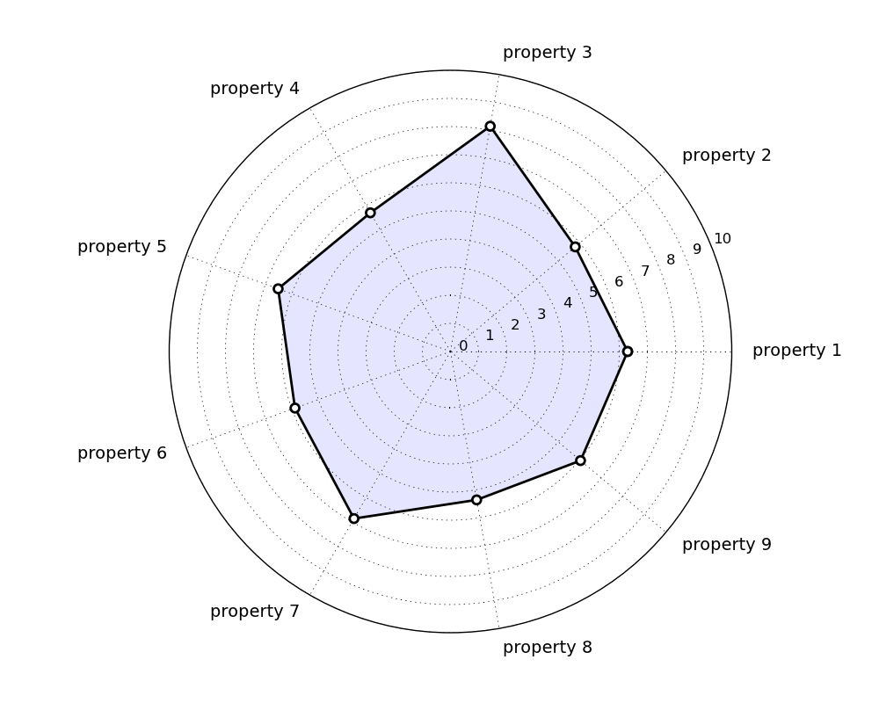
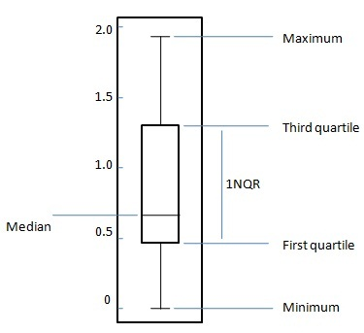
Visualization
Comparison to a reference (still to be defined)
Comparison to total population (relative position and range)
E.g. Radar plot Box plot

Slide 4
Proposed KPIs
ENERGY INDICATORS | COST INDICATORS | COMPUTATION INDICATORS
Achieved energy savings | Development time | Computation time
Energy use | Cost savings | Compilation time
Energy efficiency | Extra hardware costs | Flexibility of supported formulations
Primary energy use | Data requirements | Compactness
ENVIRONMENTAL INDICATORS | Payback period | Usability
CO2 emissions | IEQ INDICATORS | Scaling of computation time
Share of RES | Thermal (dis)comfort | Scalability
Flexibility provided to grid | IAQ (dis)comfort | Robustness/Fault tolerance
 |  | Optimality

Slide 5
Energy KPIs
CAN BE DROPPED
Name: Energy Savings
Description: Energy savings achieved when implementing MPC during one year.
Units: kWh/(m².y)
Quantification: Difference in energy use with respect to a reference controller → What to use as a reference?
Output needed from emulator:
Proposed by: Michael Wetter
Conclusion: we shouldn’t calculate energy savings but energy use instead (see next slide).

Slide 6
Energy KPIs
TO BE CALCULATED
Name: Energy Use
Description: Energy use in one year of simulation.
Units: kWh/(m².y)
Quantification: Sum of the energy used by all appliances working on acclimatization for one year.
Output needed from emulator:
Proposed by: Iago
Conclusion: we should calculate this one and split it by application → Heating, cooling, ventilation and lighting (if implemented). Use kWh instead of kWh/m2/y and perform annual tests instead of representative weeks.
Notes:
Recall! Why kWh?

Slide 7
Energy KPIs
CAN BE DROPPED
Name: Energy Efficiency
Description: Seasonal performance.
Units: %
Quantification:
Output needed from emulator:
Proposed by: Iago
Conclusion: Redundant.

Slide 8
Energy KPIs
CAN BE DROPPED
Name: Primary Energy Use
Description: Seasonal performance.
Units:
Quantification:
Output needed from emulator:
Proposed by: Iago
Conclusion: this is derived from energy use.

Slide 9
Environmental KPIs
TO BE CALCULATED
Name: CO2 emissions
Description: Estimated CO2 emissions proposed by the solution.
Units: kg CO2/y or ton CO2/y
Quantification:
Output needed from emulator:
Proposed by: Iago
Conclusion: this one certainly needs to be calculated.

Slide 10
Environmental KPIs
CAN BE DROPPED
Name: Share of RES
Description: estimated used RES from the grid and self-production.
Units: kWh
Quantification:
Output needed from emulator:
Proposed by: Iago
Conclusions: This one is derived from energy use.
Notes:
Which factors to be used? They depend on the energy mix → table per country?

Slide 11
Environmental KPIs
TO BE CALCULATED
Name: Flexibility provided to grid
Description: Some indication of load flexibility provided to grid.
Units:
Quantification:
Output needed from emulator:
Proposed by: Michael Wetter
Conclusion: Need to have further thoughts about this one. Krzysztof will keep us informed about discussions within the Annex 67 where they are already working on a common way to define flexibility.

Slide 12
Cost KPIs
TO BE CALCULATED
Name: Development time
Description: Human time required for generating MPC controller.
Units: hours.
Quantification:
Output needed from emulator:
Proposed by: Filip
Conclusions: this KPI should be quantified qualitatively with different categories of implementation time.

Slide 13
Cost KPIs
CAN BE DROPPED
Name: Cost savings
Description: Similar to energy savings, but cost depends also on the price signal.
Units: USD/EUR
Quantification: Difference in operational cost with respect to a reference controller → What to use as a reference?
Output needed from emulator:
Proposed by: Krzysztof, Christian
Conclusion: Use cost instead of cost savings. Lump energy use into one cost.
Notes:
Recall!

Slide 14
Cost KPIs
CAN BE DROPPED
Name: Extra hardware costs
Description: In case of additional hardware required for the installation of the MPC.
Units: USD/EUR
Quantification: Sum of the cost of installing any extra-hardware required to get the MPC running (sensors, interfaces to BMS, …).
Output needed from emulator:
Proposed by: Javier
Conclusions: Hard to quantify, still not clear from the discussion.
Notes:
Recall

Slide 15
Cost KPIs
TO BE CALCULATED
Name: Data requirements
Description: cost of gathering data for training grey- and black-box models, or even for calibrating white-box models (if needed).
Units: USD/EUR
Quantification: Cost of installing additional sensors and exciting the building (if needed).
Output needed from emulator:
Proposed by: Javier
Conclusions: this KPI should be quantified qualitatively with different categories of data requirements. 2 types: 1) special excitations, 2) extra sensors or not.

Slide 16
Cost KPIs
TO BE CALCULATED
Name: Payback period
Description: Period needed to recover the cost of the initial investment.
Units: months
Quantification: (Initial investment)/(monthly cost savings)
Output needed from emulator:
Proposed by: Javier
Conclusion: common cost tables for computing payback period. Very hard to quantify in practice?
Notes:
Recall!

Slide 17
Indoor Environmental Quality KPIs
TO BE CALCULATED
Name: Thermal (dis)comfort
Description: Deviation from allowed comfort bounds.
Units: Kh
Quantification: (Thermal deviation)*time
Output needed from emulator:
Proposed by: Michael
Conclusion: we use thermal discomfort as this one is already adopted by the community. We should calculate it in K*h and maximum K. Two further discussion points: 1) what if the building is unoccupied? 2) How to treat multi-zone?.

Slide 18
Indoor Environmental Quality KPIs
CAN BE DROPPED
Name: Indoor Air Quality (dis)comfort
Description: Deviation from target specifications about the quality of the air inside the building. Lighting, glare…
Units: concentrations of pollutants.
Quantification: (Operations target) – (Operations achieved)
Output needed from emulator:
Proposed by: Davy
Conclusion: this one is ‘a nice-to-have’.

Slide 19
Computation KPIs
TO BE CALCULATED
Name: Computation time
Description: Computation time per MPC solution
Units: Seconds
Quantification: time required for an MPC computation → from getting the measurements till deliver optimal solution
Output needed from emulator:
Proposed by: Filip
Conclusion: should be normalised with standard computation benchmark. It is a good indicator for scalability.

Slide 20
Computation KPIs
CAN BE DROPPED
Name: Compilation time
Description: Computer-time required for generating MPC controller.
Units: Seconds
Quantification:
Output needed from emulator:
Proposed by: Filip
Conclusion: can be part of development time.

Slide 21
Computation KPIs
CAN BE DROPPED
Name: Flexibility of supported formulations
Description: Type of supported formulations.
Units: NLP/LP/MILP/MINLP/QP/QCQP/...
Quantification:
Output needed from emulator:
Proposed by: Filip
Conclusion: not strongly needed.

Slide 22
Computation KPIs
CAN BE DROPPED
Name: Compactness
Description: Number of optimisation variables.
Units: Seconds
Quantification:
Output needed from emulator:
Proposed by: Filip
Conclusion: not strongly needed.

Slide 23
Computation KPIs
CAN BE DROPPED
Name: Usability
Description: The ease of use for the user.
Units:
GUI used to interface to solver.
Code-based framework used to interface to solver.
Direct interface to solver.
Quantification:
Output needed from emulator:
Proposed by: Filip
Conclusion: this one is derived from other indicators like development time.

Slide 24
Computation KPIs
CAN BE DROPPED
Name: Scaling of computation time
Description: Scaling of computation time with respect to number of states nx, constraints nc, control intervals ni.
Units: O(nx^a), O(nc^b), O(ni^c)
Quantification:
Output needed from emulator:
Proposed by: Filip
Conclusion: not strongly needed.

Slide 25
Computation KPIs
CAN BE DROPPED
Name: Scalability
Description: Absolute bound for model size in terms of number of states nx, constraints nc, control intervals ni, given a certain computation time and/or memory.
Units: nx, nc, ni
Quantification:
Output needed from emulator:
Proposed by: Filip
Conclusion: not strongly needed.

Slide 26
Computation KPIs
CAN BE DROPPED
Name: Robustness/Fault tolerance
Description: Ability to deal with uncertainty of input data, possibly missing data or inaccurate models due to changing system characteristics.
Units: Percent of passed (predefined) tests.
Quantification:
Output needed from emulator:
Proposed by: Krysztof, Christian
Conclusion: difficult to quantify/standardize?
Notes:
Recall!!!

Slide 27
Computation KPIs
CAN BE DROPPED
Name: Optimality
Description: Comparison to known optimal solution if possible, or best known solution so far – similar to energy/cost savings but comparative basis. Could apply to constraint violations.
Units: %
Quantification:
Output needed from emulator:
Proposed by: Dave
Conclusion: not strongly needed.

Slide 28
Conclusions
Which indicators to keep?
How to calculate them from the emulators?
ENERGY INDICATORS | COST INDICATORS | COMPUTATION INDICATORS
Achieved energy savings | Development time | Computation time
Energy use | Cost savings | Compilation time
Energy efficiency | Extra hardware costs | Flexibility of supported formulations
Primary energy use | Data requirements | Compactness
ENVIRONMENTAL INDICATORS | Payback period | Usability
CO2 emissions | IEQ INDICATORS | Scaling of computation time
Share of RES | Thermal discomfort | Scalability
Flexibility provided to grid | IAQ (dis)comfort | Robustness/Fault tolerance
 |  | Optimality
TO BE CALCULATED
TO BE CALCULATED
TO BE CALCULATED
TO BE CALCULATED
TO BE CALCULATED
TO BE CALCULATED
TO BE CALCULATED
TO BE CALCULATED

