Slide 1


MPC formulation - FastSim Javier Arroyo IBPSA Project 1 Berlin Meeting 27/Feb/2018

Slide 2
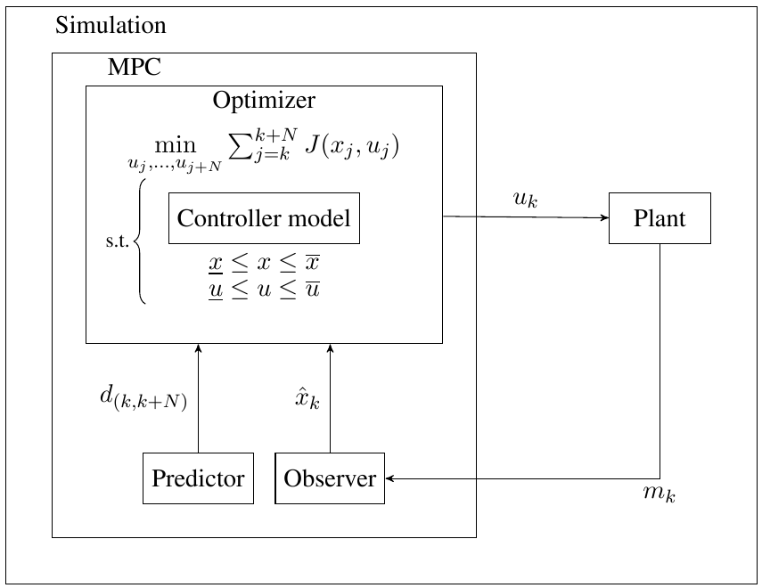
FastSim: an overview
FastSim = “A Python-Based toolbox for implementation and assessment of control algorithms in buildings”
Object Oriented
Modular
Scalable
Notes:
Talk about connection with Dymola.
Modular → Scalable.
Using Python as the master allows to easily use models from other platforms as emulators. For example, it can be linked with a Test Case from BOPTEST

Slide 3
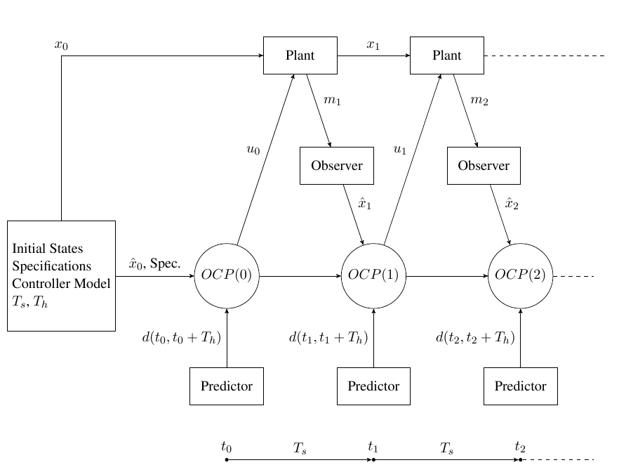
FastSim: an overview

Slide 4
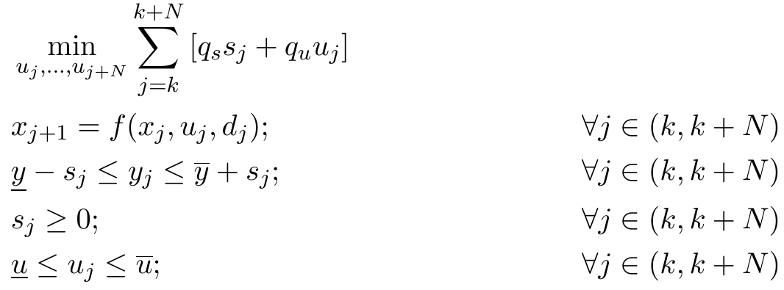


MPC formulation
Decision variables: Heat/Supply temperature to the zones → High level MPC
Objective and constraints:
Optimization language:
Solver: Bonmin (Basic Open-source Nonlinear Mixed INteger programming) is an experimental open-source C++ code for solving general MINLP (Mixed Integer NonLinear Programming)

Slide 5
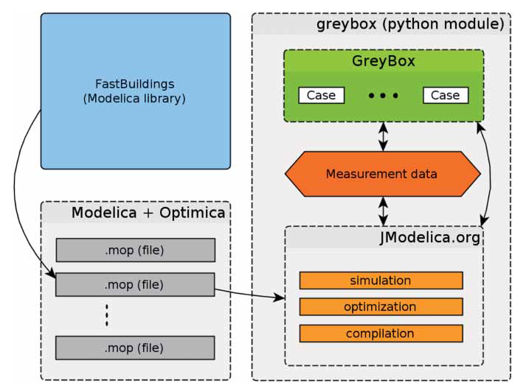

MPC formulation
Controller model:
“Easy RC builder” of FastSim:
From grey-box toolbox
From manual input
From SS matrices:
From grey-box model
From black-box model
From linearized white-box model
Observer:
Time varying Kalman Filter
Predictor:
From Dark Sky
From CSV
From TMY
…
Ref: “Toolbox for development and validation of grey-box building models for forecasting and control”, Roel De Coninck, Lieve Helsen

Slide 6
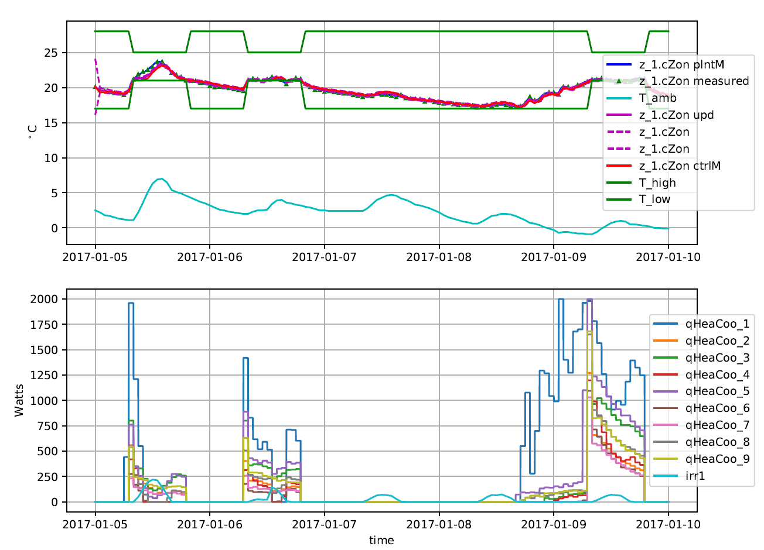
Test: 9 zone residential building

Slide 7
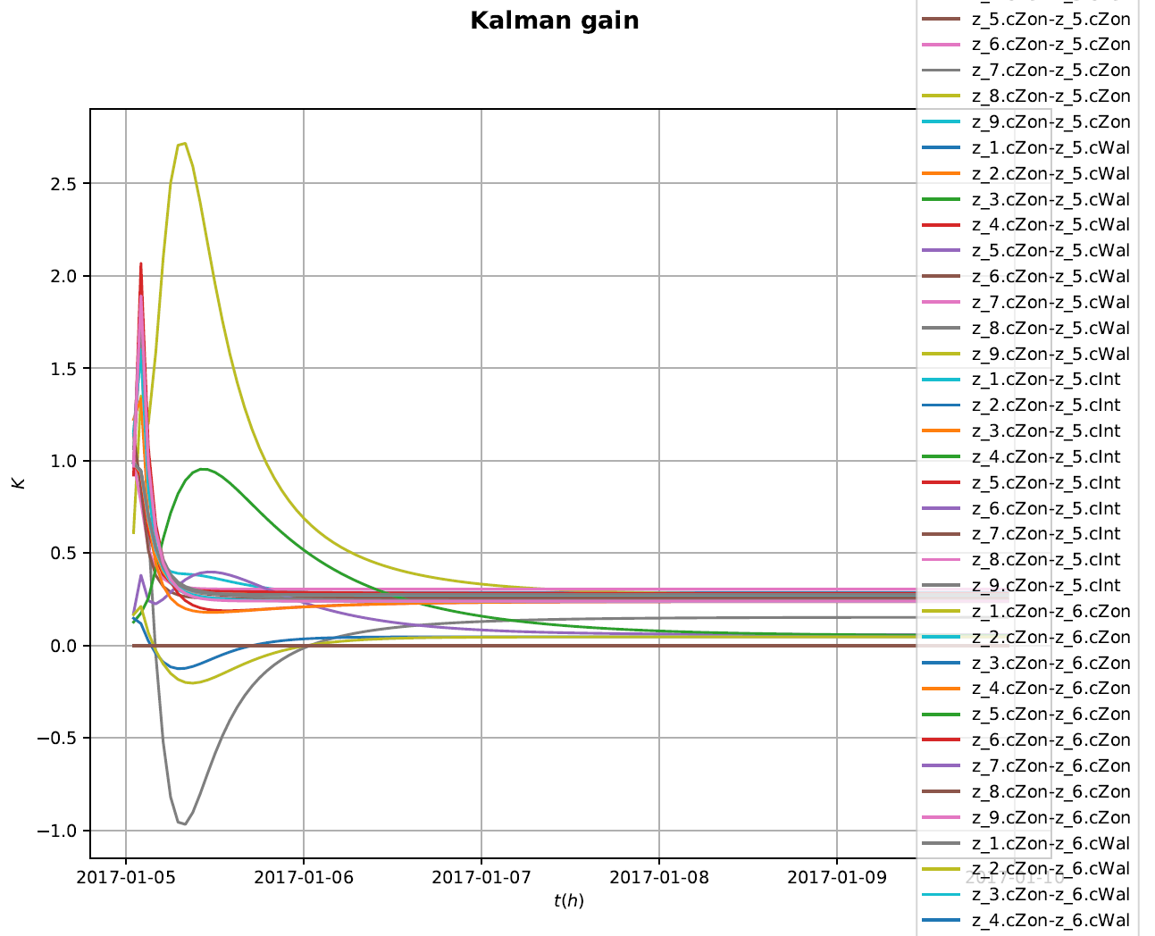
Test: 9 zone residential building

