Slide 1

MPC @ LBNL
David Blum
Postdoctoral Fellow
Building Technology and Urban Systems Division
Lawrence Berkeley National laboratory
Office: 90-3145
Phone: +1 (510) 486-4741
Email: dhblum@lbl.gov

Slide 2
MPC @ LBNL
PIs:
Michael Wetter, Jessica Granderson, Eleanor Lee, Tianzhen Hong, Rich Brown, Mary Ann Piette
Researchers:
David Blum, Christoph Gehbauer, Baptiste Ravache, Guanjing Lin, Marco Pitroni, Michael Spears
Affiliates and Collaborators:
Lisa Rivalin (Engie), Krzysztof Arendt (SDU), Ruoxi Jia (UCB), Gerald Schweiger (TU Gratz), Filip Jorissen (KU Leuven), Petri Jantunen (Aalto)

Slide 3
MPC @ LBNL
1) Overview of Projects
2) Collaboration Goals

Slide 4
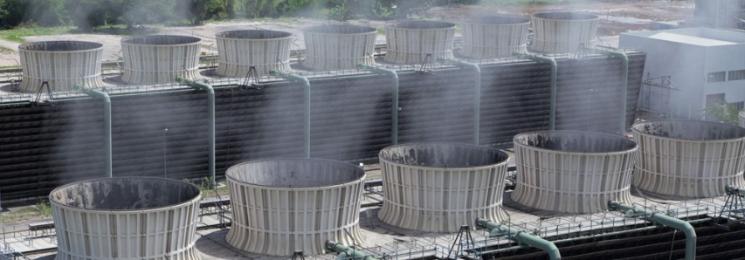
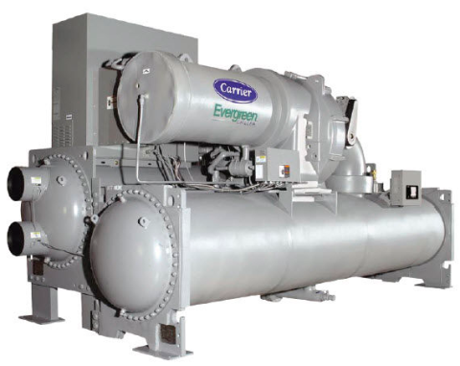
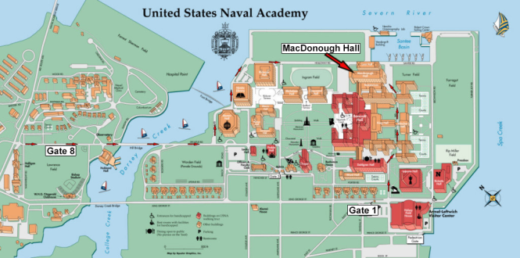
Chilled Water Plant Control (Completed)
Problem: Tradeoff chiller power for tower power
Funding: Department of Defense ESTCP Program
Outside Wet-Bulb
Tower
Chiller
Return
Condenser Water Loop
Supply
Power
Condenser Return
Temperature
Return
Supply
Chilled Water Loop
Notes:
A Solar house
There are many other Applications.

Slide 5
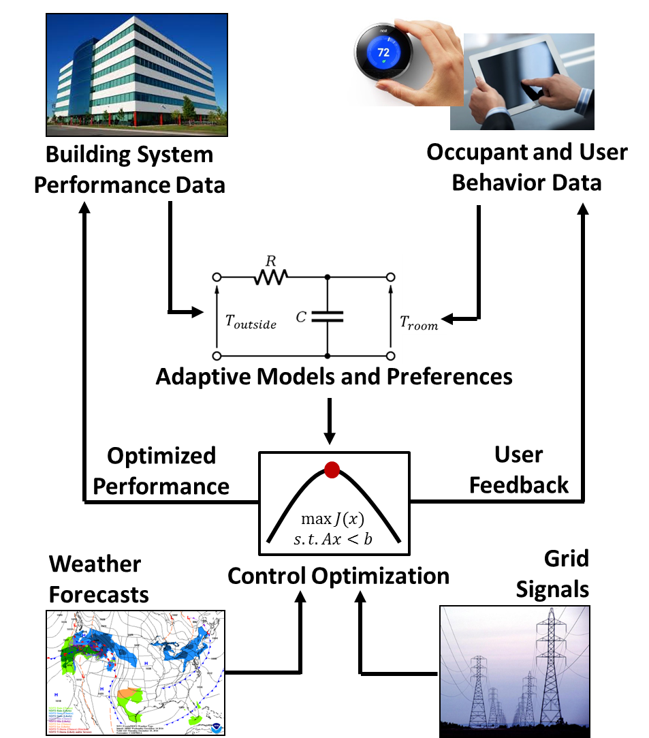
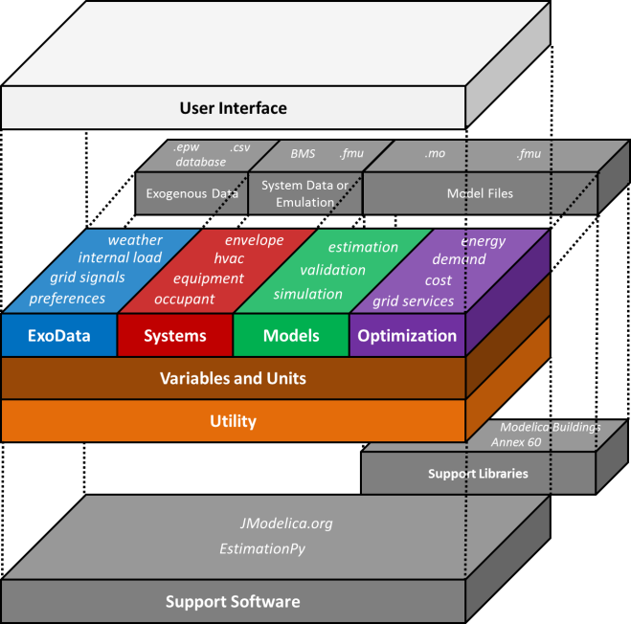
Open-Source Software Development (On going)
Problem: Develop, demonstrate, distribute MPC software
Funding: U.S. Department of Energy U.S.-China Clean Energy Research Center
Figure from Blum, D. H. and M. Wetter “MPCPy: An Open-Source Software Platform for Model Predictive Control in Buildings.” Proceedings of the 15th Conference of International Building Performance Simulation, Aug 7 – 9, 2017. San Francisco, CA.
Notes:
A Solar house
There are many other Applications.

Slide 6


Occupant-Integrated Building HVAC Control (On going)
Problem: Minimize energy consumption and improve thermal comfort
Funding: U.S. Department of Energy U.S.-China Clean Energy Research Center
Data Center
Cooling Towers
Fan Power
Return Air
Occupant behavior
and preferences
RTU
Office Area
Fan power
Compressor power
Supply Air
Interior
Diffuser
Perimeter
Diffuser
Heatpump
Fan power
Compressor power
Pump power
UFT Boxes
Return Water
Supply Water
Notes:
A Solar house
There are many other Applications.

Slide 7
Dynamic Façade Control (On going)
Problem: Tradeoff daylight, glare, lighting, heating and cooling
Funding: California Energy Commission
Image
Shading
Electric lighting
Heat gain
Heater/
Cooler
Glare
Daylight
Sun movement
Notes:
A Solar house
There are many other Applications.

Slide 8
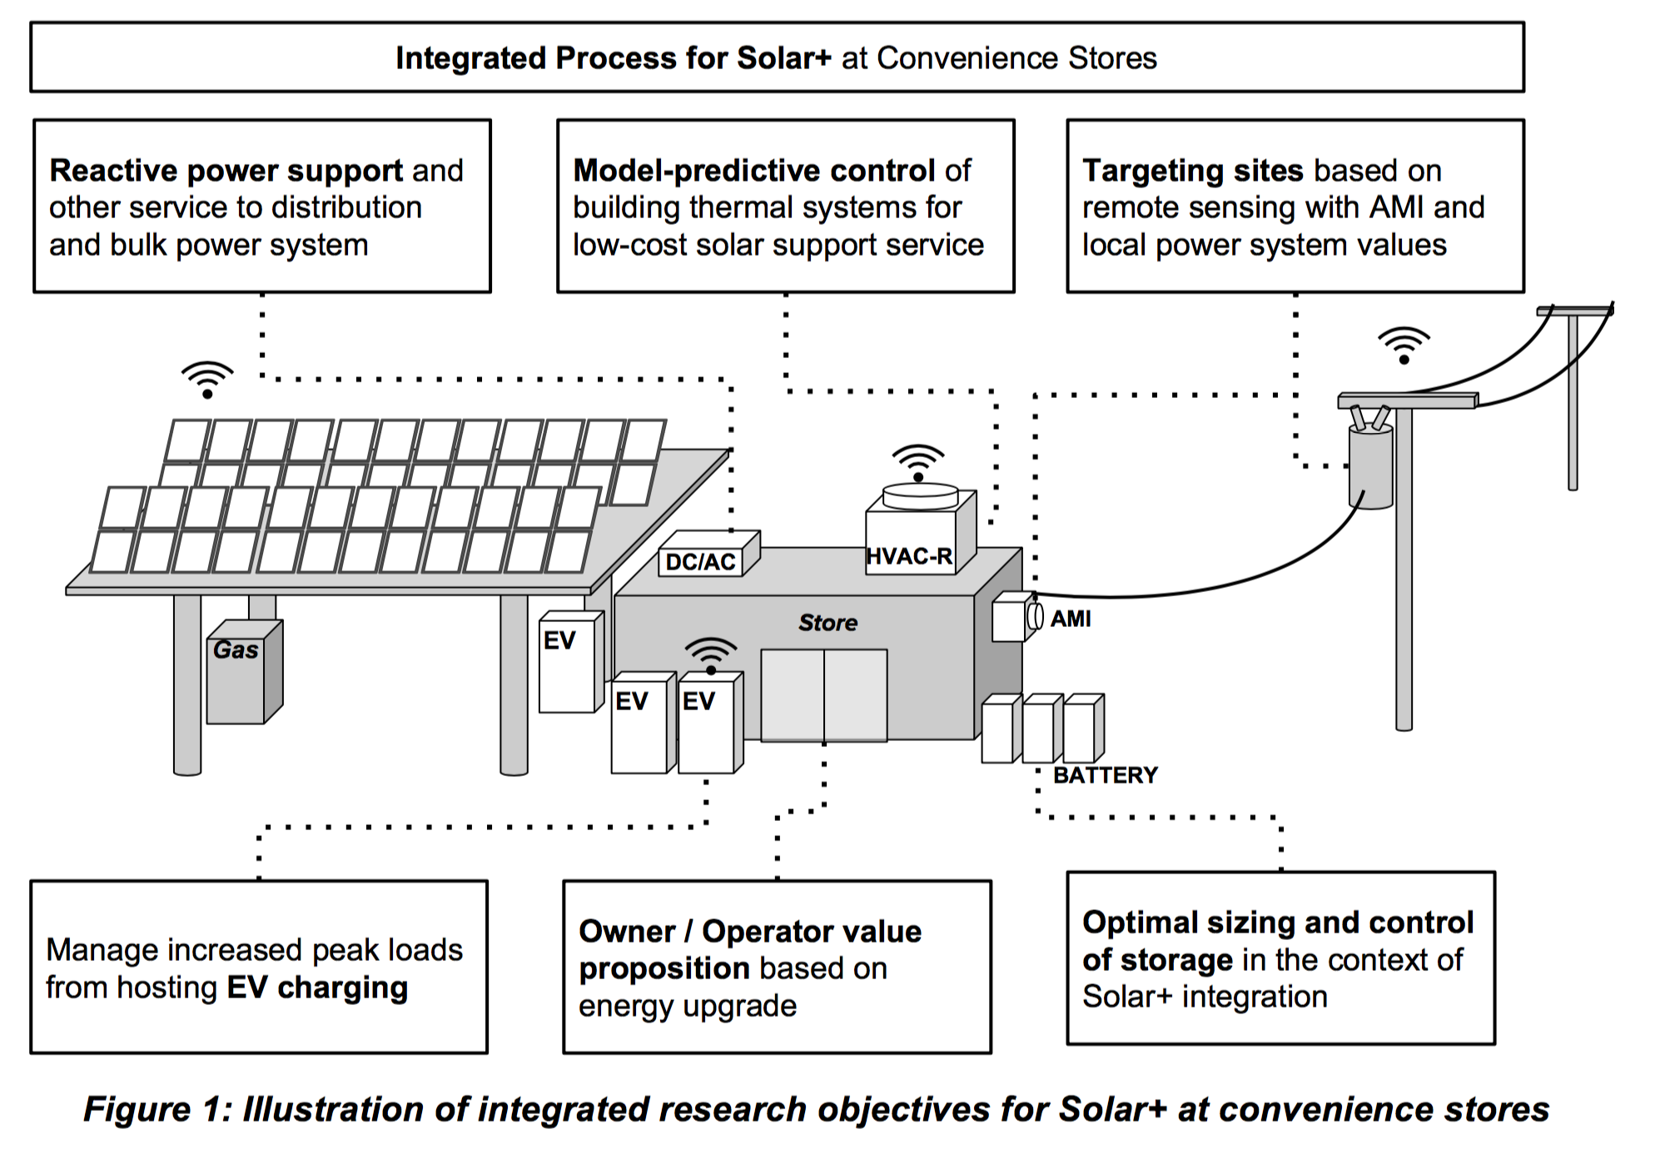
Convenience Store Refrigeration, HVAC, PV, and Battery Integration (Started)
Problem: Manage net load to provide grid services
Funding: California Energy Commission
Figure from Peter Alstone 2017.

Slide 9
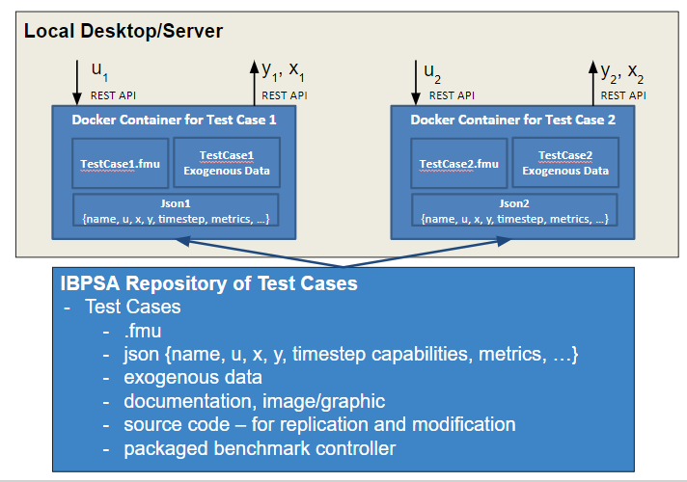
Building Optimization Testing (BOPTEST) Framework (Started)
Problem: Develop methods and test cases for advanced control systems
Funding: U.S. Department of Energy Building Technologies Office

Slide 10
What we hope to get out of participating in WP 1.2
Insights on modeling and optimization approaches to different applications.
Practical issues with implementations – dealing with faults, sensors, data, controllability.
Tools available or in development.
Collaboration on Modelica library development.
Collaboration on BOPTEST development.
How far can Modelica take us?
Establish future collaboration partners and exchanges.

