Slide 1

Problem Formulation
David Blum
Postdoctoral Fellow
Building Technology and Urban Systems Division
Lawrence Berkeley National laboratory
Office: 90-3145
Phone: +1 (510) 486-4741
Email: dhblum@lbl.gov

Slide 2
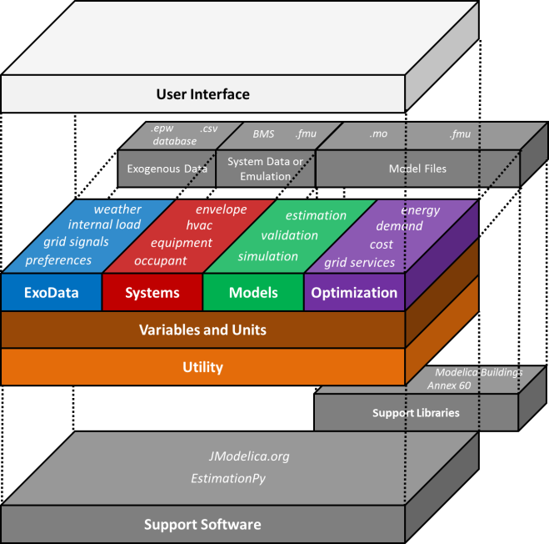



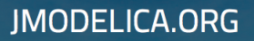
Tool
Blum, D. H. and M. Wetter “MPCPy: An Open-Source Software Platform for Model Predictive Control in Buildings.” Proceedings of the 15th Conference of International Building Performance Simulation, Aug 7 – 9, 2017. San Francisco, CA, Accepted.
MPCPy
Open-source software framework for MPC in buildings
https://github.com/lbl-srg/MPCPy
Features
Exogenous data collection
Building system emulation or
data collection
Grey-box parameter estimation
Control optimization
Non-MPC-expert usability
Design
Python scripting
Utilize support software
Extensible
Open-source

Slide 3
Tool
General Process with MPC Platform
model.mo
model.mop
Optimica
direct collocation &
derivatives
casADi
NLP solve
IPOPT
Optimal
Control
Law
JModelica
case information
solution information
User
MPCPy

Slide 4
Tool
Coefficient Estimation
model.mo
model.mop
Optimica
direct collocation &
derivatives
casADi
NLP solve
IPOPT
Optimal
Control
Law
JModelica
coefficient
information
measurement
weather
Internal load
User
MPCPy

Slide 5
Tool
Control Optimization
model.mo
model.mop
Optimica
direct collocation &
derivatives
casADi
NLP solve
IPOPT
Optimal
Control
Law
JModelica
objective
constraint def
weather
internal load
prices
constraint val
User
MPCPy

Slide 6
Tool
package Example
model House
parameter Real R “Resistance”;
parameter Real C “Capacitance”;
parameter Real COP “Coefficient of Performance”;
input Real T_amb “Ambient Temperature”;
input Real Q_hvac “HVAC heating power”;
Real T “Indoor Air Temperature”;
Real P “HVAC Electrical Power”;
equation
C*der(T) = (T_amb-T)/R + Q_hvac;
P = Q_hvac/COP;
end MPC;
model MPC_initialize
House mpc_model(R = r, C = c, COP = cop);
input Real T_amb = mpc_model.T_amb;
input Real Q_hvac = mpc_model.Q_hvac;
input Real price;
Real J(start = 0);
equation
der(J) = mpc_model.P*price;
end MPC_init;
optimization MPC_optimize(objective=J(finalTime))
extends MPC_initialize;
input Real T_lte_constraint;
constraints
mpc_model.T < T_lte_constraint;
end MPC_optimize;
end Example;
Original Model
Initialization Model
instantiate original model
add necessary inputs
add additional inputs
add objective variable
define objective equation
(could include soft constraints)
Optimization Definition
use initialization model
add constraint inputs
define constraints

Slide 7
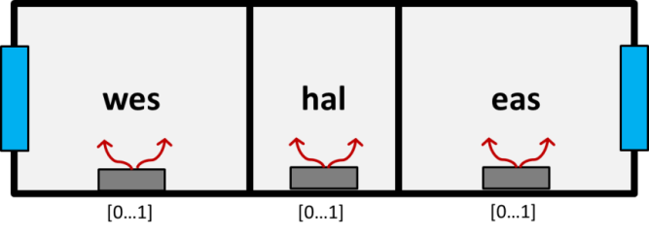
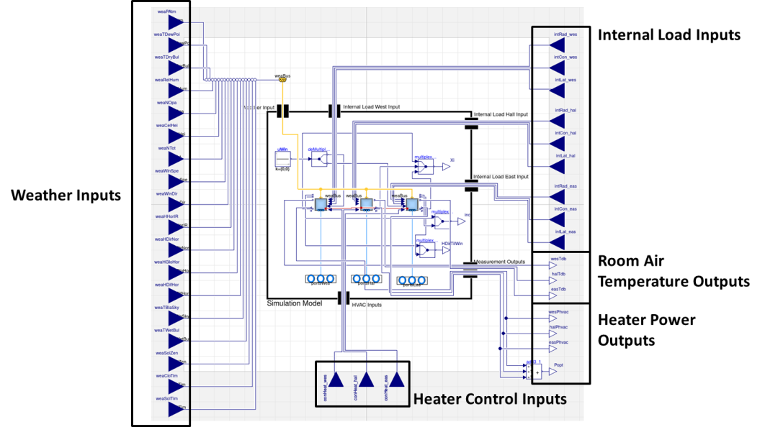
Example
Detailed model for building emulation
Test building design
Detailed building model in Modelica

Slide 8
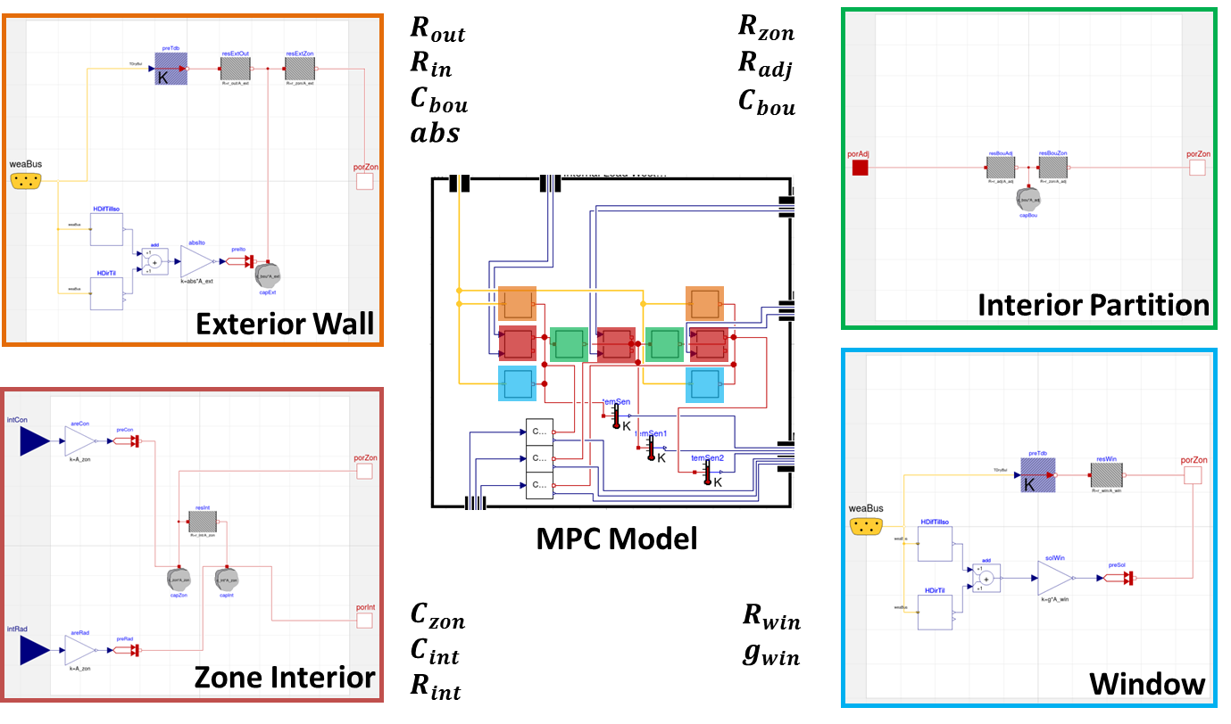
Example
“Grey-box” three-zone RC envelope model for MPC

Slide 9
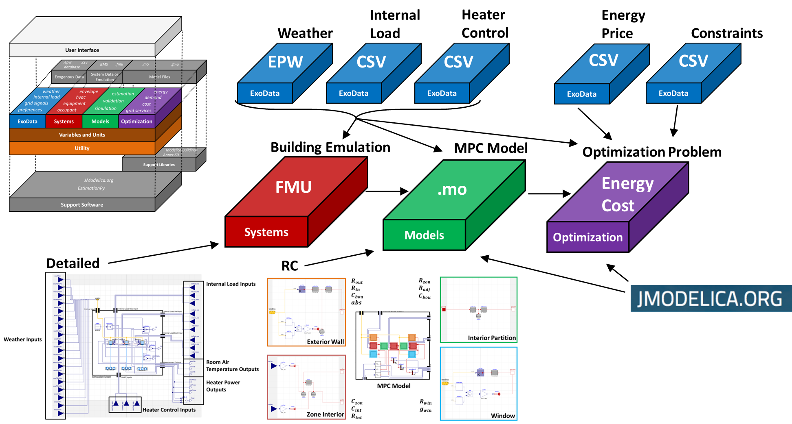
Example

Slide 10
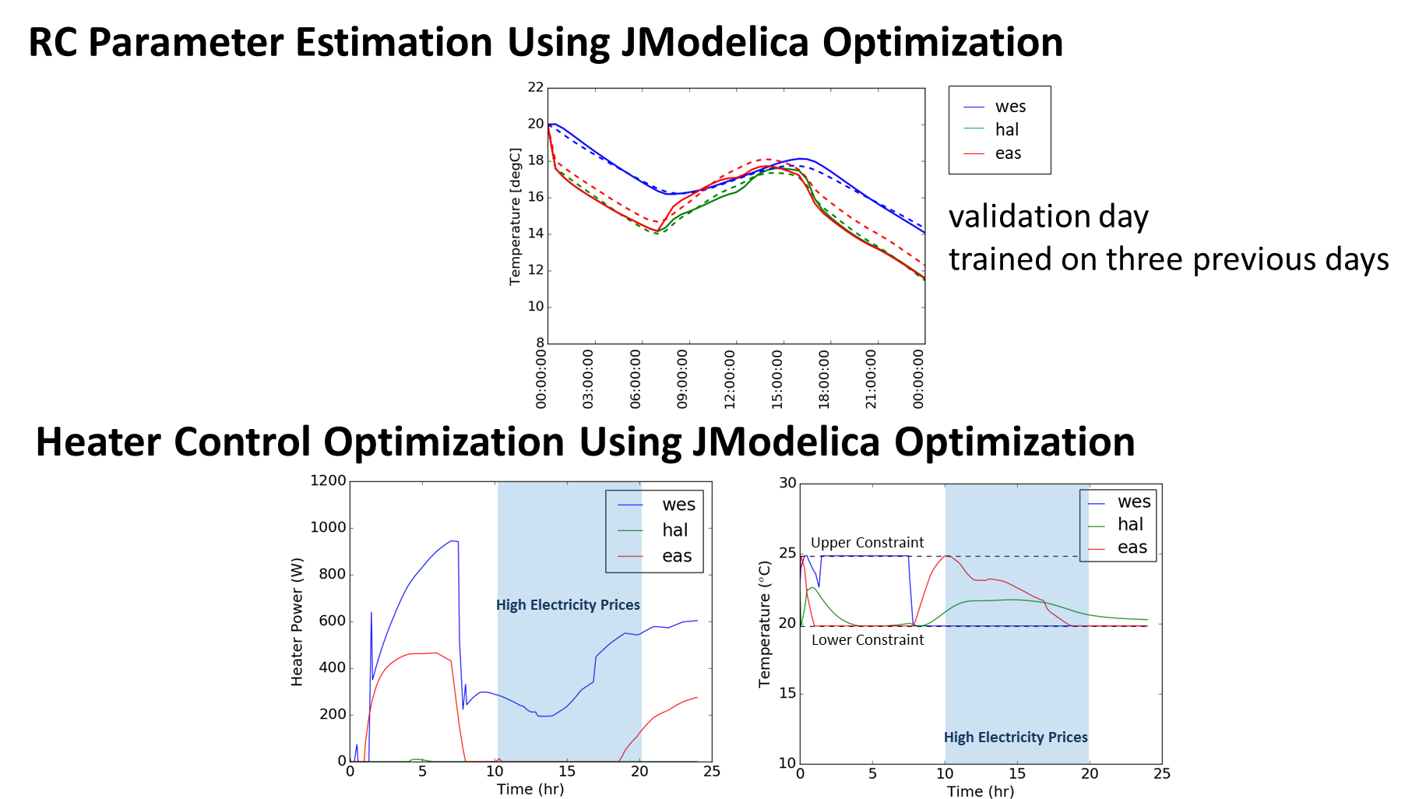
Example

Slide 11
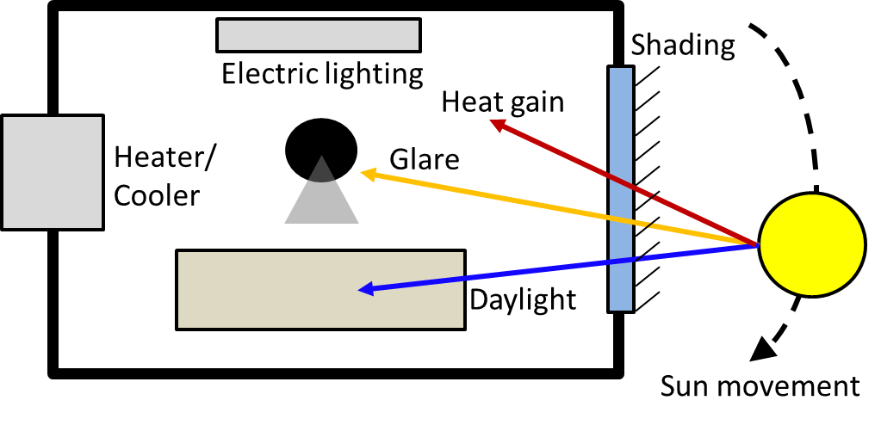
Other Formulations
Dynamic Façade Control (On going)
Problem: Tradeoff daylight, glare, lighting, heating and cooling
Funding: California Energy Commission
Objective:
HVAC Energy + Lighting Energy + Glare Penalty + View Penalty + Shade Movement Penalty
Optimization Variables:
Derivative of shade position
Constraints:
Room Temp, Workplane Illuminance
Nonlinearity:
Glare Penalty, Shade WPI/SHG/Glare Physics
Major Challenges: Discrete shade positions, daylighting models, embedded controller, <5 min control step
Notes:
A Solar house
There are many other Applications.

Slide 12
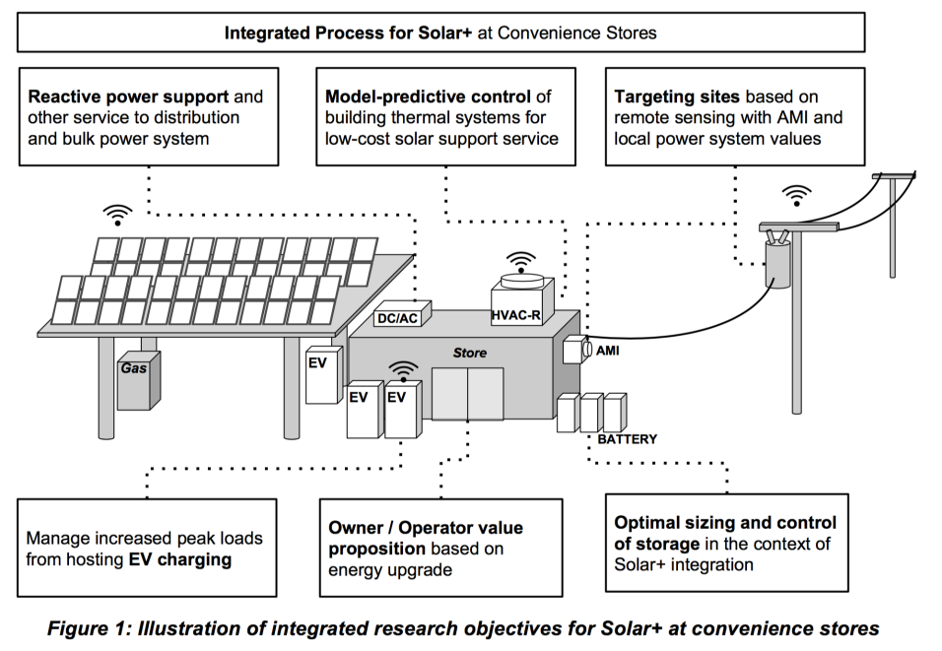
Other Formulations
Convenience Store Refrigeration, HVAC, PV, and Battery Integration (Started)
Problem: Manage net load to provide grid services
Funding: California Energy Commission
Objective:
HVAC Energy + Battery Consumption – PV Generation
Optimization Variables:
Refrigeration On/Off, RTU On/Off, Battery Power Flow
Constraints:
Store Temp, Ref. Temp, Freezer Temp, Battery Charge/Discharge , Battery SOC
Nonlinearity:
Refrigeration, RTU, Battery Charging Efficiencies
Major Challenges: Mixed-Integer, PV Forecasting

Slide 13
Thank you!
David Blum
Postdoctoral Fellow
Building Technology and Urban Systems Division
Lawrence Berkeley National laboratory
Office: 90-3145
Phone: +1 (510) 486-4741
Email: dhblum@lbl.gov

Slide 14
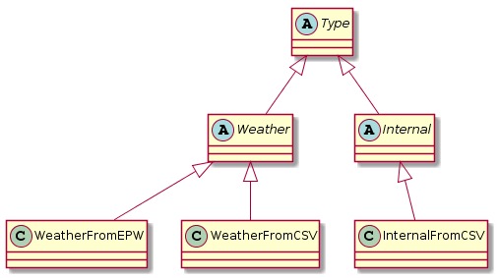
LBNL Work
Blum, D. H. and M. Wetter “MPCPy: An Open-Source Software Platform for Model Predictive Control in Buildings.” Proceedings of the 15th Conference of International Building Performance Simulation, Aug 7 – 9, 2017. San Francisco, CA, Accepted.
MPCPy
Open-source software framework for MPC in buildings
https://github.com/lbl-srg/MPCPy

Slide 15
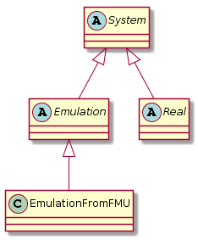
LBNL Work
Blum, D. H. and M. Wetter “MPCPy: An Open-Source Software Platform for Model Predictive Control in Buildings.” Proceedings of the 15th Conference of International Building Performance Simulation, Aug 7 – 9, 2017. San Francisco, CA, Accepted.
MPCPy
Open-source software framework for MPC in buildings
https://github.com/lbl-srg/MPCPy

Slide 16
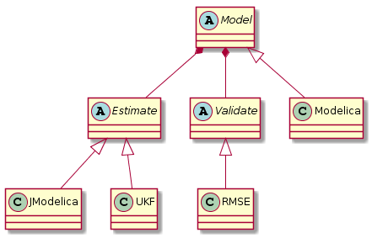
LBNL Work
Blum, D. H. and M. Wetter “MPCPy: An Open-Source Software Platform for Model Predictive Control in Buildings.” Proceedings of the 15th Conference of International Building Performance Simulation, Aug 7 – 9, 2017. San Francisco, CA, Accepted.
MPCPy
Open-source software framework for MPC in buildings
https://github.com/lbl-srg/MPCPy

Slide 17
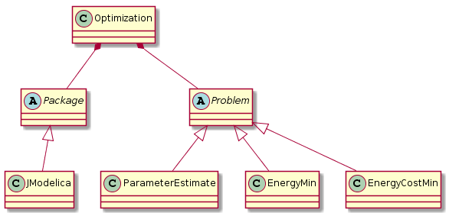
LBNL Work
Blum, D. H. and M. Wetter “MPCPy: An Open-Source Software Platform for Model Predictive Control in Buildings.” Proceedings of the 15th Conference of International Building Performance Simulation, Aug 7 – 9, 2017. San Francisco, CA, Accepted.
MPCPy
Open-source software framework for MPC in buildings
https://github.com/lbl-srg/MPCPy

