Slide 1
Dijkstra's Algorithm
Presented by
Antaine Ó Conghaile
& Brendan Toolan

Slide 2
Introduction

Slide 3
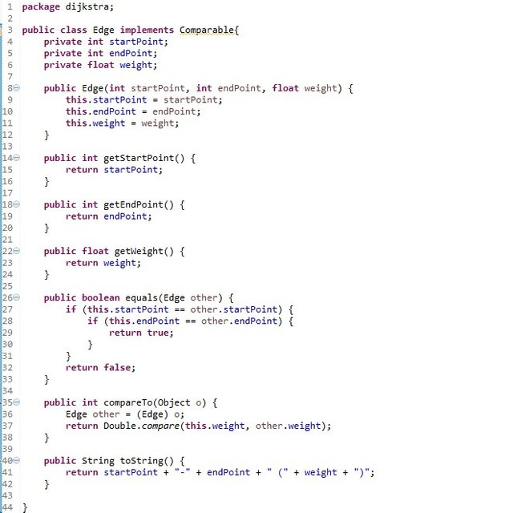
Dijkstra's Algorithm, what is it?

Slide 4
Brief Explanation of Algorithm
Calculates the shortest route through a graph based on the distance between nodes.

Slide 5
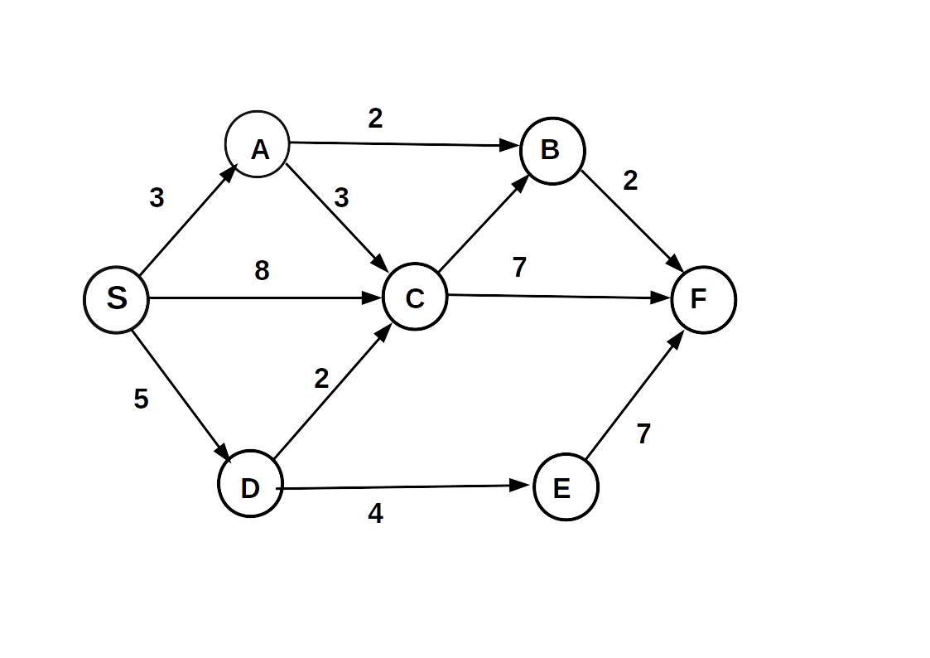
Example of Dijkstra Algorithm Graph

Slide 6

Dijkstra History
Created by Edsger Dijkstra (1930-2002)
Professor most of his life(Insert colleges and dates)
Created Dijkstra’s Algorithm in 1959
Turing Award winner 1972

Slide 7
How does it work?
Simple Example
2

Slide 8
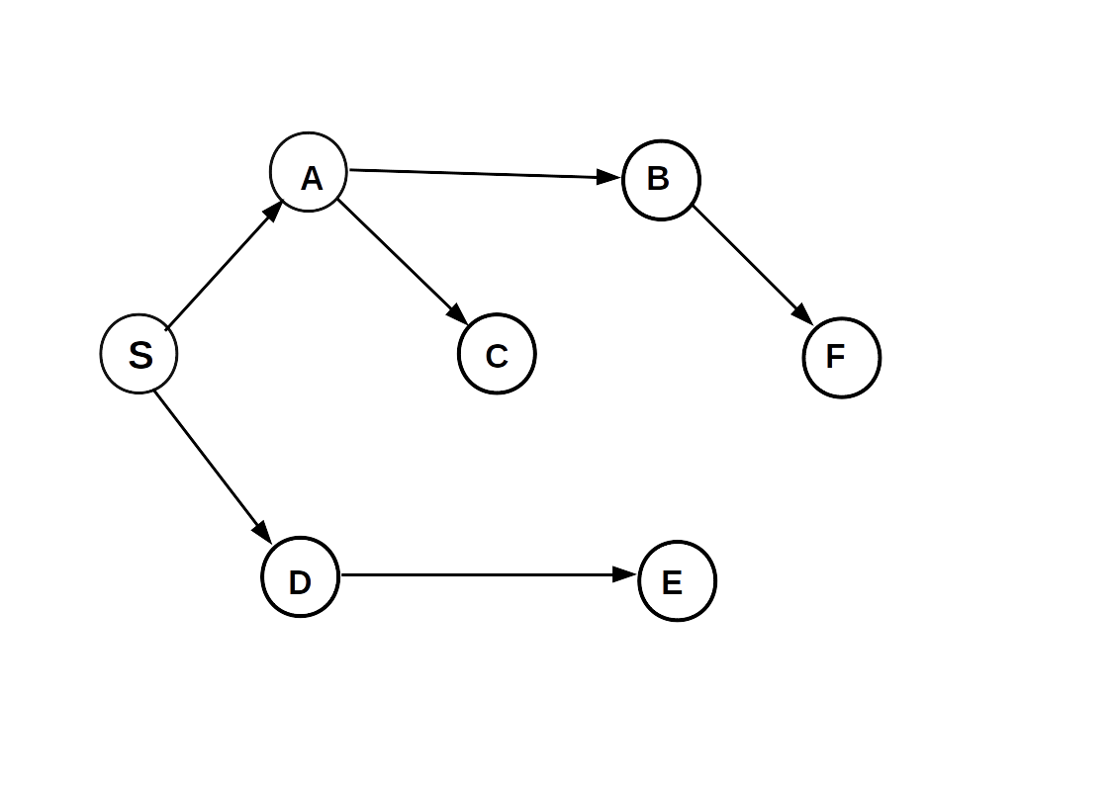
Solution
Vertex | Distance | Parent
S | 0 | Nil
A | 3 | S
B | 5 | A
C | 6 | A
D | 5 | S
E | 9 | D
F | 7 | B

Slide 9
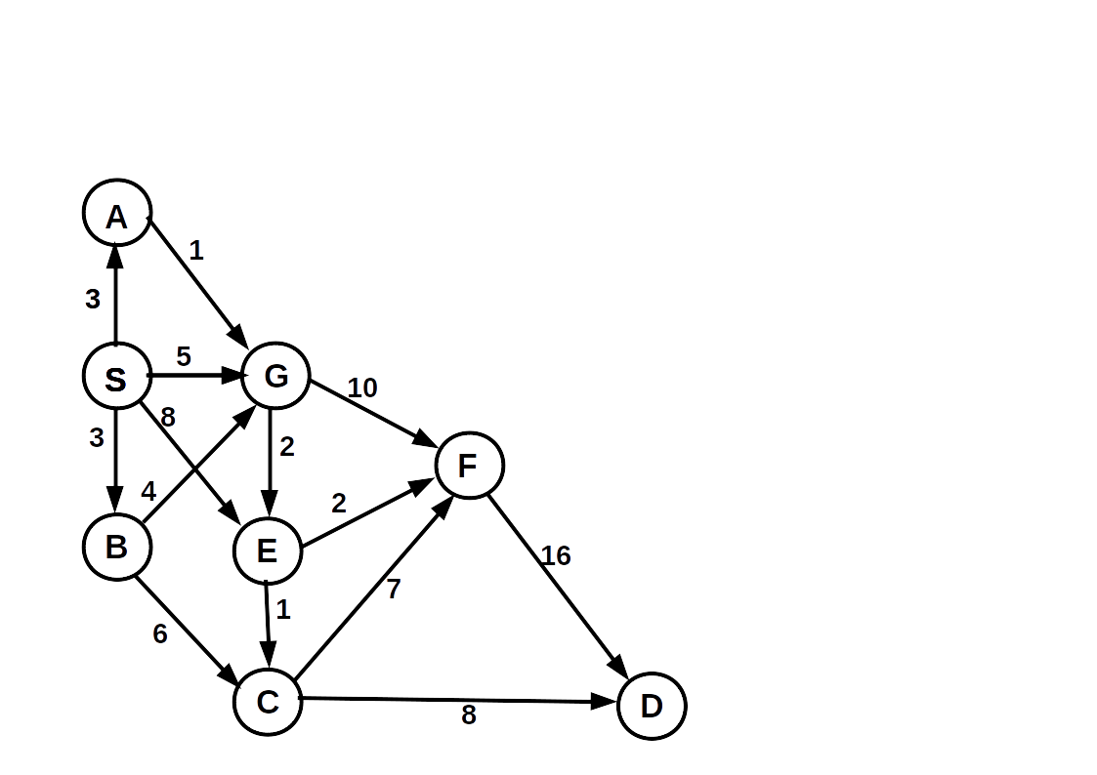
Complex Example

Slide 10
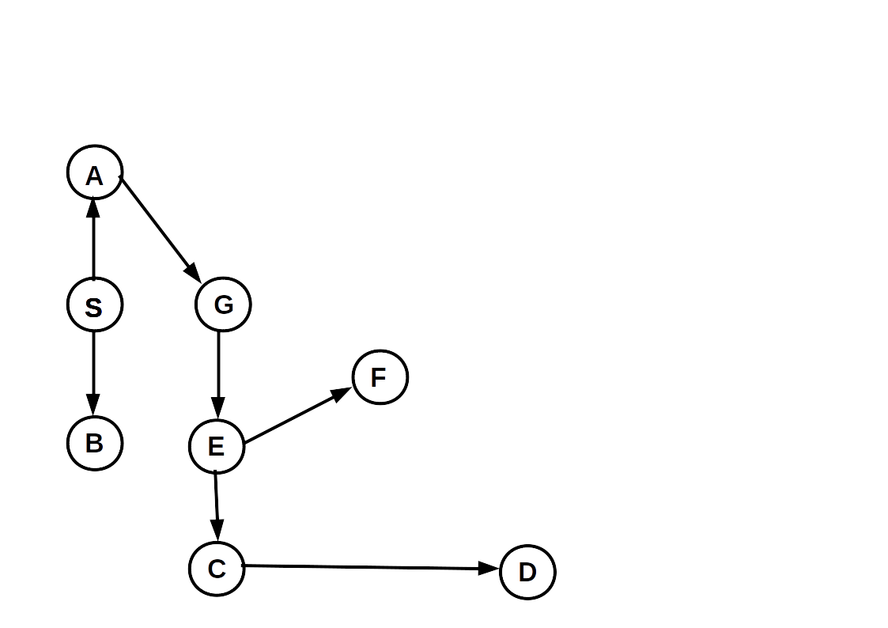
Solution
Vertex | Distance | Parent
S | 0 | Nil
A | 3 | S
B | 3 | S
C | 7 | E
D | 15 | C
E | 6 | G
F | 8 | E
G | 4 | A

Slide 11
Uses in Code

Slide 12
Code Example

Slide 13
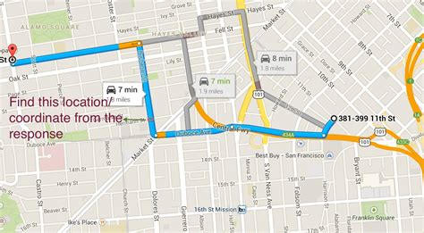
Real Life Application
Device

Slide 14
Devices

Slide 15
Pros and Cons
Pros
  Used in Google Maps
  Used in Telephone Networks
  Calculates the shortest distance on maps

Slide 16
Pros and Cons
Cons
  Can’t handle negative edges
  Most go through every route even when the most efficent route is found

Slide 17
Conclusion

Slide 18
References

Slide 19
Questions?

