Slide 1
Professional Practice in IT
Cathal Butler (G00346889) & Morgan Reilly (G00303598)

Slide 2
Aims & Objectives
The aim was to use a 3-tier architecture to develop a functional application – Client/Server/Database
We wanted to simplify students lives by having their grades and timetable in one convenient location
Our objective was to do this in a fashion that was efficient and user-friendly

Slide 3


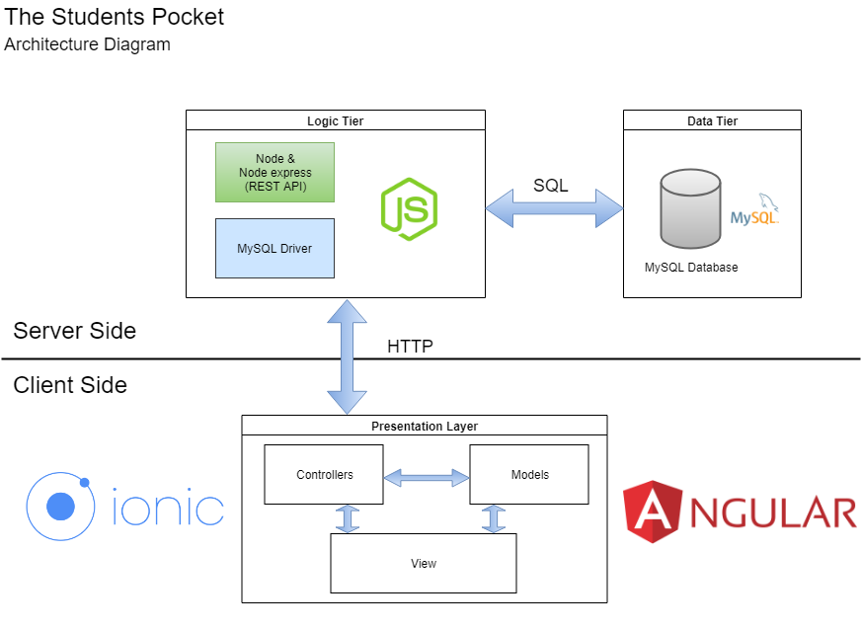

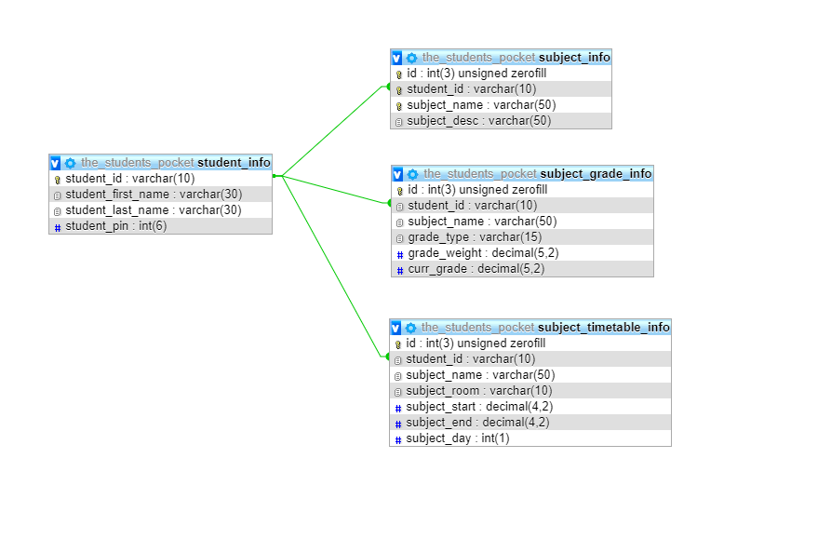


Architecture

Slide 4
Problems Encountered
Initially had decided to go with MongoDB. It proved to be problematic so moved to MySQL
Issue with page refresh where the user's fresh data isn’t shown unless a hard-refresh is performed
Had issues porting application to mobile

Slide 5
Conclusions
Pair programming to a while to get used to
Design clashes, technology clashes, issues with meeting up due to work/other projects etc…
Learned a lot about the usage of git
Gained more knowledge of technologies and database used
Both glad to have done this project as we feel these skills will stand to us in our final year
Both happy with the outcome of the project

