Slide 1

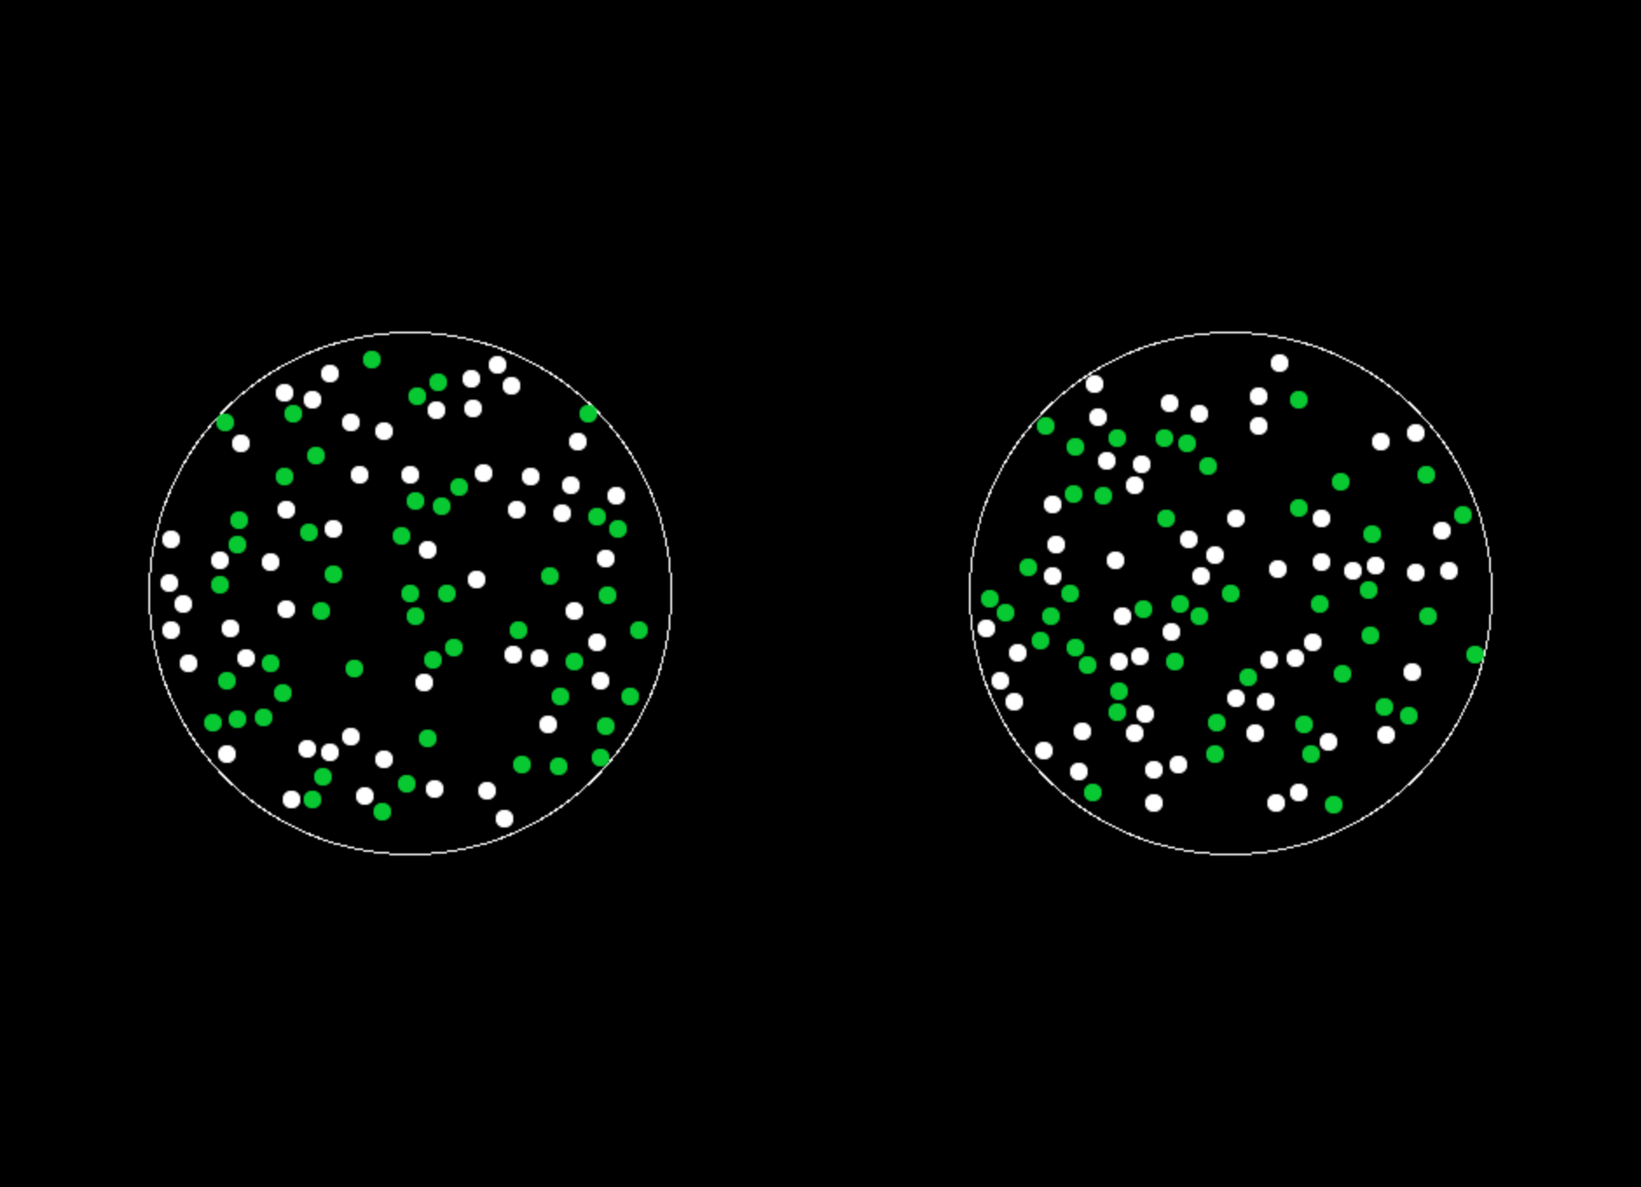
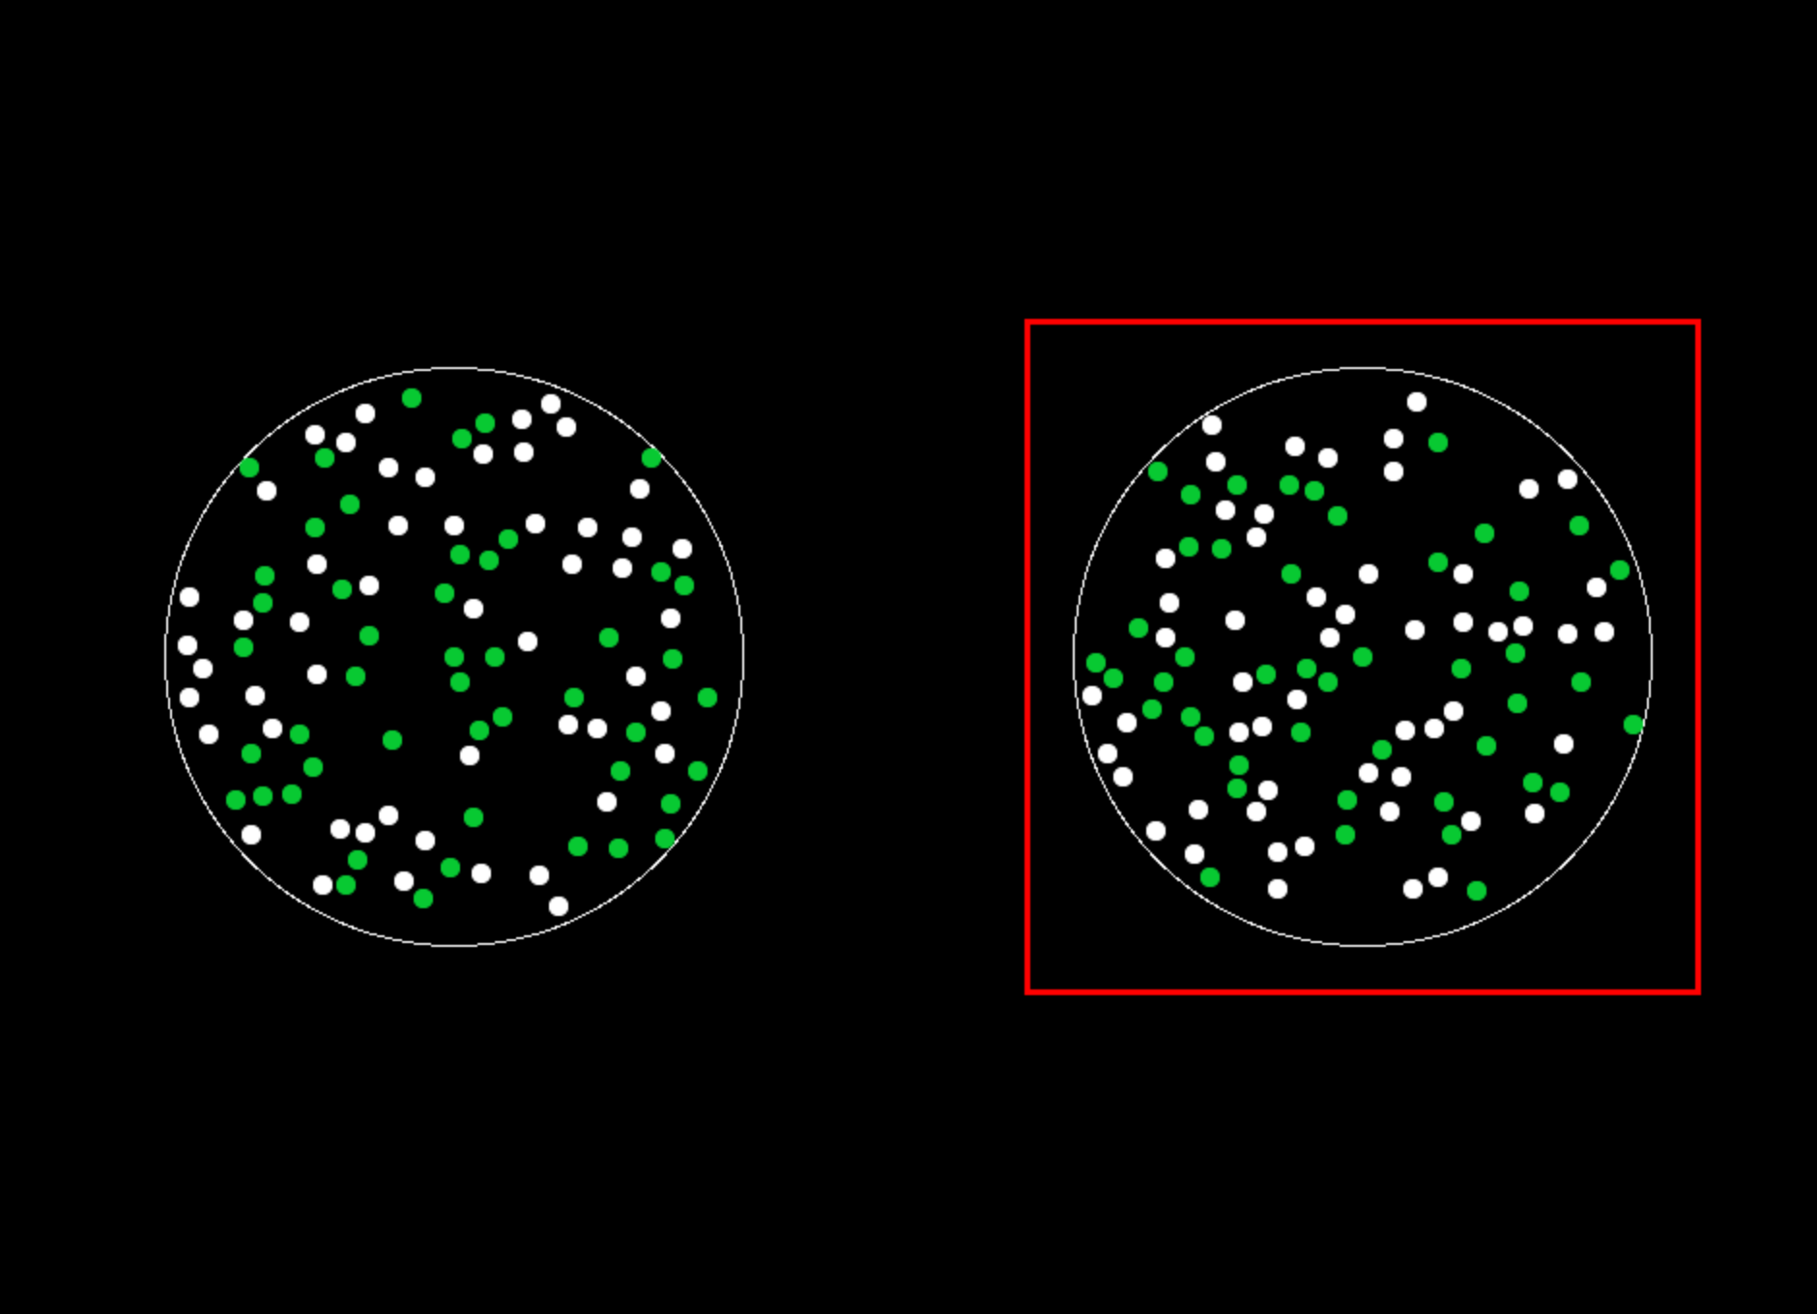
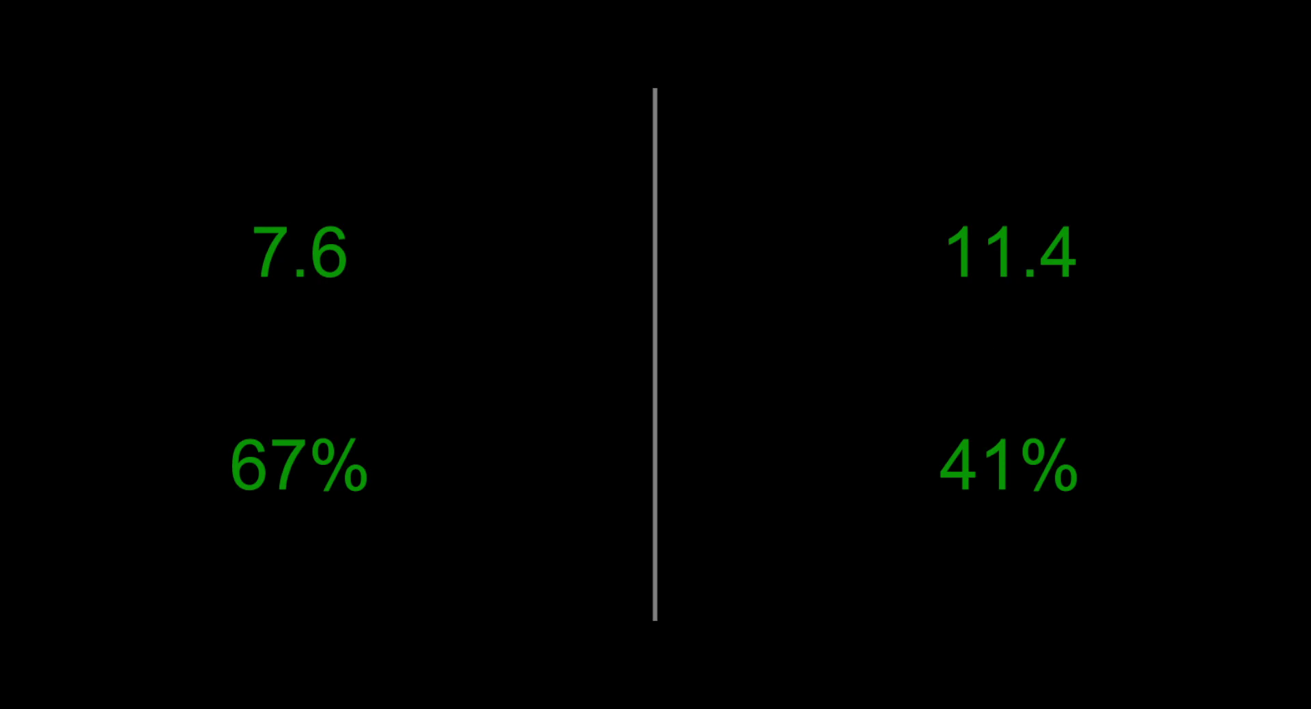
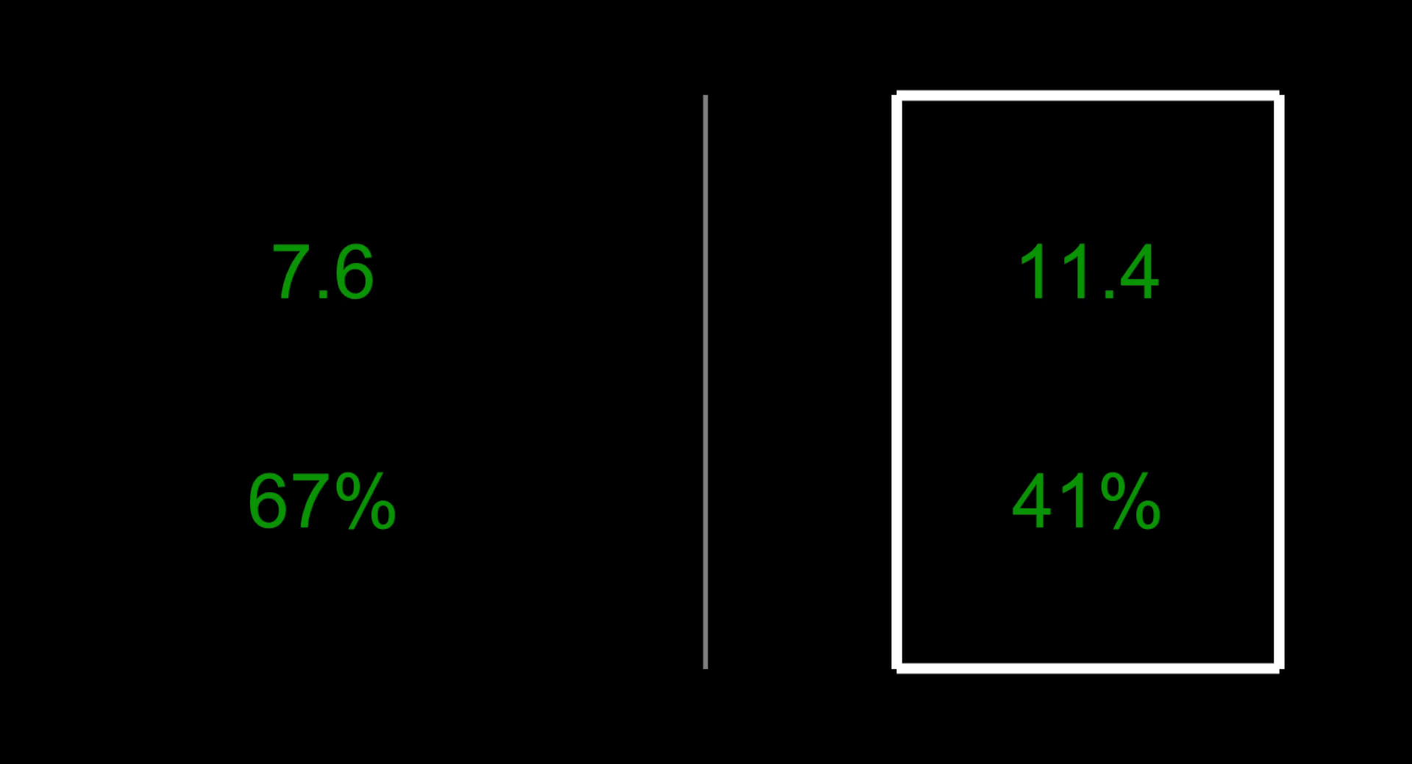
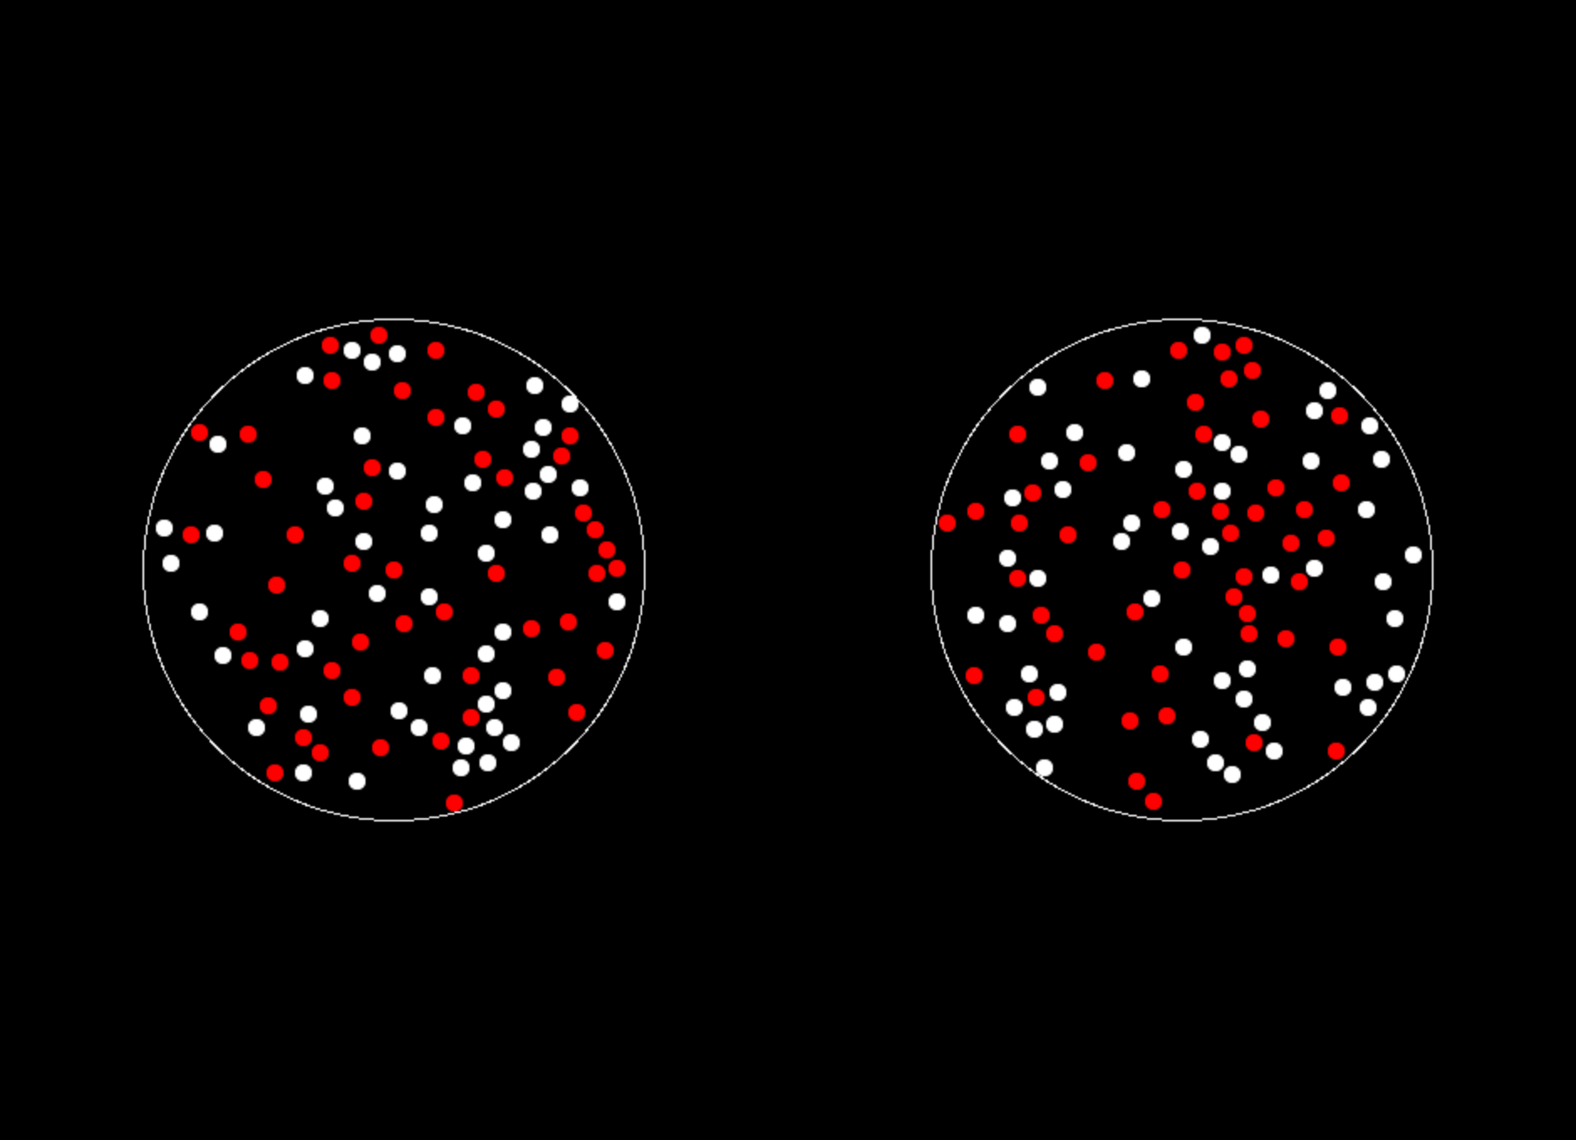
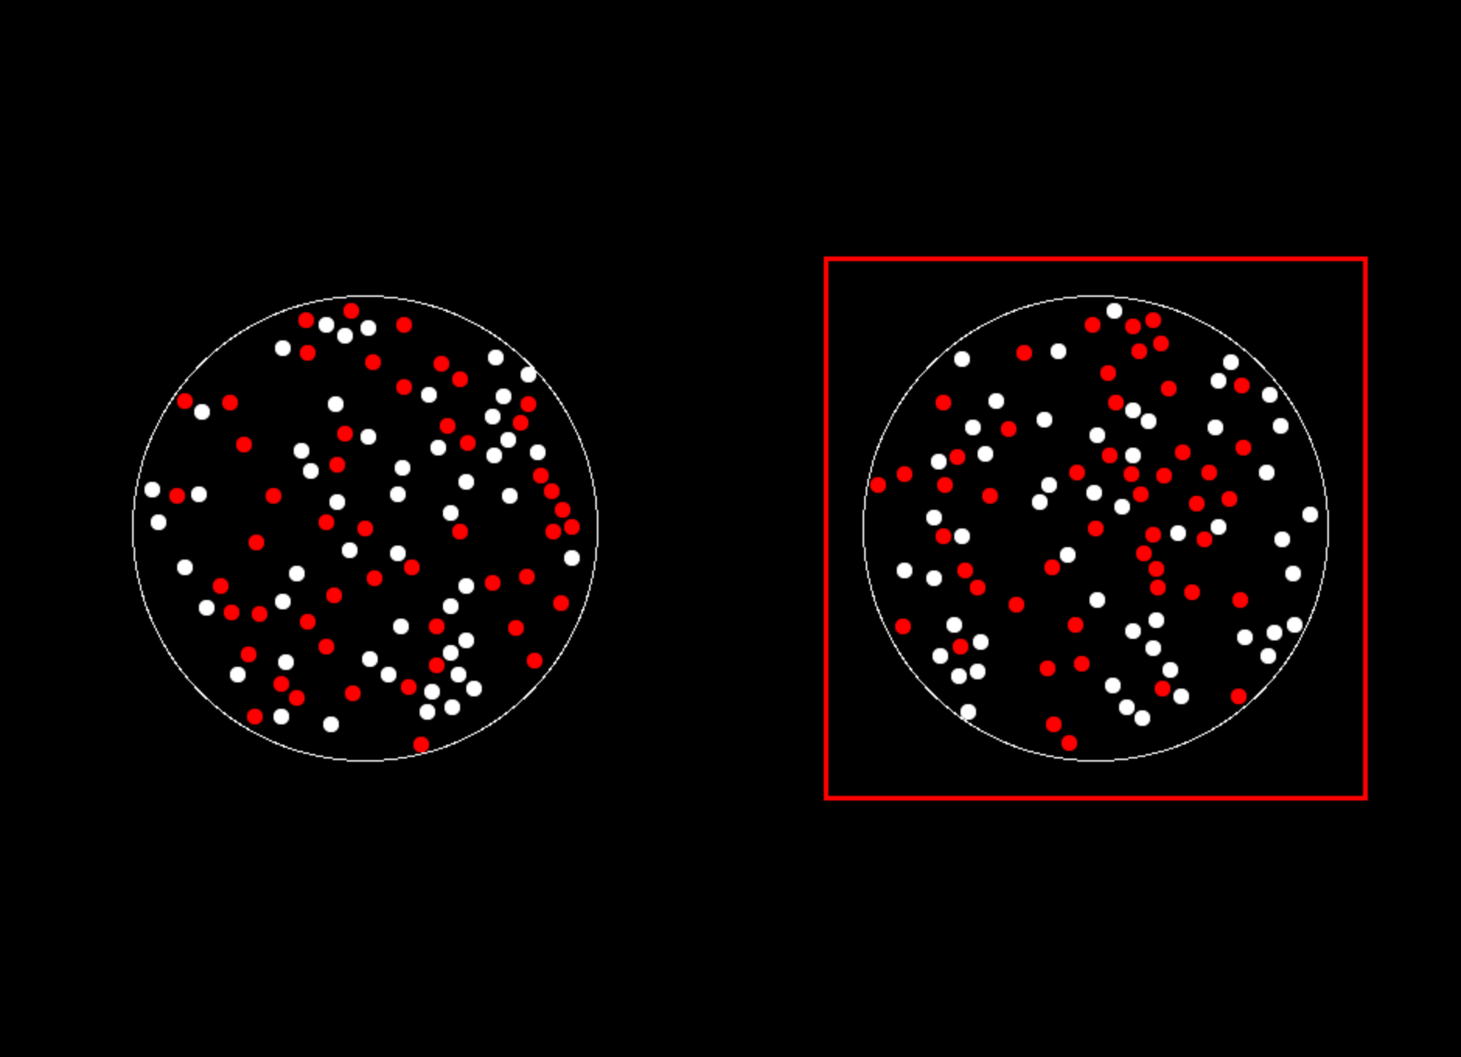
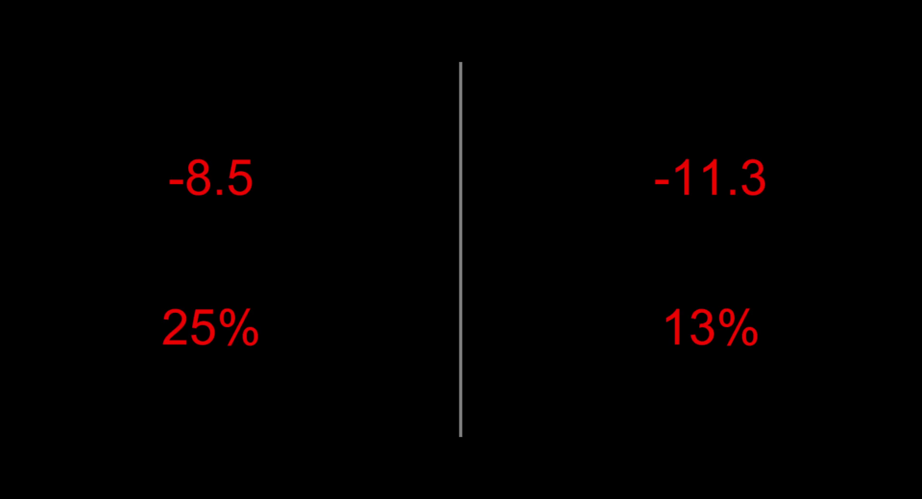
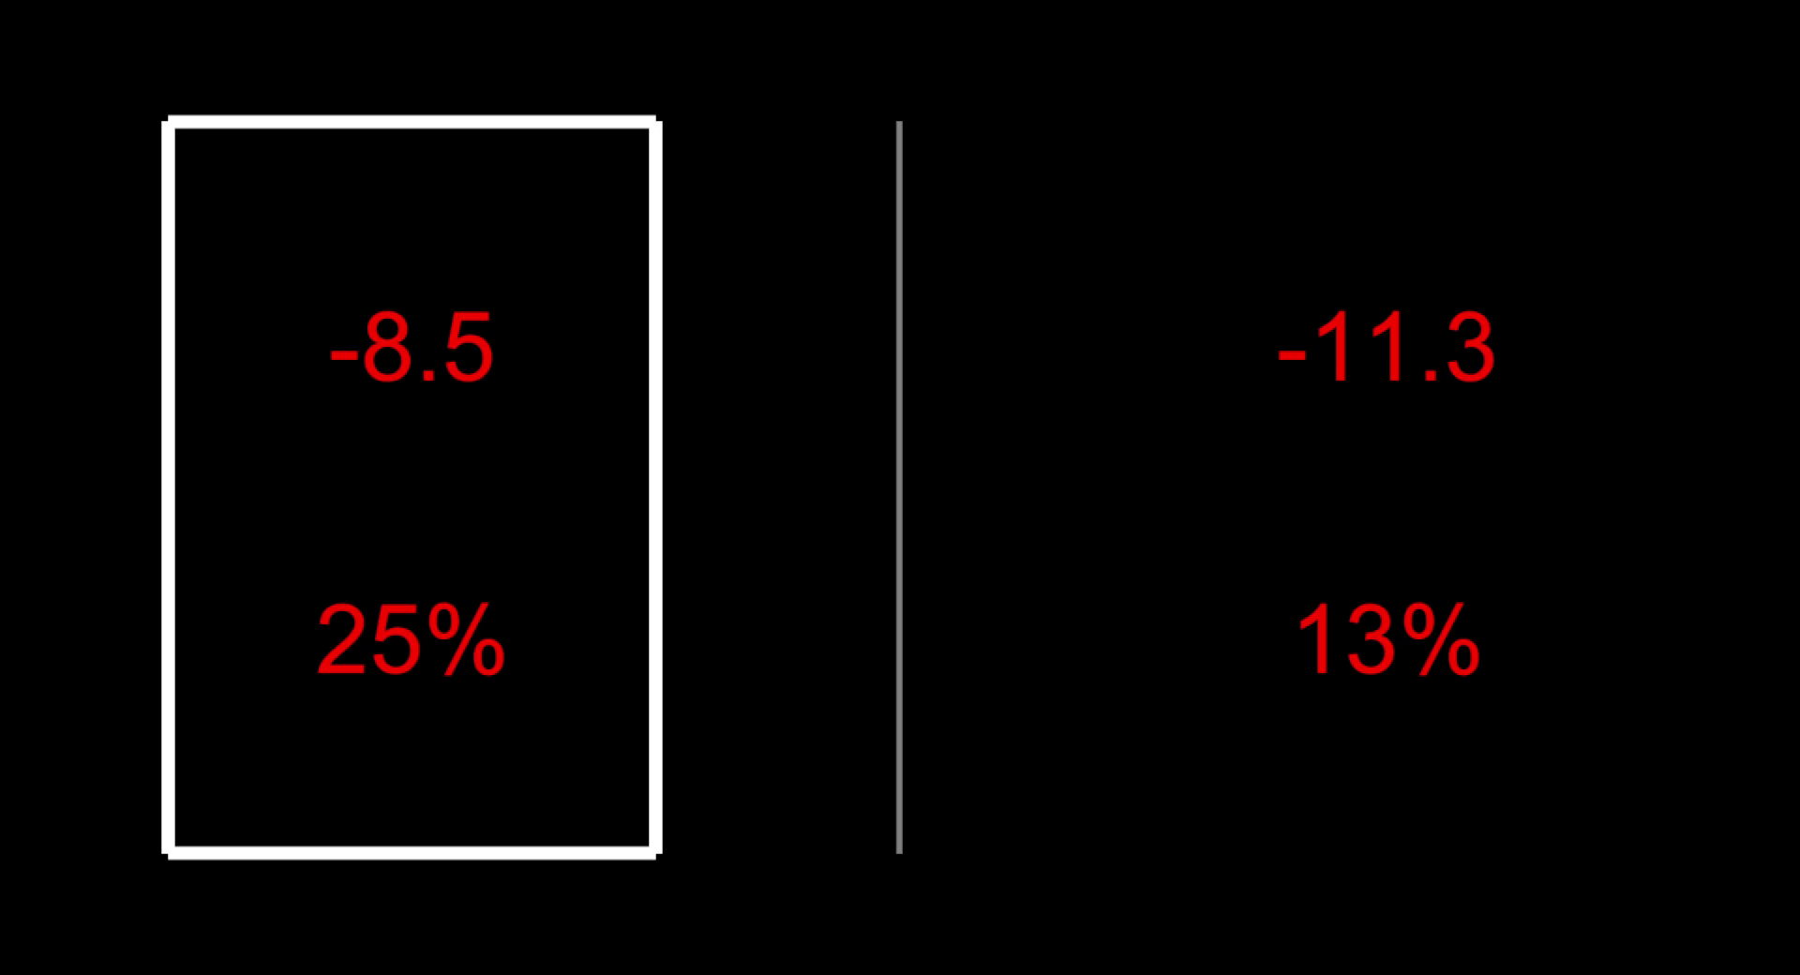
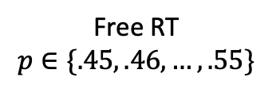
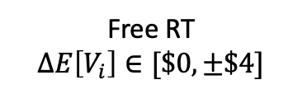
Study 1
Study 2
Gain
Gain
7.6
11.4
7.6
11.4
67%
41%
67%
41%
Loss
Loss
-8.5
-11.3
-8.5
-11.3
25%
13%
25%
13%
ITI
1 s
Free RT
$$p∈\{.45, .46, …, .55\}$$
Feedback
1 s
ITI
1 s
Free RT
$$ΔE\left[V_{i}\right]∈[\$0, ±\$4]$$
Feedback
1 s
Eye-tracking
Eye-tracking

