Slide 1
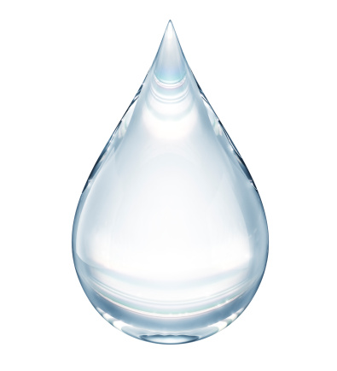
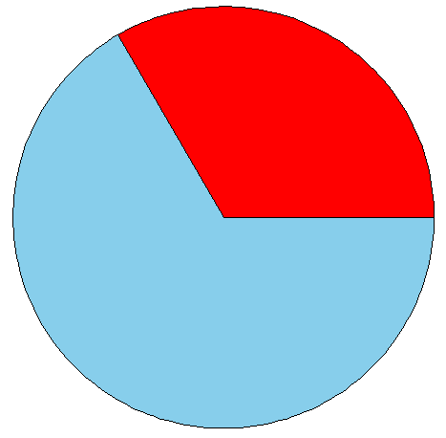
Swallow
1 s
3-6 s
6 s
2 s
1-9 s

