Slide 1
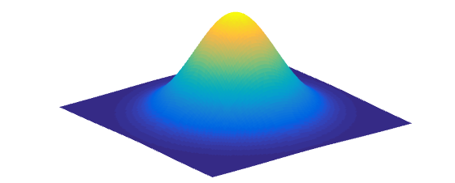
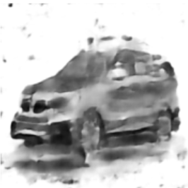

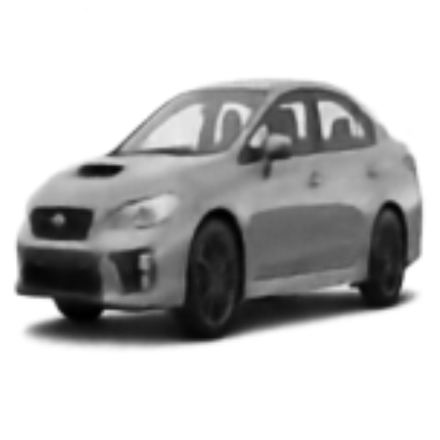
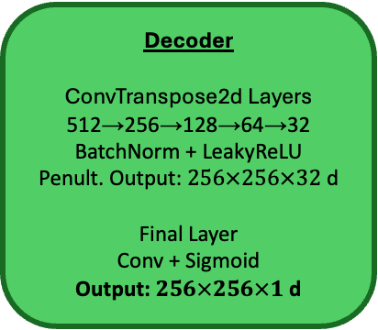

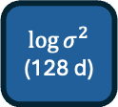
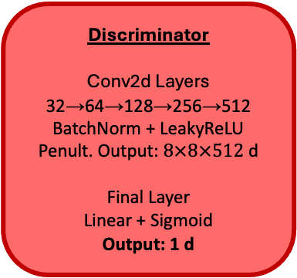
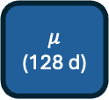
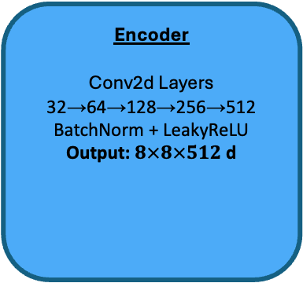
Standard Normal Prior
Random
Sampled Latent
Vector
(128 d)
Random Sample
Input Image
$256×256×1$ d
Encoder
Conv2d Layers
32→64→128→256→512
BatchNorm + LeakyReLU
Output: $8×8×512$ d
Latent Distribution
Decoder
ConvTranspose2d Layers
512→256→128→64→32
BatchNorm + LeakyReLU
Penult. Output: $256×256×32$ d
Final Layer
Conv + Sigmoid
Output: $256×256×1$ d
Discriminator
Conv2d Layers
32→64→128→256→512
BatchNorm + LeakyReLU
Penult. Output: $8×8×512$ d
Final Layer
Linear + Sigmoid
Output: 1 d
Linear
$$μ$$
(128 d)
Sampled Latent Vector
(128 d)
$$\log{σ^{2}}$$
(128 d)
Reconstruction
Linear
Capabilities
Reconstructions
Store latent distribution
Generate from random samples
Latent traversals
Interpolations
Reconstructions over epochs
Parameters
Image size: 256
Kernel: 3, Stride: 2
Latent dimensions: 128
Max KLD weight (starts at 0.01): 0.75
Adversarial weight: 1.0
Reconstruction vs sample weight: 0.5
Learning rate: 0.0001
Epochs: 150
Batch size: 128
VAE Loss
KL divergence of latent distribution from standard normal (scheduler)
MSE of reconstruction versus input image
Failing to trick discriminator with reconstructed and sample images
Discriminator Loss
Incorrectly identify real versus reconstructed or sample images

