Slide 1
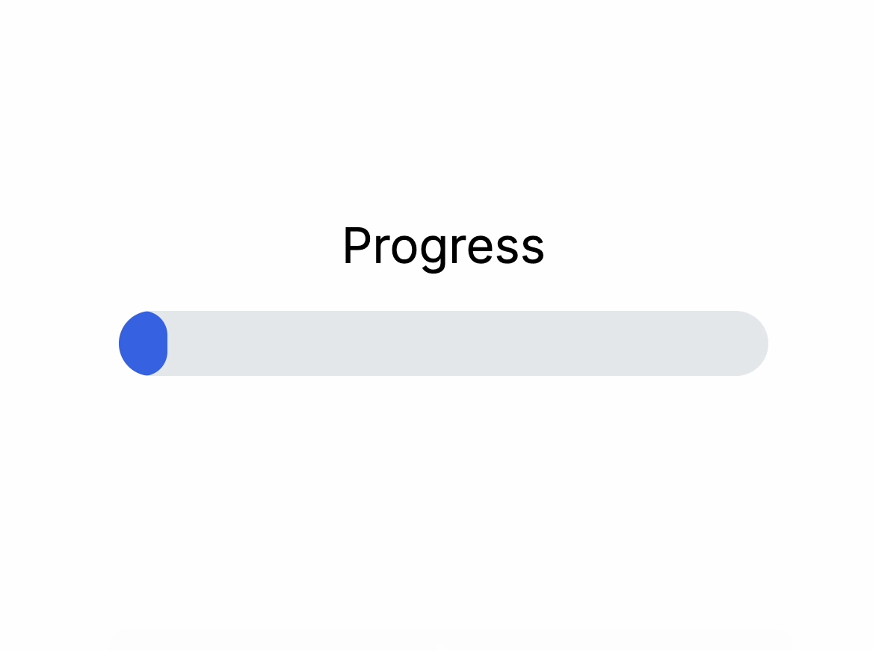
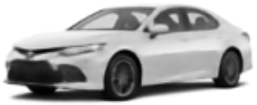
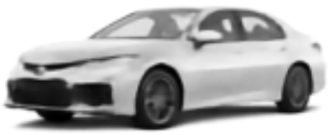


Latent Traversal Judgement Study
Describe what is different between these images.
ITI (Progress Bar)
2 seconds
Judgement Response
Up to 60 seconds

