Slide 1
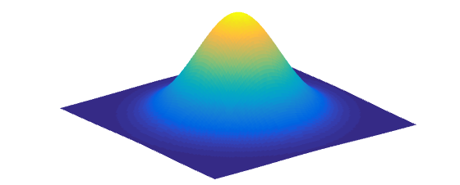
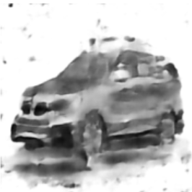

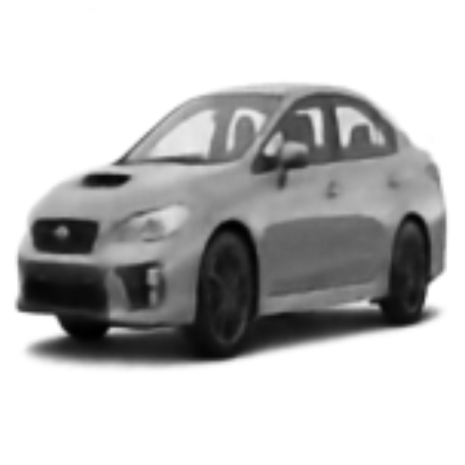
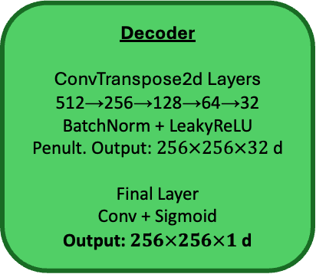

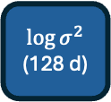
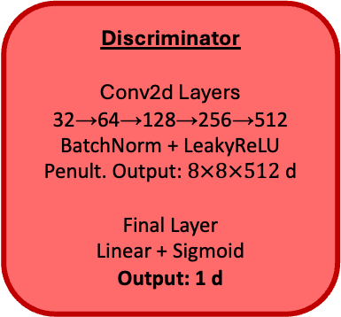
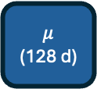
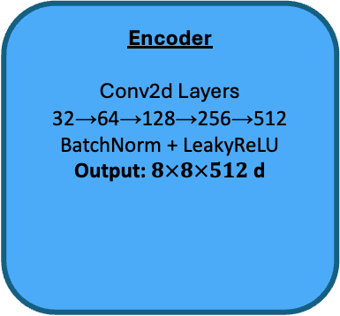
Standard Normal Prior
Random
Sampled Latent
Vector
(128 d)
Sample
Input Image
$256×256×1$ d
Encoder
Conv2d Layers
32→64→128→256→512
BatchNorm + LeakyReLU
Output: $8×8×512$ d
Latent Distribution
Decoder
ConvTranspose2d Layers
512→256→128→64→32
BatchNorm + LeakyReLU
Penult. Output: $256×256×32$ d
Final Layer
Conv + Sigmoid
Output: $256×256×1$ d
Discriminator
Conv2d Layers
32→64→128→256→512
BatchNorm + LeakyReLU
Penult. Output: $8×8×512$ d
Final Layer
Linear + Sigmoid
Output: 1 d
Linear
$$μ$$
(128 d)
Sampled Latent Vector
(128 d)
$$\log{σ^{2}}$$
(128 d)
Reconstruction
Linear
VAE Loss
KL divergence of latent distribution from standard normal
MSE of reconstruction versus input image
Failing to trick discriminator with reconstructed/sample images
Discriminator Loss
Incorrectly identify real versus reconstructed or sample images

