Slide 1
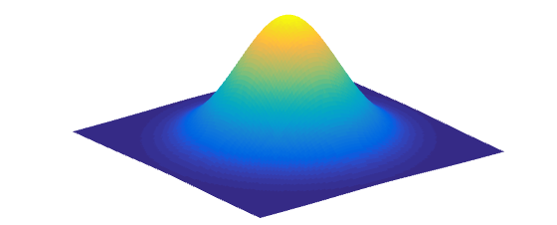
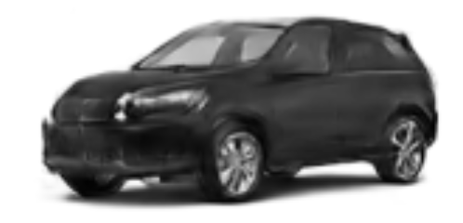

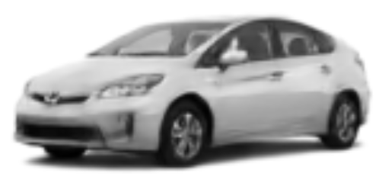

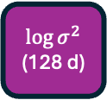
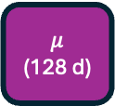
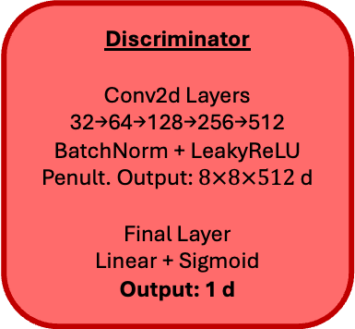
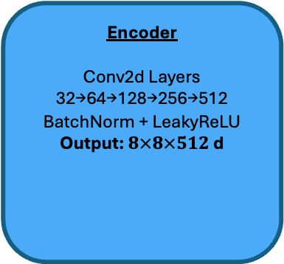
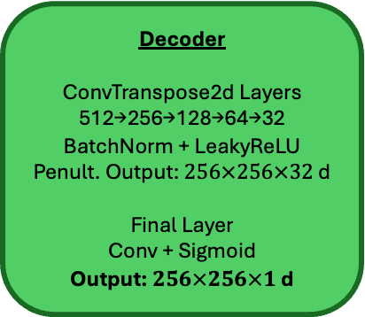
Standard Normal Prior
Random
Sampled Latent
Vector
(128 d)
Random Sample
Encoder
Conv2d Layers
32→64→128→256→512
BatchNorm + LeakyReLU
Output: $8×8×512$ d
Latent Distribution
Decoder
ConvTranspose2d Layers
512→256→128→64→32
BatchNorm + LeakyReLU
Penult. Output: $256×256×32$ d
Final Layer
Conv + Sigmoid
Output: $256×256×1$ d
Discriminator
Conv2d Layers
32→64→128→256→512
BatchNorm + LeakyReLU
Penult. Output: $8×8×512$ d
Final Layer
Linear + Sigmoid
Output: 1 d
Input Image
$256×256×1$ d
$$μ$$
(128 d)
Linear
Sampled Latent Vector
(128 d)
Linear
$$\log{σ^{2}}$$
(128 d)
Reconstruction
Year
Brand
Body
Doors
Sales
Classifiers 1-4
16d of latent→128 FC nodes→64 FC nodes
BatchNorm + LeakyReLU
Output: labels 1-4 logits
Sales Regression
16d of latent→128 FC nodes→4 FC nodes
BatchNorm + ReLU
Output: MSE Yr1 + Yr2
VAE Loss
3-term KL divergence loss (see Sisodia et al. (2024) for details)
L1 reconstruction loss
Binary cross-entropy loss for failing to trick the discriminator
Classifier Loss
Cross-entropy loss for failing to predict the correct label, summed over classifiers
Regression Loss
Mean squared error of predicted sales for first two years
Discriminator Loss
Binary cross-entropy loss for failing to detect real vs fake images

