Slide 1


Bitcoin & Ethereum Price prediction using a Long Short-term Memory model
Notes:
My project involved using machine learning techniques to build a model that would learn to predict future price patterns in the cryptocurrency market.

Slide 2
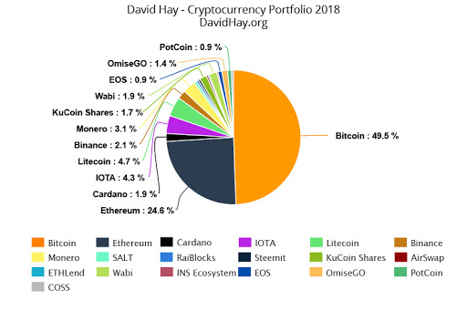
Motivation
Investing in Cryptocurrency such as Bitcoin and Ethereum can be a great way to make a decent amount of money, it can also be a great way to lose a decent amount of money.
I was determined to gain an advantage in the markets of Ethereum and Bitcoin through the help of machine learning techniques.
By using historical market patterns and applying these patterns to the cryptocurrency market, I set out to achieve a model that could predict the future price trends
Notes:
My motivation for undergoing this project was having recently began investing in cryptocurrency, I was wondering what was the best current way to predict future prices.
Investing in Cryptocurrency such as Bitcoin and Ethereum can be a great way to make a decent amount of money, it can also be a great way to lose a decent amount of money.
I was determined to gain an advantage in the markets of Ethereum and Bitcoin through the help of machine learning techniques.
By using historical market patterns and applying these patterns to the cryptocurrency market, I set out to achieve a model that could predict the future price trends
I believe that having a machine to learn the historical data and give me more insight into what the market future could look like would help improve my trading skills.

Slide 3
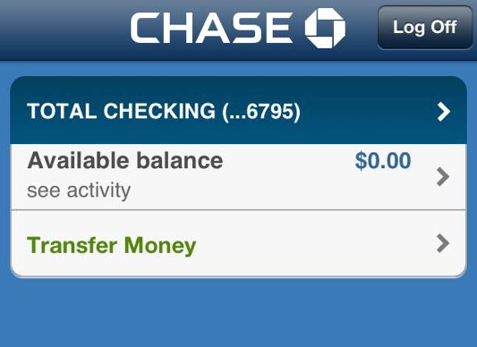
Precise problem being Addressed
Notes:
The precise problem that I am attempting to address with this project is the fact that I, like many of you may be as well, have no money and would like to have sources of passive income to one day try and change this. This project is aimed to helping the average user be able to read markets easier and make more sound investing decisions both short and long term.

Slide 4

High-level Solution
1. Bring in data from API call and save as csv file
2. process data to prepare for use with machine learning algorithm
3. Build the LSMT (Long Short-term Memory) model
4. Train the model on the training data
5. Test the model on the testing data
6. Plot the results
Notes:
The high-level solution approach to my project were as follows:
Step 1. Bring in data from a coinbase.com API call (coinbase.com is a website where you can buy and sell cryptocurrency) and save as csv file.
Step 2. Process the data to prepare for use with machine learning algorithm
Step 3. Build the LSMT (Long Short-term Memory) model
Step 4. Train the model on the training data
Step 5. Test the model on the testing data
Step 6. Plot and analyze the results
Step 7. Adjust hyperparameters and repeat

Slide 5
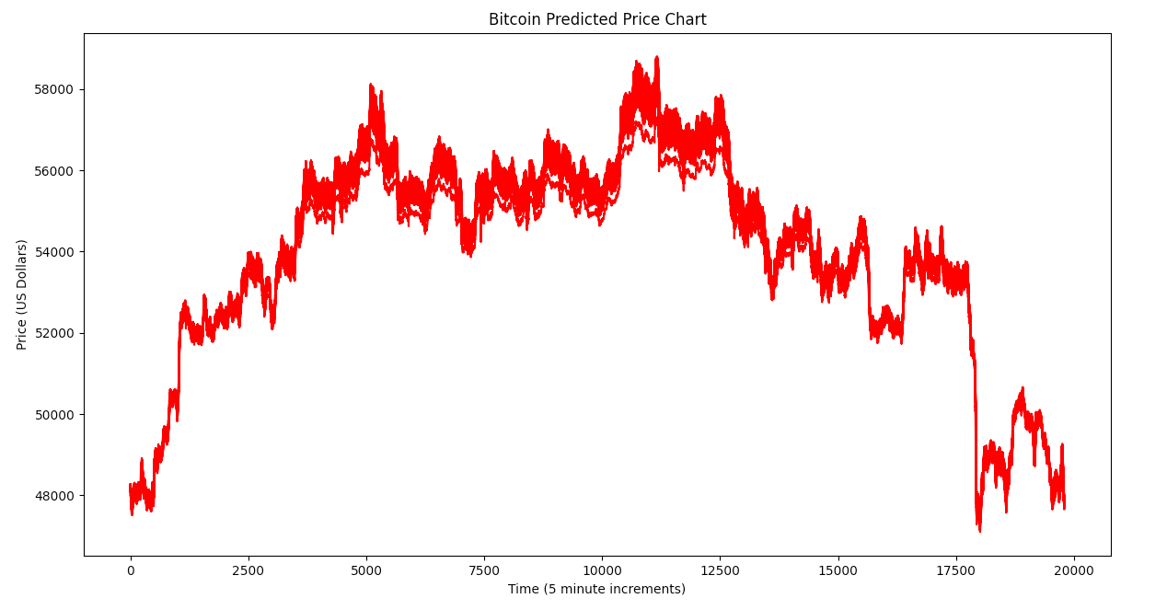
Bitcoin Batch size 32 Results
Notes:
This is how the Bitcoin model performed on the testing data when trained with a 32-batch size.

Slide 6
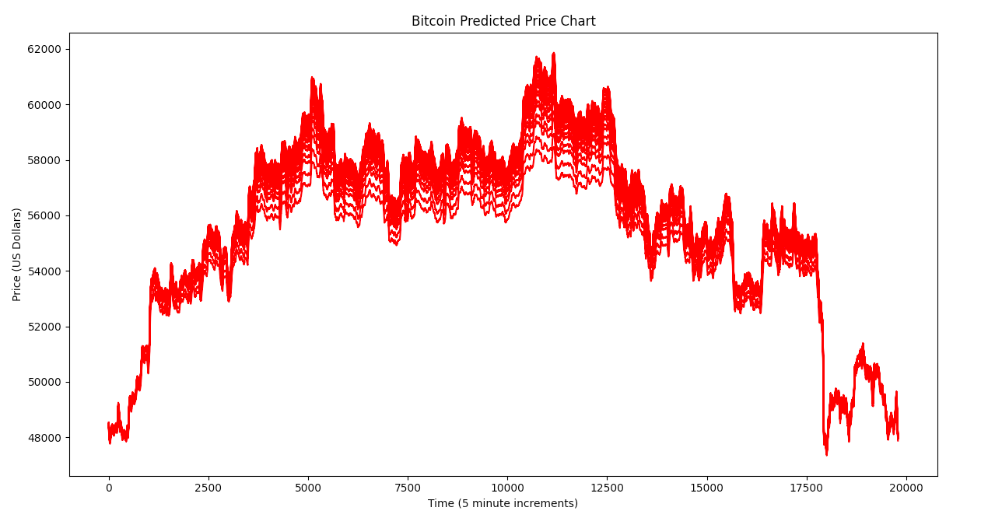
Bitcoin Batch size 64 Results
Notes:
64-batch size has the same trend prediction but slightly more accurate price predictions

Slide 7
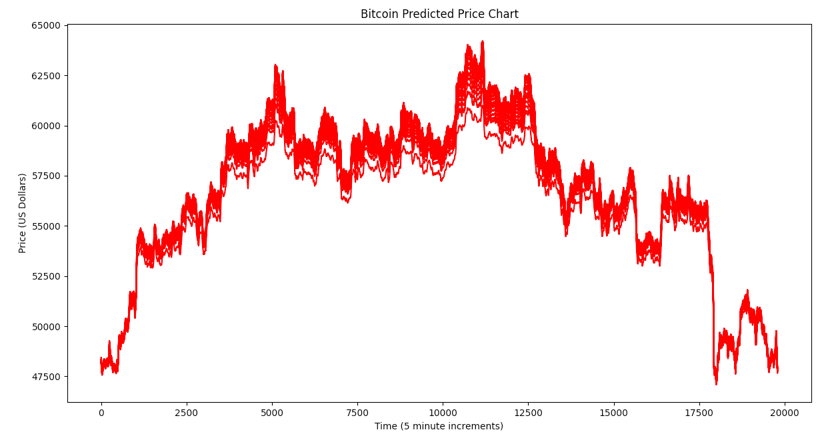
Bitcoin Batch size 128 Results
Notes:
128-batch size has the most refined pattern and price predictions thus far.

Slide 8
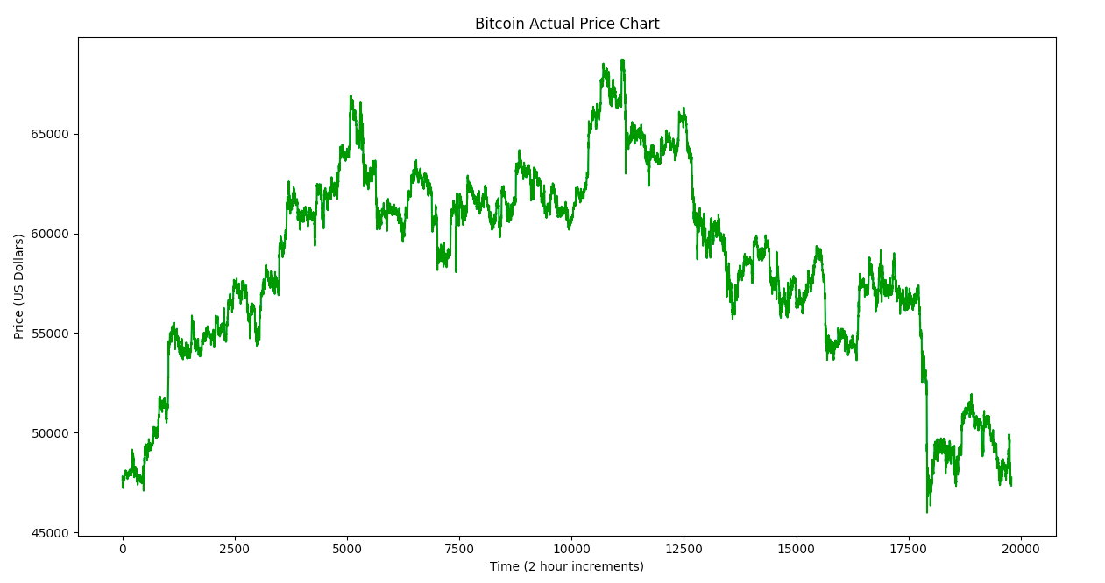
Bitcoin Actual Price Chart
Notes:
This was the actual price chart for Bitcoin over the testing time period. As clearly shown, the model was very good at predicting the overall price ‘pattern’ that the data employed, although the price predictions were slightly off from the actual results.

Slide 9
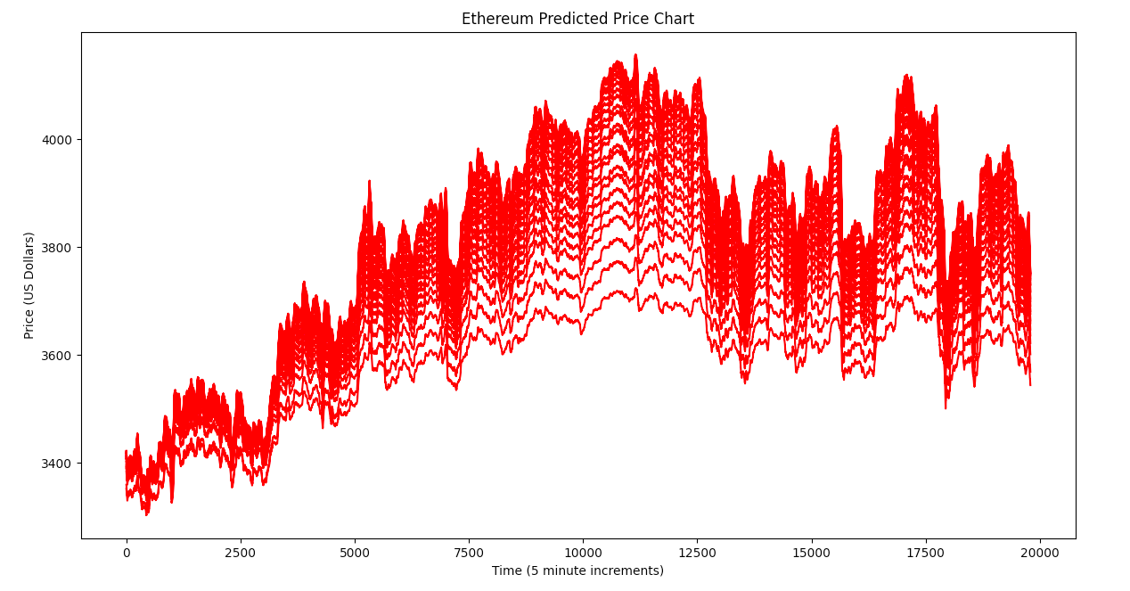
Ethereum Batch size 32 Results
Notes:
This is how the Ethereum model performed on the testing data when trained with a 32-batch size.

Slide 10
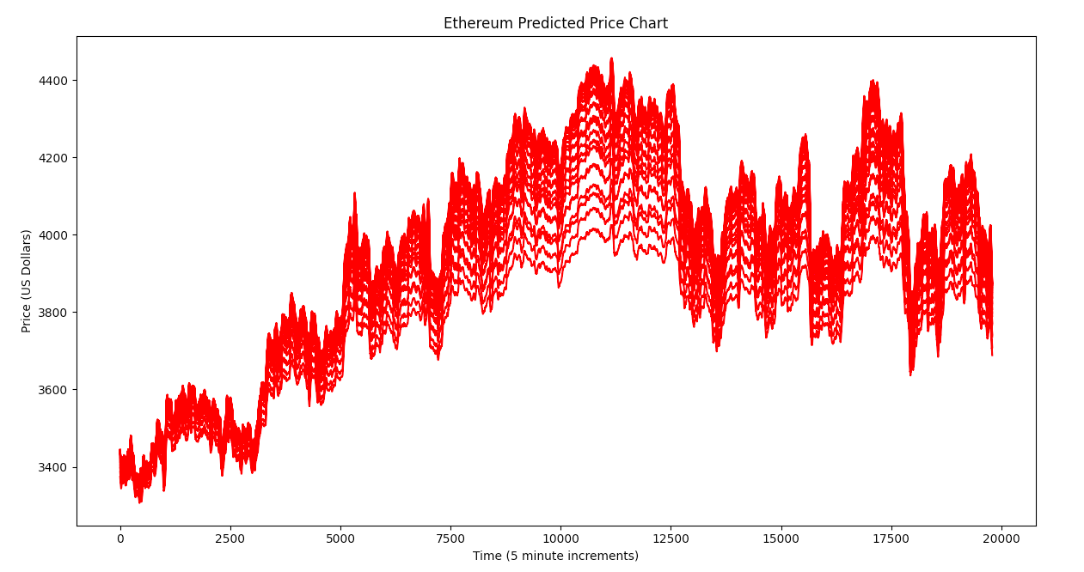
Ethereum Batch size 64 Results
Notes:
64-batch size has a slightly smaller range for the prediction values

Slide 11
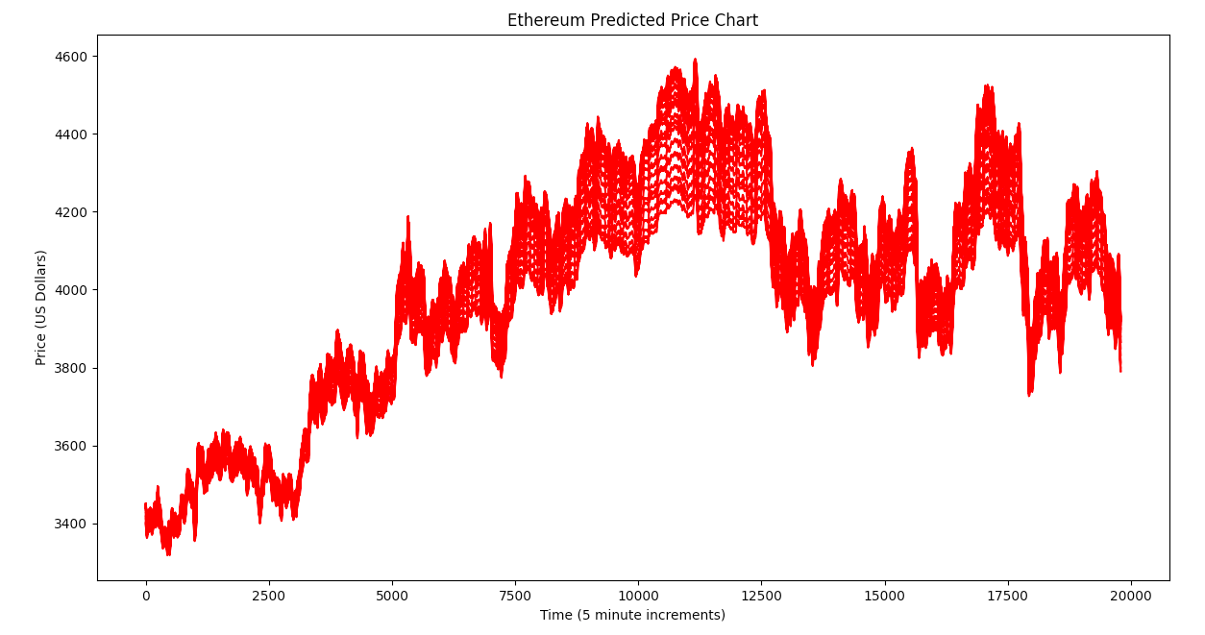
Ethereum Batch size 128 Results
Notes:
128-batch size has an even smaller range of values all while maintaining the same overall price trend curve.

Slide 12
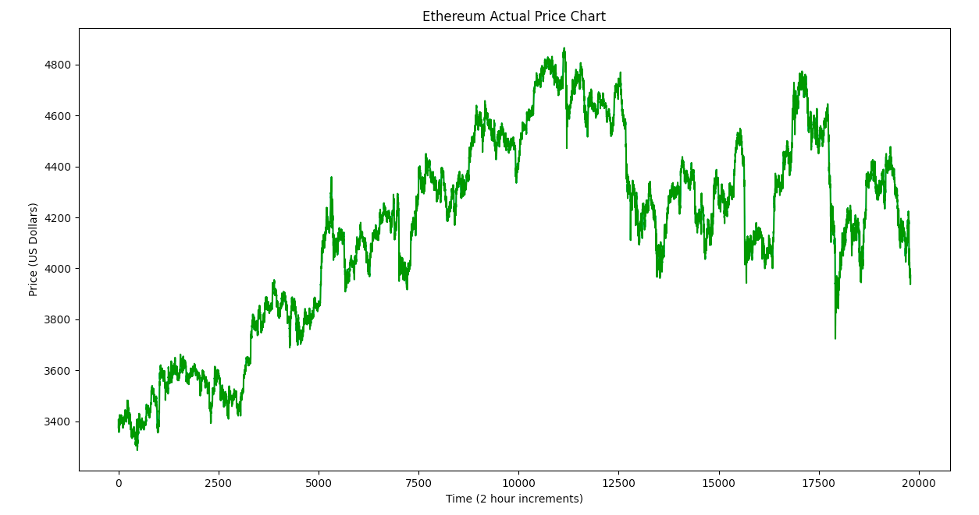
Ethereum Actual Price chart
Notes:
This was the actual price chart for Ethereum over the testing time period. Again, the model was very good at predicting the overall price’ pattern’ that the data employed, although the price predictions were slightly off from the actual results.
Overall, both models did exceptionally well, and with a few minor tweaks, I would feel comfortable trusting either of these models to give me accurate information about future price trends in either the Bitcoin or Ethereum markets.

