Slide 1
Project 2: AWS ETL - JOB
Performing Extract, Transform, Load (ETL) Operations on covid_19.csv dataset

Slide 2
Problem Statement
Read data from csv file stored on AWS S3
Lists max Cases for each country/region and province/state
Lists max Deaths for each country/region and province/state
List max Recoveries for each country/region and province/state
Stores the aggregated output in parquet format

Slide 3
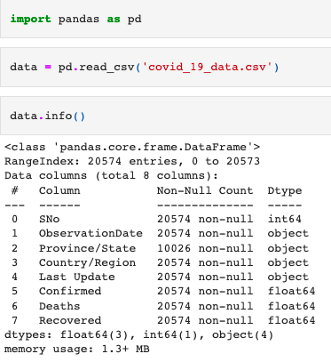
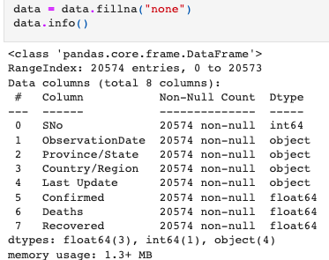
Data at a glance
- I notice that there are a considerable amount of missing values from the covid_19.csv dataset in the Province/State column.
- This is a considerable amount of data points missing from a column that I need to group the data by.
- I determined that the easiest way to fix this is to fill all the null values with the value “none”.
- The purpose of doing this is to allow me to just essentially create a new province/state “none” that the data points missing that value will automatically be assigned to.

Slide 4
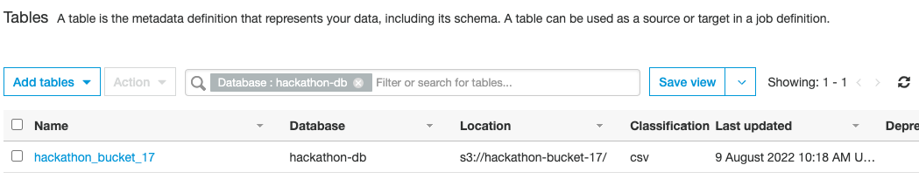
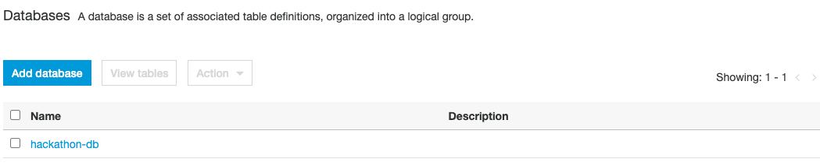
Database & bucket setup
I create my 3s bucket and upload the covid_19.csv into that bucket before opening AWS Glue studio and creating a database

Slide 5
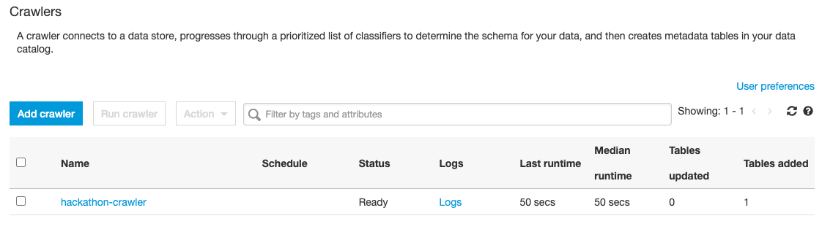
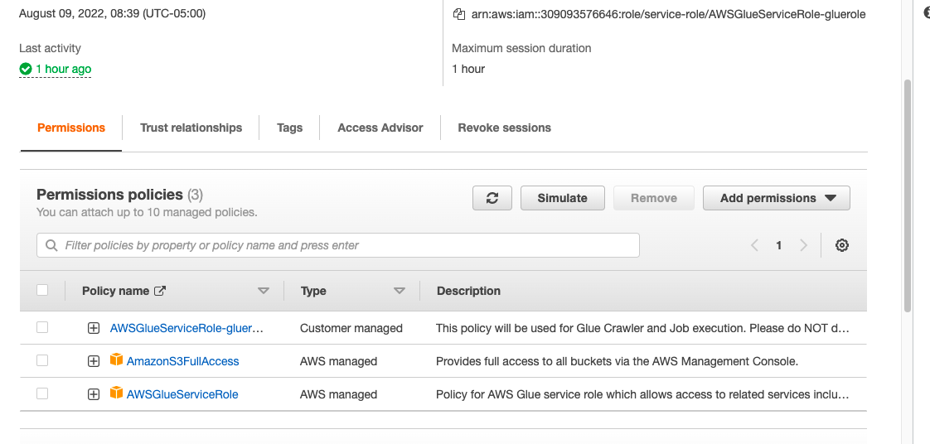
Creating Crawler & IAM user

Slide 6
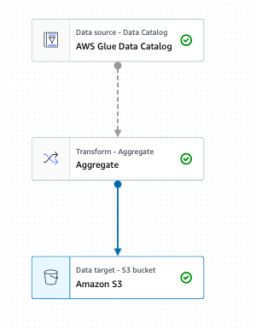
ETL Model
Here I use the AWS glue interactive studio to choose the database I created as my Data source pointing to the table “covid_19.csv”
I perform the aggregate function on the data and choose the output target as my s3 bucket that I created previously. I specify the file type to be saved as parquet files.

Slide 7
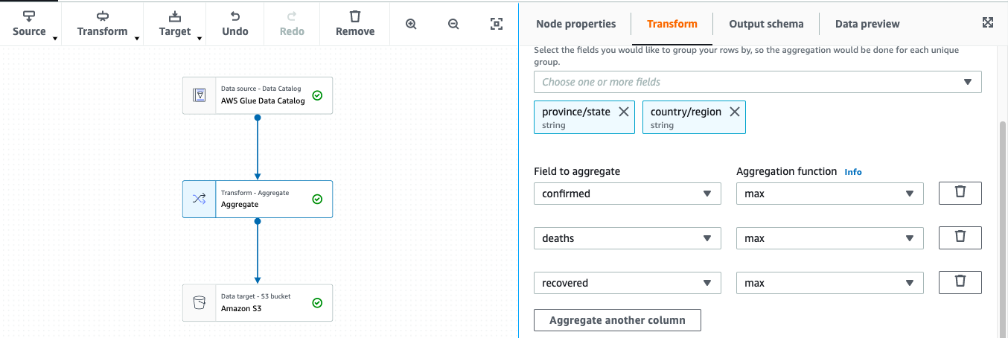
ETL Aggregate function
I choose an aggregate function from the transform dropdown list which applies to the data source and sends the transformed data to the data target.
I can easily specify for the data to be grouped by the “province/state” and “country/region” before adding multiple aggregate functions to be performed. (max for confirmed cases, deaths, and recoveries).

Slide 8
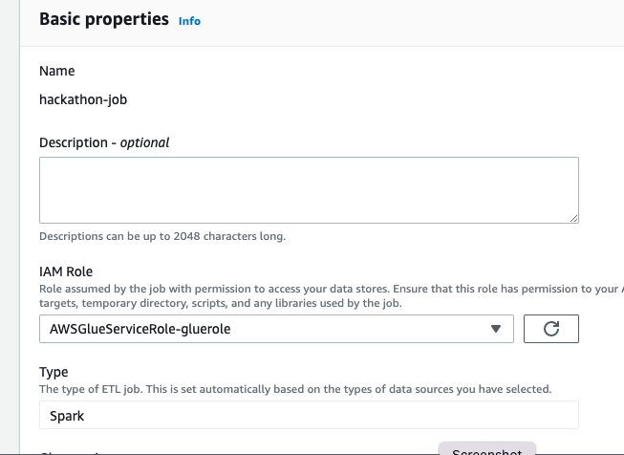
ETL JOB Details
This step is important so I wanted to include a screenshot here because the job will fail due to invalid permission if the IAM role is not correctly assigned prior to executing the job.
Here I add my gluerole that I created previously which contains all permissions to access aws glue as well as all of the s3 bucket permissions.

Slide 9
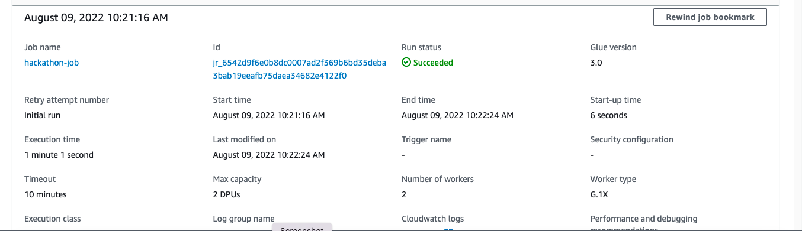
Job details
After successfully saving my job, I click to run my job and wait a minute before checking the job details tab. This lets me know that my script has run successfully and gives me some details about the job such as execution time, number of workers, run status, etc..

Slide 10
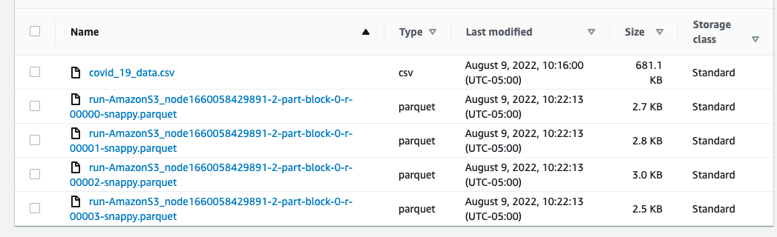
S3 Bucket results
Next I check my 3s bucket to ensure that the parquet files were correctly outputted to my specified data target.
I can see that there are some new parquet files now existing within the bucket as expected.

Slide 11
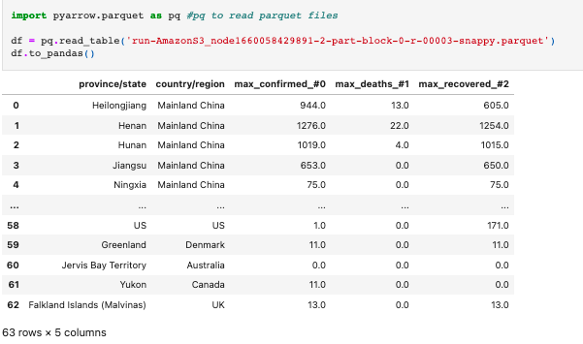
Examining the Output
Here I import a library to allow me to work with parquet files in python. I read in one of my output parquet files as a sample and convert it to a pandas dataframe before displaying the output. Here I can see that the output looks about as expected with the max confirmed cases, deaths, and recoveries being displayed for each province/state and country/region.

