Slide 1

HexTanx
Justin, Malik, Brenden, and Sialas

Slide 2
Goal
HexTanx:
Top-down, capture-the-flag tank shooter with random item generation and enemy tank difficulty that increases as the game goes on
The player wins when the player captures the flag on all three levels.
The player loses when they die or when the enemy tank captures the flag.
Justin

Slide 3
Story of the Game
The planet Titan-4 is under attack in the year 2342. A powerful enemy group has taken control of a key resource, and it's up to you to take it back. As a tank commander, your mission is to capture flags across three different zones.
Each time you succeed, the enemy gets stronger. You need to outmaneuver them and secure all the flags before they capture yours or destroy your tank.
Justin

Slide 4
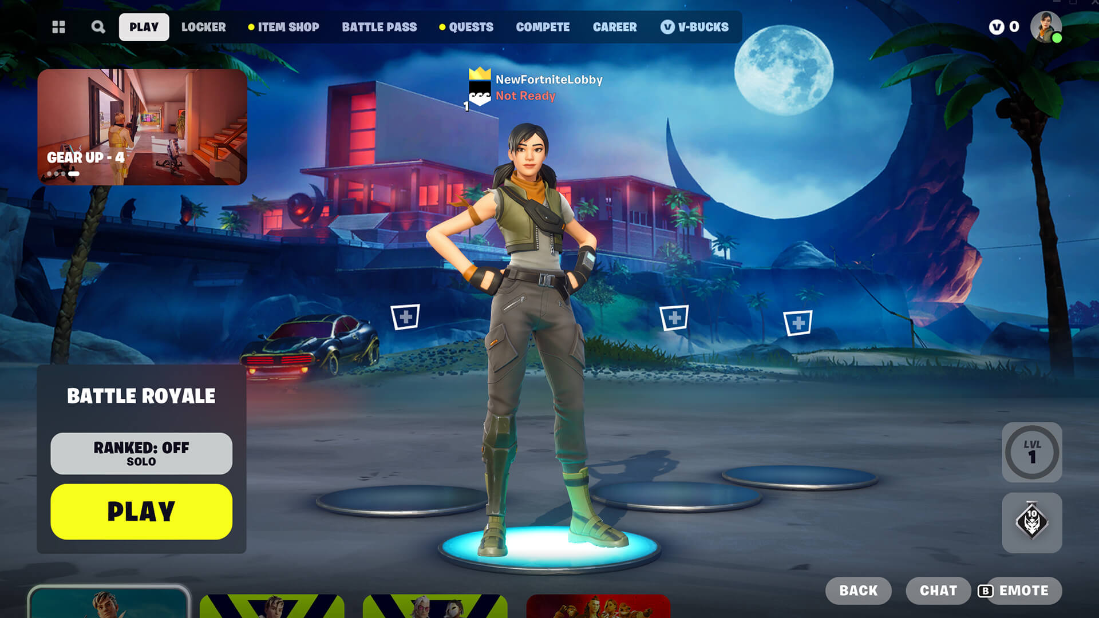
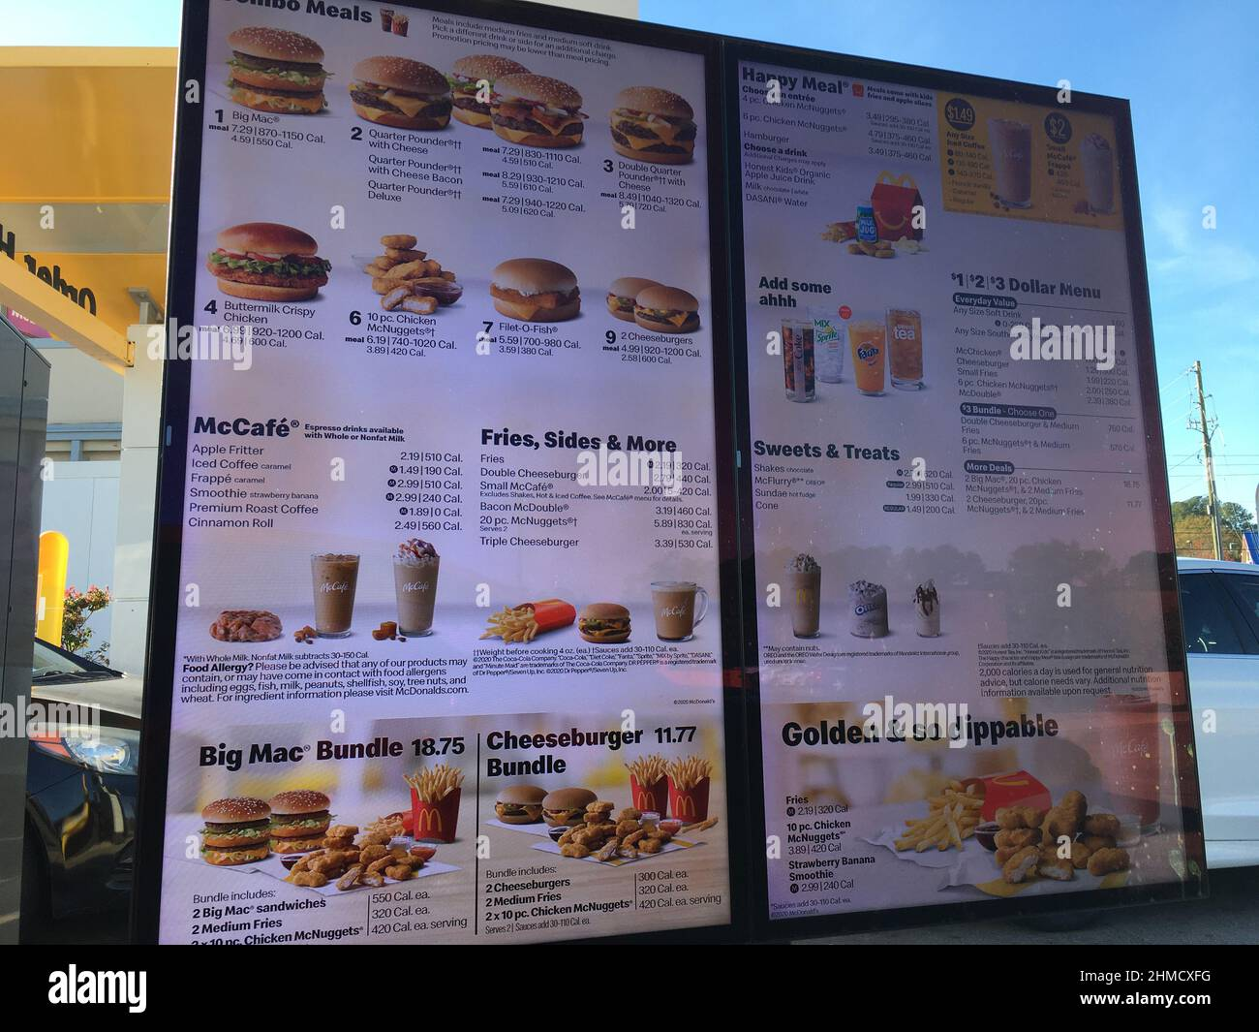
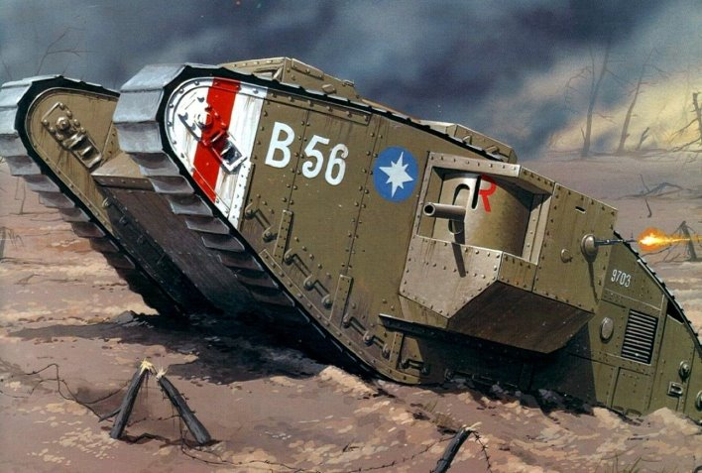
Storyboard
The player will be greeted with a start menu when they boot the game
Justin

Slide 5
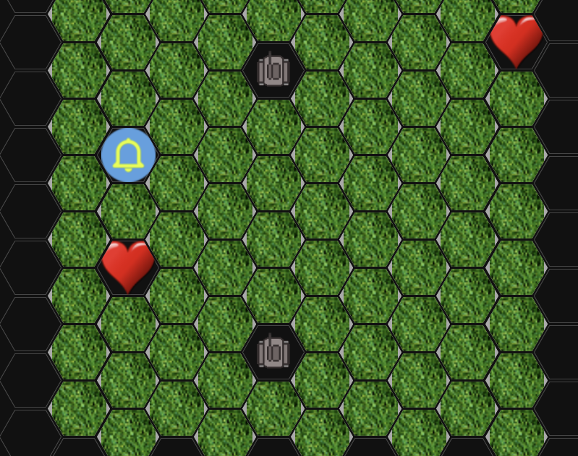
Storyboard
A map is created and the items, enemy and player are placed.
Brenden

Slide 6
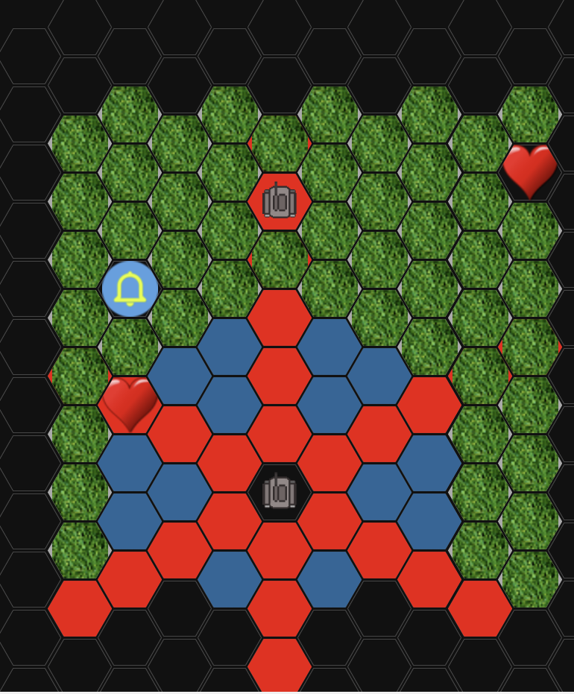
Storyboard
First it is the players turn the map will change color to indicate where they player can move and where they can shoot.
Sialas

Slide 7
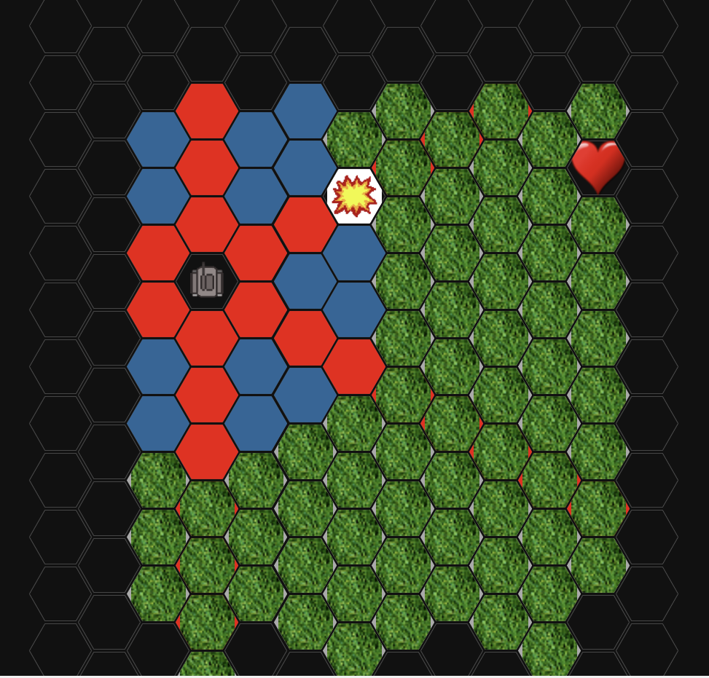
Storyboard
Enough successful hits will blow up the enemy tank!
Malik

Slide 8
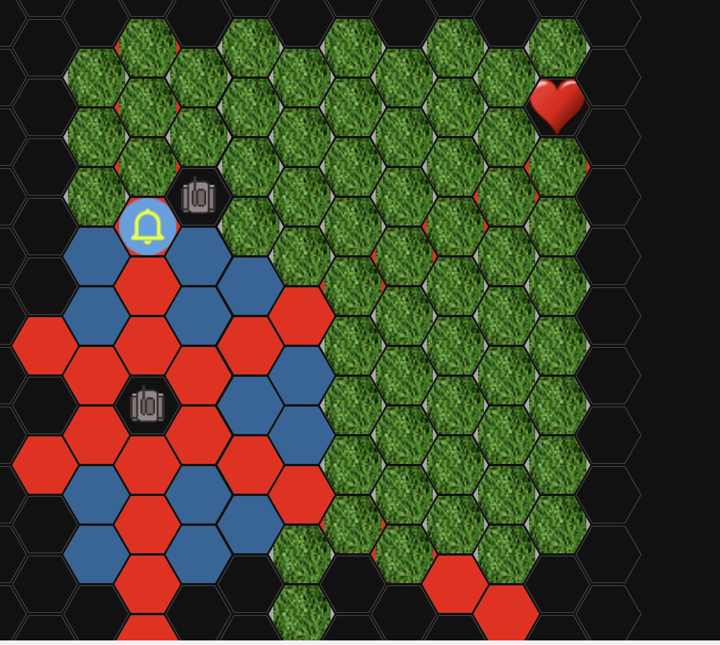
Storyboard
The enemy will take a turn and either move or shoot at the player.
Brenden

Slide 9
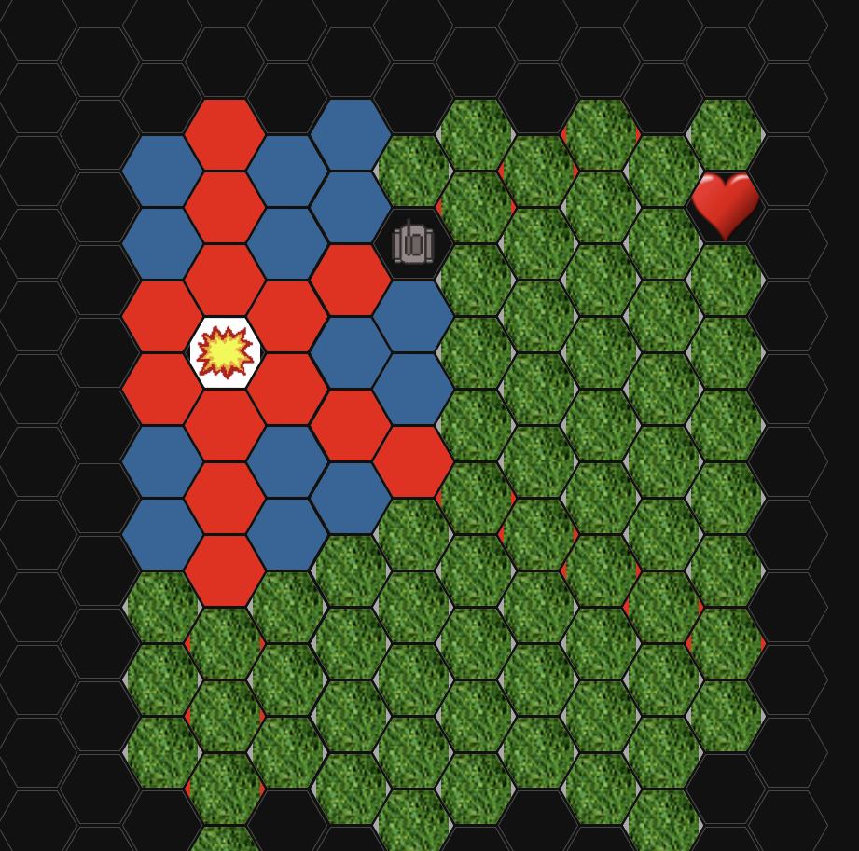
Storyboard
Careful the player can be blown up too!
Sialas

Slide 10
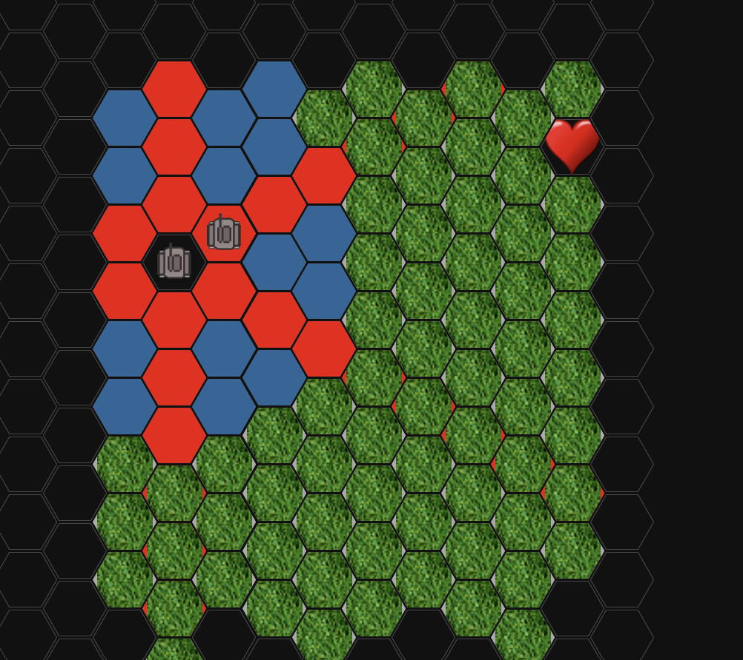
Storyboard
First to get to the Flag is the winner.
Malik

Slide 11
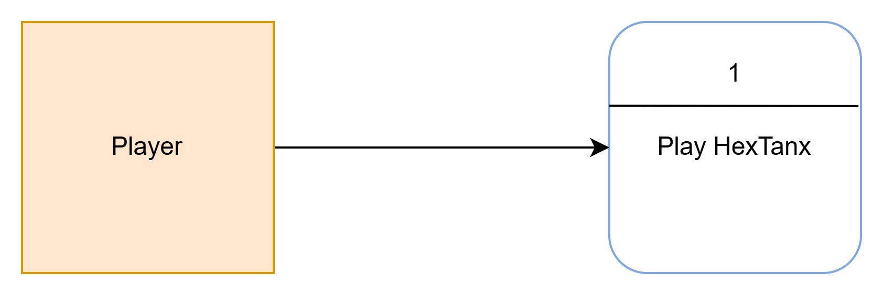
Context Diagram
Justin

Slide 12
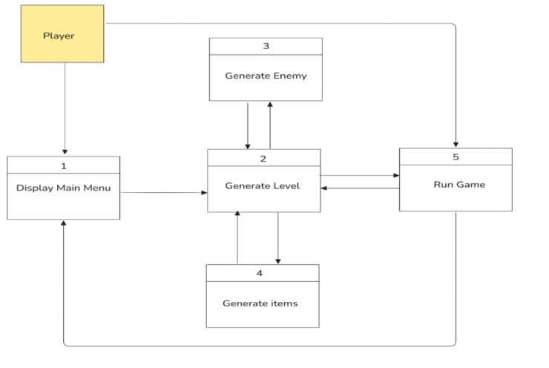
Diagram level 0
Justin

Slide 13
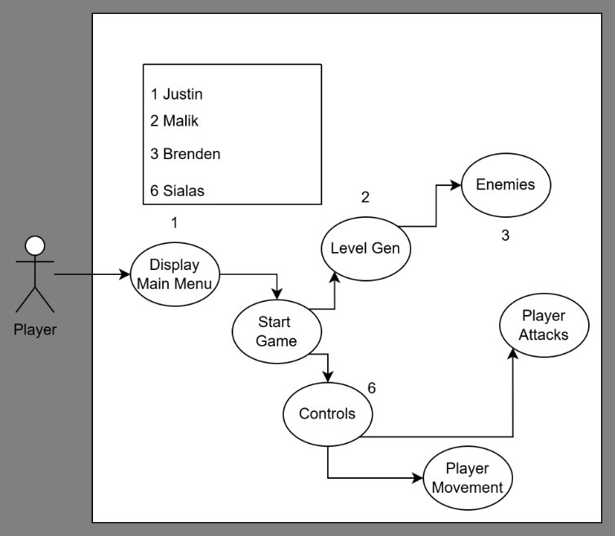
Global Use Case
Justin

Slide 14
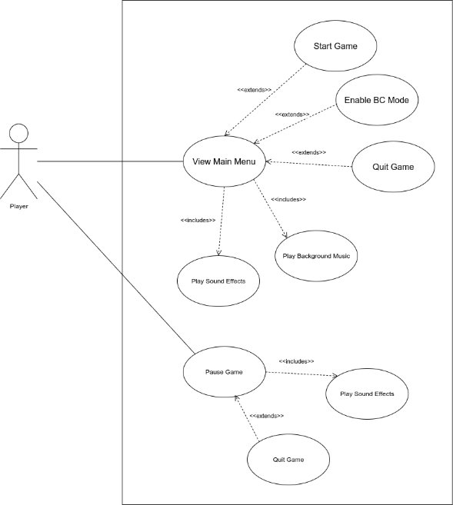
Justin - TL1

Slide 15
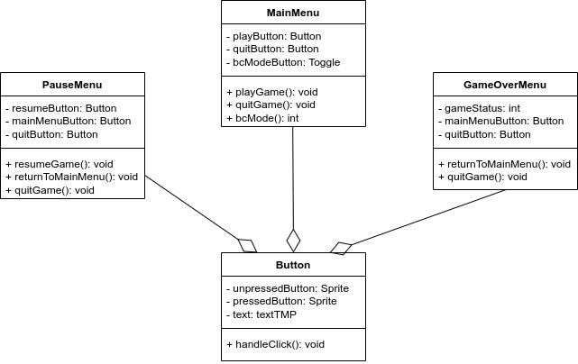
Justin - TL1
Complexity:
5/10
Priority:
2 essential
Main menu, pause menu, game over menu, and buttons

Slide 16
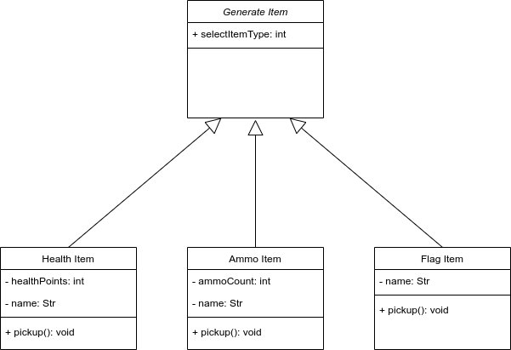
Justin - TL1
Complexity:
7/10
Priority:
1 must have
Item generation including health, ammo, and the flag

Slide 17
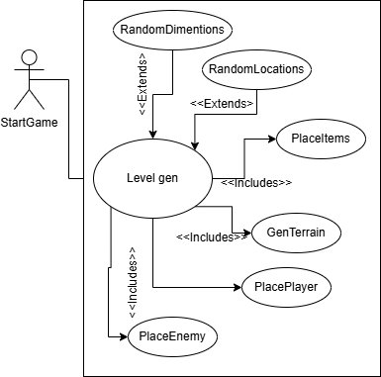
Malik - TL2

Slide 18
Malik - TL2
Features:
Map Creation
Terrain/Tiles
Place Objects
Track Positions

Slide 19
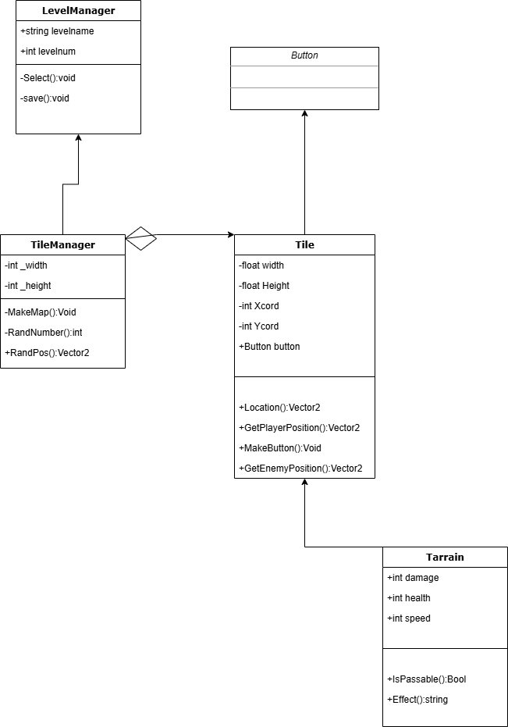
Malik - TL2
Complexity:7/10
Priority: 1 Must Have
Create the map and place all tile.
Chose random locations for the Items, Terrain and Flag.
Place the player and enemy.
Track the location of all objects.
Tiles will be interactable Buttons.

Slide 20
Brenden- TL3
Features:
Turn Controller
AI Enemy Controller
Enemy Creation/Generation

Slide 21
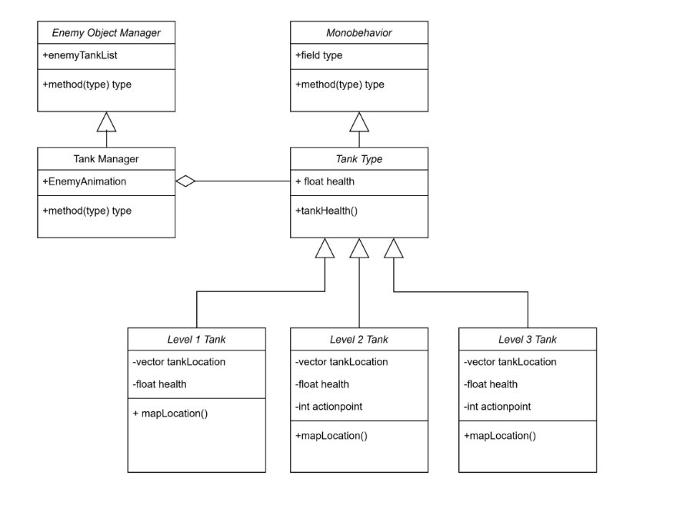
Enemy Creation
Complexity:
7/10
Priority:
2 essential
3 Tank levels/types:
Lvl 1 – Simple Tank Shoots and Moves
Lvl 2 – Better Shooting, More Health
Lvl 3 – Advanced Moving, Crazy good Shooting
Brenden

Slide 22
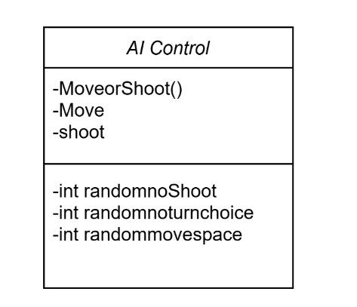
AI Controller
Complexity:
8/10
Priority:
2 essential
Enemy will randomly choose to move or shoot
Enemy will move to random space
Brenden

Slide 23
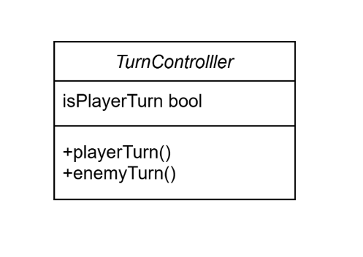
Turn Controller
Complexity:
2/10
Priority:
1 must have
Very basic Boolean to decide who's turn it is to relinquish control
Vital for the overall goals for HexTanx
Brenden

Slide 24
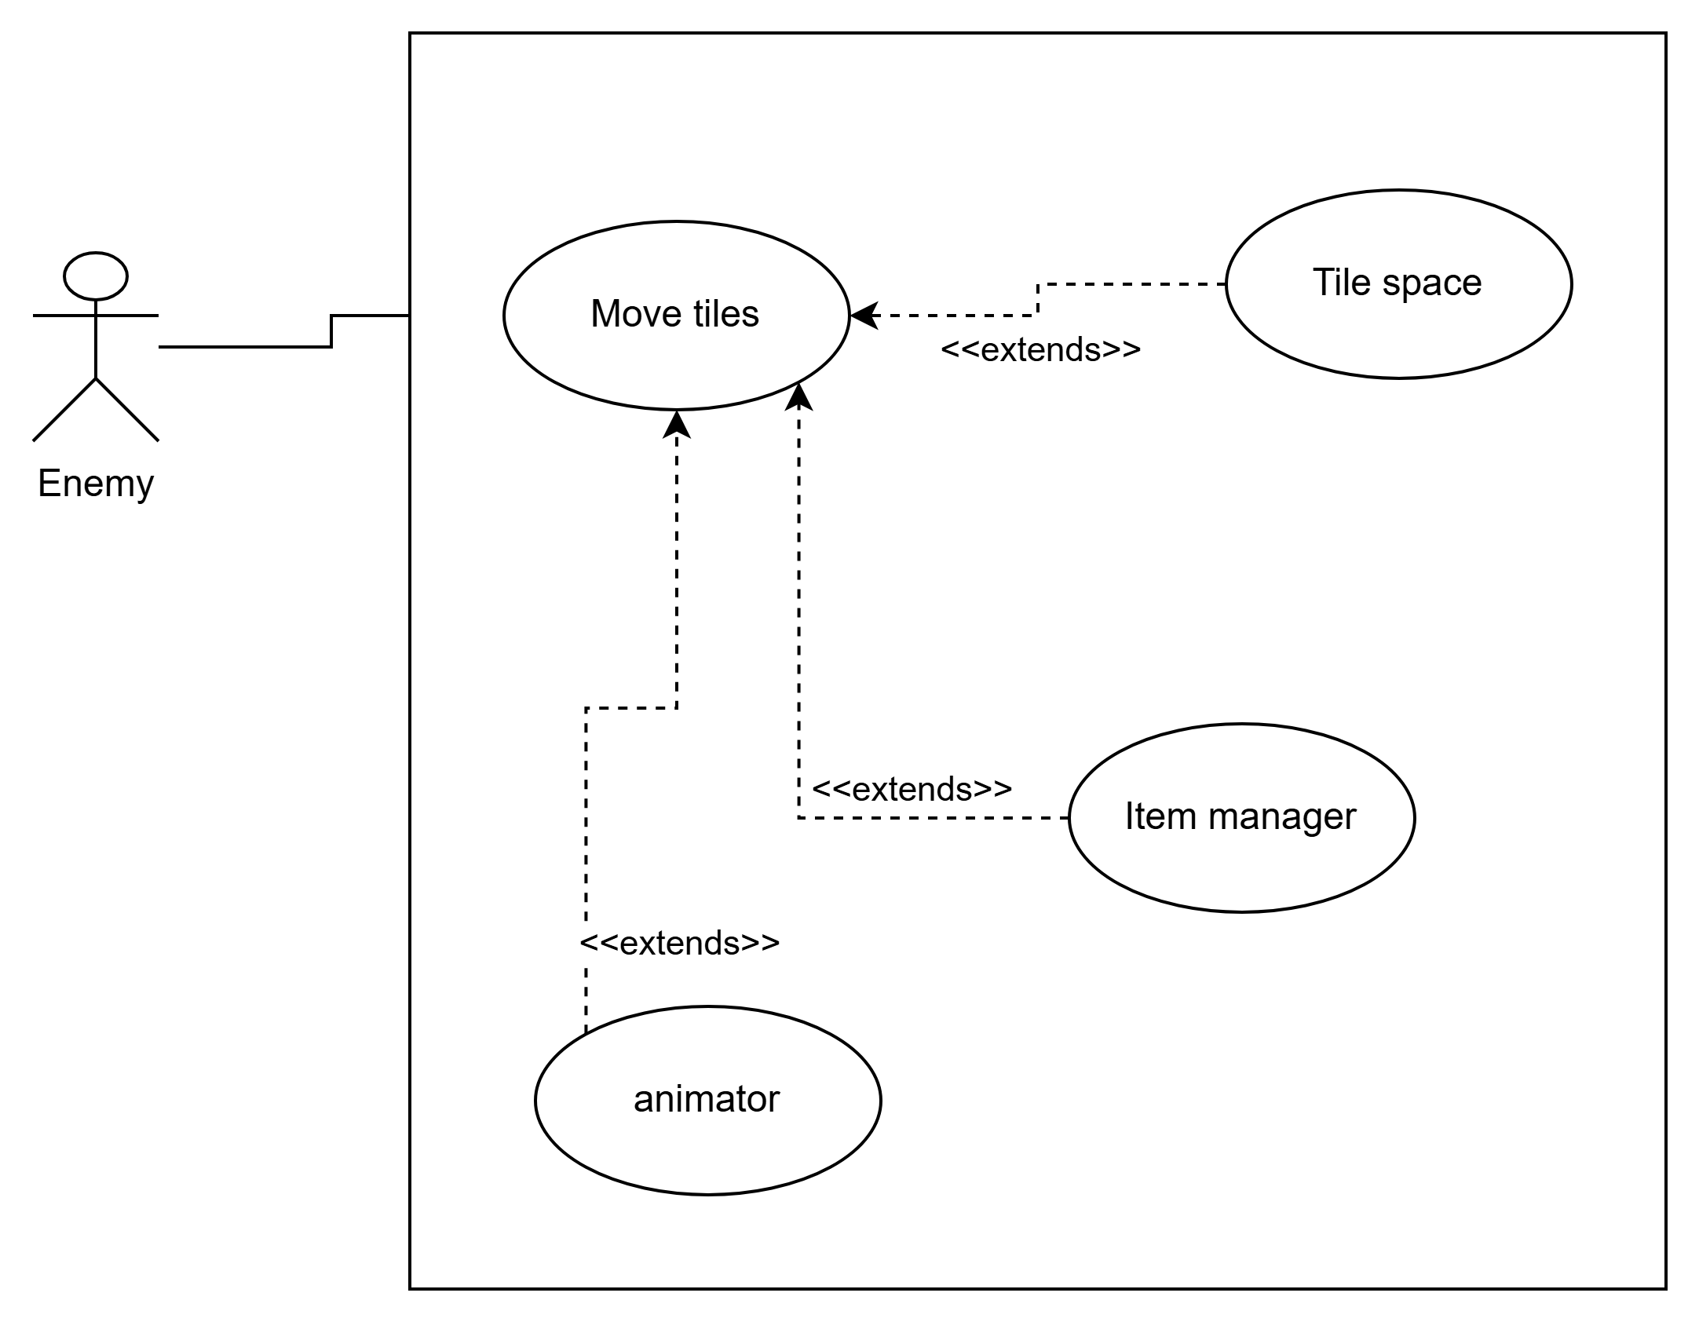
Use Case
Enemy will choose to move
The tile space, the item manager, and animator will all extend to the moving of tiles.
Brenden

Slide 25
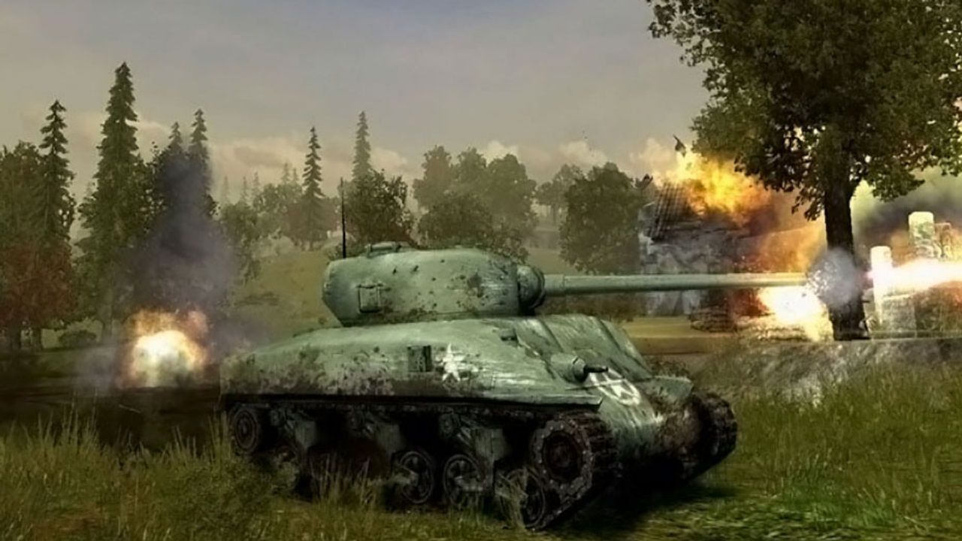
Sialas – TL6
Main Features:
Player Controls
Sound Design
Mobile Port

Slide 26

Player Controls
Complexity
- 7/10
Priority:
-1 Must have
All player controls – moving/shooting
Sialas

Slide 27
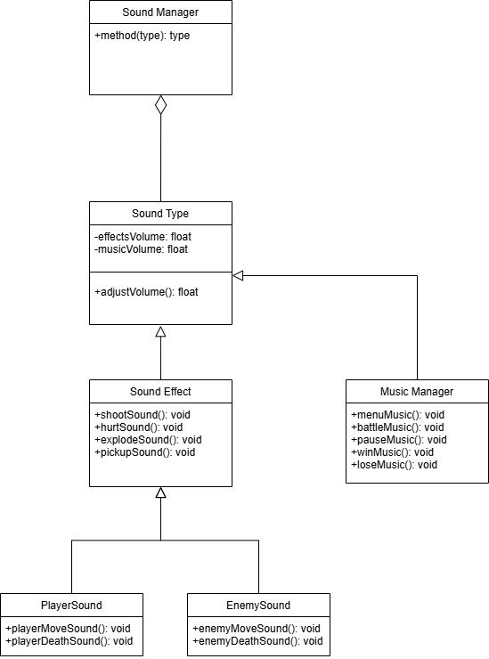
Sound Manager
Complexity
- 2/10
Priority:
-3 Non essential
All music / sound effects
Sialas

Slide 28
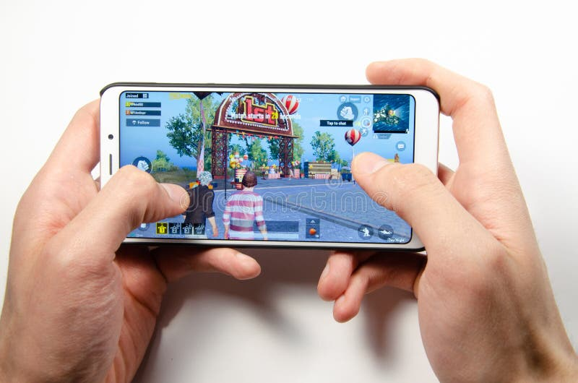
Mobile Port
Complexity
- 4/10
Priority:
-3 Non essential
Making a port of the game to mobile devices
Sialas

Slide 29
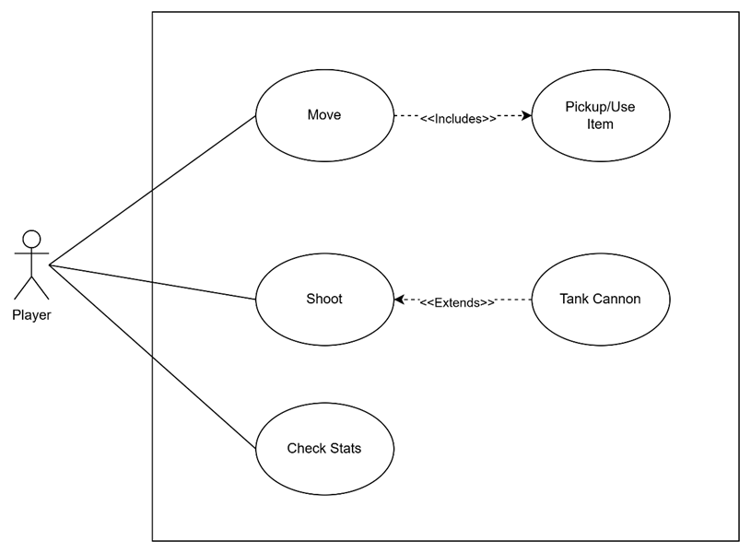
Use Case
Sialas

Slide 30
Any questions?

