Slide 1

HexTanx Storyboard
Justin, Malik, Brenden, and Sialas

Slide 2
Goal
HexTanx:
Top-down, capture-the-flag tank shooter with random item generation and enemy tank difficulty that increases as the game goes on
The player wins when the player captures the flag on all three levels.
The player loses when they die or when the enemy tank captures the flag.
Justin

Slide 3
Story of the Game
The planet Titan-4 is under attack in the year 2342. A powerful enemy group has taken control of a key resource, and it's up to you to take it back. As a tank commander, your mission is to capture flags across three different zones.
Each time you succeed, the enemy gets stronger. You need to outmaneuver them and secure all the flags before they capture yours or destroy your tank.
Justin

Slide 4
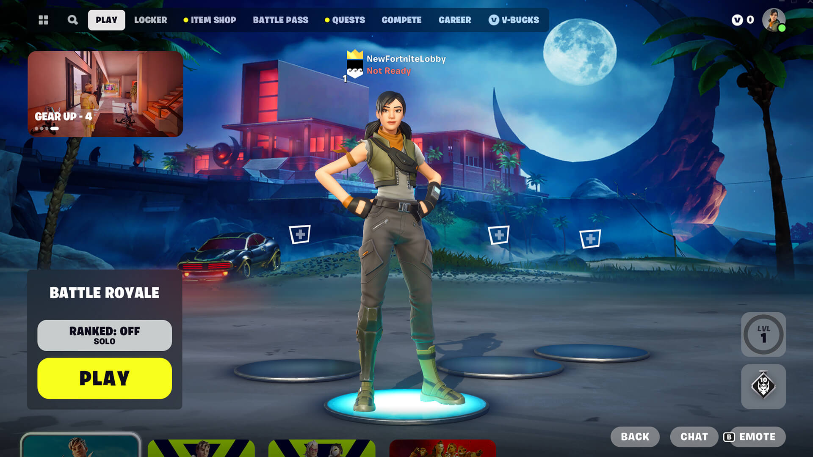
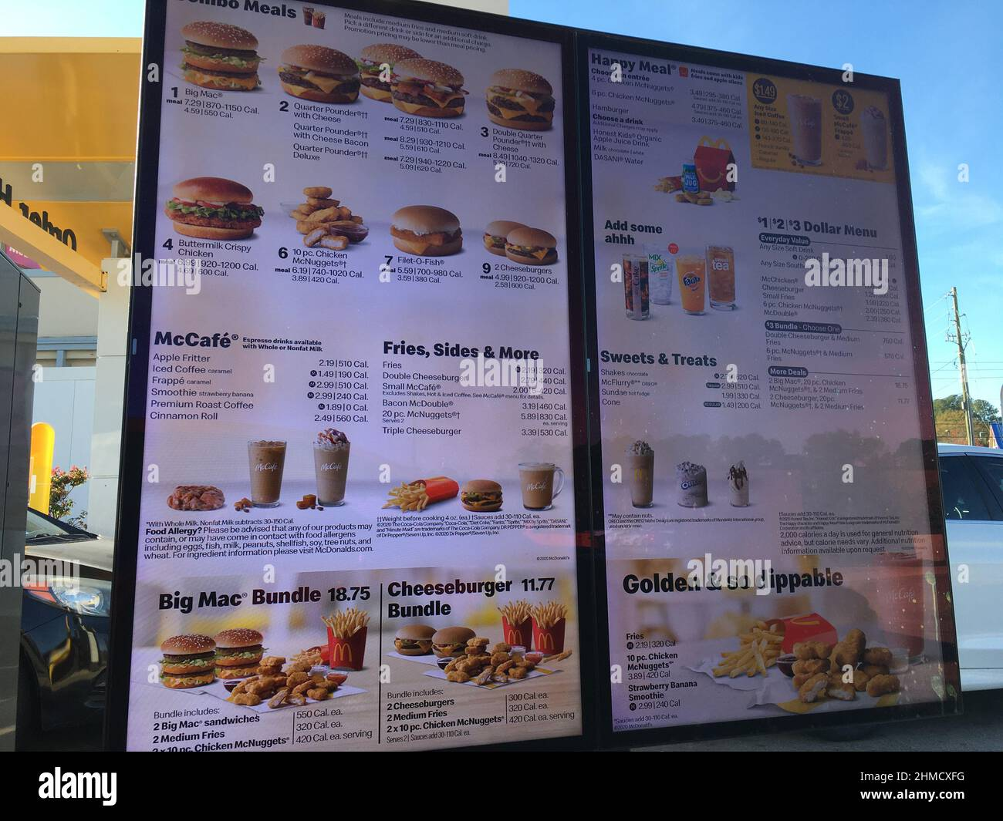
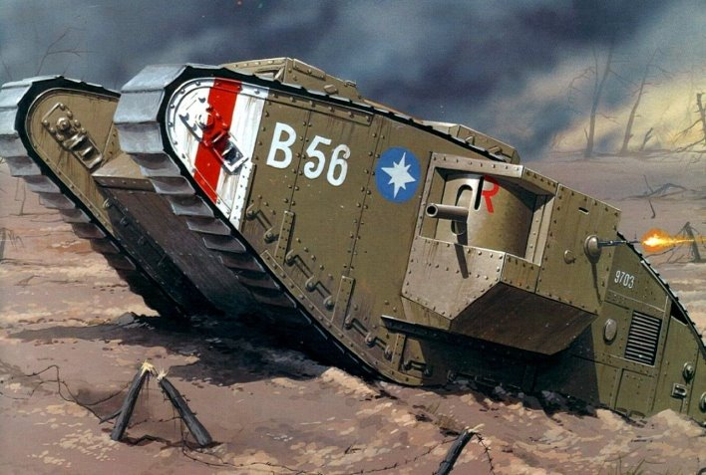
Storyboard
The player will be greeted with a start menu when they boot the game
Justin

Slide 5
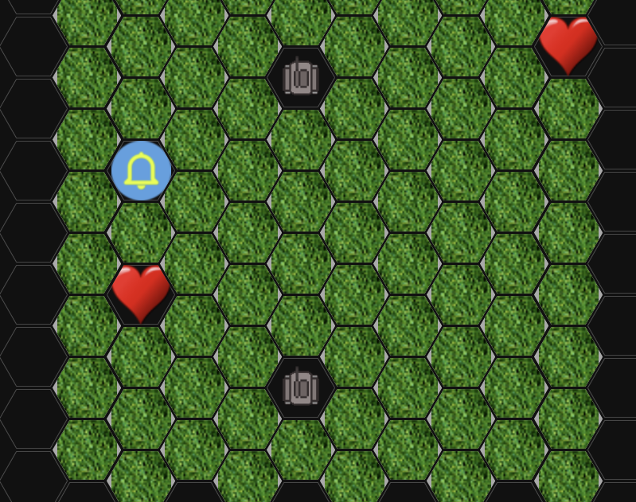
Storyboard
A map is created and the items, enemy and player are placed.
Brenden

Slide 6
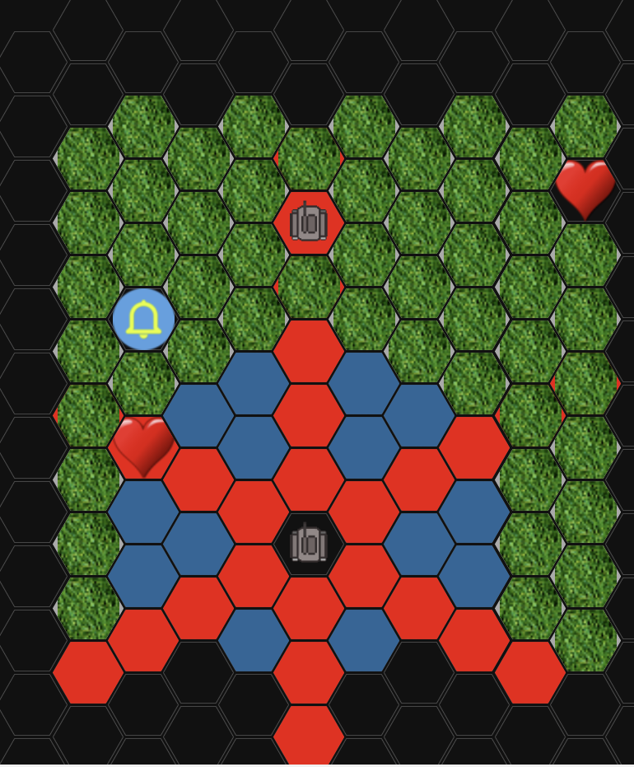
Storyboard
First it is the players turn the map will change color to indicate where they player can move and where they can shoot.
Sialas

Slide 7
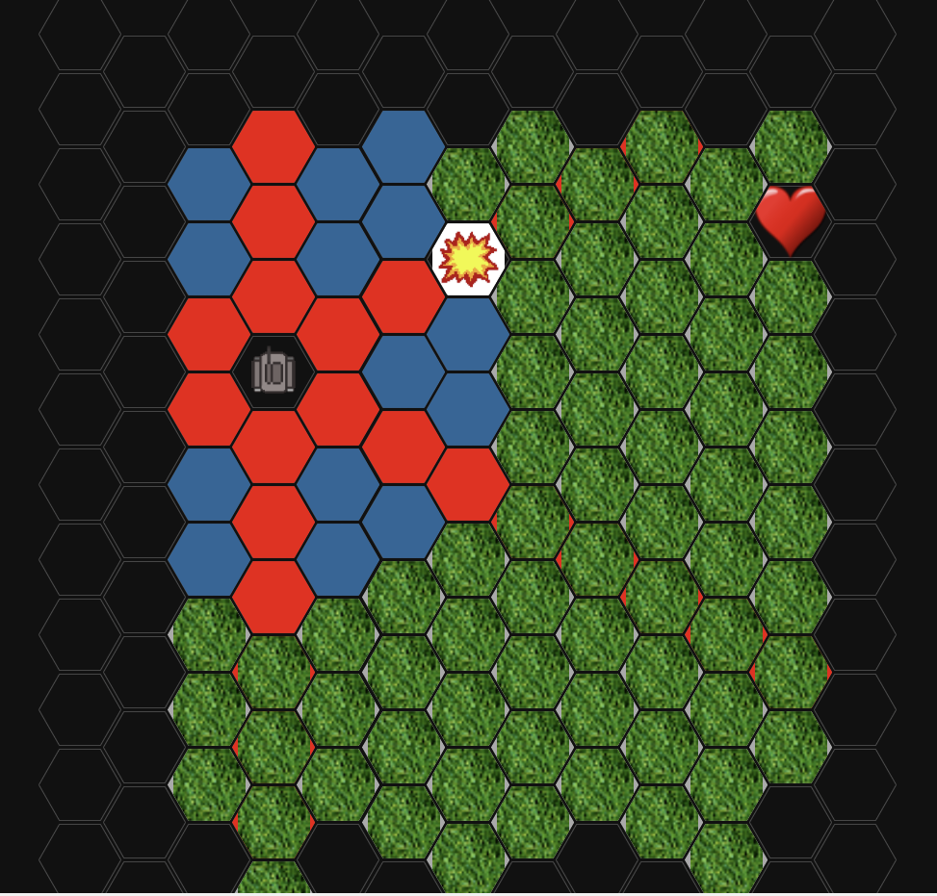
Storyboard
Enough successful hits will blow up the enemy tank!
Malik

Slide 8
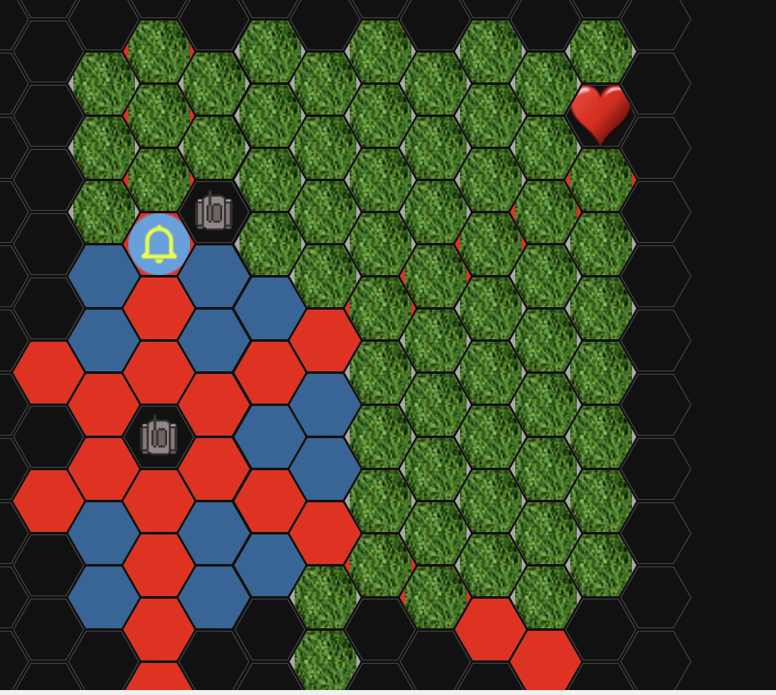
Storyboard
The enemy will take a turn and either move or shoot at the player.
Brenden

Slide 9
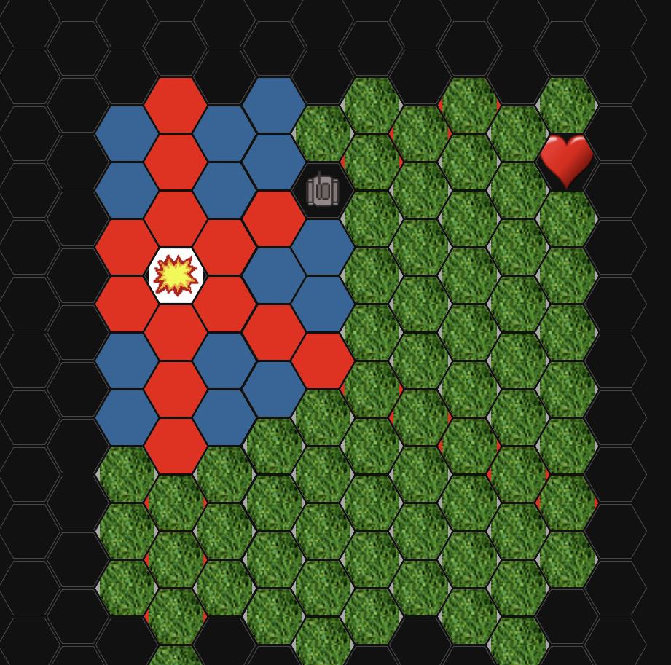
Storyboard
Careful the player can be blown up too!
Sialas

Slide 10
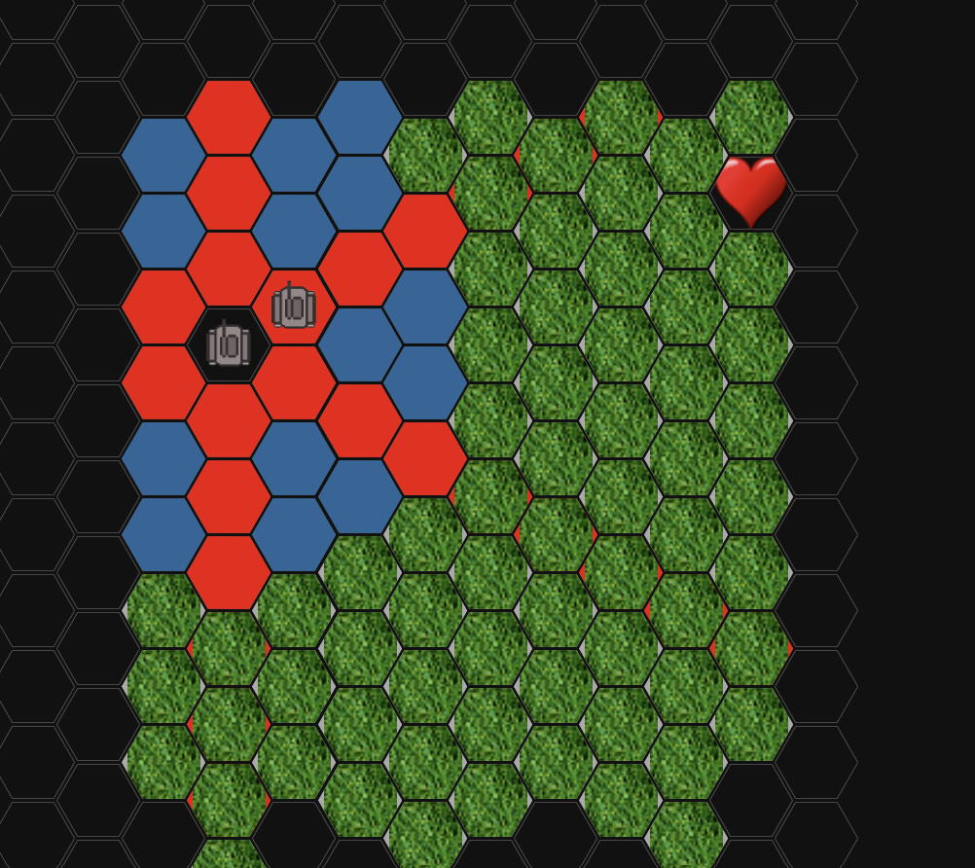
Storyboard
First to get to the Flag is the winner.
Malik

