Slide 1
GUI

Slide 2
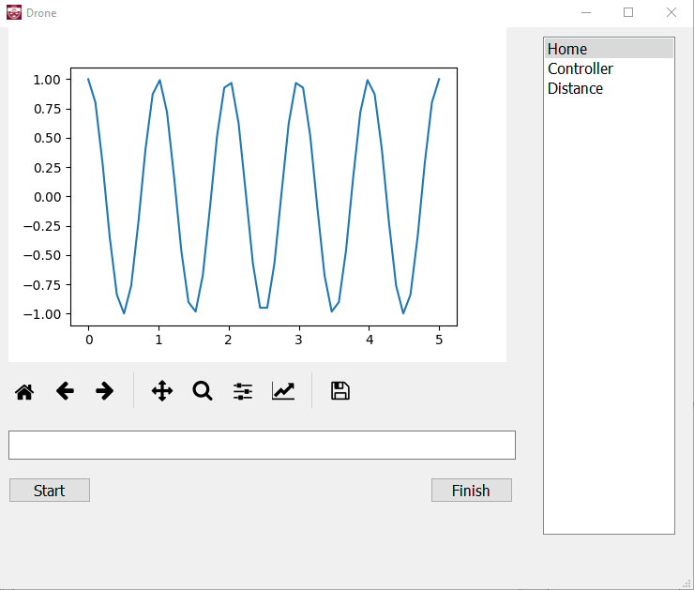
GUI Design
Layout designed using Qt Designer
Developed using PyQt5
Language is Python

Slide 3
Key Features
Configure axis settings for the PS4 controller
Display “Live” plots of altitude and distance
Ability to configure host IP and port number to connect to the socket

Slide 4
Live plots
Data read in using serialized dictionaries from Raspberry Pi
By default the altitude vs. time plot is displayed on homepage
Distance vs. time plot will be displayed on a different widget

Slide 5
Live plots
Have the ability save the plot in various
Formats
Can scroll through live plot
Able to configure plot parameters
Such as min/max values, plot color, etc

