Slide 1
Approximation Augmentation
Given a 3CNF expression,find the maximum number of clauses that can be satisfied by some assignment of T/F to its variables
Max 3SAT
Input
Max Independent
Set
Max 3SAT
Solution
Given an undirected graph, G, find the largest set of independent vertices in the graph
Notes:
I had part E and F, and to expand off of what you just saw. I performed a reduction from Max 3Sat to Max Indpenendent Set. A quick reminder is that Max3Sat is asking for the maximum number of clauses that can be satisfied by some assignment of T/F to its variables and Max Independent Set finds the largest set of independent vertices in a graph. We discussed in class how to reduce Max3Sat to MaxIndependentSet, so I’m just going to quickly gloss over that:

Slide 2
Approach Explained
Reduction: each variable becomes a vertex.
Vertices are connected (have an edge) if…
they are in the same clause
their contradiction exists in another clause
Make vertices DISTINCT
how will we be able to identify what clause a vertex is in?
vertex indices formatted as tuples (clause, variable)
randomly select starting vertex
remove it and its neighbors from ind_set
Runtime: O(m^2)
PSEUDOCODE:
max_ind_set_rand(graph):
r_graph = graph
ind_set = []
while r_graph
v = random vertex from r_graph
ind_set.append(v)
for u in v’s neighbors: r_graph.pop(u)
r_graph.remove(v)
return ind_set
Notes:
So, to convert from Max3Sat into IndependentSet, we need obviously need a graph. Each variable in the sentence will be a vertex in the graph, to keep variables distinct across clauses, I used a tuple as my vertex indices to keep variables distinct across clauses. This also helped make sure that a variable is not selected more than once from each clause

Slide 3
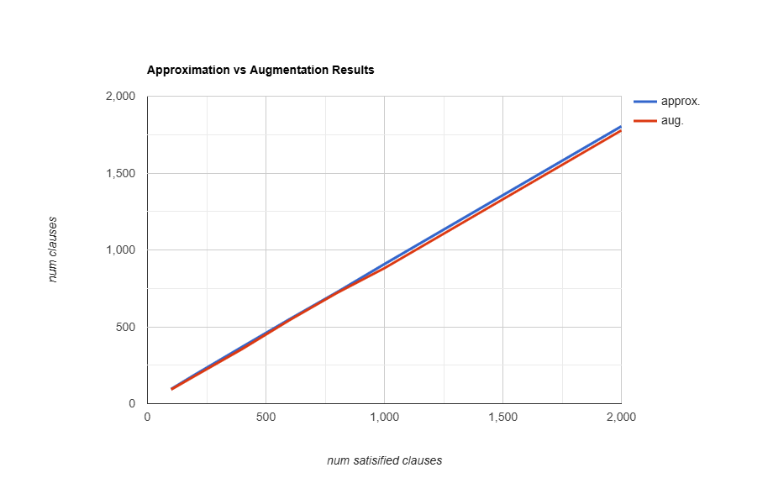
Comparing Results
input size | approx. | augment.
100 | 95 | 94
200 | 189 | 182
400 | 370 | 355
600 | 550 | 543
800 | 725 | 715
1000 | 908 | 892
2000 | 1804 | 1776
Notes:
While both solutions provide an approximation of the

Slide 4
Interesting Observations
both approximation and augmentation utilize randomization, but output differed
increasing the amount of runs of the augmented solution, increases the optimal solution for the augmentation (but at the cost of runtime)
similarities decreases as input size increases
How would a greedy approximation look like with a reduction?

