Slide 1
Max 3-SAT Approximation
Brendan Hom

Slide 2
Approximation Strategy
Strategy: Utilize randomness and anytime
Random - Randomly assign boolean values to each variable.
Iteratively flip the truth value of each variable one at a time. After each flip, compute the new number of satisfied clauses. Retain the flip if it improves the solution; otherwise, revert the flip.
Anytime - Stop after 5 consecutive iterations with no improvement or when all clauses are satisfied.
Pseudocode
max_3sat_approx(n, clauses, assignments)
best_count, num_loops = 0
Randomly assign each variable True or False
while (num_loops < 5)
for var in n
Flip truth value of variable
curr_count = satisfied_clauses (clauses,
assignments)
if cur_count > best_count
best_count = cur_count
reset num_loops
else
revert truth value
increase num_loops by 1
Return best_count

Slide 3
Approximation Analytical Run Time
Randomly assigning truth values to each variable; O(n) where n is the number of variables
satisfied_clauses iterates over each clause; O(m) where m is the number of clauses
max_3sat_approx has two loops:
Outer loop: Runs up to 5 iterations: O(1)
Inner loop: Iterates over each variable and uses satisfied_clauses; O(n * m)
Overall Runtime: O(n * m)
Pseudocode
max_3sat_approx(n, clauses, assignments)
best_count, num_loops = 0
Randomly assign each variable True or False
while (num_loops < 5)
for var in n
Flip truth value of variable
curr_count = satisfied_clauses (clauses,
assignments)
if cur_count > best_count
best_count = cur_count
reset num_loops
else
revert truth value
increase num_loops by 1
Return best_count

Slide 4
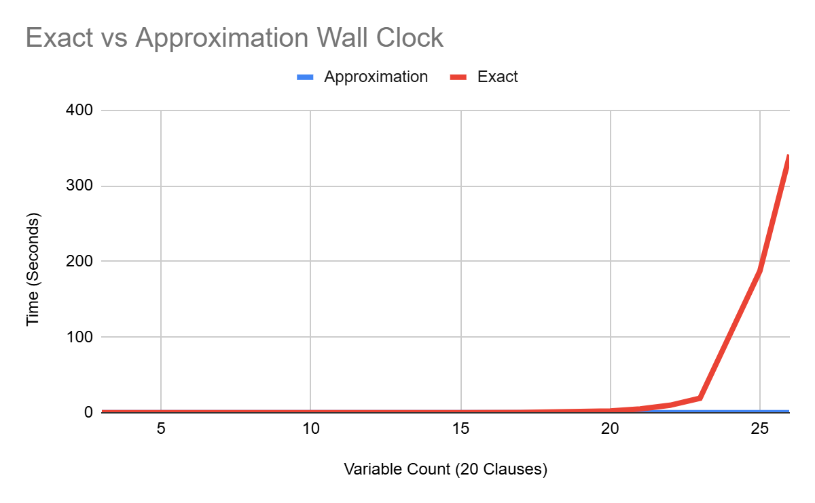
Runtime Comparison
Approximation Runtime: O(n * m)
Exact Solution Runtime: O(2^n * m)

Slide 5
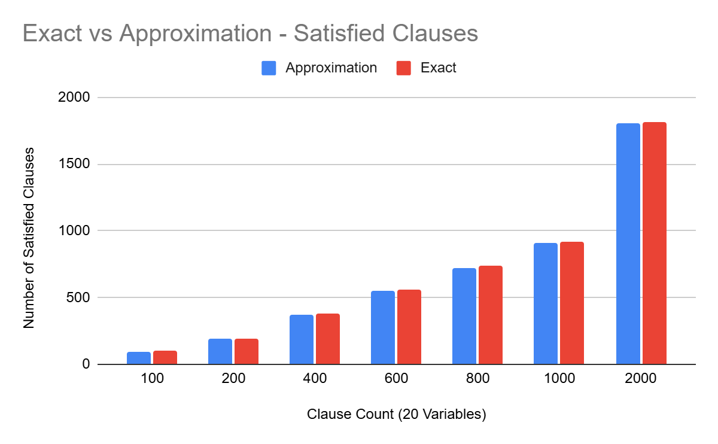
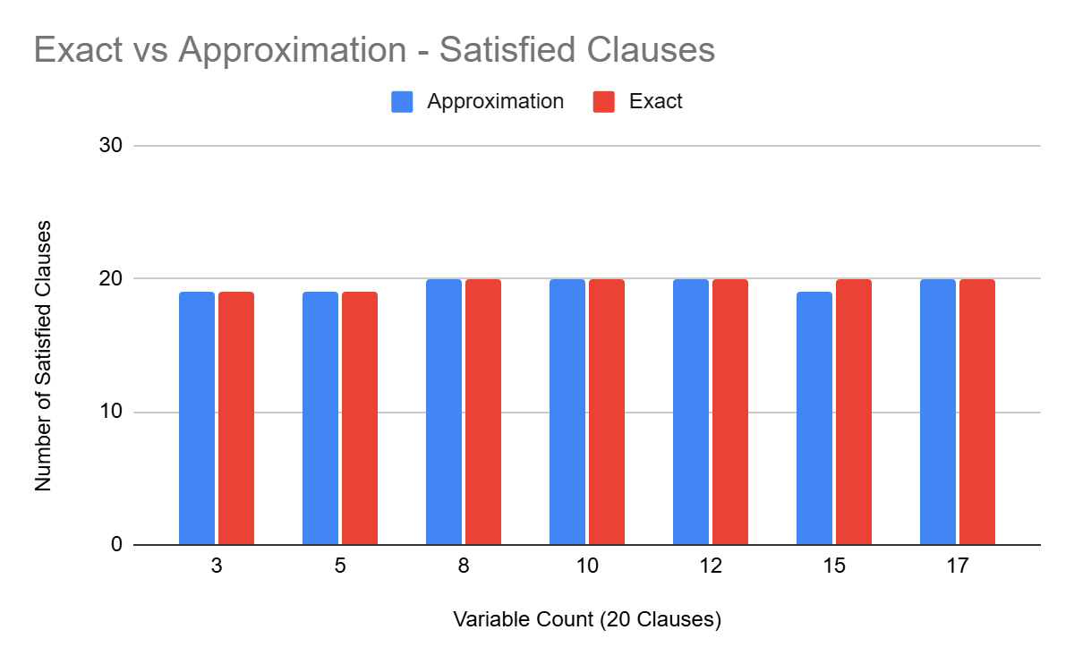
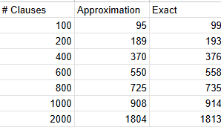
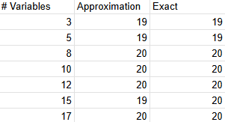
Non-Optimal Approximation Instances
As the number of clauses m increases, the approximation algorithm becomes less optimeal. The gap between the approximation and the optimal solution grows because:
The search space expands, and random or greedy approaches struggle to find the optimal solution.
The probability of satisfying all clauses decreases as more clauses are added.

