Slide 1

AIML INTERNSHIP
HENOTIC TECHNOLOGY PRIVATE LIMITED
7th July 2022 to 06th September 2022
Presented by:
S. Brenjoel
20B91A05S4
DEPARTMENT OF COMPUTER SCIENCE AND ENGINEERING,SRKREC

Slide 2
CONTENTS
INTRODUCTION ABOUT DATASET
OBJECTIVE
DATA SCIENCE PROJECT LIFE CYCLE
RESULTS
RECOMMENDATIONS AND CONCLUSIONS
REFERENCES

Slide 3
Bank Customer Churn Prediction
DATASET:

Slide 4
INTRODUCTION ABOUT DATASET
The data is related with direct marketing campaigns of a banking instructions.
The marketing campaigns were based on phone calls. . Customers who received phone calls not be unique and a same customer might receive multiple phone calls.
This dataset is about the customers of the bank based on various factors like geography, account balance, card holder and the estimated salary of the customer.

Slide 5
OBJECTIVE
The main agenda of this project is:
Perform extensive Exploratory Data Analysis(EDA) on the Bank Dataset.
To build an appropriate Machine Learning Model that will help the bankto know the persons who have exited the bank and who are still active.

Slide 6
Data Science Project Life Cycle
Data Pre-processing
Check the Duplicate and low variation data
Identify and address the missing variables
Handling of Outliers
Categorical data and Encoding Techniques
Feature Scaling
Selection of Dependent and Independent variable
In this dataset, the target variable is Exited
3. Training Models

Slide 7
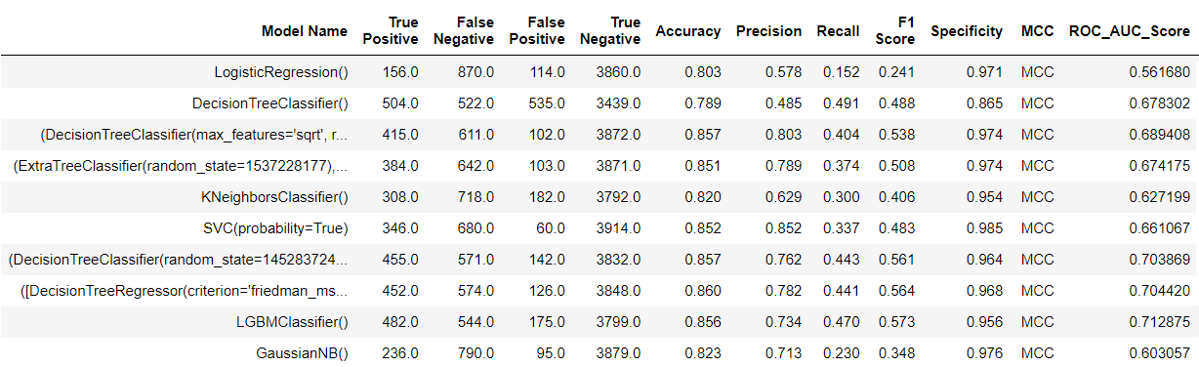
Results
Based on the analysis , these are the results generated from different models

Slide 8
Results
The model results in the following order by considering the model accuracy, F1 score and RoC AUC score.
1) Decision Tree Classifier
2) XGB Classifier
3) LGBM Classifier

Slide 9
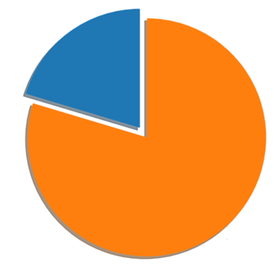
RECOMMENDATIONS AND CONCLUSIONS
Exited (20.4%)
Retained (79.6%)
Proportion of customer churned and retained

Slide 10
REFERENCES
https://www.kaggle.com/code/kmalit/bank-customer-churn-prediction

Slide 11
THANK YOU

