Slide 1
Segment Tree
Range Updates
By: Ilia, Grady, and Edward

Slide 2



Recall: segment Trees
Goal: Efficient queries and updates on an array
Traditional Segment Tree:
Range Queries:
Point Updates:
Range Updates:
Need to do a point update for entire range
Now: Can we support update queries on entire ranges in time as well?

Slide 3
Range updates
New Goal: Create a segment tree variant that supports the following queries:
update(l,r,δ) – add δ to each value in the range A[l...r]
max(l,r) – return the maximum value in the range A[l...r]
While keeping the original O(log n) runtime.
Our overall structure is still the same – each node will store the maximum over its range, as usual
Challenge: manually updating each seg-tree node that falls within the query range takes O(n log n) time!

Slide 4
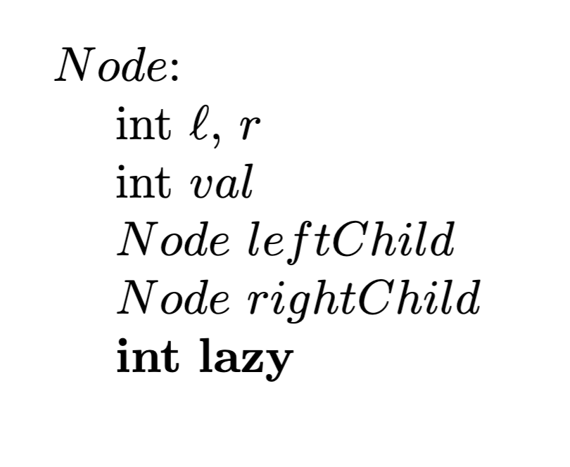
Solution: “lazy propagation”
Key Idea:
Don’t update every node, update only the topmost segments
Defer updates to their children until needed (lazily)
Add a new lazy field to our nodes that stores pending additions that need to be applied to the range
Updates occur when traversing down the tree and encountering pending changes
Only immediate children are updated through “push mechanism”

Slide 5
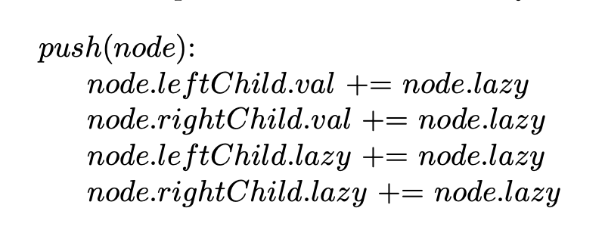
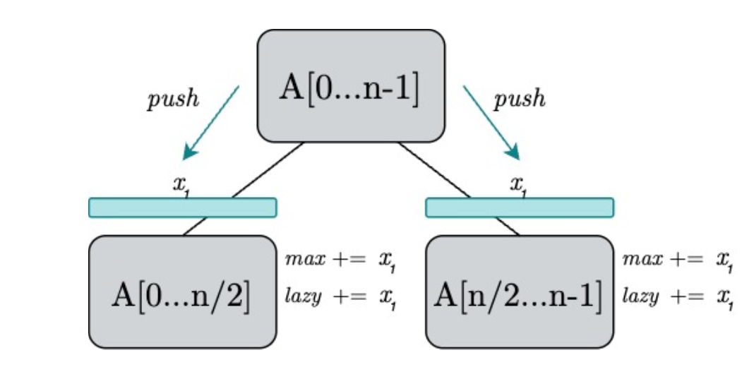
Key new method: push
Our segment tree needs a new method to perform the lazy propagation
When called on a node, push simply passes down the node’s lazy addition to its children
Note: Along with the children’s values, we also need to update their own lazy fields for future lazy propagation

Slide 6
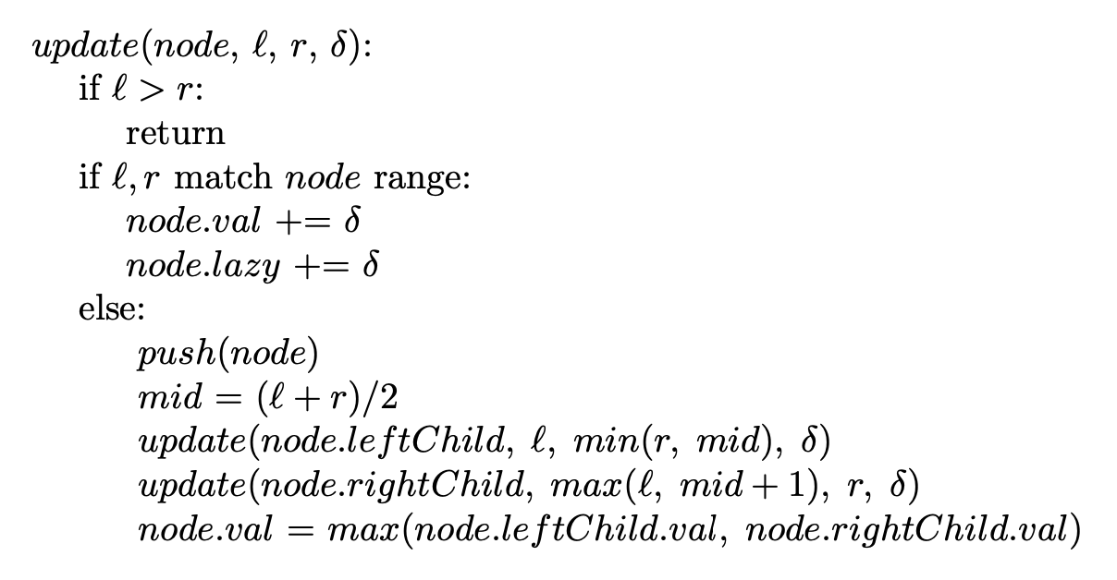
Update
With the new push method, our update method is relatively standard
If the query range matches the node’s, add δ to its value as well as its lazy value
Otherwise, call push on the current node to propagate any updates, recursively update our children, then update our own value by merging our children’s

Slide 7
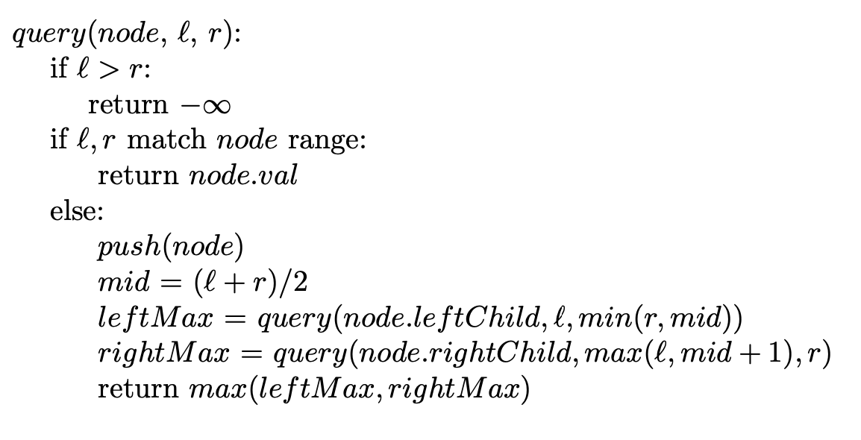
Query
Get the max of the highest-level segments that fall within a range
When reaching a segment that falls within a range, return the stored max value
Otherwise, push the pending changes down to the two children and continue to traverse the tree

Slide 8
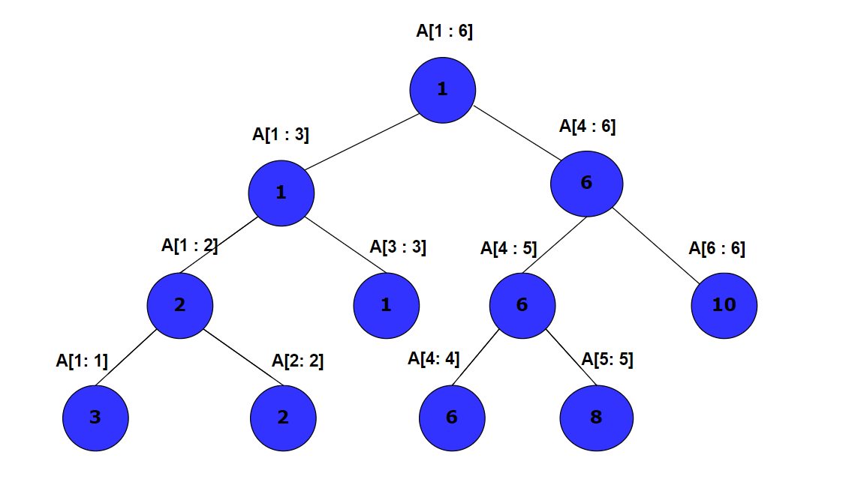
Briefly: Adding to a range, getting a specific index
When updating, store the value to be added to the highest segments that are inside the range, instead of each leaf
When getting the value at an index, as you return up the tree, add the value stored at each vertex

Slide 9
Briefly: Assigning to a range, getting a specific index
When updating, store the value to be assigned to the highest segments that are inside the range, instead of each leaf
Mark these segments, indicating that all the values below are equal to the value stored at the vertex
If encountering a marked vertex, push:
mark the two child vertices and update the values
unmark current vertex
Getting the value at an index by traversing down the tree
when traversing down the tree, when encountering a marked vertex, push

Slide 10
Material From:
https://cp-algorithms.com/data_structures/segment_tree.html#range-updates-lazy-propagation

