Slide 1


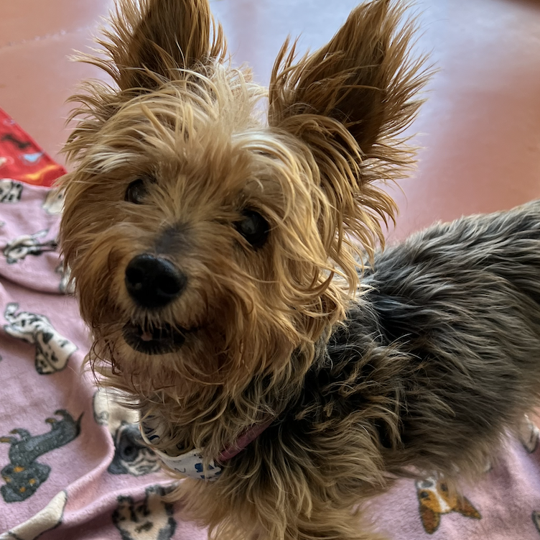
Pet Expression Predictions
Group 6
Mathew Stuart
Mitchell Simms
Brennan Currie
Helena Mabey
Notes:
Helena starts

Slide 2
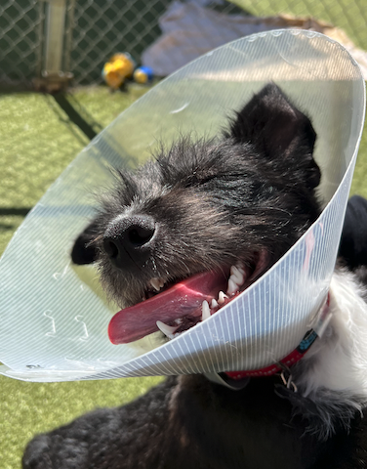
What are they thinking??
Notes:
Pets are part of our family but do we really know what they are thinking?
Have you ever wondered if your pet is happy, sad, or even angry?
Using a dataset found on Kaggle, we set out to determine if we could, within a certain level of accuracy, determine a pet’s emotion just based on its picture.

Slide 3
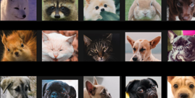
Overview of the Project
Use a machine learning model to accurately predict a pet’s emotion
Minimum of 75% Accuracy
Evaluate multiple models
Notes:
Our goal of this project was to implement a machine learning model to predict at or above 75% classification accuracy.
Multiple libraries were utilized for the creation of our model including numpy, keras utilities, models, and layers, tensorflow, sklearn, and matplotlib.
We also used some new libraries, tkinter and PIL to create a real-life application to run our model against various test samples.

Slide 4
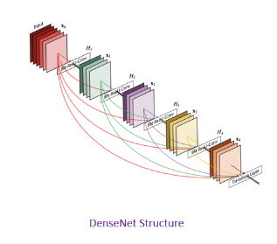
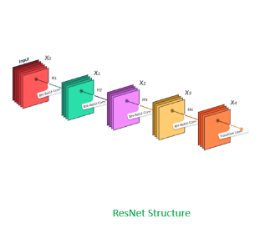
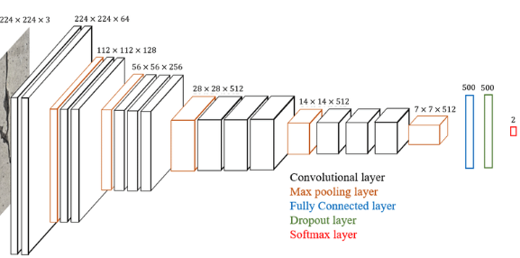
Which Model to Use?
Sequential Model
DenseNet Model
EfficientNet Model
ResNet Model
VGG16 Model
Notes:
Working as a group, we evaluated which models to use for this dataset and outcomes.
We were able to run the dataset as it was. We were able to get some accuracy if the splits for train and test were even. We determined that the dataset was considerably smaller than we would need to run nearly any of the models and return favorable results.
We then worked to augment the original data, with by using a pre-split and augmented dataset directly from Kaggle or completing our own augmentation by duplicated, flipping, or even scrambling the data.

Slide 5
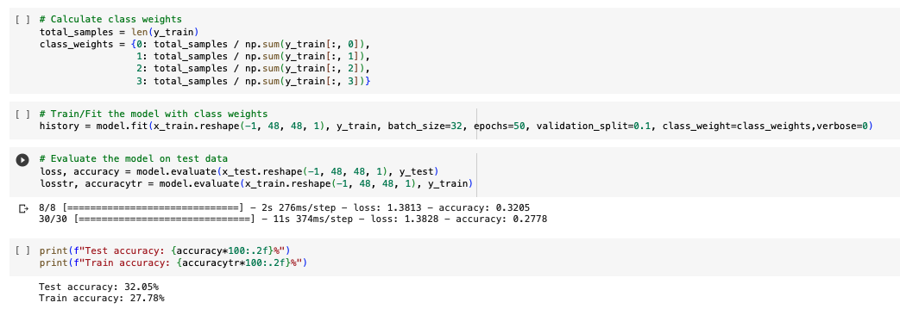
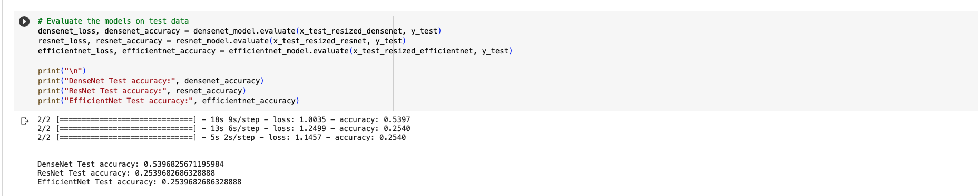
Testing, Optimizing, and Results
Sequential Model
EfficientNet Model
DenseNet Model (first attempt)
ResNet Model
Notes:
Brennan starts
We tried multiple models before deciding on which two presented results with the highest accuracy.
Sequential was the most basic model we attempted. The test accuracy was returned at 32%. This model used the original dataset prior to any augmentation.
We then located a starter code on Kaggle for our dataset that examined EfficientNet, DenseNet, and ResNet. We were able to manipulate this code and return the listed results:
EfficiencyNet: 25%
ResNet: 25%
DenseNet: 54%
After evaluating these results, we opted to dig further into the DenseNet model. We also wanted to expand on the VGG16 model we discussed previously in the class for picture recognition.

Slide 6
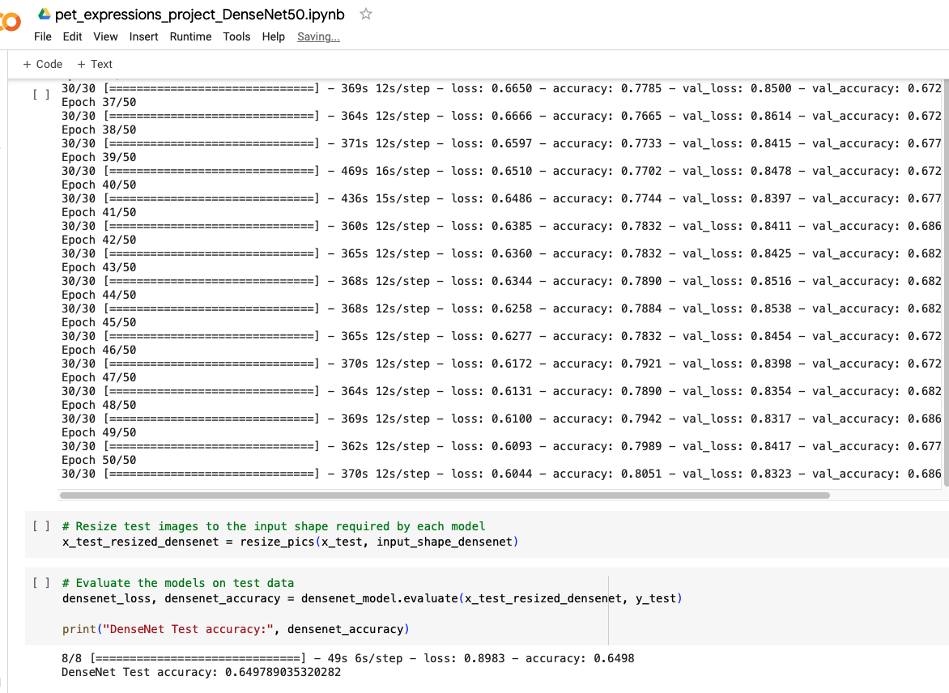
Testing, Optimizing, and Results
DenseNet Model
Notes:
We had the most success with the DenseNet model.
We were able to augment the training data using various methods including flipping, duplicating, and scattering.
We also used methods to slow the learning rate using ReduceLROnPlateau as well as putting in an early stop with EarlyStopping.
Epoch sizes varied through our multiple optimization attempts, anywhere from 5 to 100 epochs. In the example above, we were able to achieve nearly 65% test accuracy within 50 epochs.

Slide 7
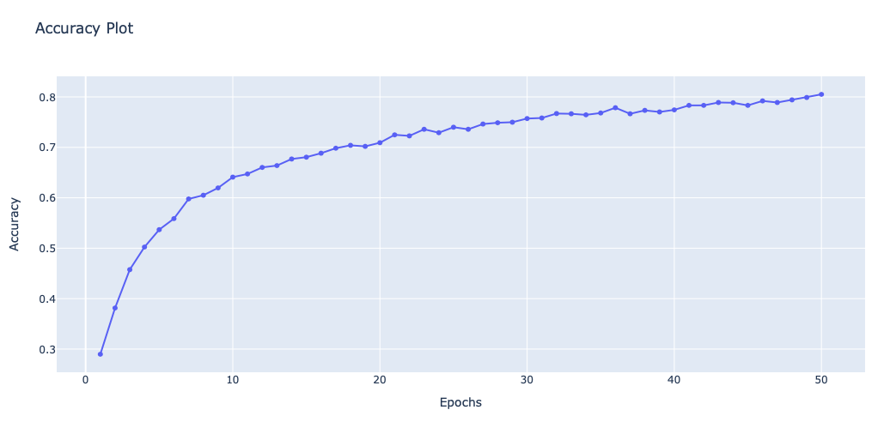
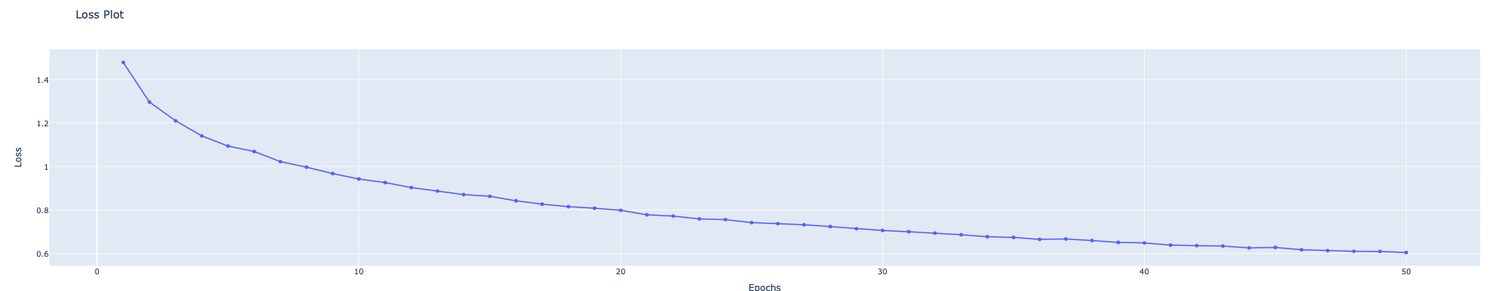
Testing, Optimizing, and Results
DenseNet Model
Notes:
The graphs show both the accuracy rate and loss rate over time based on epoch.
You can see that the accuracy continued to climb through the 50th epoch but we found the increase was not substantial enough to warrant the extended processing time of 100 epochs.

Slide 8
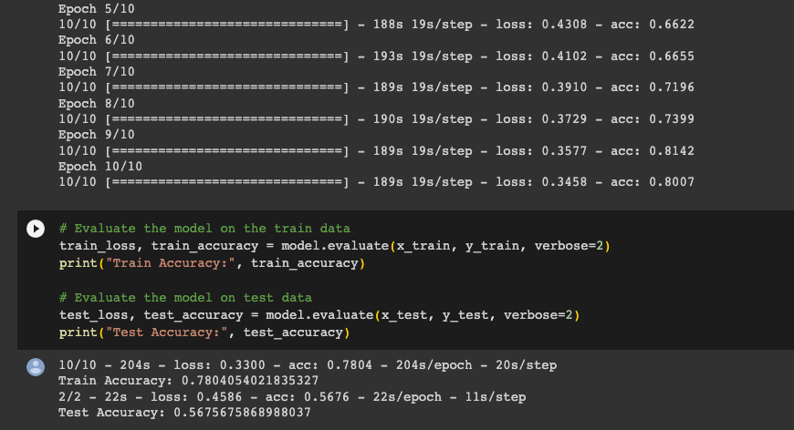
Testing, Optimizing, and Results
VGG16 Model
Notes:
Mitchell starts, visual geometry group 16, image input size of 224,224,3. We added input, convolutional, pooling, fully connected layers for classification. Softmax activation output layer. Our top validation accuracy was 55%. Could get better with a larger sample size, vgg works better with big data sets.
We tested multiple VGG16 models through our optimization trial
The highest test accuracy returned was 57% using the pre-split train, test, validate dataset provided by the developer on Kaggle. This set consisted of 1000 training files, 38 testing files, and 36 validation files. It was run over 10 epochs as we found anything higher reduced the test accuracy.
In all VGG16 models, the training accuracy was considerably higher than the test accuracy.

Slide 9
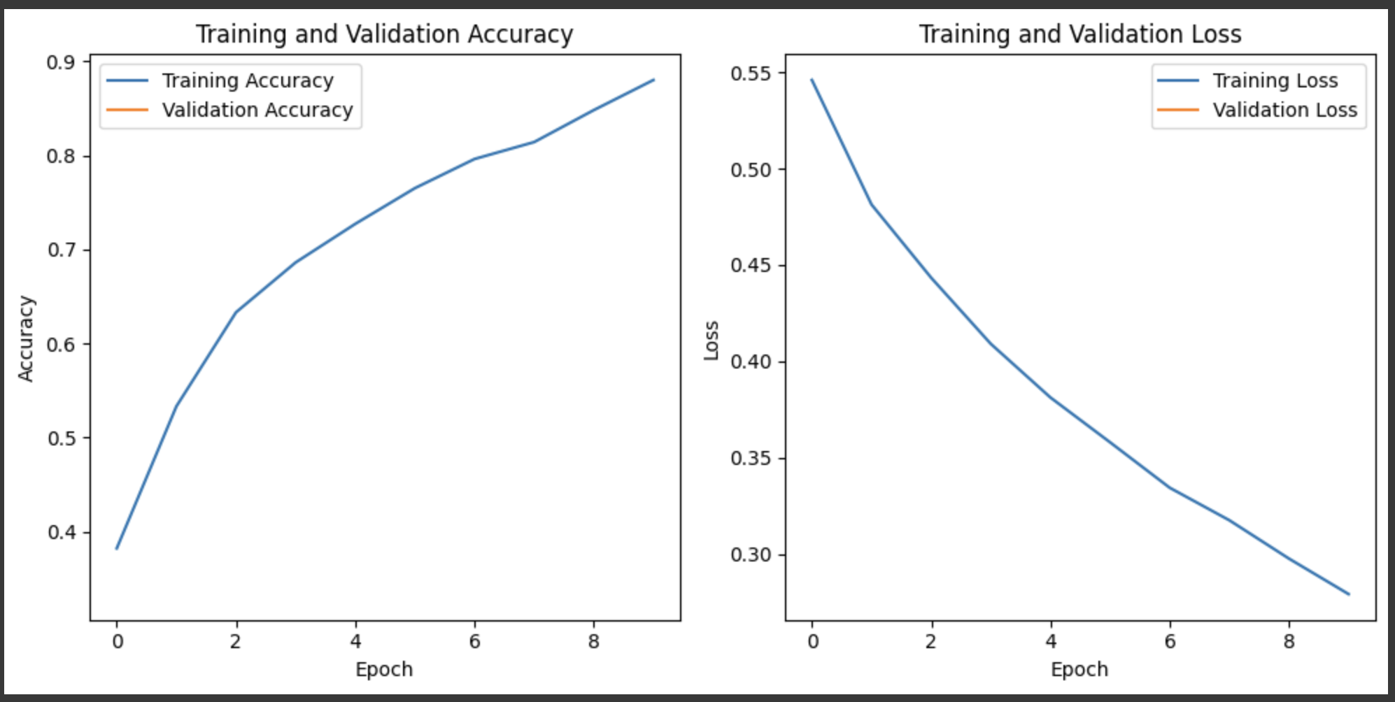
Testing, Optimizing, and Results
VGG16 model
Notes:
In nearly every VGG16 model, our training accuracy was above 80% which led us to believe the model was overfit.
This could have been attributed to the smaller dataset size as it was returned on nearly every adaptation of the dataset we attempted.
Because of this fear off the model being overfit, we opted to go with the DenseNet model for our real-life application, a desktop prediction generator.

Slide 10
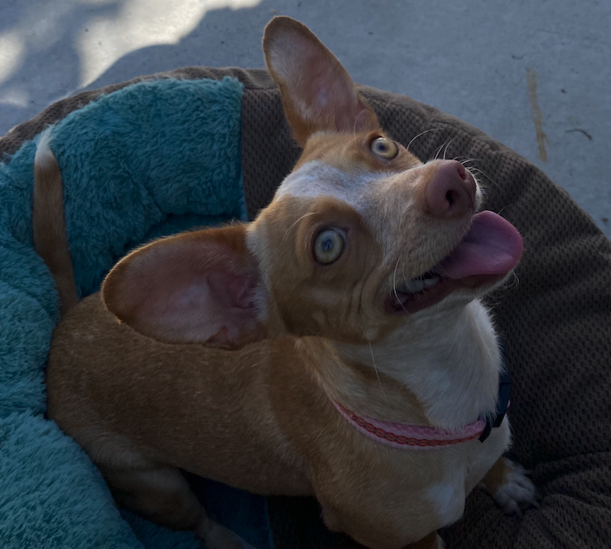
Real Life Application!
Notes:
Mathew starts
Ok, so now we have the code and we feel it is accurate based on other examples we returned. Even the Kaggle samples were at or below 65%.
We located code that assisted us in creating a desktop application to use our model to predict pet’s emotions. It is run from the terminal and we will provide a real-life set of test samples and results at the click of a button on the desktop.

Slide 11
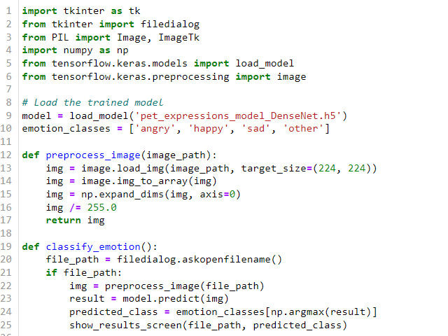
Desktop Application Coding
Notes:
Using two new libraries, tkinter and PIL, we were able to create a desktop model with click to activate button.
This code works by reading in the h5 produced by our DenseNet model which is activated using the terminal.

Slide 12
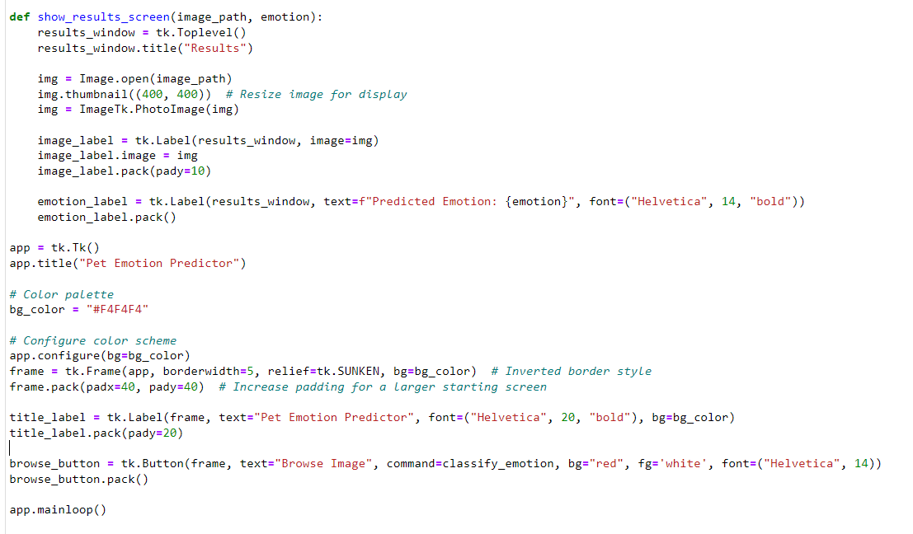
Desktop Application Coding
Notes:
The user then is provided a click to predict button which directs them to choose a picture file to evaluate.
Once evaluated, it returned the predicted result with an image of the picture subject.
Mathew’s real-life example here. Once complete return to PowerPoint for final slide.

Slide 13
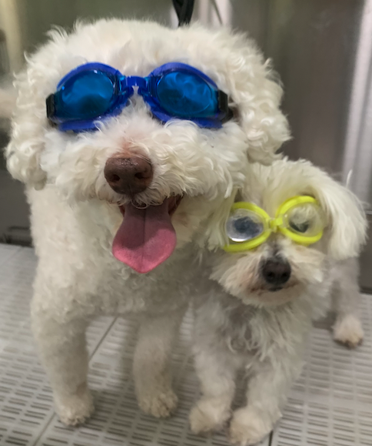
A Round of A-Paws to All our Presenters!!

