Slide 1
Statistical Process Control
Part 1: Basic concepts and Construction of C-chart
© 2006 Thomas F. Gattiker

Slide 2
Sources of Variation
Common causes of variation
  Random causes that we cannot identify a single source
  Unavoidable
  the performance of any human or machine is variable over time
  Assignable causes of variation
  A single cause can be identified and eliminated
  Occurs when there has been an important change in some aspect of the process
    e.g. new employee training, equipment wears out or breaks, contaminated raw material received from supplier, daylight savings time, environmental change (humidity, traffic)
  Also known as special cause variation

Slide 3
Sources of Variation:
Managerial Implications
When special cause variation creeps into our process, we want to be able to detect it so we can eliminate it’s source
On the other hand, we don’t want to “overreact” to common cause variation

Slide 4
How to tell the difference between the two Causes of Variation
Both sources of variation manifest themselves as variation in some characteristic of process output (fill level of bottle, delivery time, number of customer complaints)
When only common cause variation is present, the amount of variation we observe will be the same day to day, sample to sample, shift to shift…
  the number of late deliveries per day averages 3.5 and is always between two to five
  the amount of salt in a bag of chips averages 5 grams and ranges between 4.8 grams & 5.2 grams

Slide 5
How to tell the difference between the two Causes of Variation
If we observe a value outside the normal range, we should conclude that there is more than common causes affecting our process. A special cause has crept in.

Slide 6
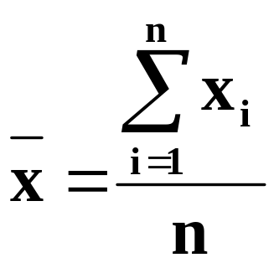
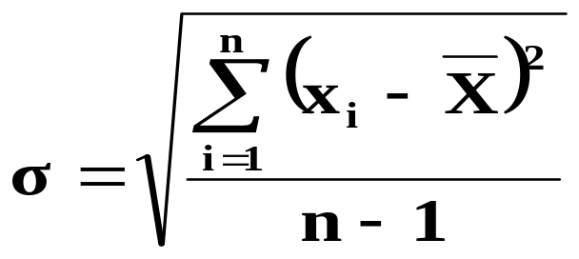
Statistical Tools
The Mean- measure of central tendency
The Range- difference between largest/smallest observations in a set of data
Standard Deviation measures the amount of data dispersion around mean. Conceptually, it is like the range.

Slide 7
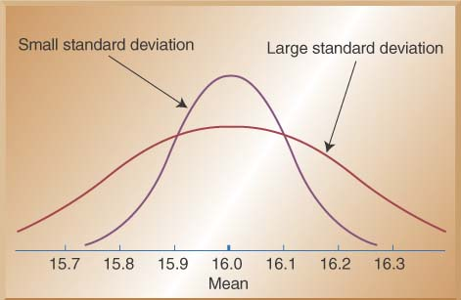
Distribution of Data

Slide 8
Std.Dev. Demystified
 | Weight | Mean Weight | Deviation
Tom | 175 | 200 | 25
Skip | 200 | 200 | 0
Frank | 225 | 200 | 25
Average absolute deviation:
(25+0+25)/3 = 17
Standard Deviation is another measure of “average” deviation

Slide 9
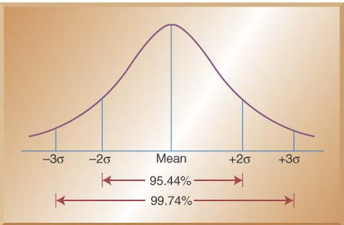
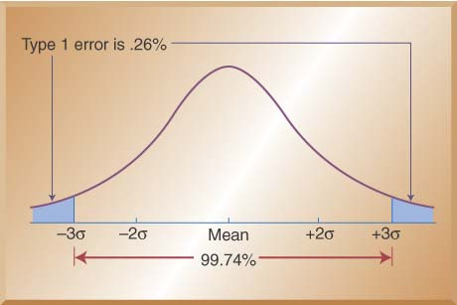
Probability
Practically all observations fall within 3 std devs on either side of the mean. There is only a .13% chance of seeing an individual 3 std dev below the mean and a .13% chance of seeing an individual 3 std dev below the mean (.26% chance total)

Slide 10
Steps in Making SPC Chart
Periodically collect samples from a process (e.g. every hour or every day). P chart: Compute proportion defective for each sample. X bar chart: Compute the mean (X bar) for each sample. R chart: Compute range for each sample.
Compute mean
Compute standard deviation. Use this to compute upper control limit (3 std dev above centerline) and lower control limit (3 std dev below centerline)
Draw centerline (mean) and control limits on chart
Plot each sample from step 1 on chart (proportion defective for P chart, X bar for X bar chart, R for R chart)
Interpret the chart: Is there evidence of an out of control condition?
Assuming these initial samples do not show an “out of control” condition, continue taking samples, plotting them on the chart and monitoring the chart for signs of an out of control condition

Slide 11
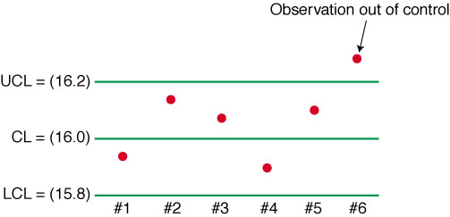
SPC Chart Elements

Slide 12
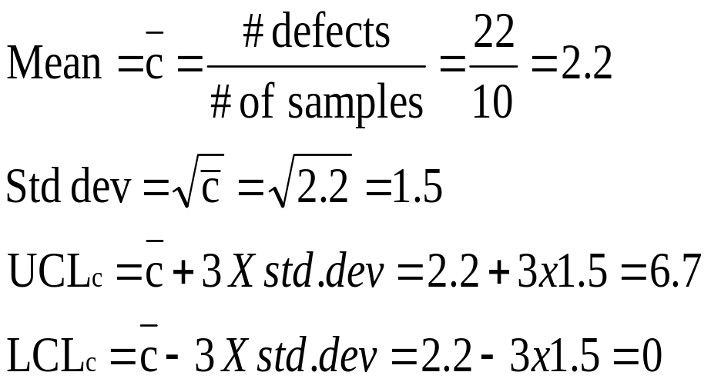
C-Chart Example: The number of weekly customer complaints are monitored in a large hotel using a c-chart. Develop three sigma control limits using the data table below.
Step 1
Week | Number of Complaints
1 | 3
2 | 2
3 | 3
4 | 1
5 | 3
6 | 3
7 | 2
8 | 1
9 | 3
10 | 1
Total | 22
Steps 2 and 3
Note: You cannot have a negative control limit so the LCL becomes 0

Slide 13
C-Chart Example
Continued
Step 4
6.7
2.2
0

Slide 14
C-Chart Example
Continued
Step 5
6.7
2.2
0

Slide 15
Interpreting the Chart
Process is out of control if
  One point outside of 3-sigma control limits
  7 points in a row all on the same side of the centerline
  7 points in a row descending. 7 points in a row ascending

Slide 16
Seven in a row descending
Seven in a row below center line

