Slide 1
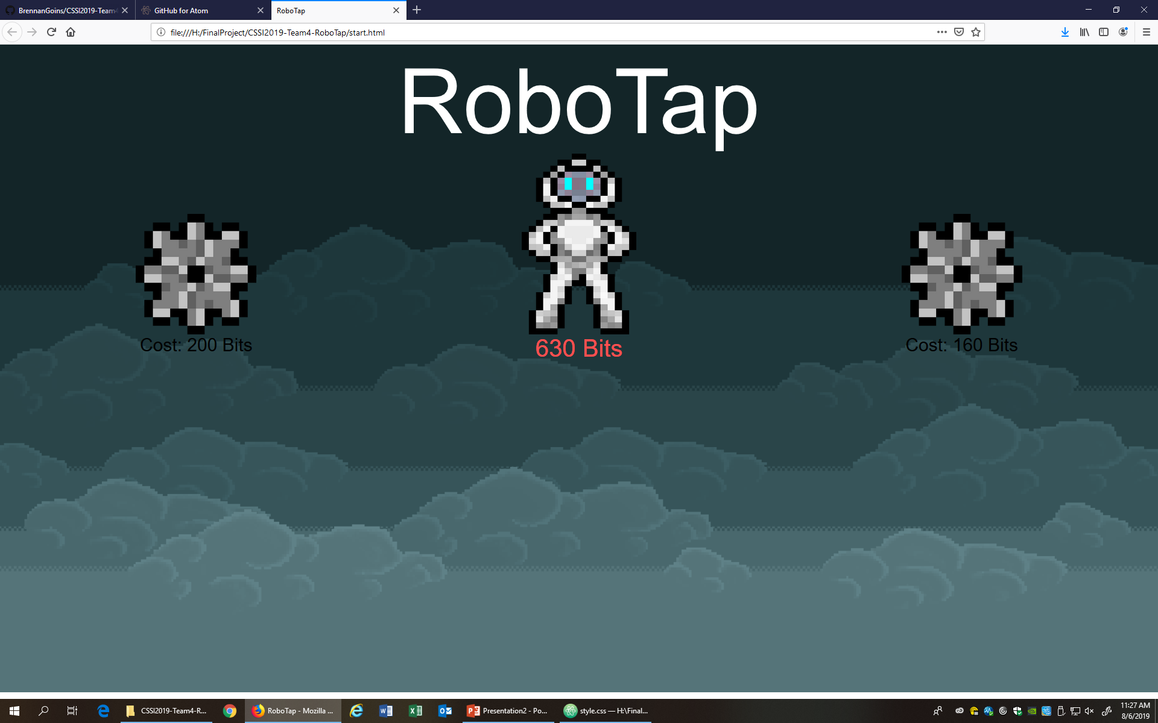
RoboTap: Day 2 Morning
Implemented upgrade system using loops, variables, and click events via js
More Image creation & css improvements/reformatting
Added Python files for hosting

