Slide 1
Form 5500 Benefits Insurance Analysis
Company Clustering & Benefits Insurance Scoring
Data Science Team

Slide 2
Executive Summary
Overview
Analysis of ~420K companies with ERISA Form 5500 filing data (sample)
Covers years 2020-2024 with historical data
Data source: Department of Labor Form 5500 filings
Key Findings
Peak filing year: 2023 with 146,403 companies (raw data)
83% of companies have fewer than 50 enrolled employees
Top industries: Healthcare, Professional Services, Construction
Top Brokers: USI, Gallagher, Lockton, Marsh & McLennan
Welfare plans: 73,677 | Pension plans: 421,818
Speaker Notes:
This presentation covers our exploratory data analysis of Form 5500 filings - the primary regulatory filings for employee benefit plans in the US. This data is foundational for our company clustering and benefits insurance scoring initiative. The analysis reveals a highly fragmented market dominated by small businesses, with significant consolidation among brokers and carriers.

Slide 3
Question 1: How Many Companies File Each Year?
Year | Companies Filing
2020 | 156,805
2021 | 155,304
2022 | 155,289
2023 | 146,403
2024 | 126,620
Filing Trends (2020-2024)

Slide 4
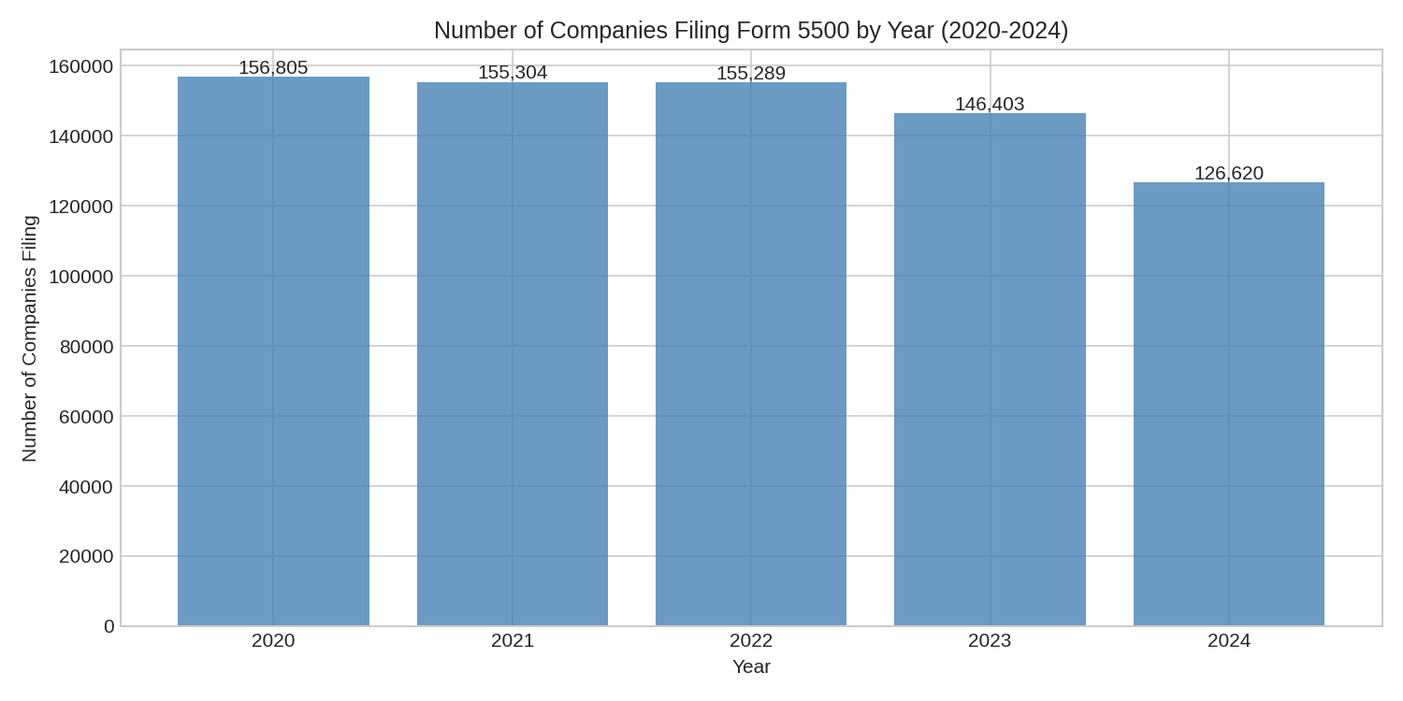
Key Observations
Stable volumes: ~150K companies file annually (2020-2023)
2024 decline: Likely due to incomplete data for latest year
500K filings sample analyzed for detailed attributes
Speaker Notes:
This chart shows Form 5500 filings over time using raw data files for accurate company counts. The volumes have been relatively stable around 150K companies per year. The decline in 2024 likely reflects incomplete data collection rather than an actual market decrease.
Companies Filing by Year

Slide 5
Question 2: Size Range by Enrolled Employees
Size Range | Filings | Percentage
0 (No Participants) | 72,793 | 14.6%
1-10 (Micro) | 175,647 | 35.1%
11-50 (Small) | 155,233 | 31.0%
51-100 (Small-Medium) | 41,515 | 8.3%
101-500 (Medium) | 39,476 | 7.9%
501-1000 (Medium-Large) | 6,506 | 1.3%
1001-5000 (Large) | 6,504 | 1.3%
5000+ (Enterprise) | 2,326 | 0.5%
Distribution Statistics
Median: 11 enrolled employees
Mean: 183 employees
25th percentile: 3 employees
75th percentile: 35 employees
Size Bin Distribution

Slide 6
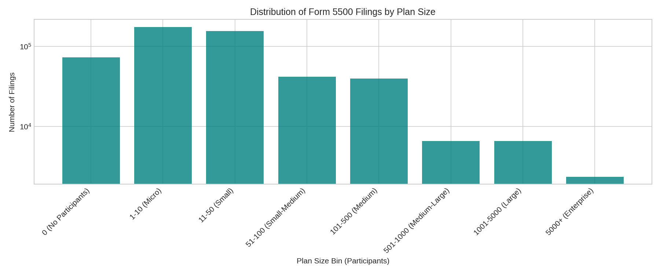
Speaker Notes:
This slide reveals a critically important insight: the benefits market is overwhelmingly composed of small businesses. Over half of all companies filing Form 5500 have 10 or fewer employees. This skew has major implications for our clustering and scoring models.
Size Distribution

Slide 7
Question 3: Primary Industry from NAICS Codes
Sector | Filings
Professional, Scientific, and Technical Services | 98,207
Health Care and Social Assistance | 91,577
Construction | 42,586
Manufacturing | 33,196
Other Services | 31,422
Finance and Insurance | 31,151
Retail Trade | 29,822
Top Industries by NAICS Code
621111 - Offices of Physicians: 32,269 filings
621210 - Offices of Dentists: 22,643 filings
541990 - Other Professional Services: 21,457 filings
541110 - Offices of Lawyers: 20,926 filings
611000 - Elementary/Secondary Schools: 10,737 filings
Sector Distribution

Slide 8
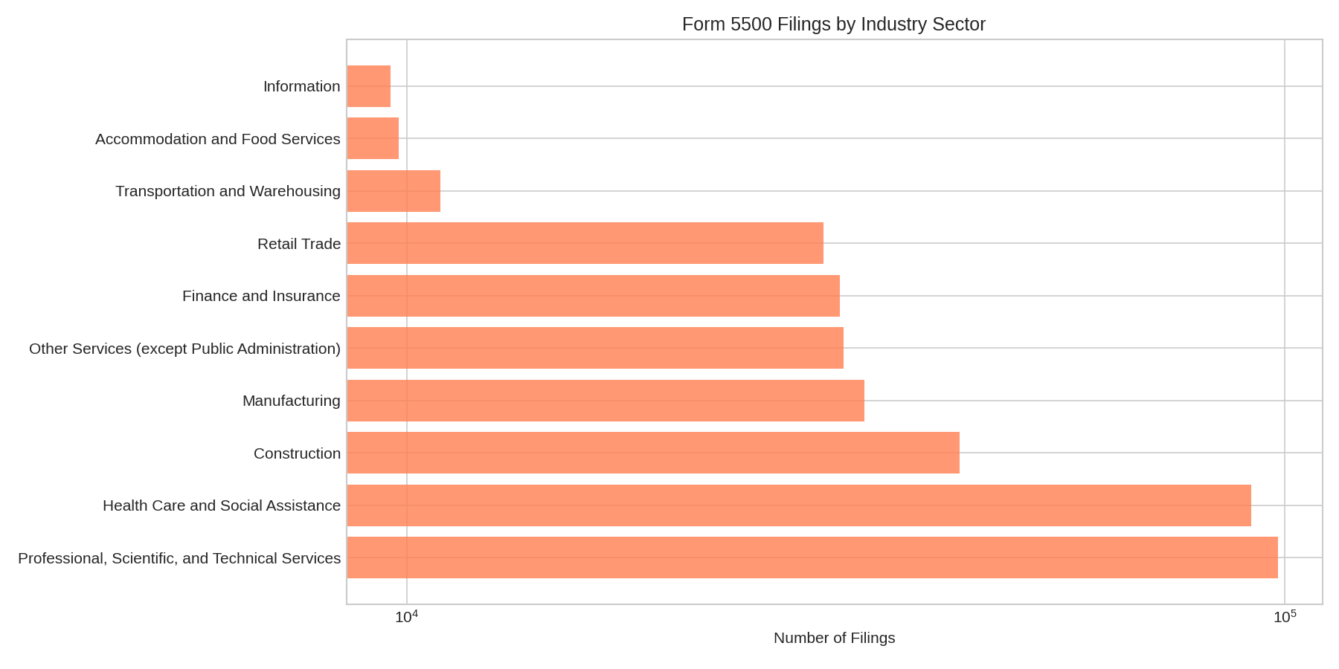
Speaker Notes:
Industry analysis reveals Professional Services and Healthcare dominate Form 5500 filings. This makes sense given: 1. Professional services firms (lawyers, consultants) have high 401(k) adoption 2. Healthcare providers (physicians, dentists) often sponsor retirement plans 3. These industries have stable, W2-employed workforces
Sector Distribution

Slide 9
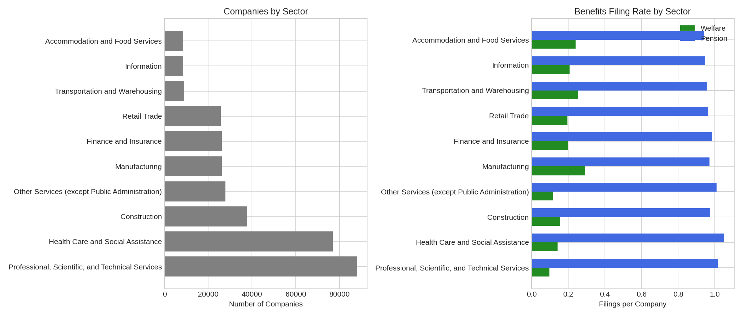
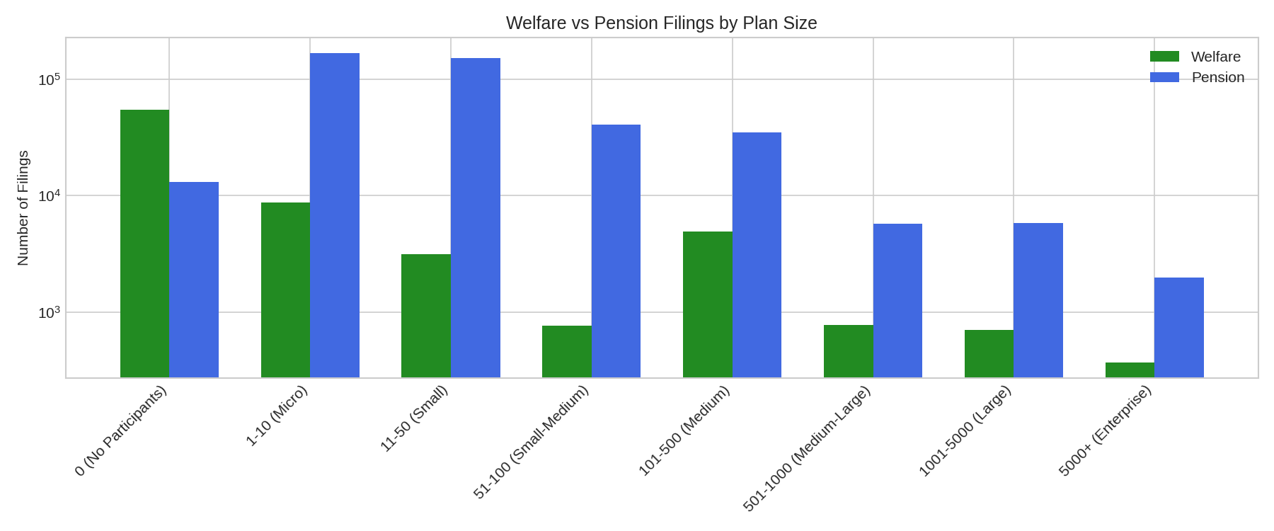
Question 4: Benefits Program Structure
Benefits by Sector
Premium Per Life by Sector
Welfare vs Pension
Welfare plans: 73,677 filings
Pension plans: 421,818 filings
Benefits by Company Size
Benefits by Size
Benefits by Sector

Slide 10
Sector | Premium per Life
Construction | $790
Professional Services | $758
Accommodation/Food | $629
Finance/Insurance | $574
Health Care | $516
Manufacturing | $486
Information | $475
Retail Trade | $309

Slide 11
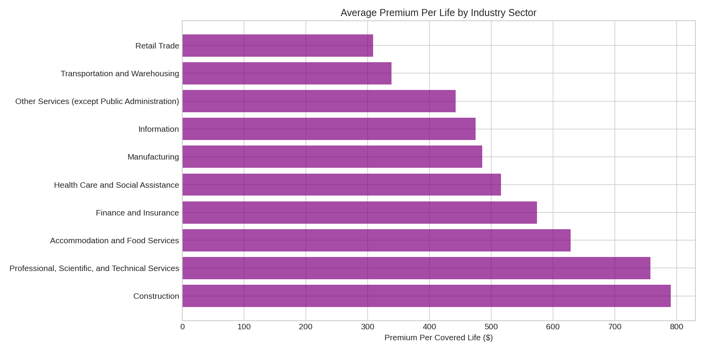
Speaker Notes:
This slide shows the financial magnitude of benefits programs and reveals important patterns: 1. Pension plans dominate filings (421K vs 73K welfare) 2. Premium per life varies significantly by industry 3. Construction has highest per-capita premiums ($790) 4. Retail has lowest ($309)
Premium per Life by Sector

Slide 12
Question 5: Top Brokers
Rank | Broker | Filings
1 | USI Insurance Services | 12,891
2 | Gallagher Benefit Services | 9,932
3 | Lockton Companies | 9,861
4 | Marsh & McLennan Agency | 9,492
5 | Mercer Health & Benefits | 6,033
6 | Willis Towers Watson | 4,306
7 | Alliant Insurance Services | 3,317
8 | Edgewood Partners Insurance | 2,641
9 | Aon Consulting | 2,437
10 | Digital Insurance | 2,008
Top 10 Brokers by Filings

Slide 13
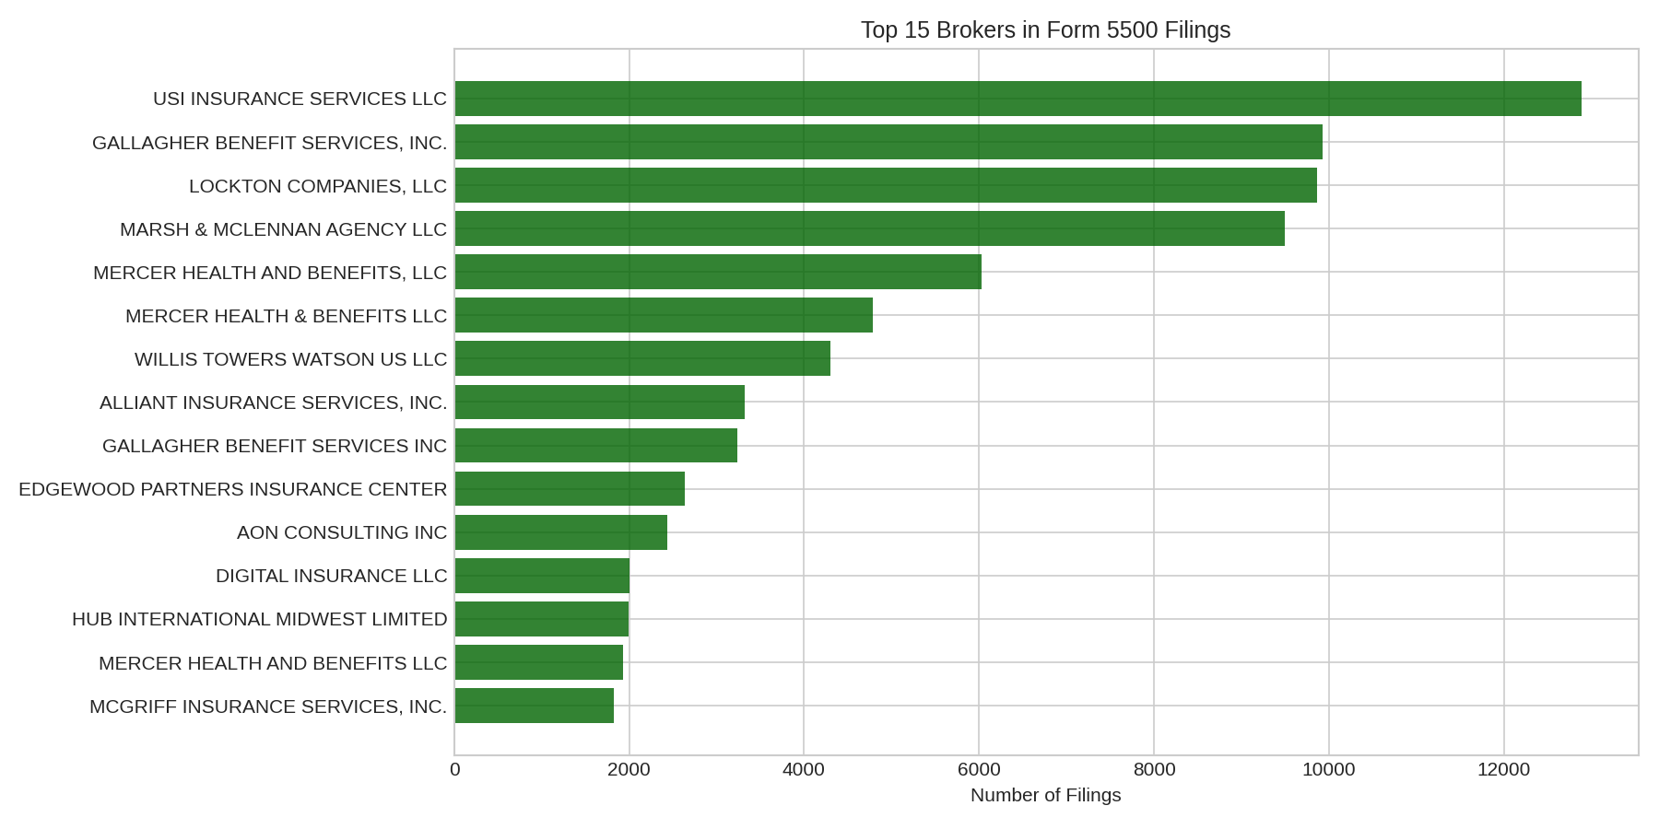
Speaker Notes:
The broker market shows significant concentration: 1. Top 4 brokers serve ~42K filings combined 2. Long tail: 30K+ unique brokers, but most have few clients 3. Name standardization needed for accurate analysis
Total: 30,984 unique brokers in sample
Top Brokers

Slide 14
Question 5: Top Carriers
Rank | Carrier | Filings
1 | Life Insurance Company of North America | 23,175
2 | United of Omaha Life | 21,419
3 | Lincoln National Life | 19,100
4 | Metropolitan Life | 18,841
5 | Unum Life Insurance | 18,477
6 | Principal Life Insurance | 16,947
7 | Vision Service Plan | 16,111
8 | Guardian Life | 11,850
9 | UnitedHealthcare Insurance | 10,876
10 | Standard Insurance Company | 9,551
Top 10 Carriers by Filings

Slide 15
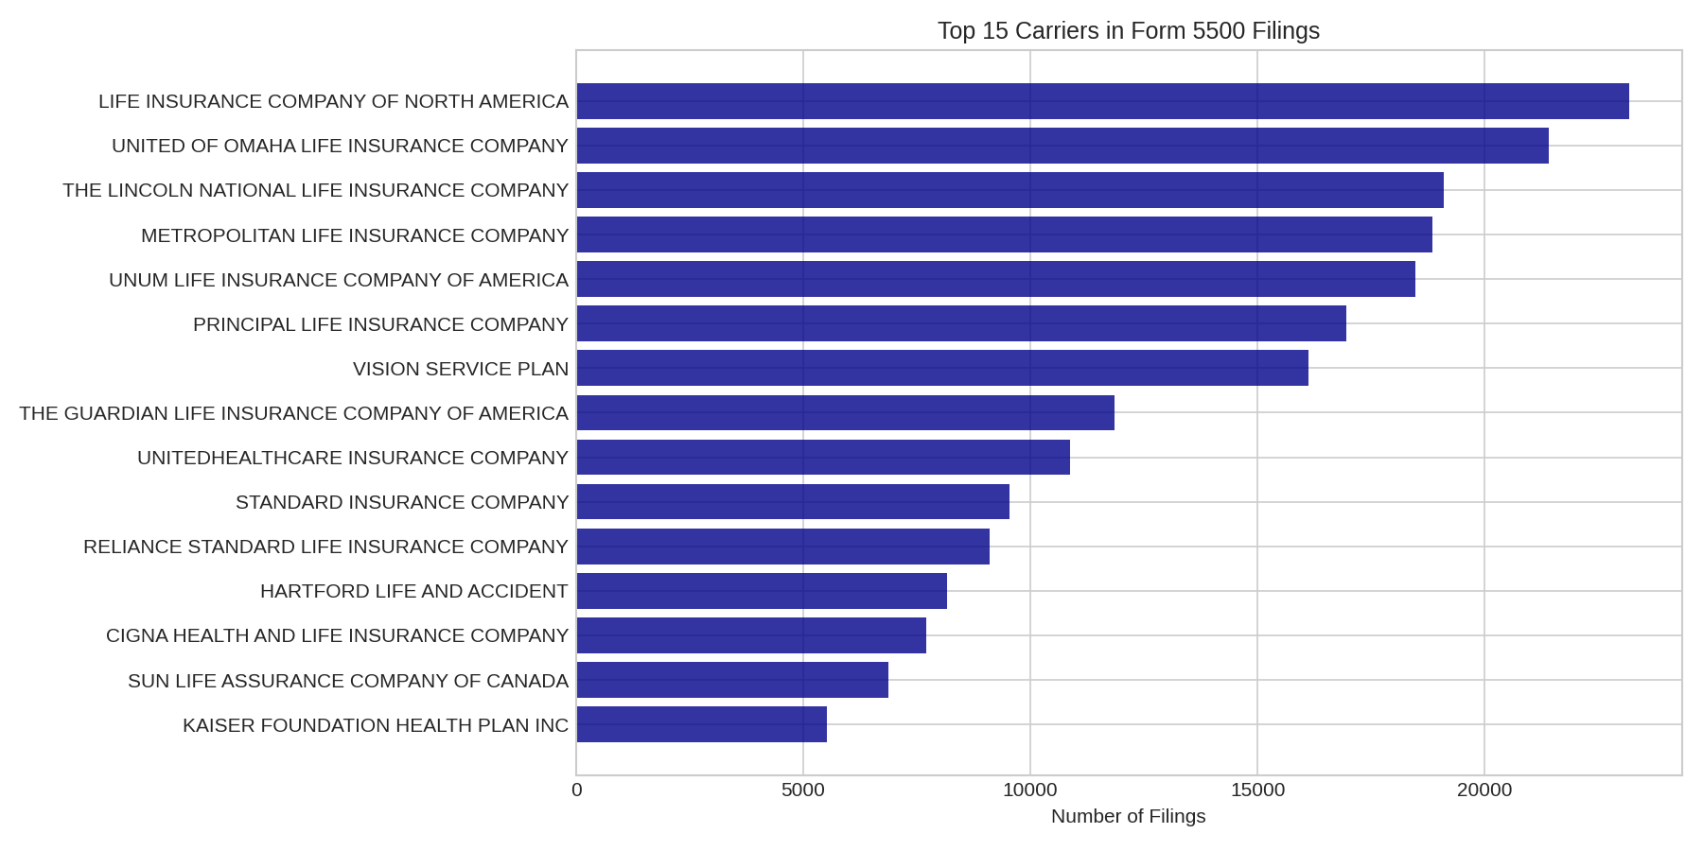
Speaker Notes:
Carrier analysis reveals: 1. Life insurance companies dominate (retirement/401k focus) 2. Health carriers present: UnitedHealthcare at #9 3. 12K+ unique carriers suggests multi-carrier common
Total: 12,844 unique carriers in sample
Top Carriers

Slide 16
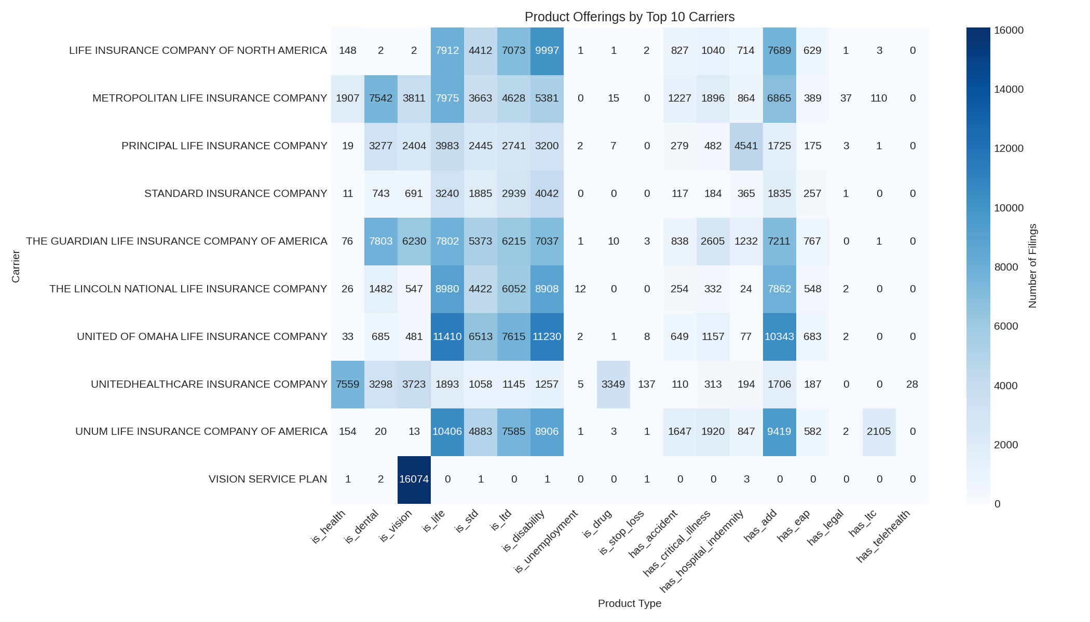
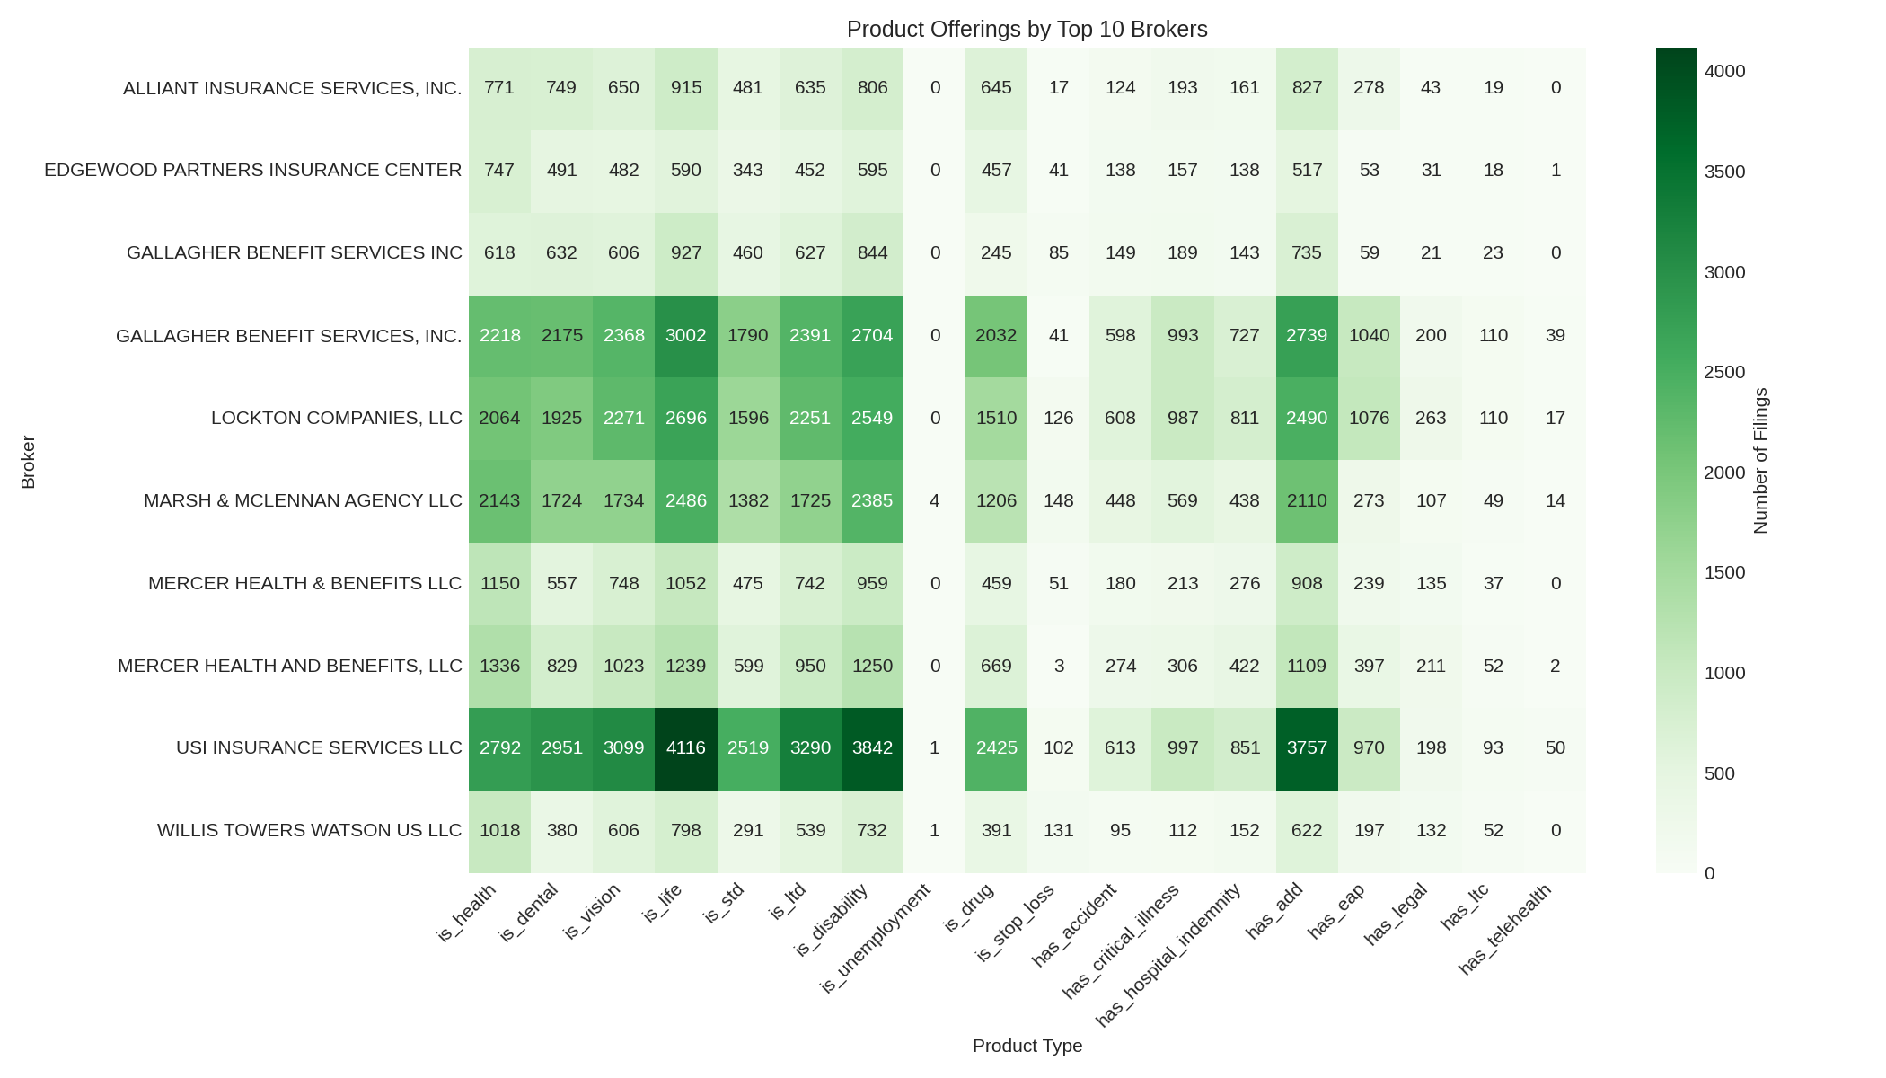
Product Offerings Overview
Broker Product Heatmap
Speaker Notes:
Product analysis shows: 1. Carriers typically offer multiple product types 2. Health, life, and disability most common 3. Top brokers represent diverse product portfolios
Benefit Types from Form 5500
Health Insurance - Most common welfare benefit
Dental & Vision - Often bundled with health
Life Insurance - Common supplemental benefit
STD/LTD - Disability coverage
Pension/401(k) - Retirement benefits
Carrier Product Heatmap
Carrier Products Heatmap
Broker Products Heatmap

Slide 17
Geographic Distribution
State | Filings
CA | 71,358
NY | 38,373
TX | 29,983
FL | 25,008
OH | 22,226
IL | 21,023
PA | 20,968
NJ | 18,756
MA | 17,193
MI | 15,278
Top 10 States

Slide 18
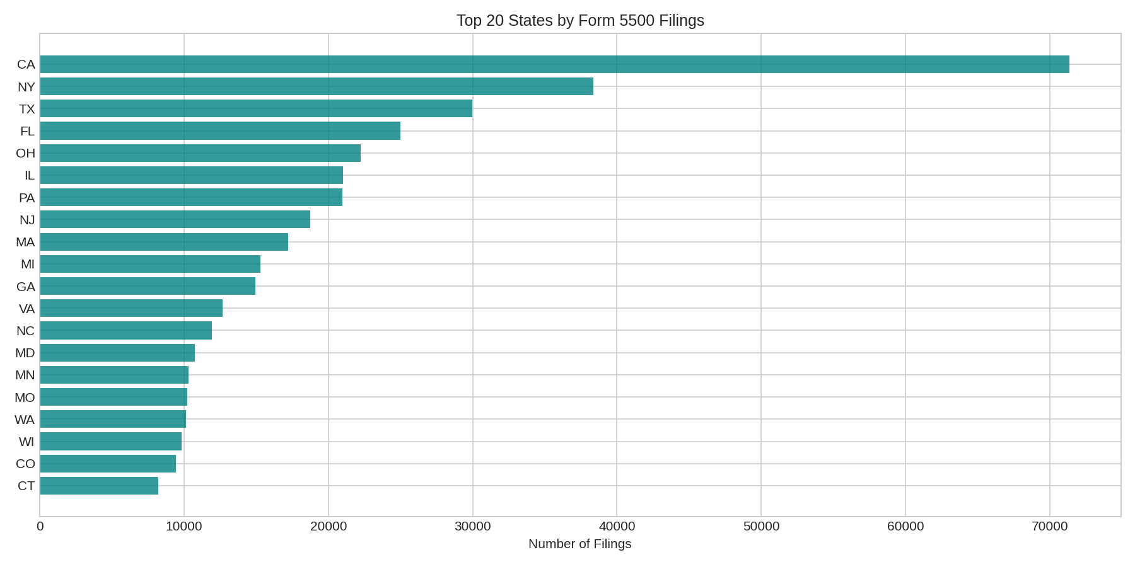
Speaker Notes:
Geographic analysis reveals: 1. California dominates with 71K filings 2. NY, TX, FL follow - consistent with population 3. Heavy concentration in coastal/urban states
State Distribution

Slide 19
Data Quality Notes
Known Issues
Missing NAICS: Many companies show “Unknown” for industry
Name standardization: Broker/carrier names need deduplication
Outlier detection: Some premium values appear incorrect
2024 data: May be incomplete due to reporting delays
Data Processing Applied
Successfully handled numpy array format in year columns
Created safe type conversions for NAICS codes
Added error handling for empty data visualizations
Speaker Notes:
We identified several data quality issues: 1. NAICS mapping gaps exist in the processed data 2. Name deduplication is critical for accurate broker/carrier analysis 3. Some premium outliers need investigation

Slide 20
Summary Statistics
Metric | Value
Total Filings (sample) | 500,000
Unique Companies (sample) | 419,872
Unique Carriers | 12,844
Unique Brokers | 30,984
Unique NAICS Codes | 706
Avg Plan Size (participants) | 183
Median Plan Size | 11
Welfare Filings | 73,677
Pension Filings | 421,818

Slide 21
Clustering Model Recommendations
Recommended Algorithms
K-Means Clustering
  Best for: Initial segmentation with spherical clusters
  Features: Company size, carrier count, product types
Hierarchical Clustering
  Best for: Industry-specific groupings
  Reveals nested relationships in NAICS codes
DBSCAN
  Best for: Finding natural clusters and outliers
  Identifies unusual benefits profiles
Gaussian Mixture Models (GMM)
  Best for: Probabilistic cluster assignments
  Companies can belong to multiple segments
Speaker Notes:
Based on our EDA, here’s our recommended clustering approach: - K-Means is starting point - interpretable, works well for size-based segments - GMM recommended for production because benefits programs aren’t mutually exclusive

Slide 22
Key Features for Clustering
Size Features
total_all_participants - Plan participant count
benefits_eligible - Employees eligible for benefits
Plan size category (small/large)
Industry Features
NAICS sector (first 2 digits)
NAICS subsector (first 3 digits)
Multi-sector indicator
Benefits Program Features
Number of unique carriers
Number of unique brokers
Product types (health, dental, vision, life, etc.)
Welfare vs pension indicators
Total premiums
Geographic Features
State/region

Slide 23
Recommendations & Next Steps
Immediate Actions
Feature Engineering: Create binary indicators for each product type
Feature Scaling: Normalize participant counts and premium values
Dimensionality Reduction: Consider PCA if features are correlated
Validation
Use silhouette score to determine optimal cluster count
Elbow method for K-Means
Cross-validate across time periods
Scoring Model
Once clusters defined, score each company
Consider: benefits complexity, premium levels, carrier quality
Build predictive model for benefits needs
Speaker Notes:
Our immediate next steps: 1. Feature engineering: Transform raw data into cluster-friendly features 2. Validation: Determine how many clusters make business sense 3. Scoring: After clustering, assign “benefits sophistication scores”

Slide 24
Questions & Discussion
Contact
Data Science Team
[Your contact information]
Additional Resources
Form 5500 Documentation
NAICS Code Reference
Raw Data Files: form-5500-data/raw/
Processed Data: form-5500-data/processed/
Visualizations: plots/
Speaker Notes:
Thank you for your attention. I’m happy to take questions about: - Data methodology and sources - Clustering approach recommendations - Feature engineering decisions - Timeline for production scoring model

