Slide 1
Dissertation Structure
Intro
About
Problem
Methodology
Backbone Extraction (local method) toy example)
Operation indicator (pyramid)
End-User indicator (global approach, anomalies*)
Rank correlation
Data Collection
Data source (TFL Api)
Data categories (Infra, Op, Traffic)
Data Modelling
The TFL (intro)
TFL decomposition (lines, routes, timetables)
Neo4J (base-graph, anomalies*)
Networkx (kpi-graph, unified lines)
Results (periods, day, Ranks)
Data analysis (statistical view)
Network analysis (Centrality, K-Core)
Maps (Cuts, Enter/Exit)
Heatmap (Matrix: periods & days)
Analysis (Network, Filtering, Indicators)
Real System Application (ranks ambivalence)
An operation approach: (ranks ambivalence)
A planning approach:
Furter steps
Enhanced Extraction methodologies (GloSS)
Development of new metrics
Couples with ML
Coupled with AI
Conclusion
Notes:
“I saved people’s lifetime”. That is bottom line. A civil engineer who saves century of lifetime by undermining the modern chaoticity.
In any big cities, transport systems is crucial to people’s life quality and one of its biggest challenges. How do we commutate in a big city?
The “Free-will” and the “Right to come and go” make this question not so easy to answered. But still, most can done to assess this important question.
Let’s pick the city of London a an example.

Slide 2
Presentation Structure
Breaking the ice (video) and Study Intro
Presenting London Transp. Systems
How it was conducted:
Data collection using TFL API
Data modelling using Neo4J and Networkx
Disparity filtering algorithm
What’s different: Toy and Distances examples
Results 1: Distances & Speed
Indicators statistics by networks: hist, avg, k-core
Networks description: centrality, degree distribution
Rank correlation using norm_kpi and alpha
Conclusion: analysis on network structures
Results 2: Traffic along the day
Enters/Exits maps: MTT, FRI, SAT, SUN
Traffic Rank Correlation: MTT, FRI, SAT, SUN
Traffic Disparity Correlation: MTT, FRI, SAT, SUN
Conclusion: Motion capture
Backbone Extraction Methodology:
Significance: Homogeneity
Local (Null model, pdf),
Transport System Challenges
An operation application:
System: Efficiency indicator
End-User: Robustness indicator
A planning application:
Fully connected, In/Out, Nash equilibrium
Furter steps steps
Advanced Extraction methodologies: GloSS or
GLANB
Development of new metrics
12. Couples with ML
Traffic Impact Prediction: n-grams
Faults Impact Prediction: classification
13. Coupled with AI
Timetable optimization
Routes recommendations
Notes:
“I saved people’s lifetime”. That is bottom line. A civil engineer who saves century of lifetime by undermining the modern chaoticity.
In any big cities, transport systems is crucial to people’s life quality and one of its biggest challenges. How do we commutate in a big city?
The “Free-will” and the “Right to come and go” make this question not so easy to answered. But still, most can done to assess this important question.
Let’s pick the city of London a an example.

Slide 3
Chp.1 - Introduction (What is about)
Notes:
“I saved people’s lifetime”. That is bottom line. A civil engineer who saves century of lifetime by undermining the modern chaoticity.
In any big cities, transport systems is crucial to people’s life quality and one of its biggest challenges. How do we commutate in a big city?
The “Free-will” and the “Right to come and go” make this question not so easy to answered. But still, most can done to assess this important question.
Let’s pick the city of London a an example.

Slide 4
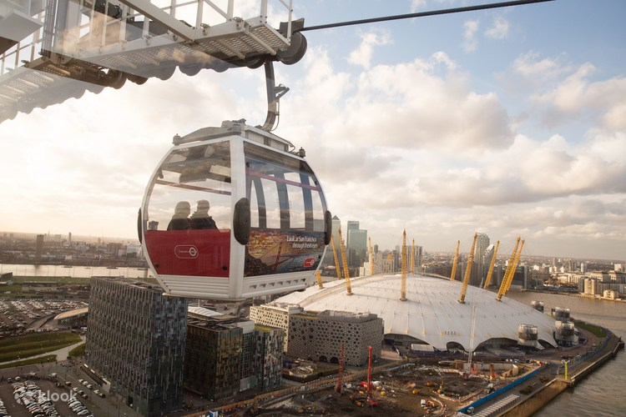

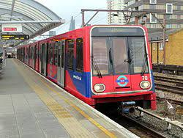
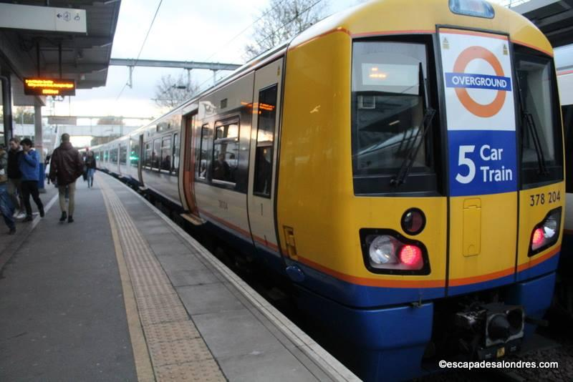
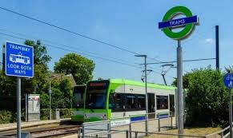
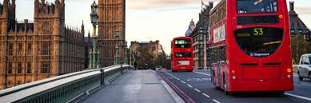
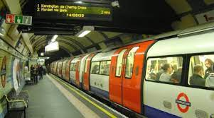
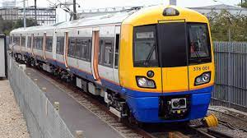
Chp.2 - Introduction (What is about)
Notes:
TODO
It would be too pretentious to say I discovered interesting things about TFL for London because I used a public dataset and the graph methods applied are well-known.
The only distinct new factor in this project is my good sense and my creativity that guided through modelling and analyzing a such efficient and complex system of transport.
The main objective is to rank edges relevance. In public system, it is natural that we think in collective relevance, but a single user do not think collectively when choosing how to commute. OK, you opt to bike to reduce CO2 emissions.
You will base you decision in your values but also to why you need to dislocate. But assumes it raining and it is cold and you need to go from A to B. Cost, time, CO2 emission, seated or standing, wi-fi connection … What drives a single users when choosing a path?
Very loosely, let’s say it time. Everyone seeks to spend as least time possible at the transport system. Why? Reason are not hard to be enummerated…
What drives operation when planning?
The sum of single users reflect the collectivity?
Single users opt for new path with minimum time, not to maximize the efficiency?
Firstly, I will apply a disparity filter to rank weighted connection between stations (edges) using a NetworkX.
Secondly, I will use Neo4J to run a lot of shortest path queries to assemble another edge ranking method, considering the same weight metrics.

Slide 5
Chp.3 - What it was conducted
Good sense:
The fastest lane should be those with higher number of passenger.
Service equality responsibility.
Additional cars should provisioned according to a given load.
New lines/routes should meet a efficiency measure that say more people arriving to their destination in less time, with less potential stress and, if possible, less energy consumption.
Data engineering:
- Collected data from TFL Unified API and NUMBAT Project. Combined data-sets from different sources and transformed so it could be modeled.
Data Modelling:
- Used Neo4J and NetworkX to model to run graph theory algorithm.
Data Analysis:
Assemble charts, maps, ranks and used statistics and correlation metrics to evaluate the results.
Conclusion:
- Acquired critic sense about the subject raising technical and moral questions about transport systems.
Notes:
TODO
What I have is results of trials which allows to compares different perspectives of a same transport system.
How it behaves in accordance to the day of the week or the time of the day. In other words, how edges relevance change accordingly the amount of people and disposal vehicles.
The speed is also relevant, but it will variate. The numerous interval_id map variety of travel time that a vehicle can reach it destiny based on the weekday and time of the day. I apologize for simplifying some of the meticulous information made available for the TFL.
Those simplification will be detailed in the Data chapter as well as the approaches used to encounter the ranks in the methodology section.
Later I will present and discuss the similarities and discrepancy of ranking methods and the transport system traffic variation. Finally, I also would like to present following steps and comment of the challenge of providing a efficient & equalitarian transportation service.

Slide 6
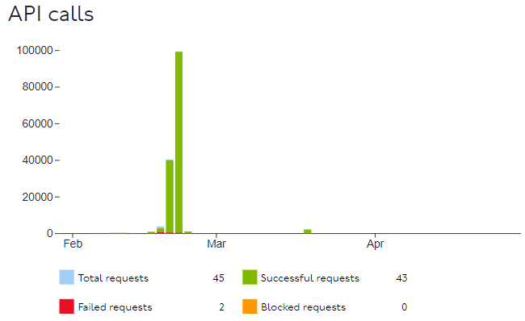

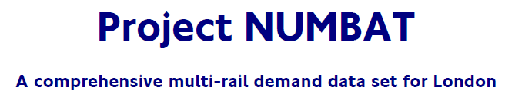
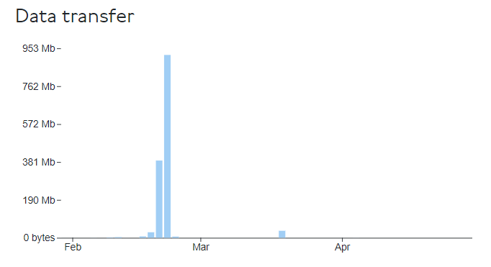
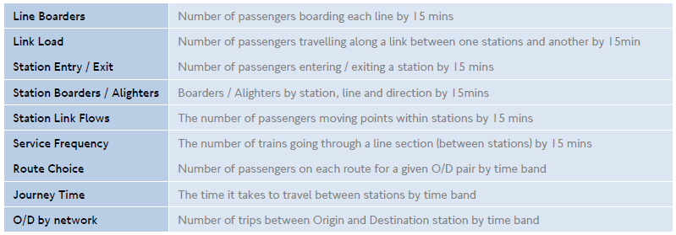
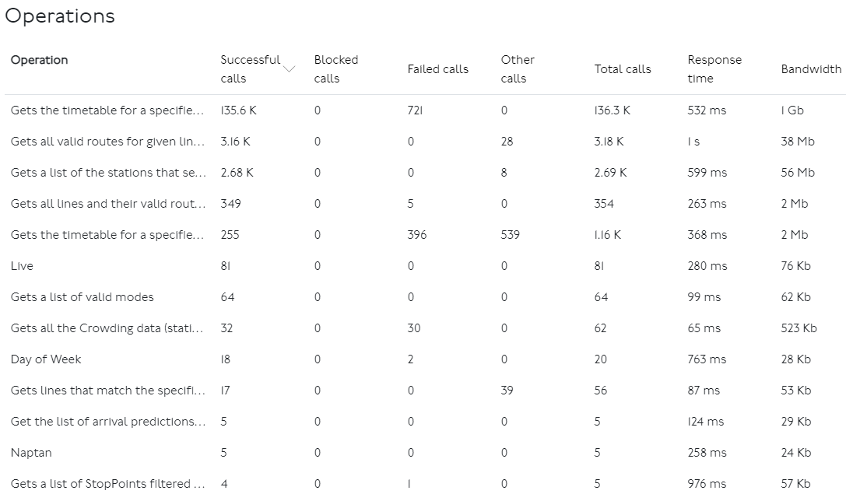
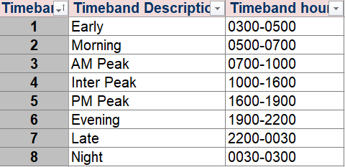
Chp.3 - Data
Notes:
TODO
Abou the data, chapter

Slide 7
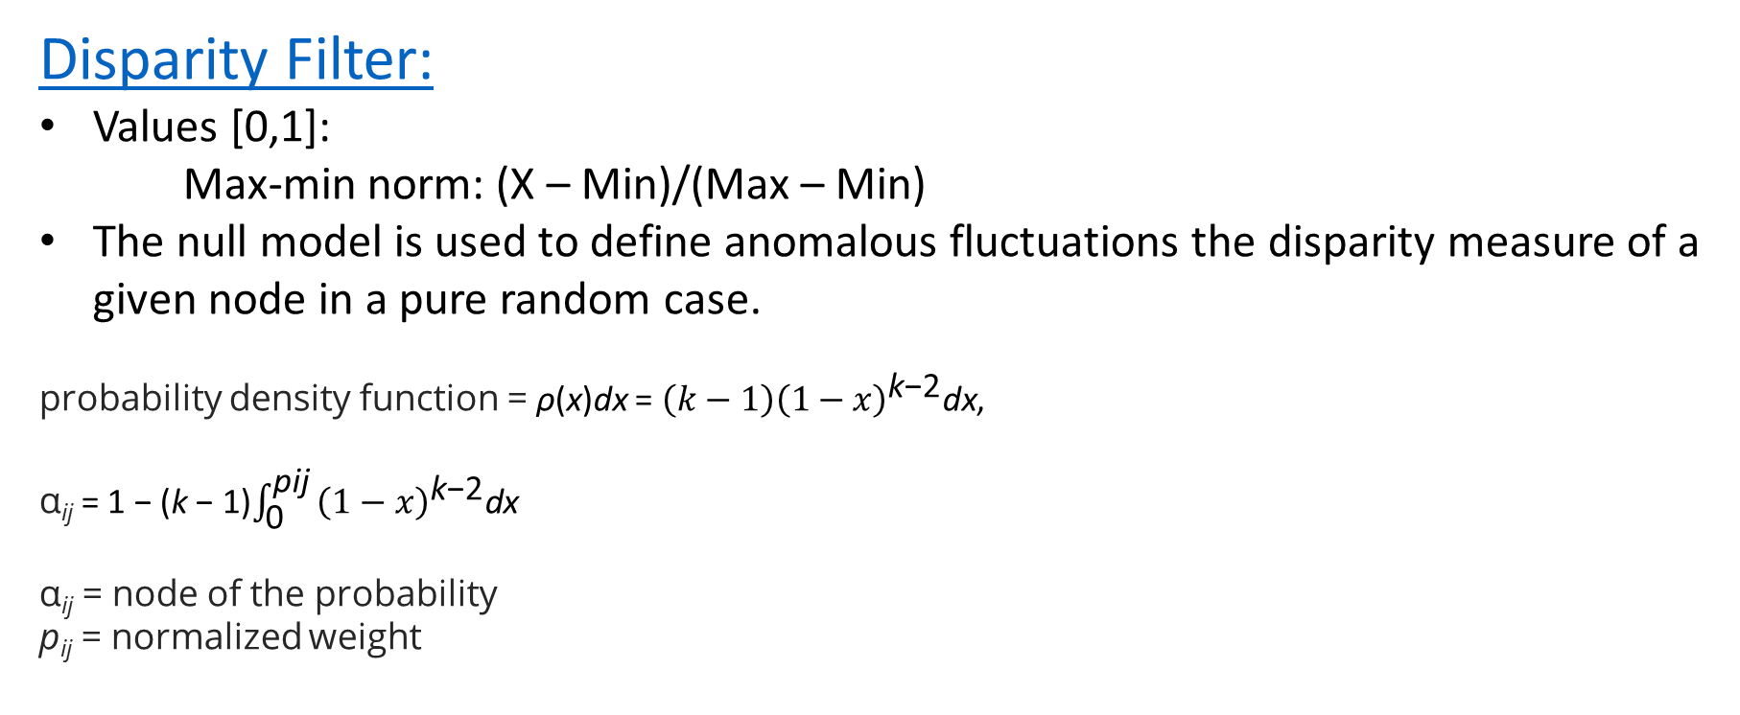
Chp.7 – Backbone Extraction Methodology
Disparity Filter:
Values [0,1]:
Max-min norm: (X – Min)/(Max – Min)
The null model is used to define anomalous fluctuations the disparity measure of a given node in a pure random case.
probability density function = ρ(x)dx = ${\left(k−1\right)\left(1−x\right)}^{\text{k}\text{−}\text{2}}\text{dx}$,
α_{ij} = 1 − (k − 1)$\int_{\text{0 }}^{\text{pij} }{{\left(1−x\right)}^{\text{k}\text{−}\text{2}}\text{dx}}$
α_{ij} = node of the probability
p_{ij} = normalized weight
Notes:
TODO
Ranking Methods:
Disparity Filter (Networkx):
It filters out edges deemed not compatible with a random distribution with a certain statistical significance (alpha).
This manner its possible to encounter different levels of heterogeneities.
Indicator: Efficient Indicator (weight), weight prob. distribution, statistical relevance, node strength, node degree,
Ranks: what are the most relevant edges in Collective angle.
*The disparity filter exploits local heterogeneity and local correlations among weights to extract the network backbone by considering the relevant edges at all the scales present in the system. The methodology preserves an edge whenever its intensity is a statistically not compatible with respect to a null hypothesis of uniform randomness for at least one of the two nodes the edge is incident to, which ensures that small nodes in terms of strength are not neglected. As result, the disparity filter reduces the number of edges in the original network significantly keeping, at the same time, almost all the weight and a large fraction of nodes. As well, this filter preserves the cut-off of the degree distribution, the form of the weight distribution, and the clustering coefficient.

Slide 8
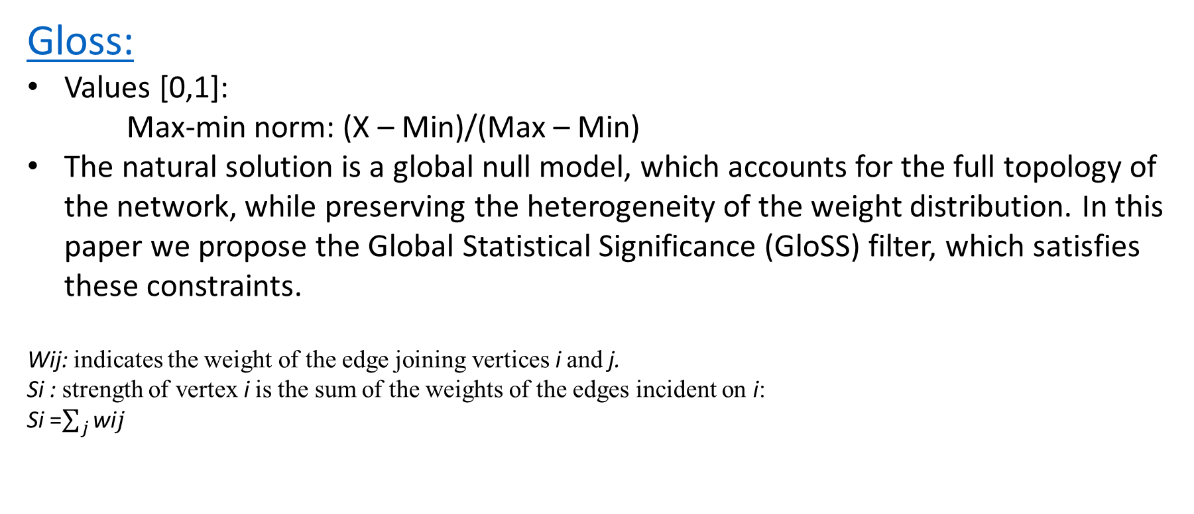
Chp.7 - Backbone Extraction Methodology
Gloss:
Values [0,1]:
Max-min norm: (X – Min)/(Max – Min)
The natural solution is a global null model, which accounts for the full topology of the network, while preserving the heterogeneity of the weight distribution. In this paper we propose the Global Statistical Significance (GloSS) filter, which satisfies these constraints.
Wij: indicates the weight of the edge joining vertices i and j.
Si : strength of vertex i is the sum of the weights of the edges incident on i:
Si =$\sum_{j}^{ }{\text{wi}j}$
Notes:
TODO

Slide 9
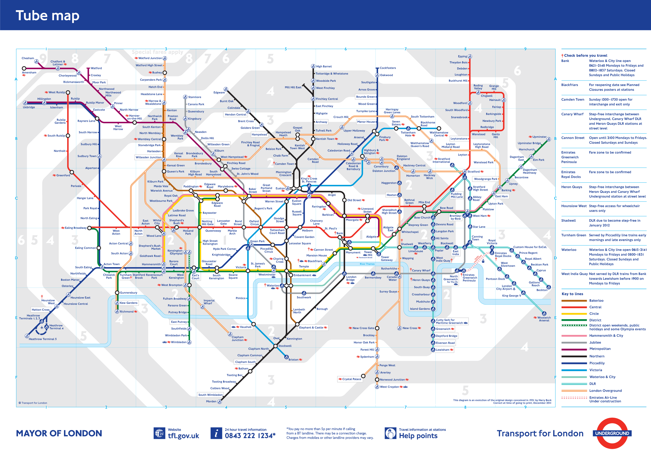
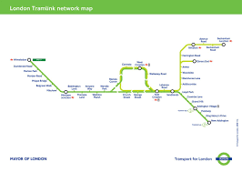
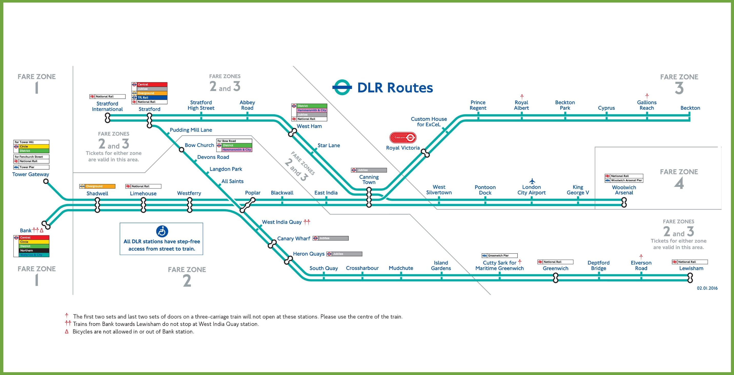
Chp.8 – Transport System Challenges
Is it possible to have a Systems with plannings (timetable and expansions) dynamically tailored to passenger's need?
TRAFFIC x ENGINEERING = Traffic ⬄ (Infra) x (Operations)
Fully connected
Single rides => More Rides => More Vehicles => More Energy => More CO2 => More Traffic => More TIME
Ideally connected (maps Org/Dest)
Vehicles Load Balance => Less Journeys
Path Redudancy => Less Stress
Notes:
TODO
“Before anything, I discovered that plan and operate an efficient transport system demands much more than what takes to use it.”
For that you need to thing in two things: TRAFFIC x ENGINEERING;
Then in three: Traffic ⬄ (Infra) x (Operations)
INFRA: what is the best possible infra-structure to serve the public?
OPERATIONS: what is the best strategy to optimizes the infra-strutures best serving the public?
I can already tell you that I do not have those answers.
A fully connected Net is the most efficient one. However, It has the highiest stress potentiel.

Slide 10
Chp.2 – Methodology – KPIs
The shortest path between Baker Street and Finchley Road is not its own edge.
Let's forget for a moment that the data is unrealistic, and pretend it is in fact what is happening.
From the journey time perspective, it the above mentioned will never be used. And, consequently, it's rupture won't cause any distress. The same happen for the following edges:
Notes:
TODO
Ranking Methods:
Disparity Filter (Networkx):
It filters out edges deemed not compatible with a random distribution with a certain statistical significance (alpha).
This manner its possible to encounter different levels of heterogeneities.
Indicator: Efficient Indicator (weight), weight prob. distribution, statistical relevance, node strength, node degree,
Ranks: what are the most relevant edges in Collective angle.
*The disparity filter exploits local heterogeneity and local correlations among weights to extract the network backbone by considering the relevant edges at all the scales present in the system. The methodology preserves an edge whenever its intensity is a statistically not compatible with respect to a null hypothesis of uniform randomness for at least one of the two nodes the edge is incident to, which ensures that small nodes in terms of strength are not neglected. As result, the disparity filter reduces the number of edges in the original network significantly keeping, at the same time, almost all the weight and a large fraction of nodes. As well, this filter preserves the cut-off of the degree distribution, the form of the weight distribution, and the clustering coefficient.
Shortest Path: (Neo4j):
Each edges will be ranked with the possible distress caused by its disruption. It means, the loss of time.
For that, it is necessary to take the user’s perspective. Thanks to NUMBAT dataset, it was possible to statically
recreate the of the user O/D route at each segment.
Indicator: Times (the less possible)
Ranks: what are the most relevant edges in User angle. The ones that saves more journey time.
Comparison Method:
→ Kendall Correlation Coefficient

Slide 11
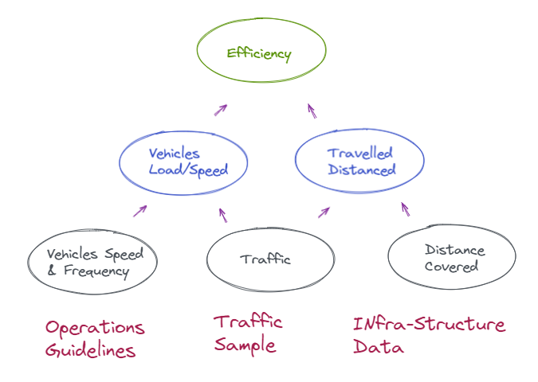
Chp.2 – Methodology – KPIs – Operation
Notes:
TODO
Ranking Methods:
Disparity Filter (Networkx):
It filters out edges deemed not compatible with a random distribution with a certain statistical significance (alpha).
This manner its possible to encounter different levels of heterogeneities.
Indicator: Efficient Indicator (weight), weight prob. distribution, statistical relevance, node strength, node degree,
Ranks: what are the most relevant edges in Collective angle.
*The disparity filter exploits local heterogeneity and local correlations among weights to extract the network backbone by considering the relevant edges at all the scales present in the system. The methodology preserves an edge whenever its intensity is a statistically not compatible with respect to a null hypothesis of uniform randomness for at least one of the two nodes the edge is incident to, which ensures that small nodes in terms of strength are not neglected. As result, the disparity filter reduces the number of edges in the original network significantly keeping, at the same time, almost all the weight and a large fraction of nodes. As well, this filter preserves the cut-off of the degree distribution, the form of the weight distribution, and the clustering coefficient.
Shortest Path: (Neo4j):
Each edges will be ranked with the possible distress caused by its disruption. It means, the loss of time.
For that, it is necessary to take the user’s perspective. Thanks to NUMBAT dataset, it was possible to statically
recreate the of the user O/D route at each segment.
Indicator: Times (the less possible)
Ranks: what are the most relevant edges in User angle. The ones that saves more journey time.
Comparison Method:
→ Kendall Correlation Coefficient

Slide 12
Chp.2 – Methodology – Operation KPIs
Infra-Structure:
Segment Length [km]
Operation:
Segment Speed [km/h] = [Length] * 60 / [Time in minutes]
Segment Frequency [Trains/h] = [#Trains per period] / [# Hour of Period]
Period Average Traffic:
Segment Hourly Average Passenger [Passengers/h] = [# Passenger] / [# Hour of Period]
Period Average Distance Travelled:
Segment Hourly Average Distance Travelled [Passengers*km] = [Passengers] *[Length]
Period Average Load:
Segment Hourly Average Load [Passengers/Train] = [Passengers] / [Frequency]
Period Average Flow:
Segment Hourly Average Flow [(Passengers/Train)*(km/h)] = [Load]*[Segment Speed]
Period Average Efficiency:
Segment Hourly Average Efficiency [(Passengers/Train)*(km/h)] = [Load] * [Segment Speed] * [Length]
Notes:
TODO
Ranking Methods:
Disparity Filter (Networkx):
It filters out edges deemed not compatible with a random distribution with a certain statistical significance (alpha).
This manner its possible to encounter different levels of heterogeneities.
Indicator: Efficient Indicator (weight), weight prob. distribution, statistical relevance, node strength, node degree,
Ranks: what are the most relevant edges in Collective angle.
*The disparity filter exploits local heterogeneity and local correlations among weights to extract the network backbone by considering the relevant edges at all the scales present in the system. The methodology preserves an edge whenever its intensity is a statistically not compatible with respect to a null hypothesis of uniform randomness for at least one of the two nodes the edge is incident to, which ensures that small nodes in terms of strength are not neglected. As result, the disparity filter reduces the number of edges in the original network significantly keeping, at the same time, almost all the weight and a large fraction of nodes. As well, this filter preserves the cut-off of the degree distribution, the form of the weight distribution, and the clustering coefficient.
Shortest Path: (Neo4j):
Each edges will be ranked with the possible distress caused by its disruption. It means, the loss of time.
For that, it is necessary to take the user’s perspective. Thanks to NUMBAT dataset, it was possible to statically
recreate the of the user O/D route at each segment.
Indicator: Times (the less possible)
Ranks: what are the most relevant edges in User angle. The ones that saves more journey time.
Comparison Method:
→ Kendall Correlation Coefficient

Slide 13
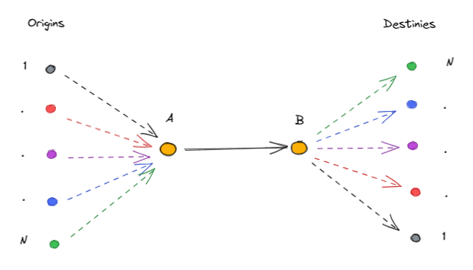
Chp.2 – Methodology – End-User KPIs
Path With the Shortest Time:
Calculate the path with shortest time for all Origins & Destinies;
For each segment, generate a list all Origins & Destinies connected;
For each segment, calculate the Origins & Destinies time ;
For each segment, calculate the Origins & Destinies traffic percentage;
Deviated Path With the Shortest Time:
Remove the segment
For each Origins & Destinies previously connected, re-calculate the time;
For each Origins & Destinies previously connected, calculate the increased time;
Weight the increased time of each Origins & Destinies by traffic percentage;
Sum all Origins & Destinies Weighted time and multiply by the segment traffic;
Human Time Distress per segment
Notes:
TODO
Ranking Methods:
Disparity Filter (Networkx):
It filters out edges deemed not compatible with a random distribution with a certain statistical significance (alpha).
This manner its possible to encounter different levels of heterogeneities.
Indicator: Efficient Indicator (weight), weight prob. distribution, statistical relevance, node strength, node degree,
Ranks: what are the most relevant edges in Collective angle.
*The disparity filter exploits local heterogeneity and local correlations among weights to extract the network backbone by considering the relevant edges at all the scales present in the system. The methodology preserves an edge whenever its intensity is a statistically not compatible with respect to a null hypothesis of uniform randomness for at least one of the two nodes the edge is incident to, which ensures that small nodes in terms of strength are not neglected. As result, the disparity filter reduces the number of edges in the original network significantly keeping, at the same time, almost all the weight and a large fraction of nodes. As well, this filter preserves the cut-off of the degree distribution, the form of the weight distribution, and the clustering coefficient.
Shortest Path: (Neo4j):
Each edges will be ranked with the possible distress caused by its disruption. It means, the loss of time.
For that, it is necessary to take the user’s perspective. Thanks to NUMBAT dataset, it was possible to statically
recreate the of the user O/D route at each segment.
Indicator: Times (the less possible)
Ranks: what are the most relevant edges in User angle. The ones that saves more journey time.
Comparison Method:
→ Kendall Correlation Coefficient

Slide 14
Chp.2 - Methodology
Path With the Shortest Time:
With all Origins and Destinies shortest path time:
AB_time = { OD_1=time_1, OD_2=time_2, OD_3=time_3, OD_4=time_4, OD_5=time_5 }
AB = [ OD_1, OD_2, OD_3, OD_4, OD_5 ]
AB_Traffic_weighted = { OD_1=per1, OD_2=per2, OD_3=per4, OD_4=per4, OD_5=per5 }
Deviated Path With the Shortest Time:
Remove the segment
AB_time' = { OD_1=time_1', OD_2=time_2', OD_3=time_3', OD_4=time_4', OD_5=time_5’ }
AB_delta = { OD_1=delta _1, OD_2=delta _2, … , OD_5=delta _5}
AB_weigthed_delta = delta_1'*per1 + … + delta_5'*per5
AB Human Distress = AB_weigthed_delta * traffic;
Notes:
TODO
Ranking Methods:
Disparity Filter (Networkx):
It filters out edges deemed not compatible with a random distribution with a certain statistical significance (alpha).
This manner its possible to encounter different levels of heterogeneities.
Indicator: Efficient Indicator (weight), weight prob. distribution, statistical relevance, node strength, node degree,
Ranks: what are the most relevant edges in Collective angle.
*The disparity filter exploits local heterogeneity and local correlations among weights to extract the network backbone by considering the relevant edges at all the scales present in the system. The methodology preserves an edge whenever its intensity is a statistically not compatible with respect to a null hypothesis of uniform randomness for at least one of the two nodes the edge is incident to, which ensures that small nodes in terms of strength are not neglected. As result, the disparity filter reduces the number of edges in the original network significantly keeping, at the same time, almost all the weight and a large fraction of nodes. As well, this filter preserves the cut-off of the degree distribution, the form of the weight distribution, and the clustering coefficient.
Shortest Path: (Neo4j):
Each edges will be ranked with the possible distress caused by its disruption. It means, the loss of time.
For that, it is necessary to take the user’s perspective. Thanks to NUMBAT dataset, it was possible to statically
recreate the of the user O/D route at each segment.
Indicator: Times (the less possible)
Ranks: what are the most relevant edges in User angle. The ones that saves more journey time.
Comparison Method:
→ Kendall Correlation Coefficient

Slide 15
Chp.2 - Methodology
Path With the Shortest Time:
With all Origins and Destinies shortest path time:
AB_time = { OD_1=time_1, OD_2=time_2, OD_3=time_3, OD_4=time_4, OD_5=time_5 }
AB = [ OD_1, OD_2, OD_3, OD_4, OD_5 ]
AB_Traffic_weighted = { OD_1=per1, OD_2=per2, OD_3=per4, OD_4=per4, OD_5=per5 }
Deviated Path With the Shortest Time:
Remove the segment
AB_time' = { OD_1=time_1', OD_2=time_2', OD_3=time_3', OD_4=time_4', OD_5=time_5’ }
AB_delta = { OD_1=delta _1, OD_2=delta _2, … , OD_5=delta _5}
AB_weigthed_delta = delta_1'*per1 + … + delta_5'*per5
AB Human Distress = AB_weigthed_delta * traffic;
Notes:
TODO
Ranking Methods:
Disparity Filter (Networkx):
It filters out edges deemed not compatible with a random distribution with a certain statistical significance (alpha).
This manner its possible to encounter different levels of heterogeneities.
Indicator: Efficient Indicator (weight), weight prob. distribution, statistical relevance, node strength, node degree,
Ranks: what are the most relevant edges in Collective angle.
*The disparity filter exploits local heterogeneity and local correlations among weights to extract the network backbone by considering the relevant edges at all the scales present in the system. The methodology preserves an edge whenever its intensity is a statistically not compatible with respect to a null hypothesis of uniform randomness for at least one of the two nodes the edge is incident to, which ensures that small nodes in terms of strength are not neglected. As result, the disparity filter reduces the number of edges in the original network significantly keeping, at the same time, almost all the weight and a large fraction of nodes. As well, this filter preserves the cut-off of the degree distribution, the form of the weight distribution, and the clustering coefficient.
Shortest Path: (Neo4j):
Each edges will be ranked with the possible distress caused by its disruption. It means, the loss of time.
For that, it is necessary to take the user’s perspective. Thanks to NUMBAT dataset, it was possible to statically
recreate the of the user O/D route at each segment.
Indicator: Times (the less possible)
Ranks: what are the most relevant edges in User angle. The ones that saves more journey time.
Comparison Method:
→ Kendall Correlation Coefficient

Slide 16
Chp.2 – Methodology – Comparisson
Comparison Method:
Kendall correlation coefficient
Notes:
TODO
Comparison Method:
→ Kendall Correlation Coefficient

Slide 17
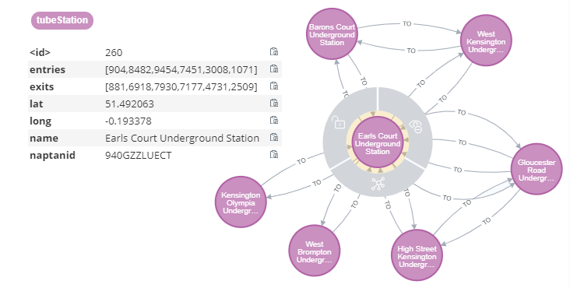
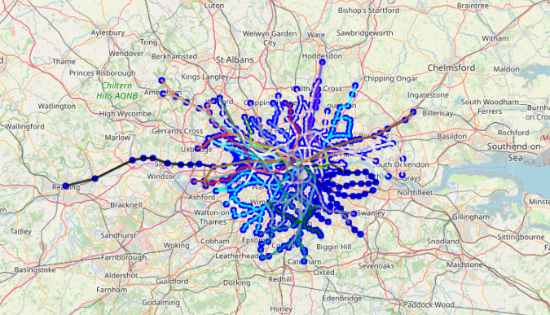
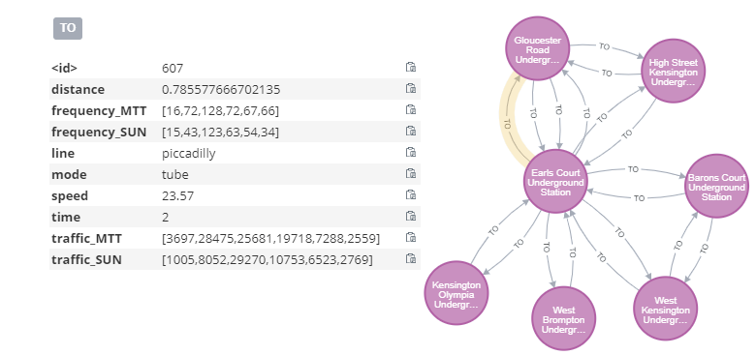
Chp.4 - Modelling
Notes:
TODO

Slide 18
Chp.4 – Modelling – Centrality by mode
Notes:
TODO

Slide 19
Chp.5 - Results
Toy disparity and ranking: speed and distance
(DLR, OverGround, Tube)
Notes:
TODO
Explain example DLR distance (JCD Team)
Show statistic: distance, speed

Slide 20
Chp.5 - Results
→ Traffic
Enter/Exists in stations (Networkx)
Notes:
TODO
Show statistic graph: Enter/Exists in stations (Networkx)
Show statistic charts: traffic, loads, traffic_distance

Slide 21
Chp.5 - Results
Inbound & Outbound Traffic: Morning (5-7) x Evening (19-22)
(DLR, OverGround, Tube)
MTT, FRI, SAT and SUN
Notes:
TODO

Slide 22
Chp.5 - Results
Operational: Speed & Frequency
Histogram (charts)
Maps (Networkx)
Notes:
Operational: Speed & Frequency
Histogram (charts) weight
Maps (Networkx)

Slide 23
Chp.5 - Results
→ User importance:
Efficience ranking comparison
Notes:
Operational: Speed & Frequency
Histogram (charts) weight
Maps (Networkx)
→ Traffic
Enter/Exists in stations (Networkx)
Load in segments (Networkx)
→ User importance:
Disparity ranking comparison
→ Collective importance:
Distress ranking comparison

Slide 24
Chp.5 - Results
→ Collective importance:
Distress ranking comparison
Notes:
Operational: Speed & Frequency
Histogram (charts) weight
Maps (Networkx)
→ Traffic
Enter/Exists in stations (Networkx)
Load in segments (Networkx)
→ User importance:
Disparity ranking comparison
→ Collective importance:
Distress ranking comparison

Slide 25
Chp.6 - Following Steps
1) Interconnect all possible modes of transport including bikes and walks.
2) Use ML models for predictions of:
TRAFFIC: Passenger flow: From network lens (keeping passenger anonymity) , use more data (daily events) to more accurately understand why traffic is generated in each segments;
OPEX: Predict disruptions and its impact considering forecasted passenger traffic to optimize maintenance planning.
Create a timetable dynamically tailored that optimize infra-structure towards the commuters needs.
CAPEX: More maintenance, less disruptions, less need for redundancy and more investment express lanes (study of origin and destination). A study considering entries and exist of studies.
Notes:
1) Interconnect all possible modes of transport including bikes and walks.
2) Use ML models for predictions of:
TRAFFIC: Passenger flow: From network lens (keeping passenger anonymity) , use more data (daily events) to more accurately understand why traffic is generated in each segments;
OPEX: Predict disruptions and its impact considering forecasted passenger traffic to optimize maintenance planning.
Create a timetable dynamically tailored that optimize infra-structure towards the commuters needs.
CAPEX: More maintenance, less disruptions, less need for redundancy and more investment express lanes (study of origin and destination).

Slide 26
Chp.7 - Conclusion
It is not necessary related to its size. But is related to how it was projected to assist the commuters.
Proper maintenances can reduce the number of disruption, for instance, it would be a waste invest in redundancies. More money could be destinated to reduce travels time.
In a real world, however, no disruptions comes with a high maintenance price.
The balance between effectiveness and robustness is a major question when comes down to a such important factor of the society evolvement.
Notes:
What is a efficient network = minimizes travel time and costs (vehicles, energy, emissions, price) assuring passenger “comfort” and “prompt mobility”.
It is important to mention that a more efficient network inherently requires more maintenance.
It is not necessary related to its size. But is related to how it was projected to assist the commuters.
In a network without disruption, for instance, it would be a waste invest in redundancies. More money could be destinated to reduce travels time.
In a real world, however, no disruptions comes with a high maintenance price.
The balance between effectiveness and robustness is a major question when comes down to a such important factor of the society evolvement.

Slide 27
Dissertation – Shortest Path Anomalies
The shortest path between Baker Street and Finchley Road is not its own edge.
Let's forget for a moment that the data is unrealistic, and pretend it is in fact what is happening.
From the journey time perspective, it the above mentioned will never be used. And, consequently, it's rupture won't cause any distress. The same happen for the following edges:
(9, 80) | 940GZZLUBST | 940GZZLUFYR
(11, 138) | 940GZZLUBNK
(11, 149) | 940GZZLUBNK
(34, 76) | 940GZZLUCTN
(71, 119) | 940GZZLUEAC | 940GZZLUKNG
(80, 9) | 940GZZLUFYR | 940GZZLUBST
(119, 71) | 940GZZLUKNG | 940GZZLUEAC
(129, 202) | 940GZZLUKNB
(138, 11) |  | 940GZZLUBNK
(149, 11) |  | 940GZZLUBNK
(202, 129)
(231, 94)
Notes:
TODO
Abou the data, chapter

Slide 28
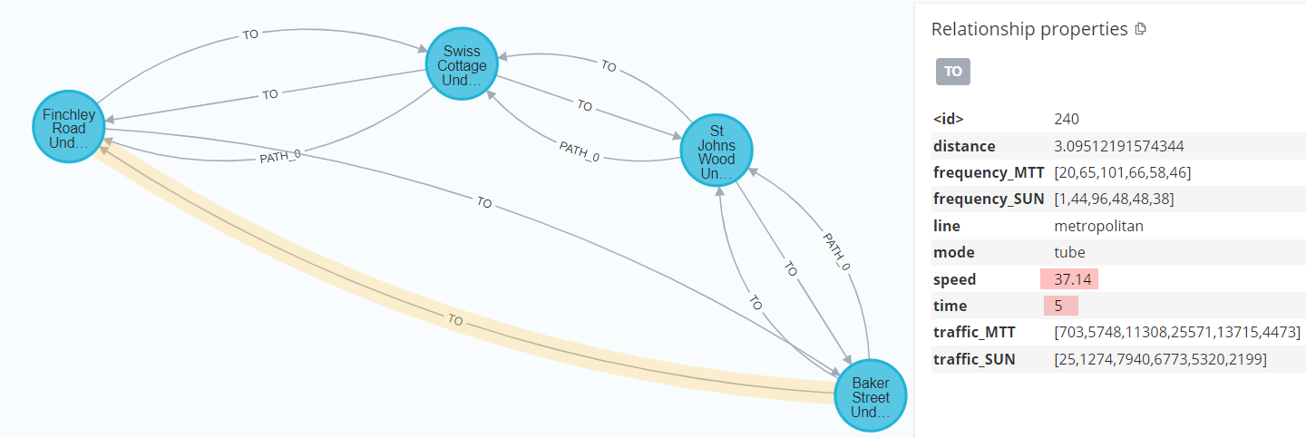
However, it's not always the case in our data. We kept it respecting the data source and we will use it to illustrate the validity of the mode.
Take by example the following subgraph:
Notes:
TODO
Abou the data, chapter

Slide 29
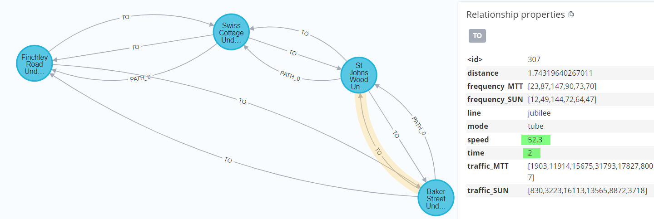
However, it's not always the case in our data. We kept it respecting the data source and we will use it to illustrate the validity of the mode.
Take by example the following subgraph:
Notes:
TODO
Abou the data, chapter

Slide 30
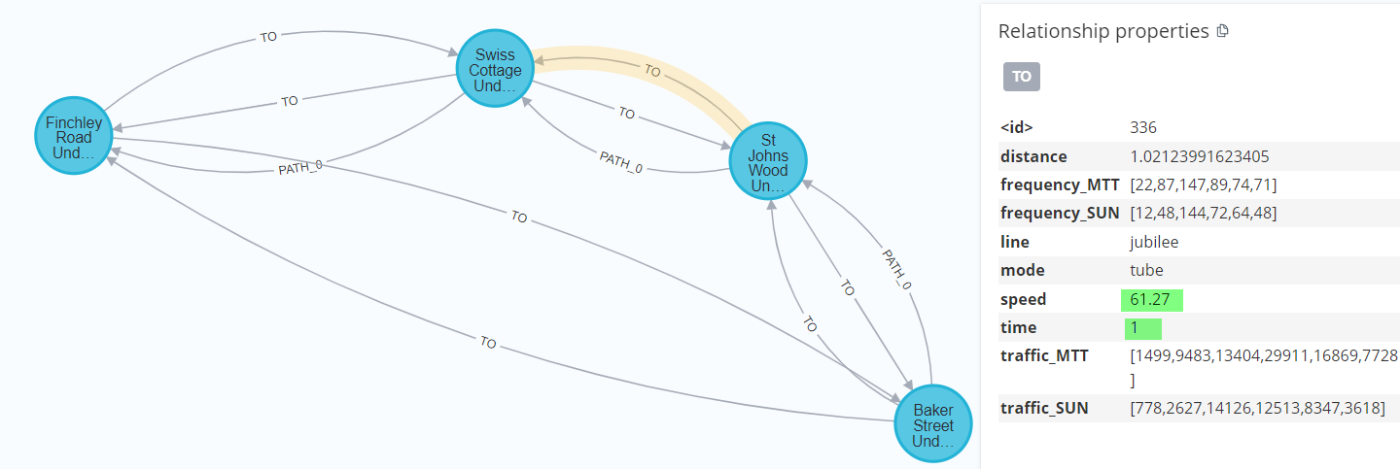
However, it's not always the case in our data. We kept it respecting the data source and we will use it to illustrate the validity of the mode.
Take by example the following subgraph:
Notes:
TODO
Abou the data, chapter

Slide 31
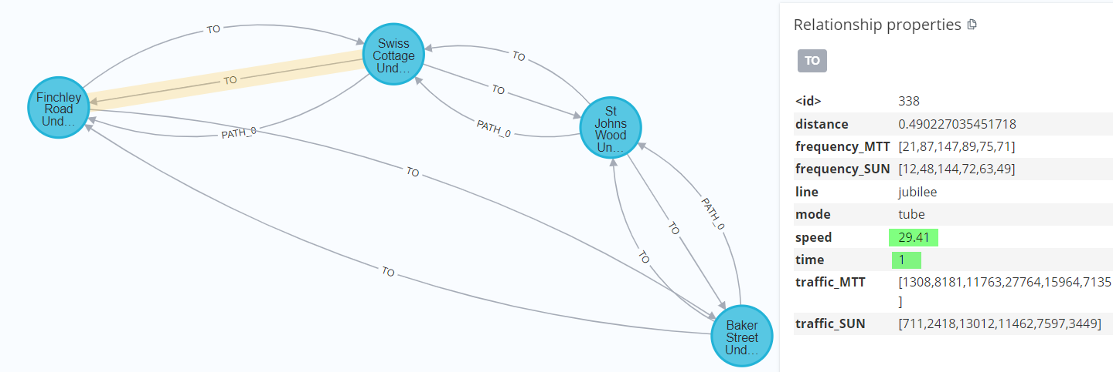
However, it's not always the case in our data. We kept it respecting the data source and we will use it to illustrate the validity of the mode.
Take by example the following subgraph:
Notes:
TODO
Abou the data, chapter

