Slide 1
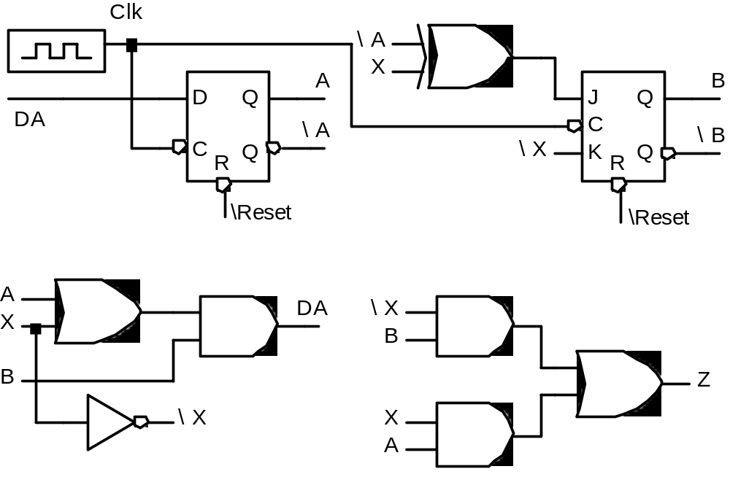
Moore and Mealy Machines
Reverse Engineering a Mealy Machine
Input X, Output Z, State A, B
State register consists of D FF and J-K FF

