Slide 1
Introduction to Deep Learning

Slide 2
Overview
Goal: Provide an introduction to deep learning concepts and how they can be applied to enhanced forest inventories (EFIs)

Slide 3
Overview
By the end of this section, you should be able to:
Explain the role of AI in EFI modelling
Distinguish AI, machine learning, and deep learning
Describe the structure of a deep neural network
Explain how models learn (loss, gradients, epochs)
Compare image-based vs. point-based deep learning
Use core deep learning terminology correctly
Recognize common forestry-specific challenges

Slide 4
What Is Deep Learning?

Slide 5
Artificial Intelligence → Machine Learning → Deep Learning
Artificial Intelligence (AI): Systems that mimic human decision-making
Machine Learning (ML): Models that improve through data-driven experience
Deep Learning (DL): ML using neural networks with many hidden layers

Slide 6
Deep Neural Networks: Key Concepts

Slide 7
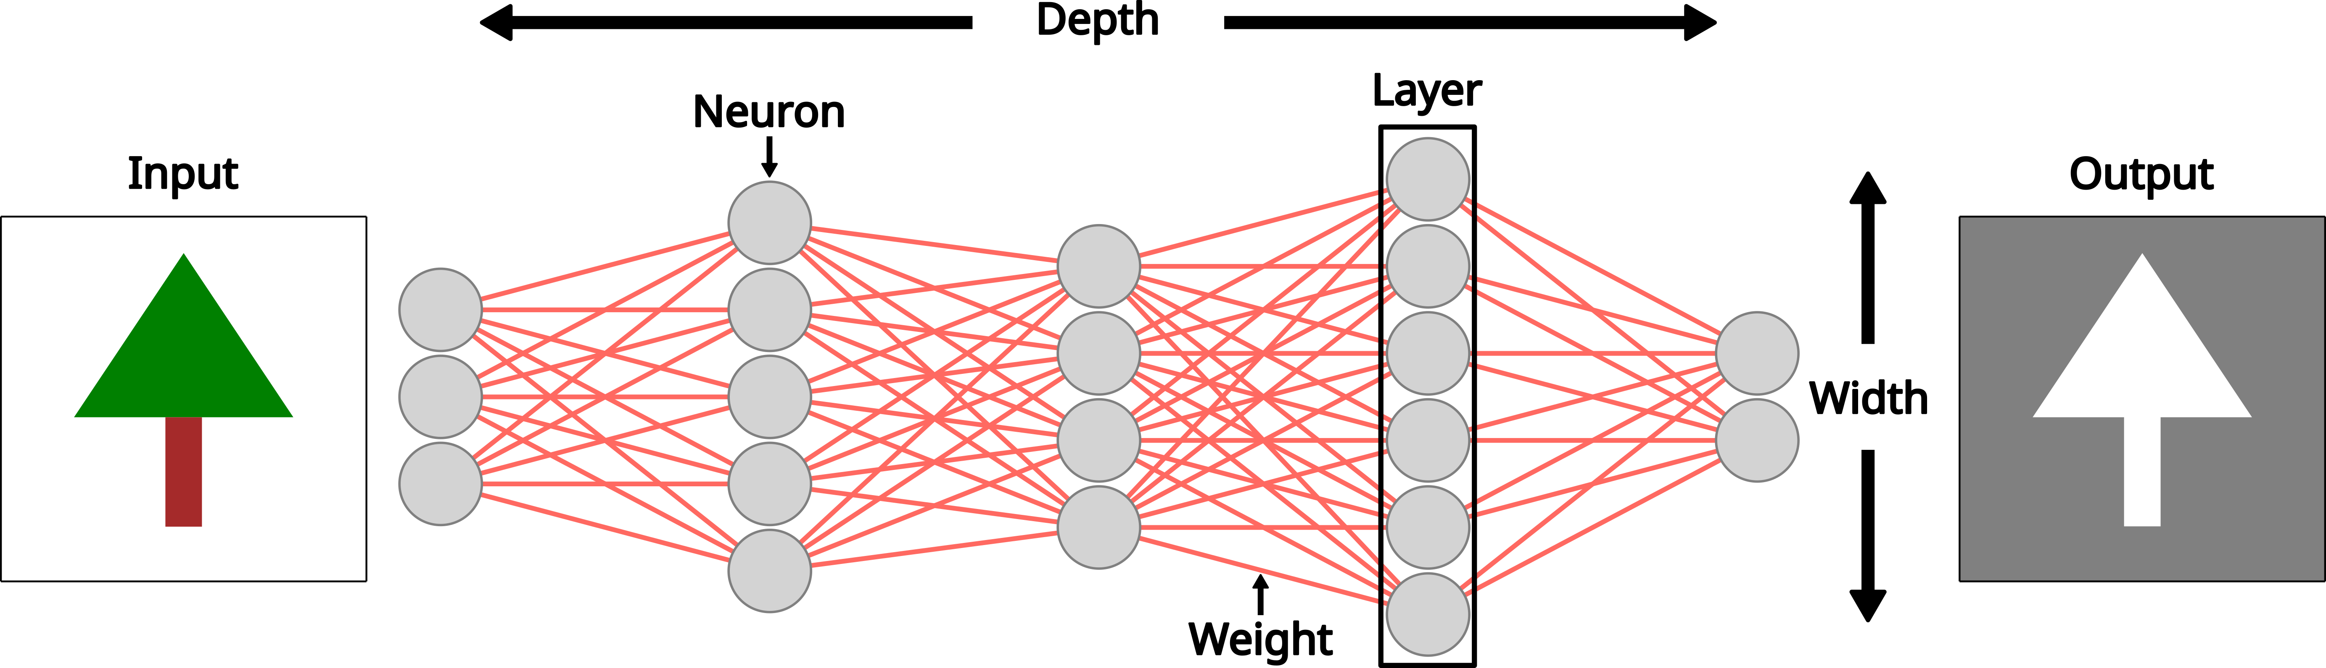
Neural Network Components
Layers: Input → hidden → output
Depth: Number of layers
Width: Number of neurons per layer

Slide 8
Neural Network Components
Trade-offs:
Increases in depth/width → increase representational power
Increases in depth/width → increase computation, overfitting risk

Slide 9
The Neuron
Fundamental unit of a neural network
Computes a weighted sum of inputs plus a bias
$$
\Large y = w_1x_1 + w_2x_2 + b
$$
Weights & biases are learned during training

Slide 10
Activation Functions
Applied to neuron output
Introduce non-linearity
Enable learning of complex relationships
Note
There are many types of activation functions, and you are encouraged to research which one would be best for your specific use case.

Slide 11
How Do Neural Networks Learn?

Slide 12
Prediction–Feedback Loop
The prediction-feedback loop is what makes learning possible as a deep neural network adapts to the patterns within the data and generalizes from them.

Slide 13
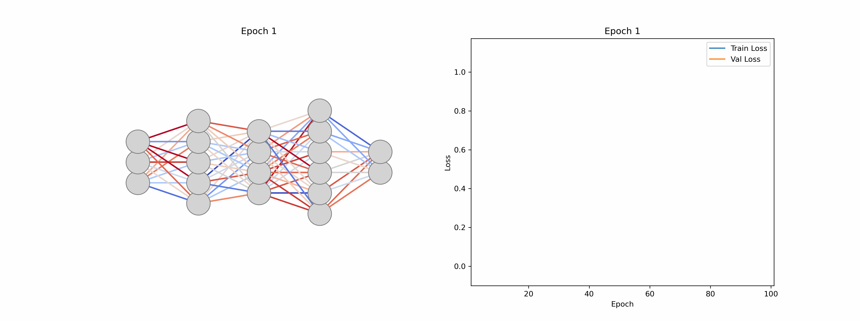
Goal: Loss, Gradients, and Epochs
Learning is driven by the loss function which guides the adjustments of the weights/biases over a number of epochs.
Loss function: Measures prediction error
Gradients: Sensitivity of loss to small changes in weights/bias
Epoch: One full pass through the training data

Slide 14
Common Deep Learning Tasks
Learning is guided by defining what the task to be accomplished is.
Classification
Regression
Segmentation

Slide 15
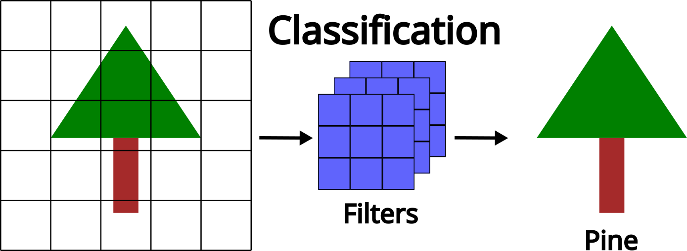
Task: Classification
Goal: Assign inputs to discrete classes
Forestry examples:
Tree species mapping
Land cover classification
Disturbance detection

Slide 16
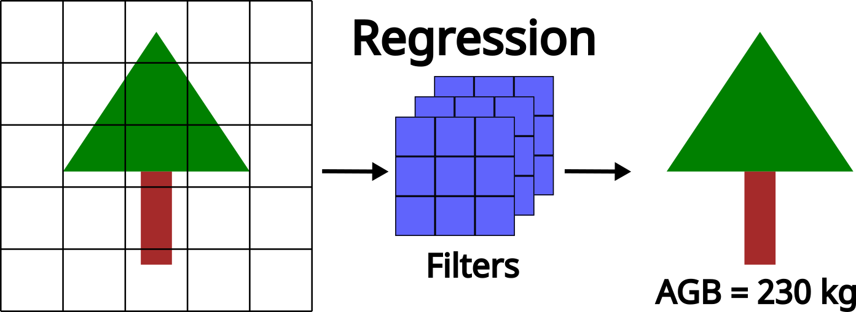
Task: Regression
Goal: Predict continuous values
Forestry examples:
Above-ground biomass
Canopy cover / LAI
Tree height, crown size

Slide 17
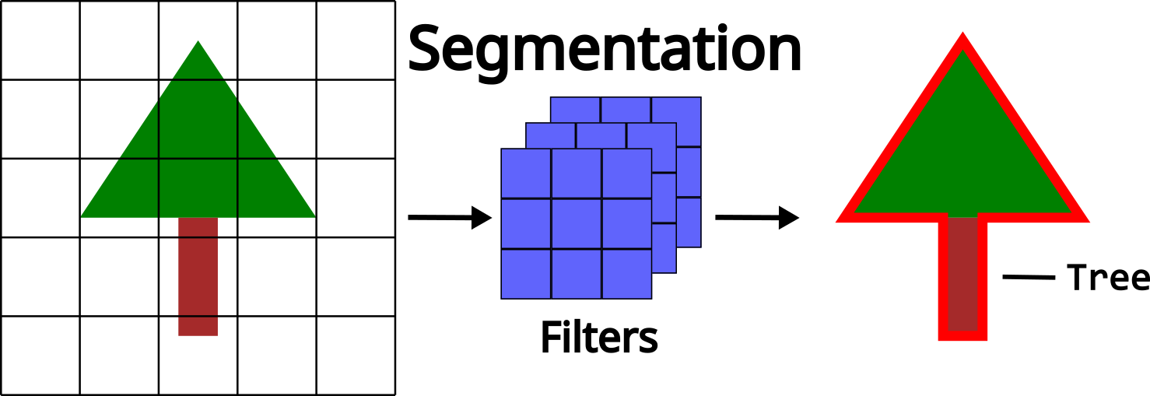
Task: Segmentation
Goal: Assign labels to every pixel or point
Forestry examples:
Tree crown delineation
Stand boundaries
Structural mapping

Slide 18
Data: Training, Validation, Testing
Learning happens through patterns identified in the data.
Training: Learn parameters
Validation: Tune hyperparameters, prevent overfitting
Testing: Final, unbiased performance estimate
Note
Never mix training, validation, and testing data. Mixing or reusing data between these datasets can lead to misleading performance metrics and poor generalization.

Slide 19
Image-Based vs. Point-Based Deep Learning
Two dominant approaches in remote sensing:
Image-based methods
Point-based methods

Slide 20
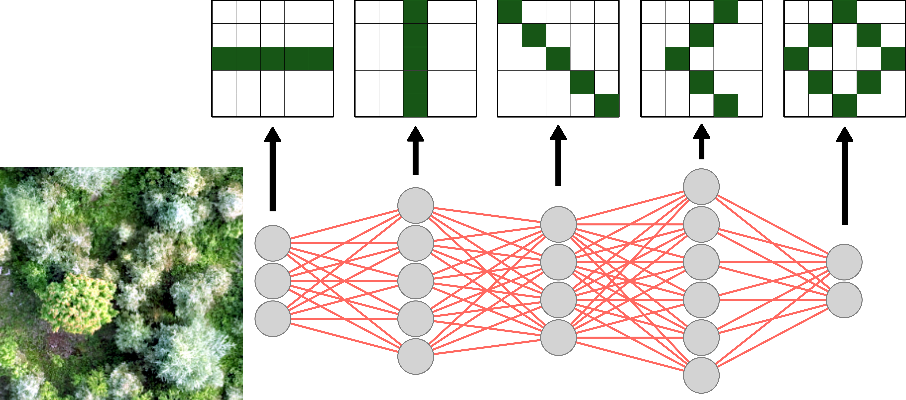
Image-Based Deep Learning
Operates on raster imagery
Learns spatial patterns and textures
Common inputs: RGB, multispectral, hyperspectral

Slide 21
Convolutional Neural Networks (CNNs)
Core image-based architecture
Use sliding filters (kernels)
Detect edges → textures → objects

Slide 22
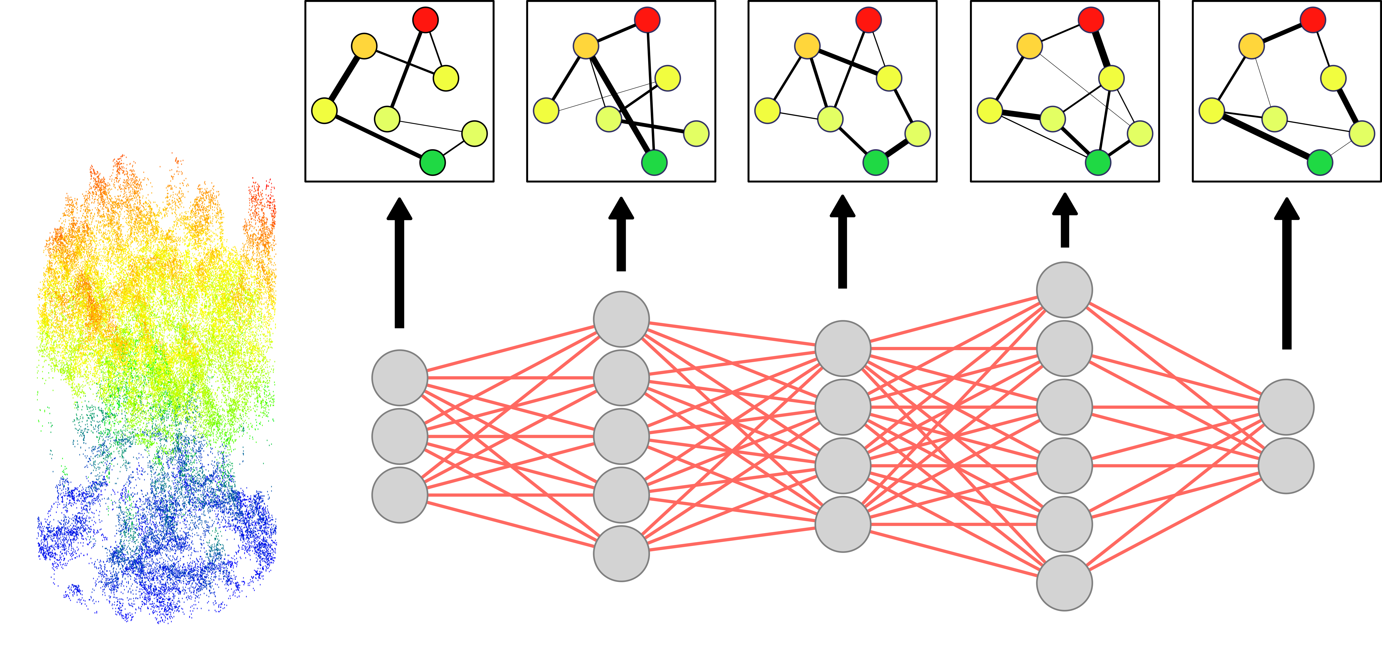
Point-Based Deep Learning
Operates directly on 3D point clouds
No regular grid structure
Learns from spatial relationships

Slide 23
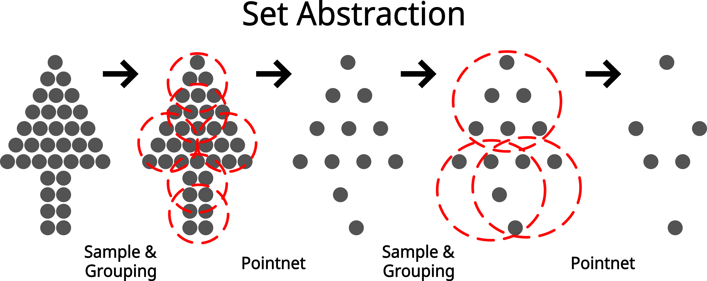
Set Abstraction
Common point-based architecture
Group nearby points instead of grids
Learn local geometry → shapes → objects

Slide 24
Core Terminology
Establishing shared language before workflows and modeling.

Slide 25
Parameters vs. Hyperparameters
Parameters: Learned values (weights, biases)
Hyperparameters: User-defined settings
  Learning rate
  Batch size
  Epochs
  Model depth

Slide 26
Inputs, Labels, Learned Features
Input features: What the model sees
Labels: What the model predicts
Learned features: Internal representations
Logits: Outputs of the final layer of a model

Slide 27
Data Augmentation
Artificially increases training diversity
Improves robustness and generalization
Especially useful with limited labels

Slide 28
Batches and Batch Size
Data processed in small subsets (batches)
Batch size: Samples per training step

Slide 29
Architecture vs. Weights
Architecture: Model/network structure (fixed)
  Number and type of layers
  How neurons/layers connect
Weights: Learned numerical values (changes)
  Updated during training
  Learned based on data

Slide 30
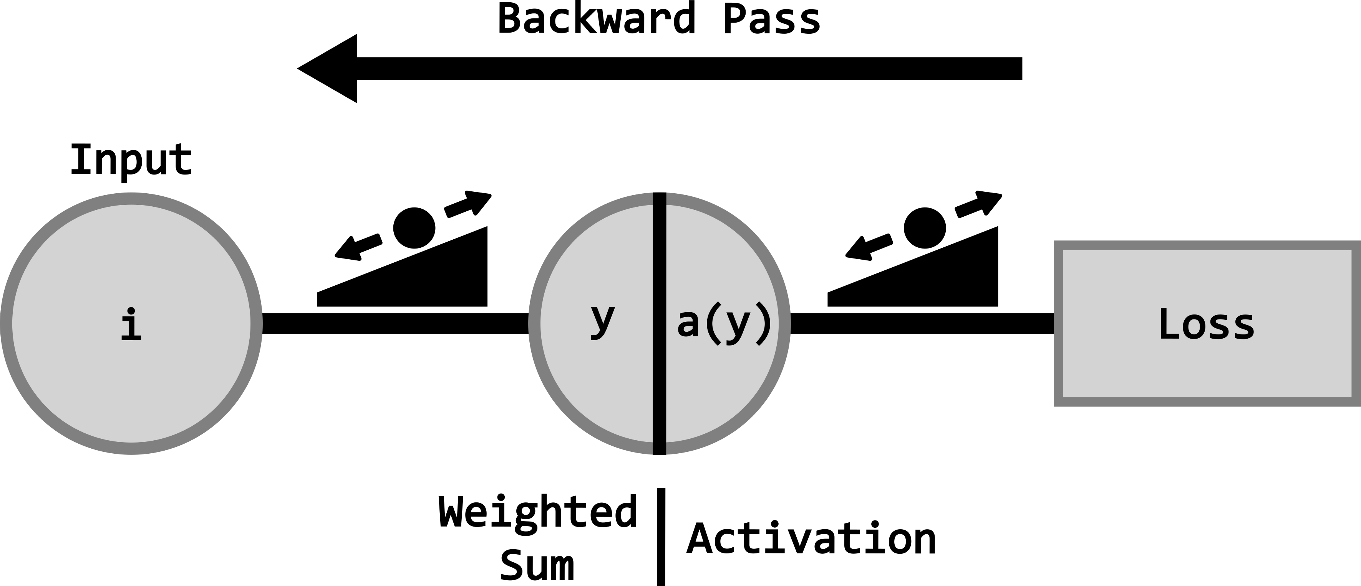
Training Loop
Repeated cycle until optimal point reached:
Forward pass (predict)
Loss computation (assess)
Backward pass (feedback)
Parameter update (adjust)

Slide 31
Transfer Learning and Fine-Tuning
Transfer learning: Start from pretrained model
Fine-tuning: Adapt weights to your domain
Common in forestry due to limited labeled data.

Slide 32
Deep Learning in Forestry: Challenges
Forestry data introduce domain-specific constraints.

Slide 33
Key Challenges and Considerations
Challenge | Impact | Common Solutions
Sensor & site variability | Poor generalization | Fine-tuning, domain adaptation
Spatial autocorrelation | Inflated accuracy | Spatial CV, sampling strategies
Class imbalance | Bias toward majority classes | Class weighting, loss design
Synthetic benchmarks | Limited real-world transfer | Domain adaptation
Limited labels | Reduced robustness | Augmentation, transfer learning

Slide 34
Important
Human expertise is essential in AI-derived forest inventories because models do not define objectives, meaning, or validity on their own. Forestry knowledge is required to select appropriate data, define training and modelling approaches, and interpret outputs/results ensuring they are scientifically sound, enabling deep learning to serve as a powerful tool for informed forest management decision-making.

