Slide 1
Using QwikLab

Slide 2
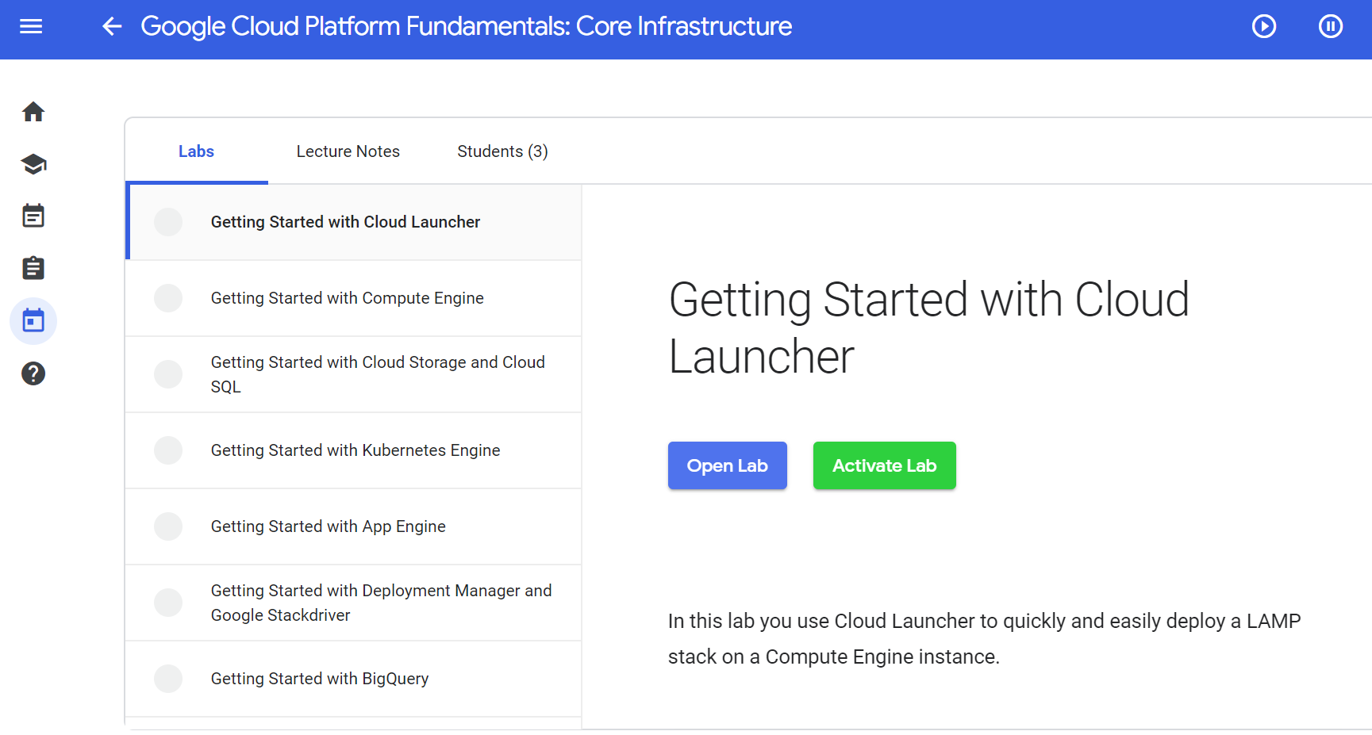
https://ddls.qwiklab.com - once on the labs section Click the green “Activate lab” button.

Slide 3
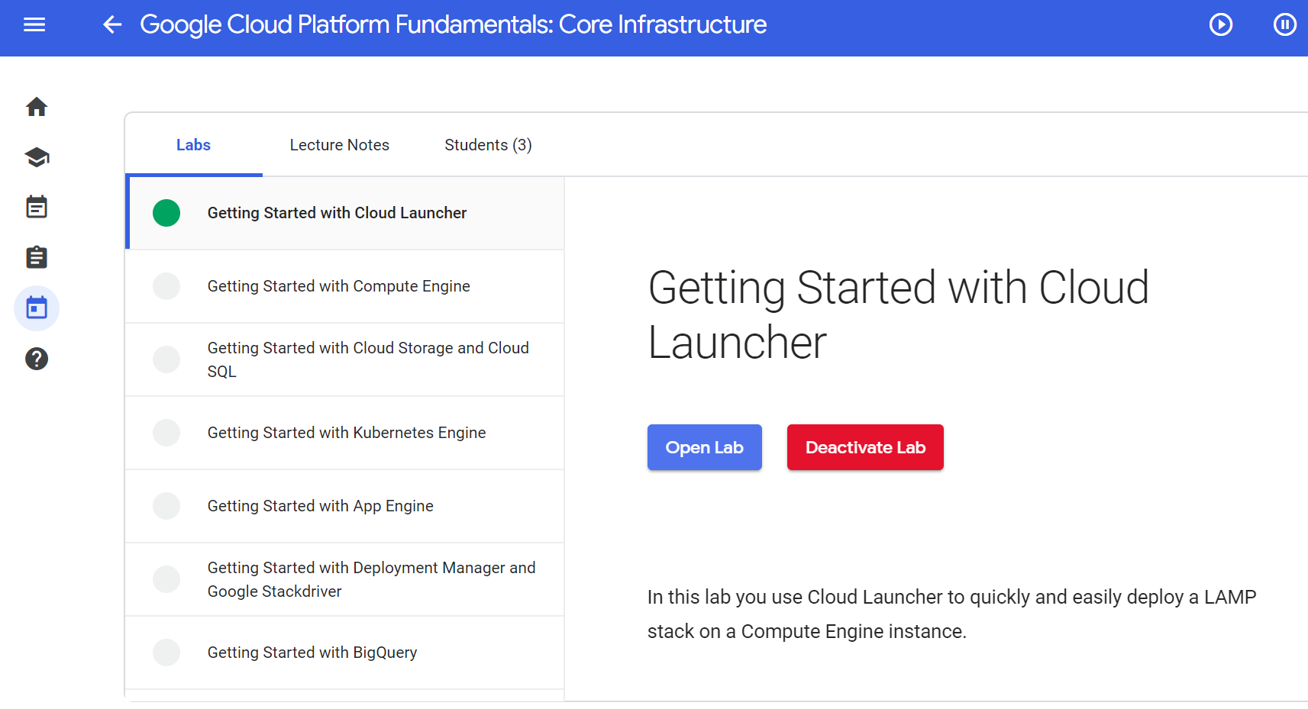
Now Click the Blue “Open Lab” Button

Slide 4
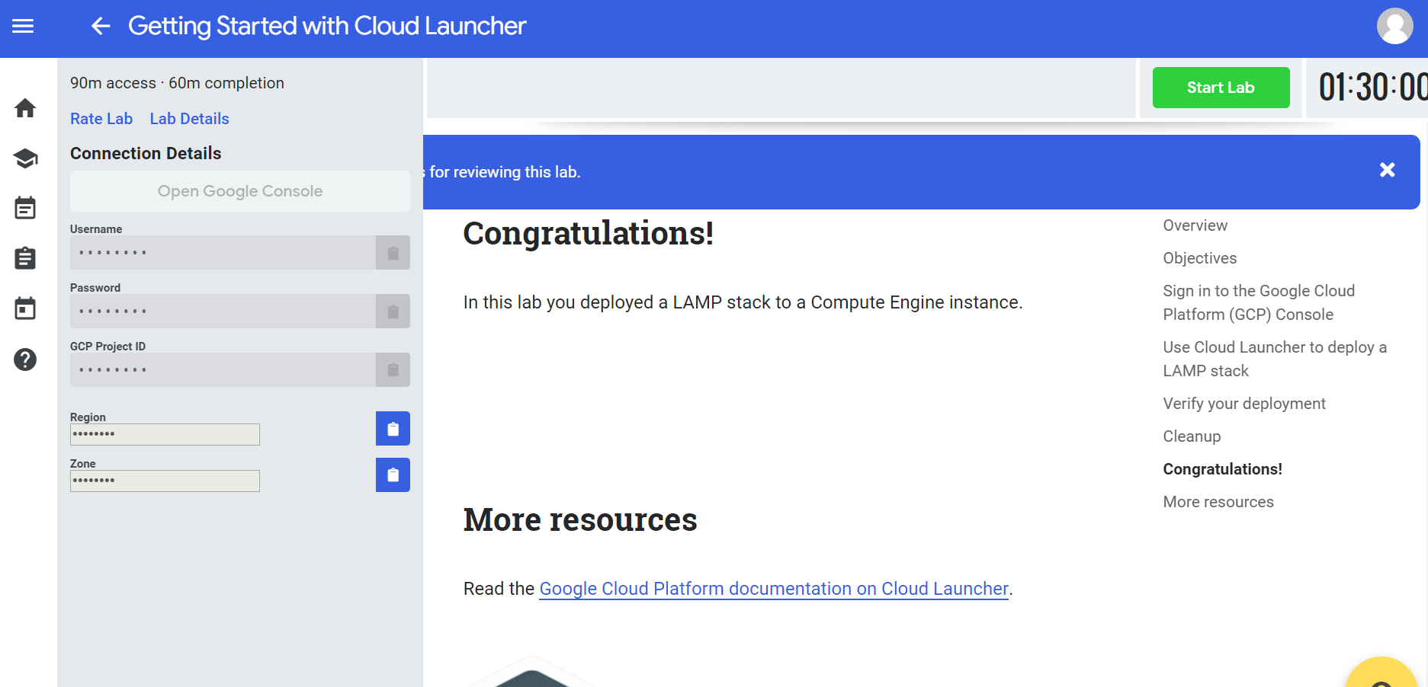
Click the Green “Start Lab” button

Slide 5
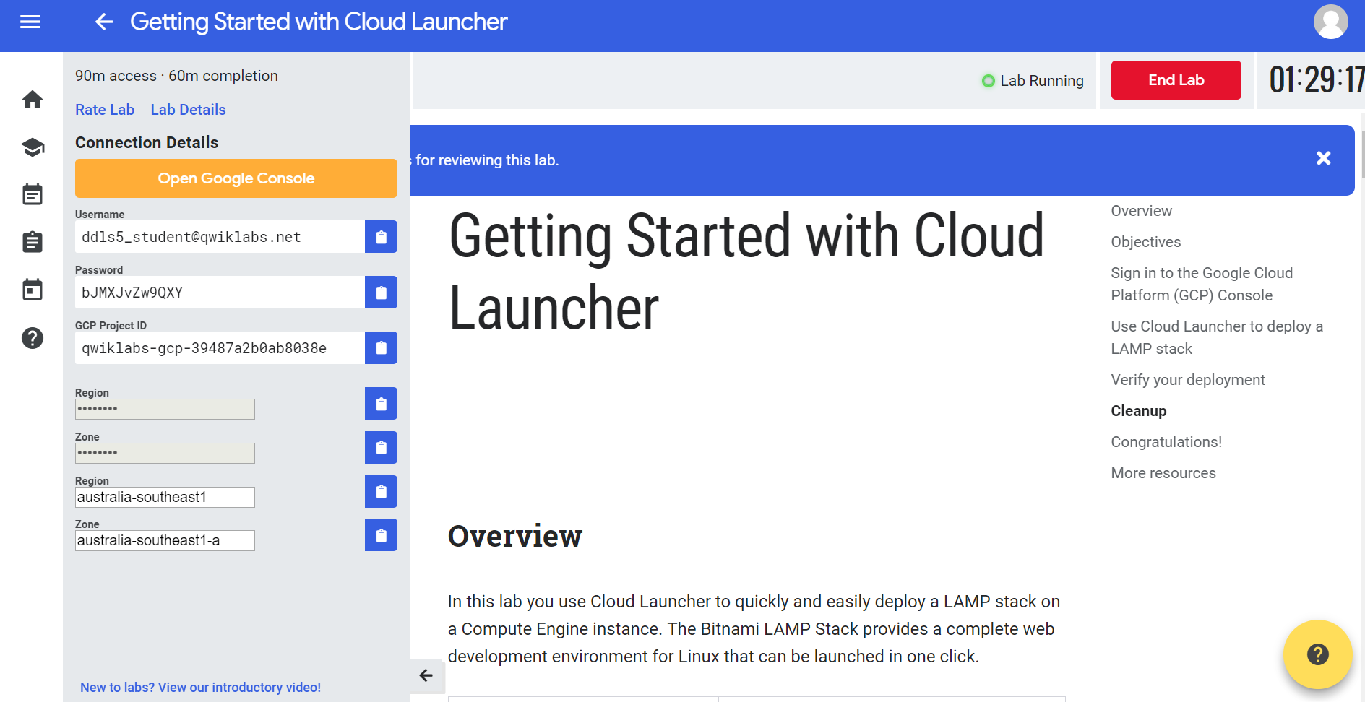
Click “Open Google Console”

Slide 6
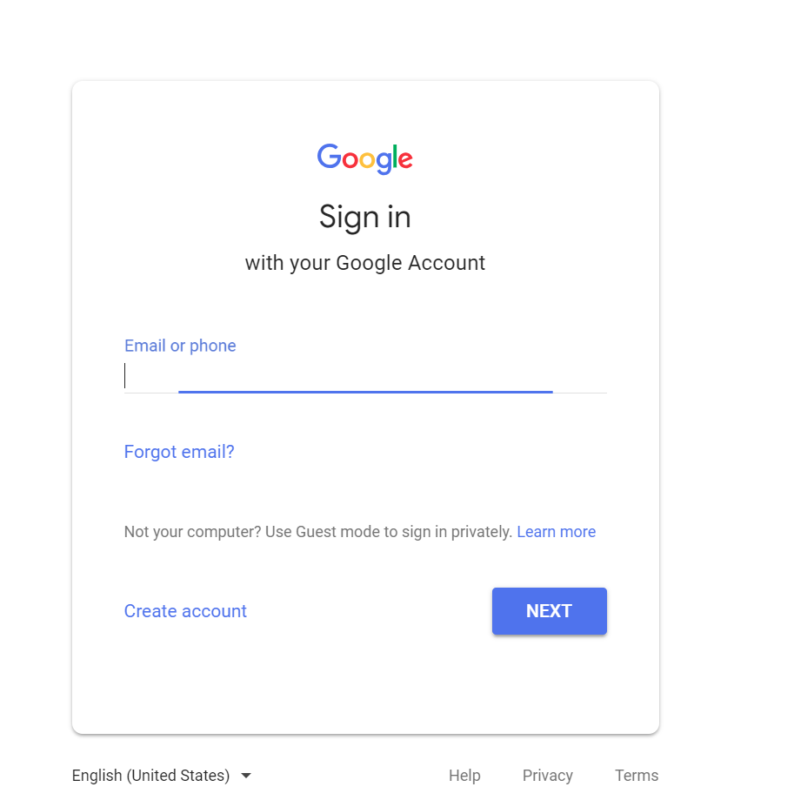
Sign-in with the automatically created credentials

Slide 7
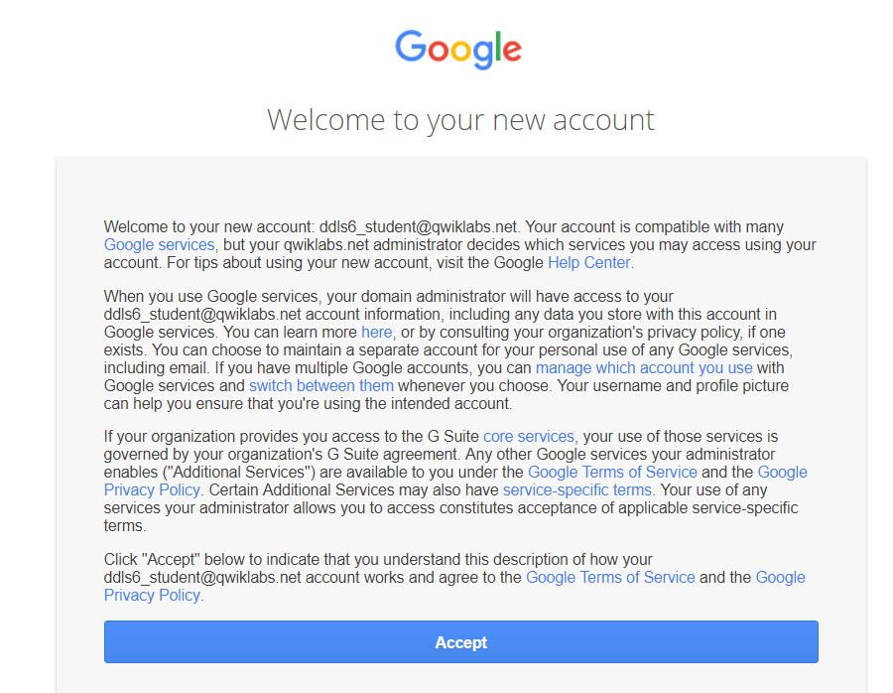
Click Accept

Slide 8
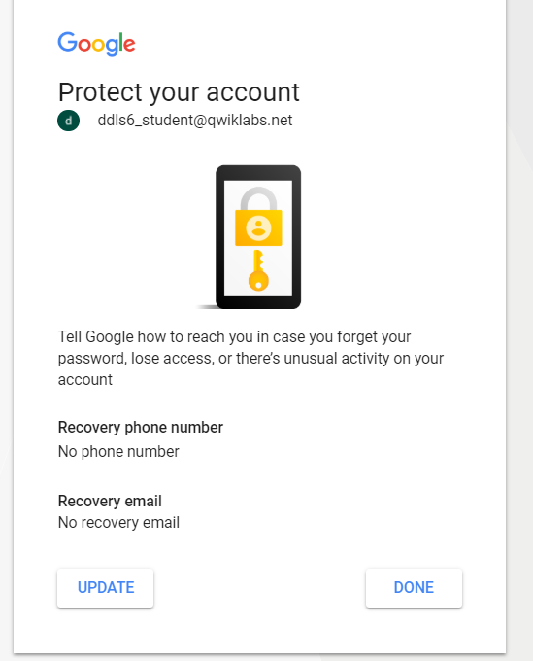
Click “Done” - as it’s a temporary sign-in no need for any recovery information

Slide 9
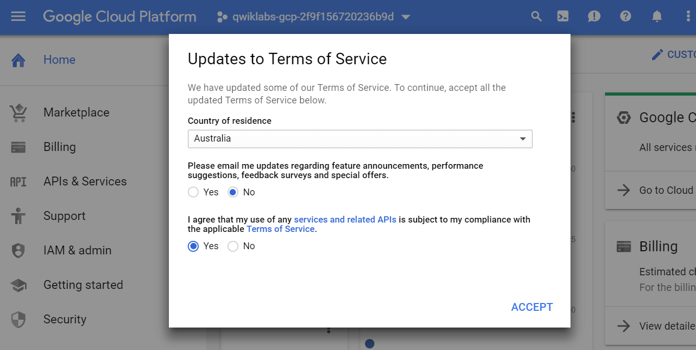
Click “No” for Email updates and “Yes” to Agree, then click “Accept”

