Slide 1
Cloud Native Applications
Notes:
Setup:
Check installed browsers
Login to Azure, GCP, and AWS.
Connect to remote desktop in Azure if needed.
Login to email if needed.
Download an image for a blob store demo.
Generate some example JSON: https://www.mockaroo.com/
Suggested Demonstrations:
GCP IaaS:
Instance-1 install nginx
Instance-2 start-up script
Azure RDP and SQL access from VS
GCP Function => NoSQL
AWS SQS and SES
AWS S3 Blob Store

Slide 2
SESSION OVERVIEW
1.
As A Service Scale
Describe the differences between the service models
2.
Cloud Native Applications
Understand how modern applications can be designed for the cloud
3.
Pay Per Provision vs Pay Per Use
Appreciate the benefits of moving our application design up the aaS scale

Slide 3
As A Service Scale

Slide 4
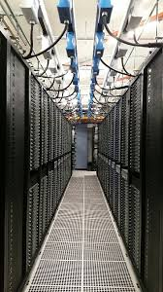
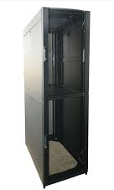



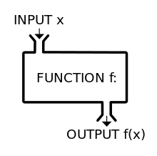
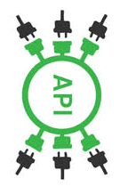
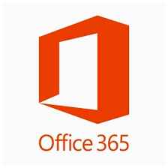
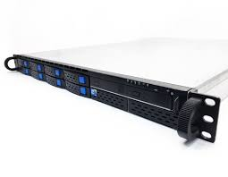




aaS SCALE OR SERVICE MODEL SCALE
Cloud Providers
Server
Co-Location
IaaS
PaaS
FaaS
AaaS
SaaS
You
Manage
They
Manage

Slide 5
WHY IS THIS IMPORTANT?
IaaS
PaaS
FaaS
AaaS

Slide 6
Cloud Native Applications

Slide 7

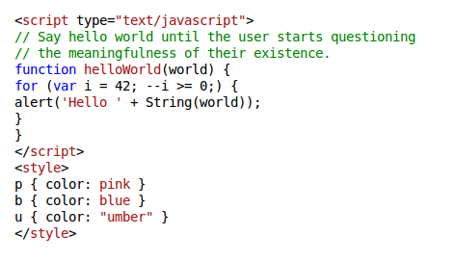

THE OLD WAY – MONOLITHIC APPLICATION
Code
Executable
Process
Compiled
Executed
A monolithic application is self-contained, and independent from other computing applications. It is responsible not just for a particular task, but can perform every step needed to complete a particular function - Wikipedia

Slide 8

THE (NOT SO) NEW WAY – MICROSERVICES AND SERVERLESS
Web Server
Registration
Message
Queue
Worker
Web API
Products
Orders
Mail Service
Blob Store
NoSQL DB
SQL DB

Slide 9
Pay Per Provision vs Pay Per Use

Slide 10
WHY IS THIS IMPORTANT?
IaaS
PaaS
FaaS
AaaS
You
Manage
Pay Per Provision
Pay Per Use
They
Manage

Slide 11
Only pay for what you use
Web Server
Registration
Message
Queue
Worker
PaaS
FaaS
PaaS
FaaS
Web API
Products
Orders
Mail Service
FaaS
FaaS
FaaS
PaaS
Blob Store
NoSQL DB
SQL DB
PaaS
PaaS
PaaS

Slide 12
SESSION REVIEW
1.
As A Service Scale
Describe the differences between the service models
2.
Cloud Native Applications
Understand how modern applications can be designed for the cloud
3.
Pay Per Provision vs Pay Per Use
Appreciate the benefits of moving our application design up the aaS scale

Slide 13
Any questions?

Slide 14

NEXT STEPS
To find out more about our range of Cloud courses visit the DDLS website @ www.ddls.com.au

