Slide 1
Web scrapping Craigslist(Auto)
Radhey Shyam

Slide 2
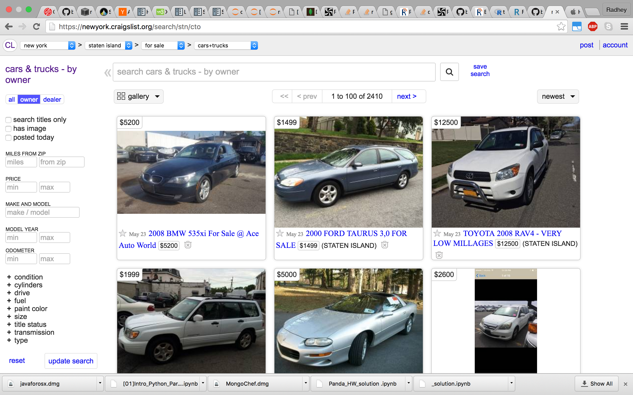

Slide 3
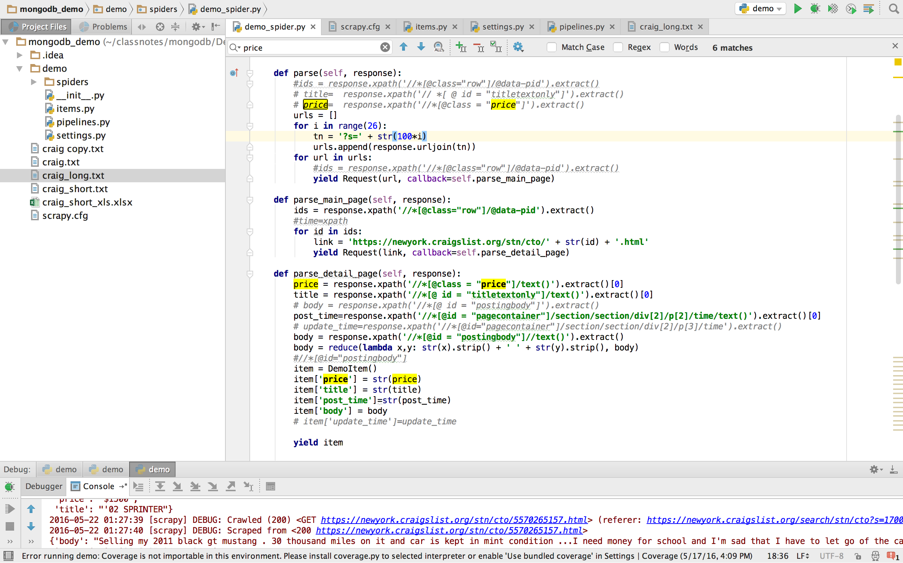

Slide 4
Motivation
Price distribution of the cars
Peak day and time of posting the ads.
Most common model years
Most common words/models on craigslist

Slide 5
Conclusion
Price range $3500-$4000 is the most common
Friday is the most common day to put day, followed by Wednesday and Saturday
Friday at 9-10 am , Saturday 8-10 am
Frequency of word in title are Ford, Nissan, miles, civic etc.
Year of the car ( more than 10 years old )

