Slide 1
Correlation between Stock Prices
Joseph Wang

Slide 2
Motivation
Understand if the short term and long term economics in different industries are correlated as manifested by stock prices

Slide 3
Data Yahoo Finance
http://finance.yahoo.com/q?s=DATA
library(quantmod) in R
Choose the adjusted stock prices
Select the years when the data are all available for the
stocks of interest.

Slide 4






The stocks of interests
XOM, CVX, INTL, AMD, GS, JPM
cvx
XOM

Slide 5
Stock prices

Slide 6
Normalized Stock Prices

Slide 7
The daily “diffference” for the stock prices
Difference(i) = stock price(i+ 1)– stock price on the day( i )
where “i” is the index for a particular day
By the difference on each day, we can predict the price on each day by knowing the stock price at some day and do accumulated sum from the day !!

Slide 8
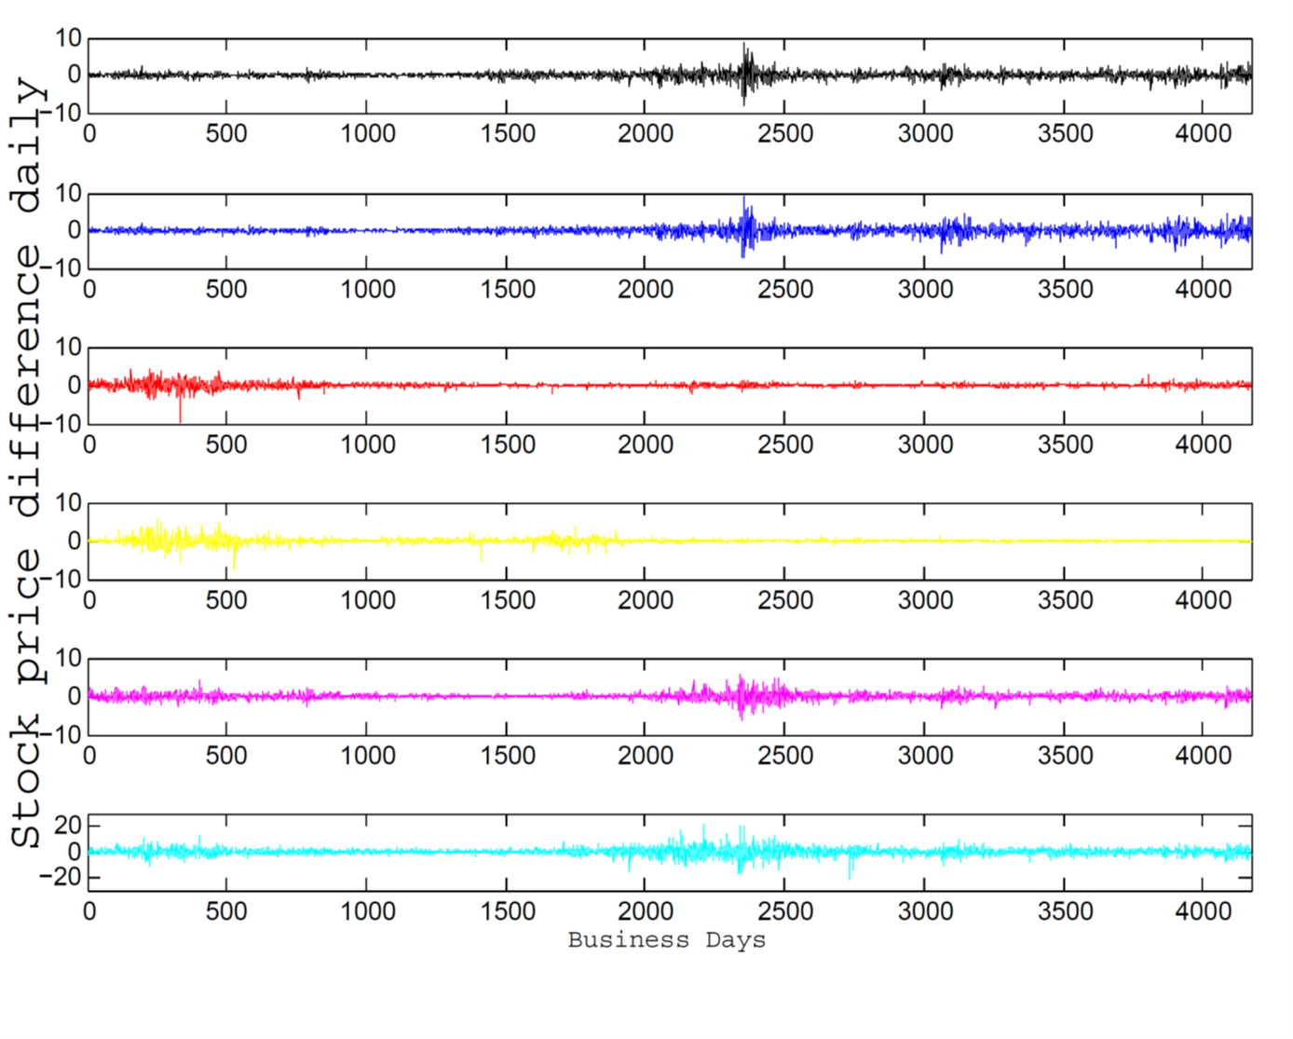
XOM
CVX
INTL
AMD
JPM
GS

Slide 10
Observations
It seems to have strong correlation for stocks within the same sectors
There seems to have strong correlation between the finance sector
and energy sector
Semiconductor sector seems not to dance with other sectors

Slide 11
Scatter plots

Slide 12



Correlation between sectors
Semiconductor
Finance
Energy
1.0000 0.3382 0.1968
0.3382 1.0000 0.4784
0.1968 0.4784 1.0000

Slide 13
Hypothesis
Null Hypothesis: One sector is not correlated with another sector
pvalue <0.05
1.0e-037 *
0 0.0000 0.9989
0.0000 0 0.0000
0.9989 0.0000 0

Slide 14
Conclusion
Semiconductor sector seems not to dance with energy sector
However, finance sector is correlated statistically with both semiconductor industry and energy industry
Chevron and Exxon have the same investment values with stronger correlation in past 10 years.

Slide 15
Correlation matrix between companies
1.0000 0.4425 0.1976 0.2213 0.0999 0.0939
0.4425 1.0000 0.3320 0.3300 0.2369 0.2209
0.1976 0.3320 1.0000 0.6926 0.4454 0.4470
0.2213 0.3300 0.6926 1.0000 0.4308 0.4303
0.0999 0.2369 0.4454 0.4308 1.0000 0.8438
0.0939 0.2209 0.4470 0.4303 0.8438 1.0000

