Slide 1
7 MAJOR FELONIES IN NYC
ARDA BERKAY KOSAR

Slide 2
Outline
THE DATASET
COMPSTAT
CRIME TYPES
DIFFICULTIES & MISTAKES
FURTHER IDEAS

Slide 3
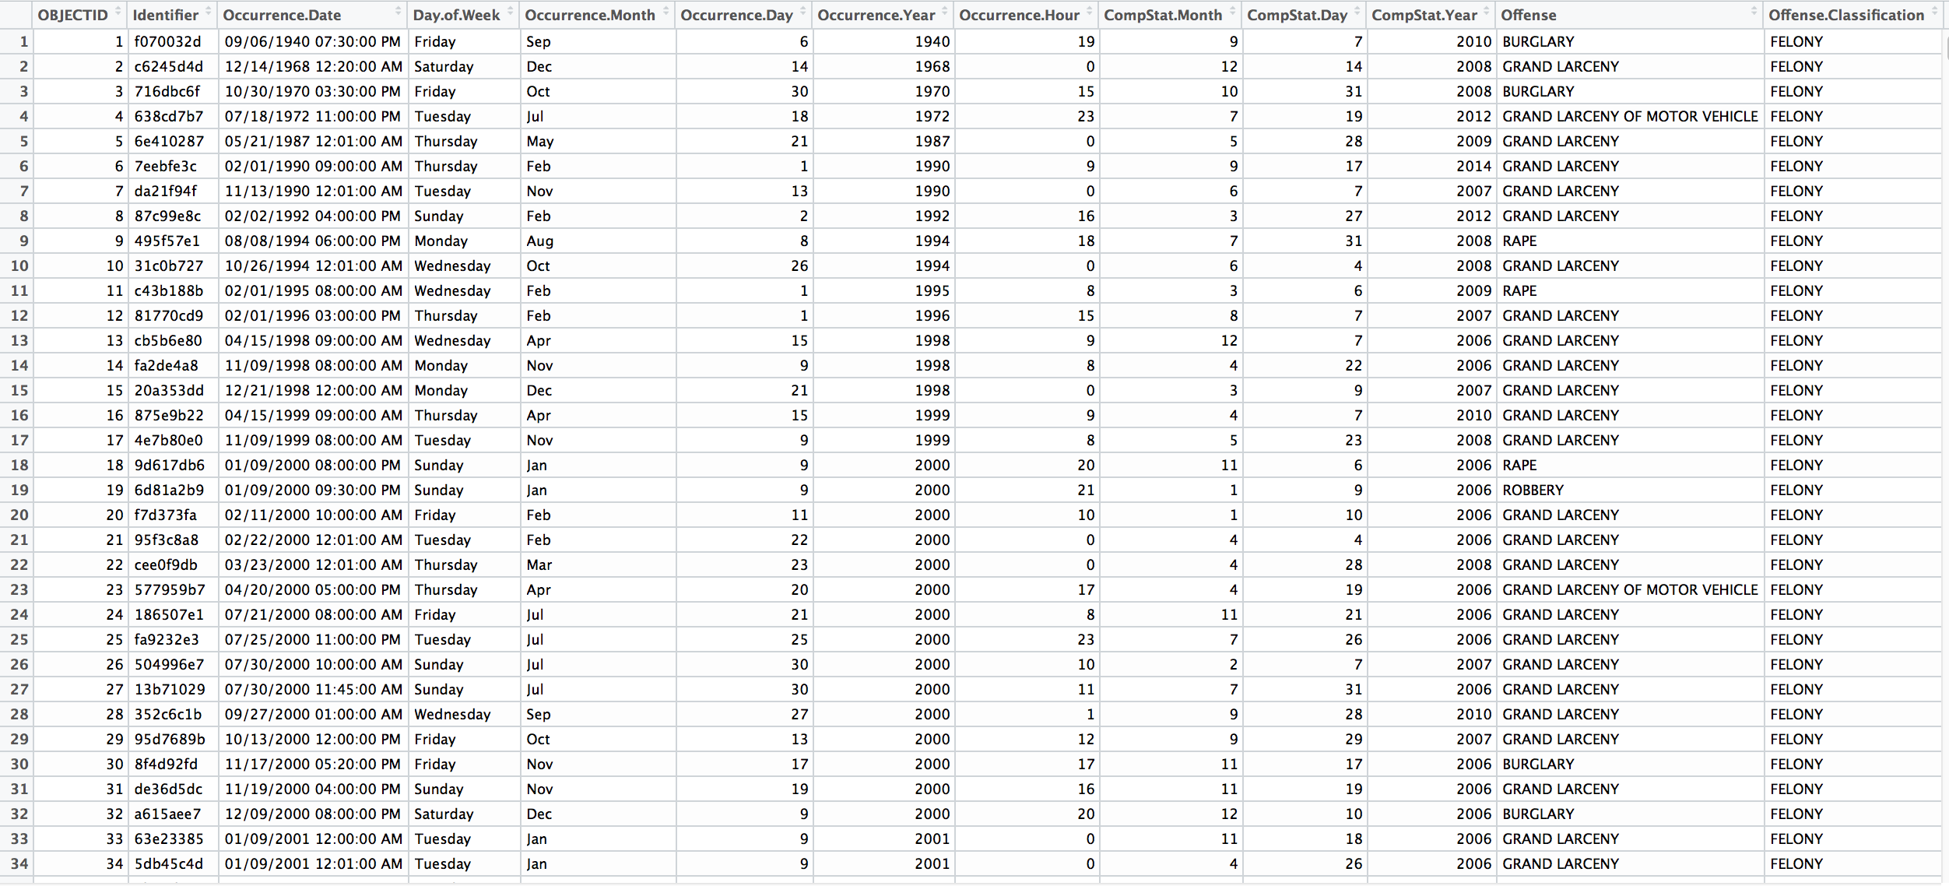
THE DATASET
What is CompStat???
1,123,465 observations
20 variables
Notes:
bbb

Slide 4
COMPSTAT
Strategic Control System
Collection and feedbackof information on crime and related quality of life issues
CompStat Process
Collect
Analyze
Map crime data
Essential police performance measures

Slide 5
CRIME TYPES
Robbery
Burglary
Rape
Fellony Assault
Grand Larceny
Grand Larceny of Motor Vehicle
Murder & Non-Negl. Manslaughter

Slide 6
CRIME TYPES Cnt’d.
Grand Larceny
Stealing property valued in excess of $1000 – money, car, antiques, clothing etc.-
Grand Larceny of Motor Vehicle
Stealing a vehicle that is worth between $30,000 - $60,000
Fellony Assault
Requires that a victim suffers a physical injury
Murder & Non-Negligent Manslaughter
Killing of one human being by another

Slide 7
DIFFICULTIES
Implementing regular R-script codes into Shiny structure
ggplot2
googleVis
Using date range inputs
Difficulty in feature engineering
Creating numeric variables
Did a terrible mistake!! Sorry Chris!!
I did not do a good data munging aaaannnndddd…........

Slide 8
I DELETED MY MISSING DATA BECAUSE OF LACK OF TIME AND THE IMPUTATIONS I TRIED SEEM TO BE NOT WORKING

Slide 9
FURTHER IDEAS
Implement Precinct coverage areas
This project is normalized by population
Normalize by flow population of boroughs depending on the occurrence time of the crime

