Slide 1
Deforestation Risk: Palming off the Earth
Wanda Wang

Slide 2

Introduction

Slide 3


Stakeholders

Slide 4
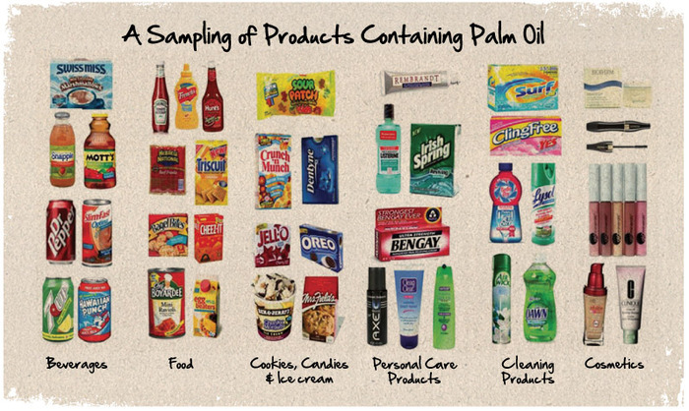
High Demand, “Green Gold”

Slide 5
The Datasets
UN Food and Agriculture - provides information on global Palm oil production and area harvested
Global Forest Watch -Palm oil Mill location data and fire alert data available for our review

Slide 6
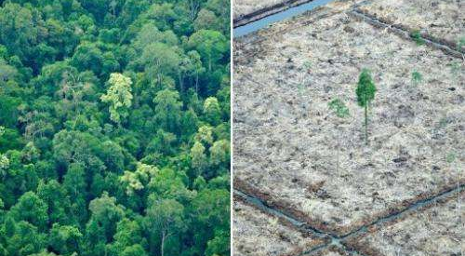
Exploratory Questions
Which countries are the top producers of Palm oil?
Where are the palm oil mills located within these countries?

Slide 7
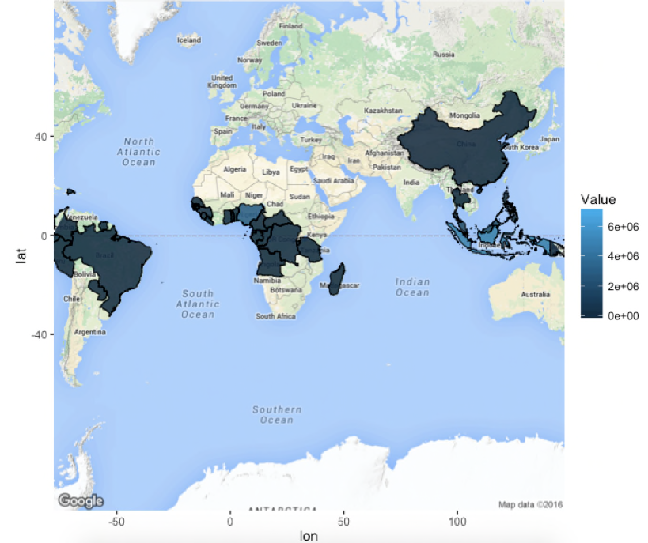

Slide 8
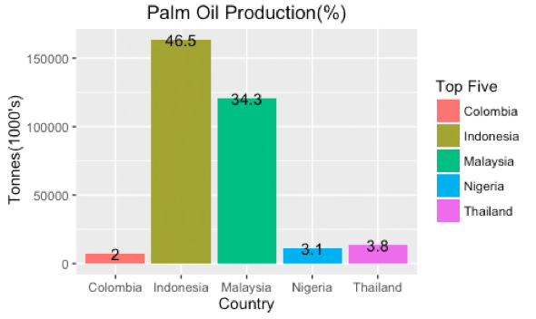
Production: Top Five

Slide 9
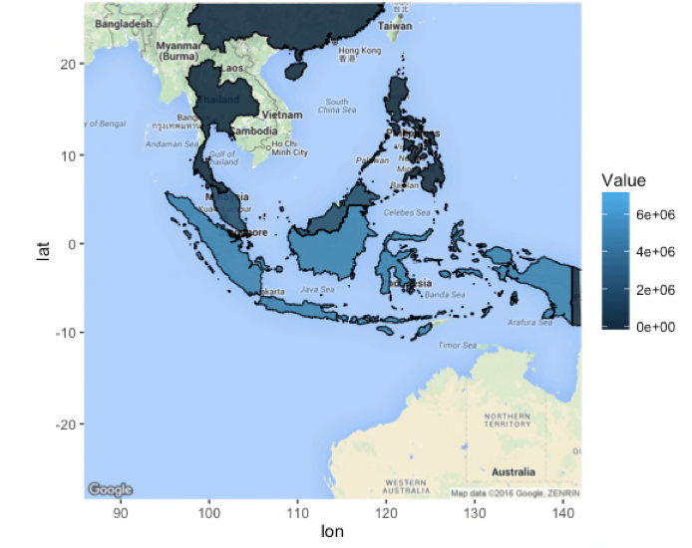
Production in Asia

Slide 10
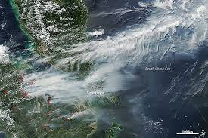
Satellite View

Slide 11
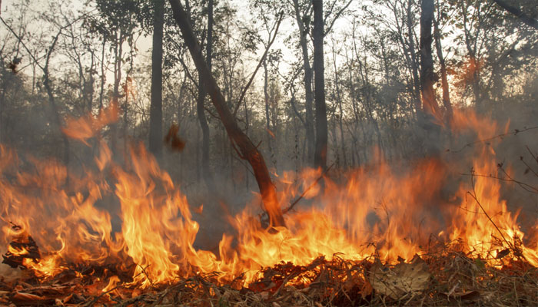
Forest Fires

