Slide 1
Yelp Review Web Scraping, Sentiment Analysis
Frank Wang
5/22/ 2016

Slide 2
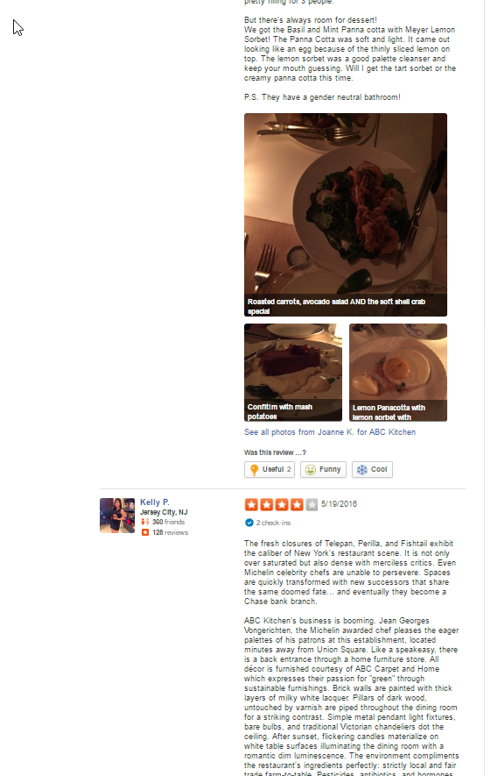
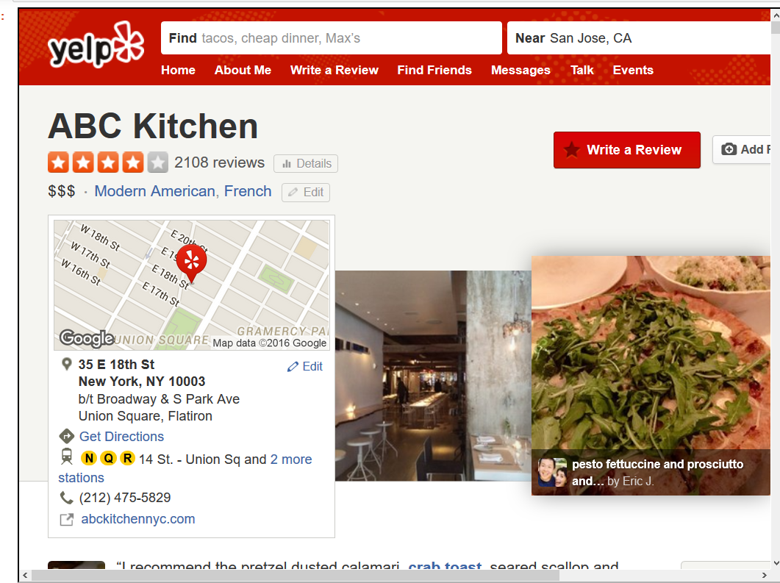
example

Slide 3
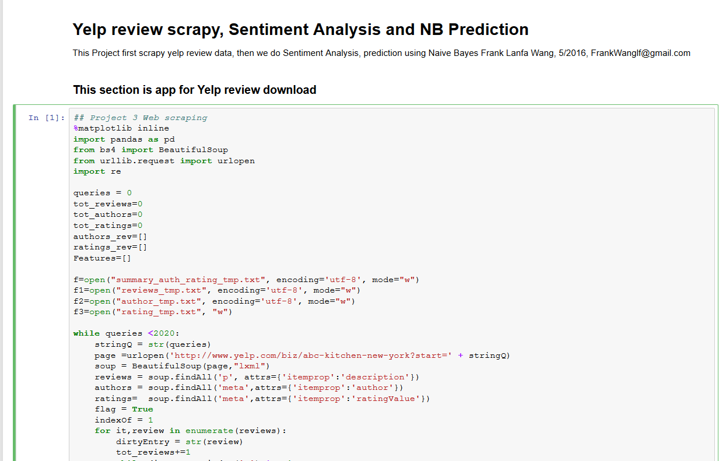

Slide 4
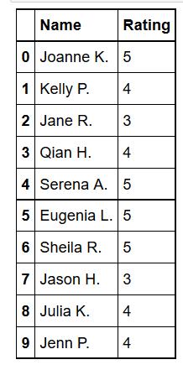
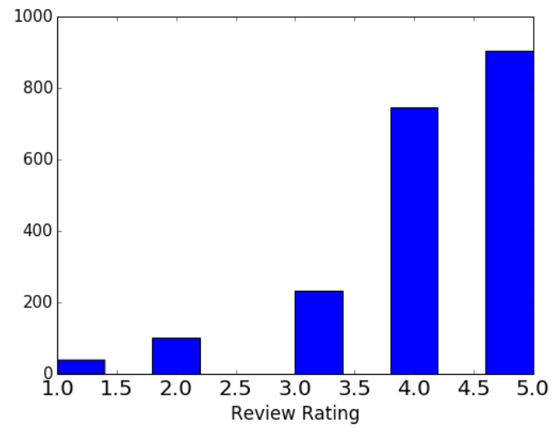

Slide 5
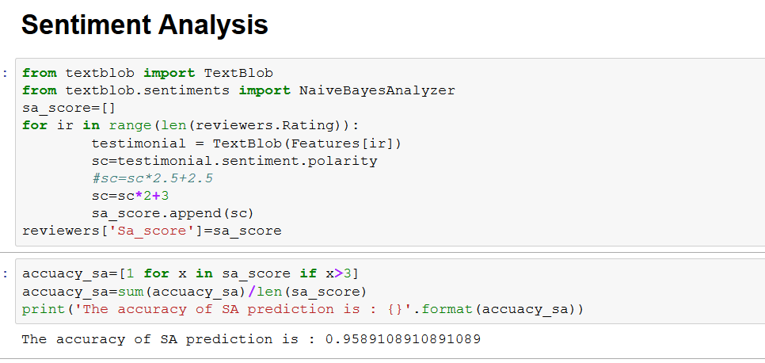
The accuracy of SA prediction is : 0.9589
The accuracy of SA prediction is : 0.9589

Slide 6
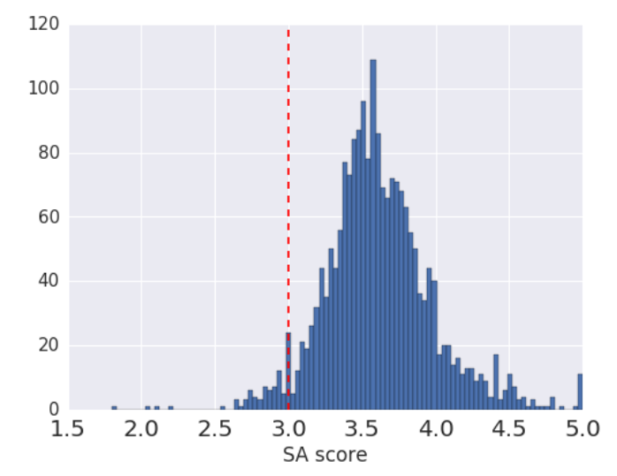
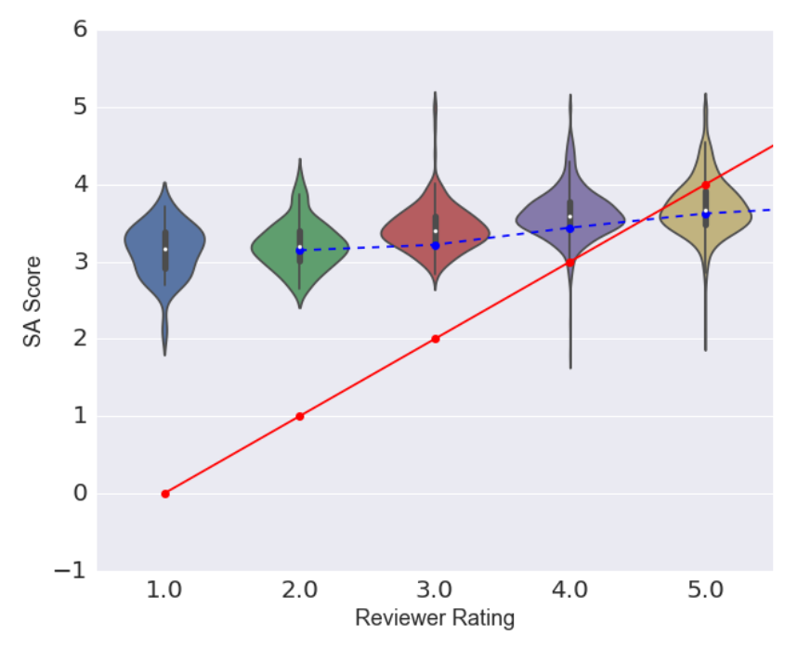
SA for restaurant review
The accuracy of SA prediction is : 0.9589
ABC Kitchen 4****

Slide 7
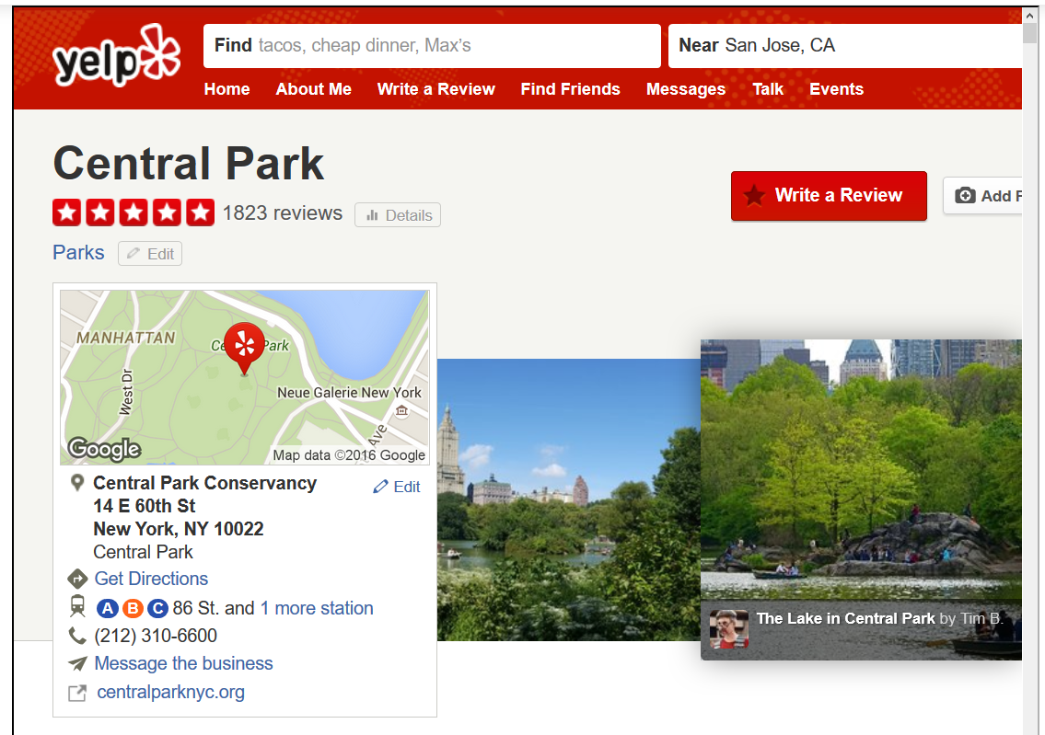
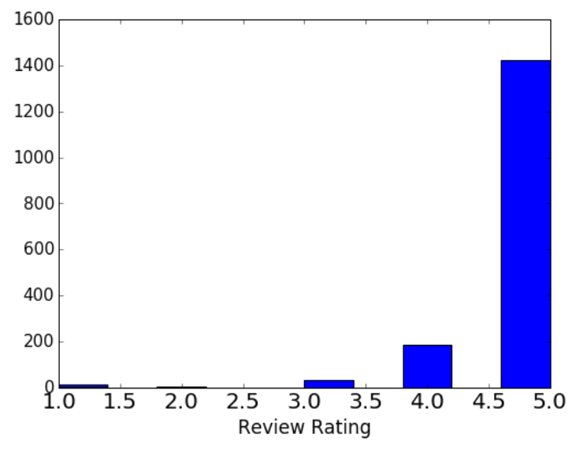
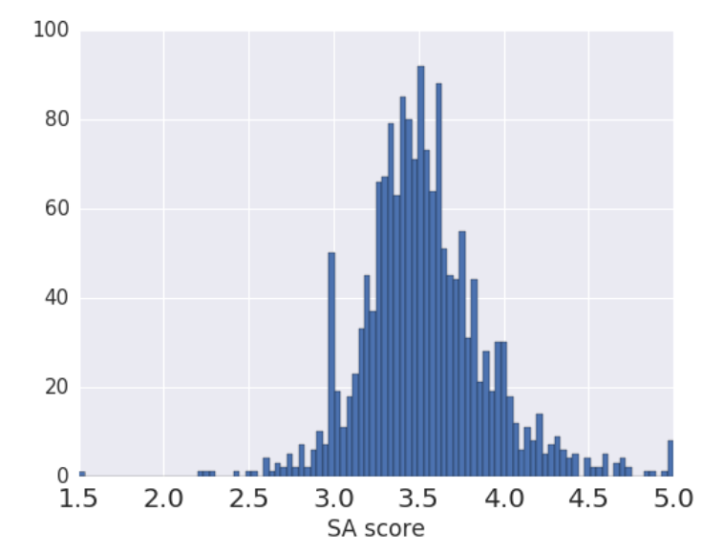
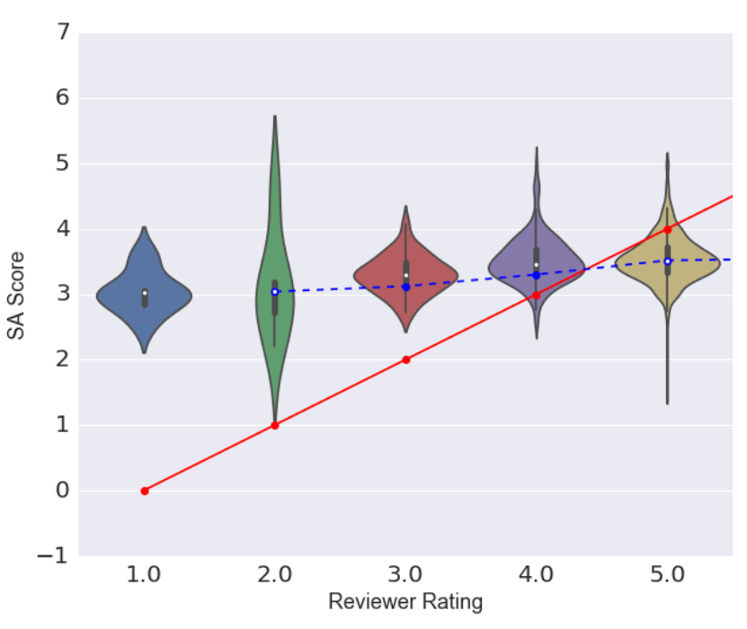
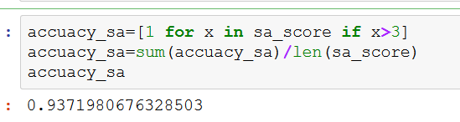
Example 2:
SA Accuracy=0.937

Slide 8
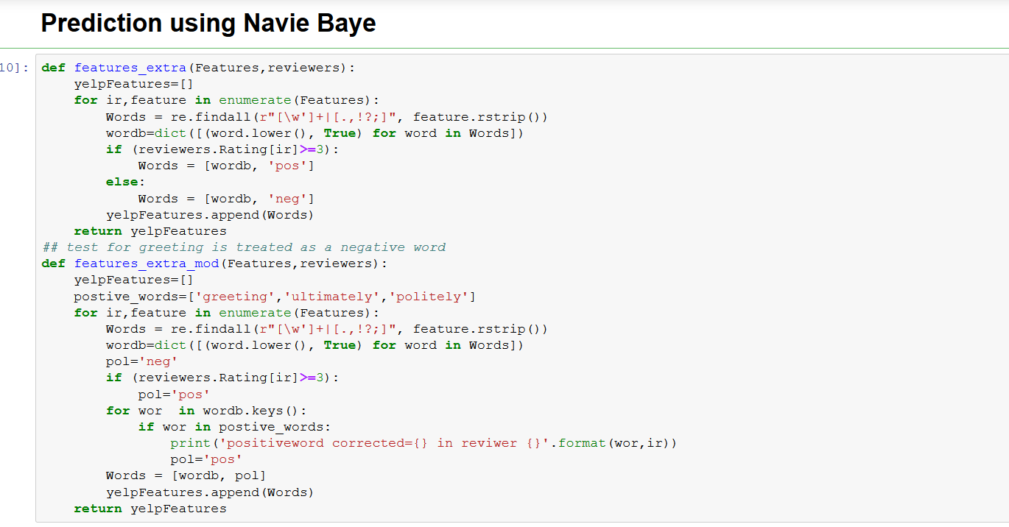

Slide 9
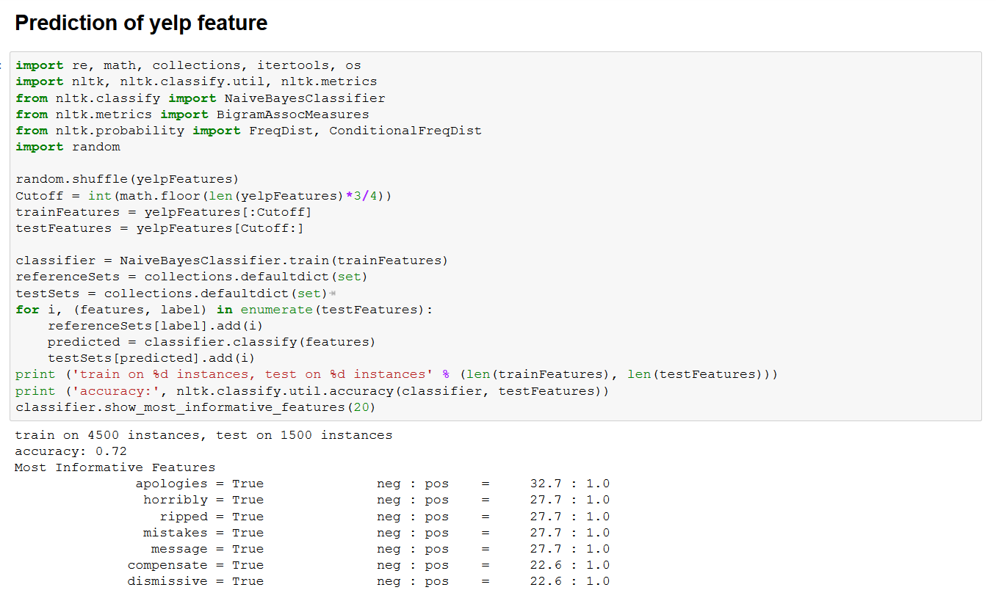

Slide 10
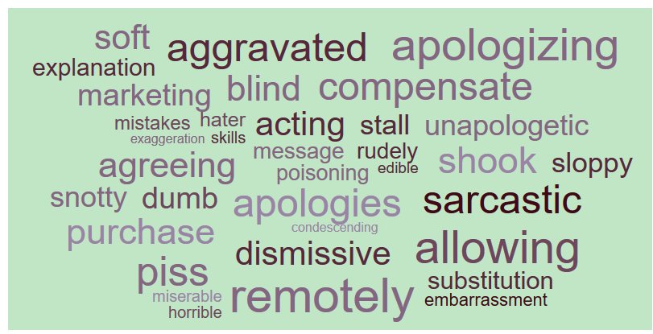

Slide 11
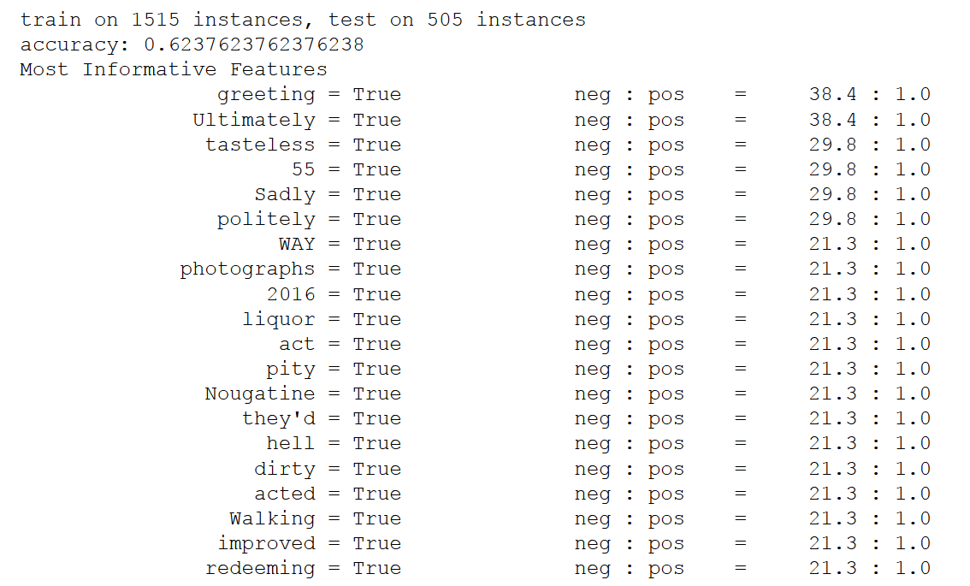
Small number of dataset

Slide 12
Really disappointed to our dining experience tonight. Thursday night, 6:30PM for 2 people.We made reservation 1 month earlier for the birthday dinner.---Environment---*Dining area:The decoration and ambiance of main area was beautiful and great, HOWEVER, they sat us in the back bar area, which was a passage between ABC Kitchen, ABC Cocina, and abcmkt. It had no decoration at all. While we ate, some people were walking on the stairs above us (we were eating under the edge of stairs. I felt some dust were falling into our dishes from it...). The customers of abcmkt also randomly walked to our area and peaked into our dishes. I felt really uncomfortable about it. I understand they didn't want to waste the space and put more tables to make money, but they should probably make it only for the bar guests, not the customers who have the full dinner.*----------.*Sundae: good idea to put salted caramel ice cream and popcorn together. It was tasty but it got very sweet at the end. The portion was big, so it's ideal to share it between 2-3 people.---Service---The staff were friendly. However, they were not attentive. It might be a busy night, so our waiter disappeared for a while time to time when we needed him. We waited for 20 mins to order dessert and 30 mins to get the bill. Some of the serving ways were also odd. Most of our dishes were dropped without any words. No greeting (we were still in the middle of conversation), no explaining, no "bon appetit". They just came and left like we were air...If you ask questions, they would answer politely. But it was really awkward.I've been to many high-end or Michelin starred restaurants. By the dining experience tonight, I don't think ABC Kitchen deserved Michelin 3 stars. Foods were good but not excellent, and the service, back bar area, and bathroom were not on the level. Overall, it was a disappointment.

Slide 13
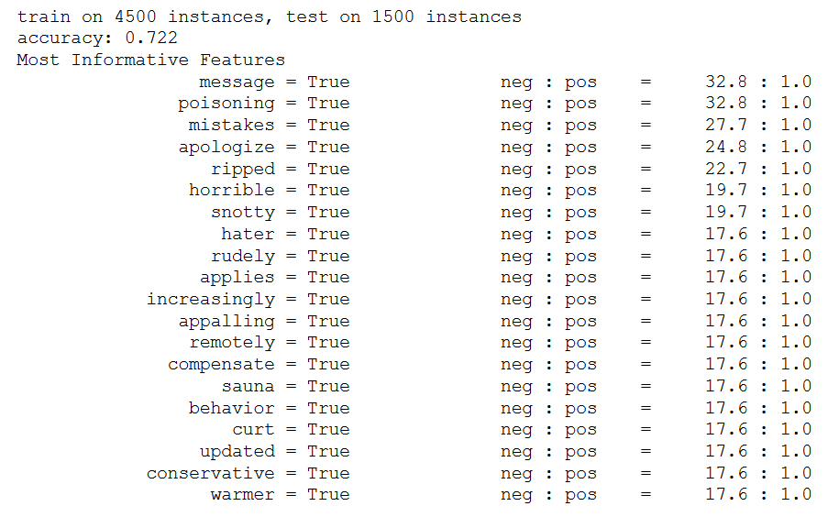

Slide 14
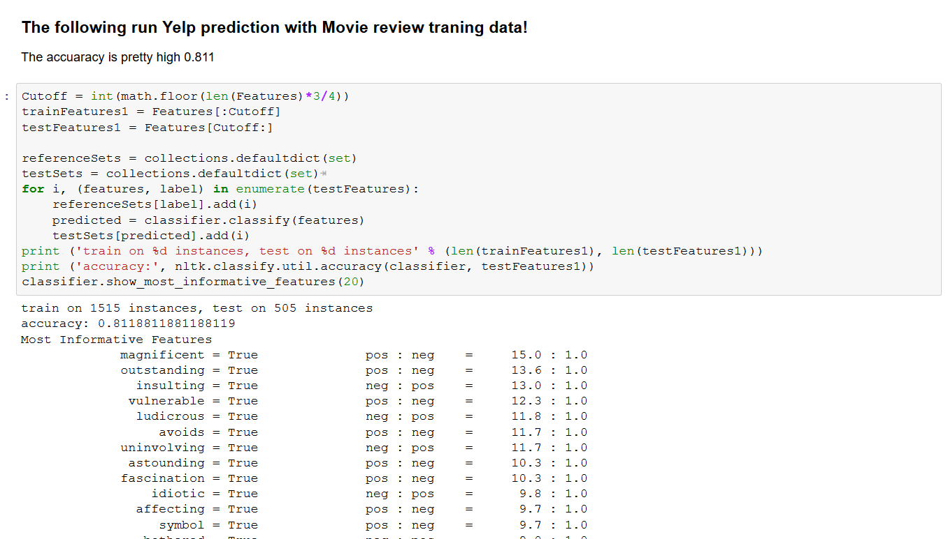

Slide 15
Summary
The Yelp review scarping and analysis using Python package
Sentiment Analysis for positive and negative prediction show good agreement (90%) with review rating
Supervised machine learning (Naive Bayes here) has a prediction accuracy is about 72% with 6000 reviewers
Further improvements with bigram and other technics.

