Slide 1
Seed Company Analysis
Zi Jin

Slide 2
Agenda
Question try to answer
Web scraping Seed-DB.com
Data analysis & Visualization
Conclusion

Slide 3
Quantify seed company’s quality using Seed-DB.com
Seed company prosperities:
0 or negative cash flows, little valuation info
Private, info not accessible
Some don’t even have products
How do I know if a seed company is likely to succeed or not in the future?
Current measurements by investors, etc.
Founders look smart
Business ideas sound great

Slide 4
Web Scraping Seed-DB.com
Seed-DB.com uses the Crunchbase API for up-to-date info on seed accelerators and their companies
Use BeautifulSoup to get
Company info
State, Accelerator, $Funding, # of Rounds
Accelerator info
State, # of Companies,$Funding,$Average Funding

Slide 5
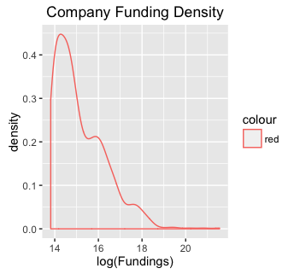
Data Exploration

Slide 6
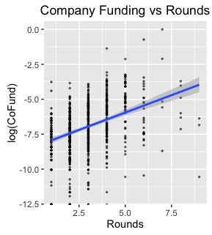
Data Exploration

Slide 7
Measurement
Assumptions:
Great accelerators only work with great startups
Measure accelerators: rank by their average funding
Great startups also receive large funding from accelerators
Company score =
0.5 * normalized company’s funding + 0.5 * normalized its accelerator’s rank

Slide 8
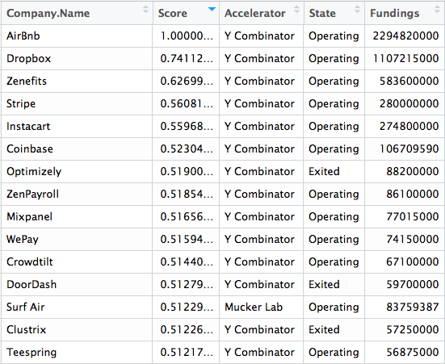
Top 10 Companies by Score

Slide 9
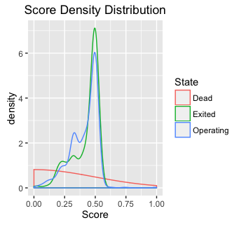
Score Density Distribution

Slide 10
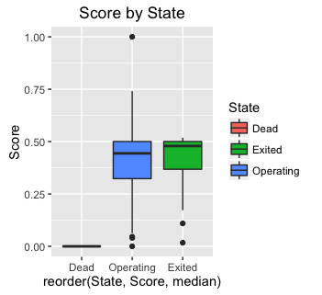
Score Boxplot

Slide 11
Conclusion
Company score =
0.5 * normalized company’s funding + 0.5 * normalized its accelerator’s rank
High scorers are more likely to succeed in the future
Accelerators tend to exit at 0.5

