Slide 1
Forecasting walmart sales
Denis Nguyen

Slide 2
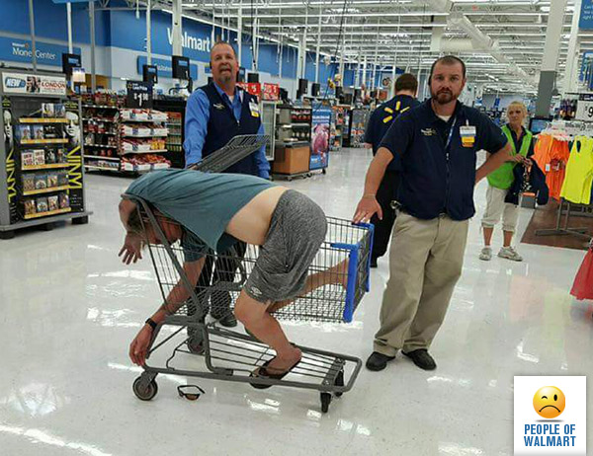
Walmart
Founded in 1962
11,527 locations in 28 countries
260 million customers each week
Revenue – $482.13 billion for the 2016 fiscal year
Gift To Society
www.peopleofwalmart.com

Slide 3
About The Data
Kaggle Competition
www.kaggle.com/c/walmart-recruiting-store-sales-forecasting
Goal: Forecast sales for each department of each store
4 Holidays
Super Bowl
Labor Day
Thanksgiving
Christmas
train.csv
Date + IsHoliday
Store + Department
Weekly Sales
test.csv
Date + IsHoliday
Store + Department
features.csv
Date, IsHoliday
Temperature, Fuel Price
Markdown
CPI (consumer price index),
Unemployment Rate
store.csv
Store Type
Store Size

Slide 4
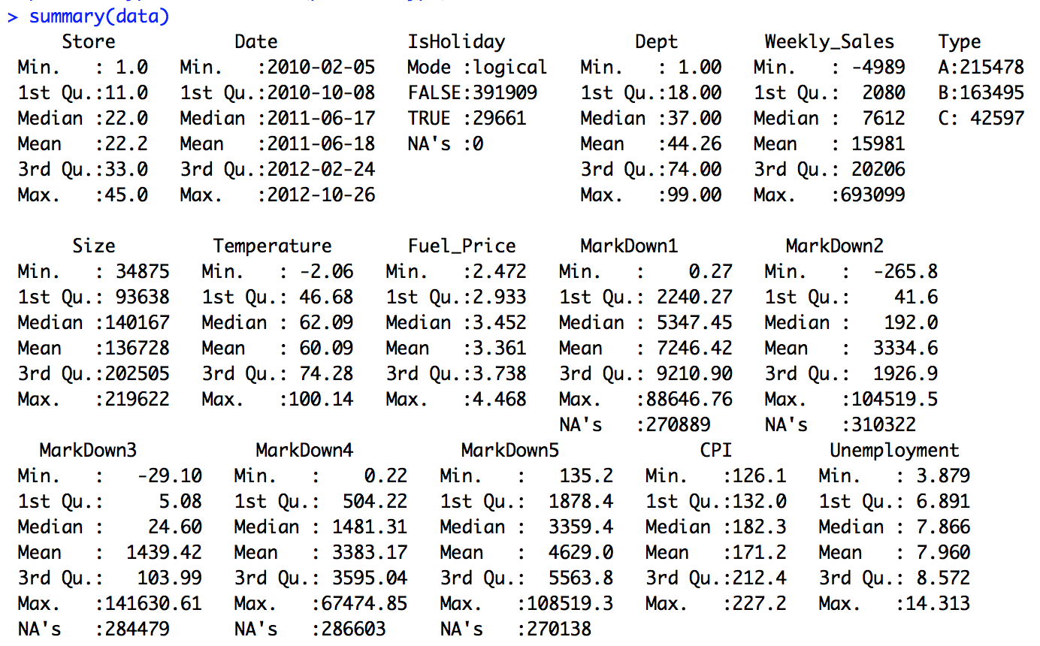
Exploring The Data
train.csv
2-5-2010 to 10-26-2012
143 weeks
test.csv
11-2-2012 to 7-26-2013
39 weeks
features.csv
2-5-2010 to 7-26-2013
77 weeks
45 stores
Up to 99 departments
CPI and Unemployment changes weekly with location
Markdown available after Nov 2011

Slide 5
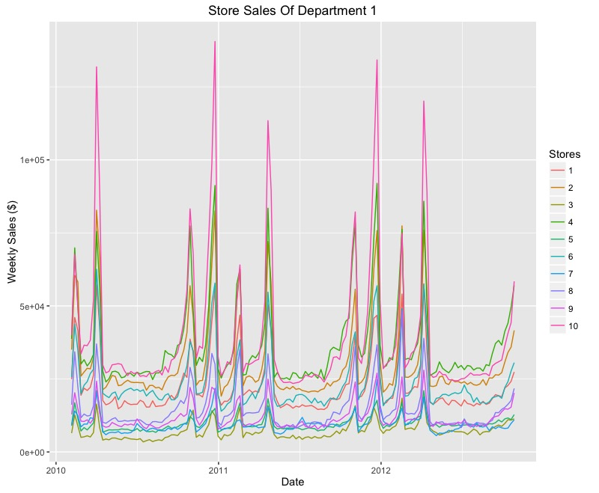

Slide 6
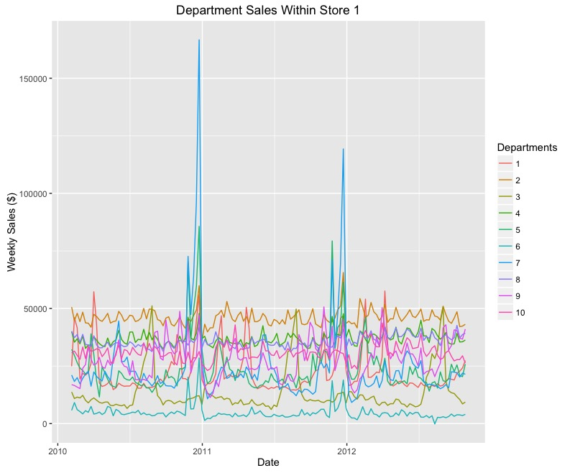

Slide 7
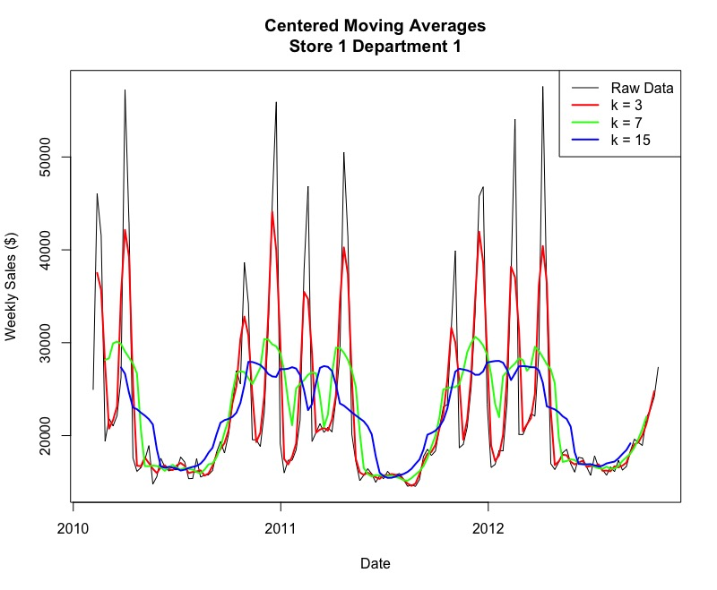

Slide 8
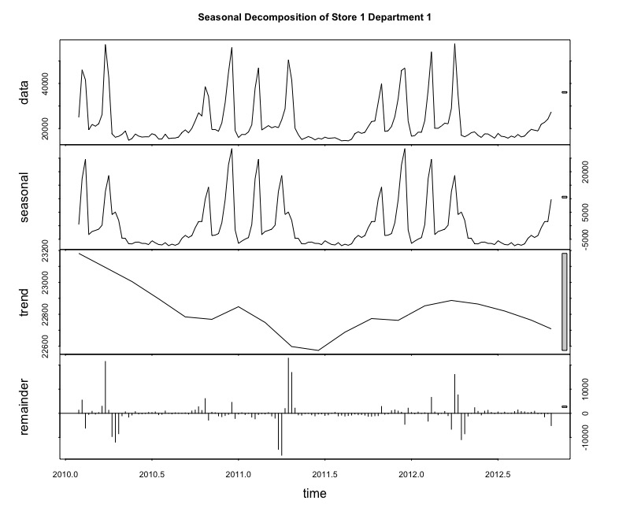
Seasonal Trend Decomposition using Loess

Slide 9
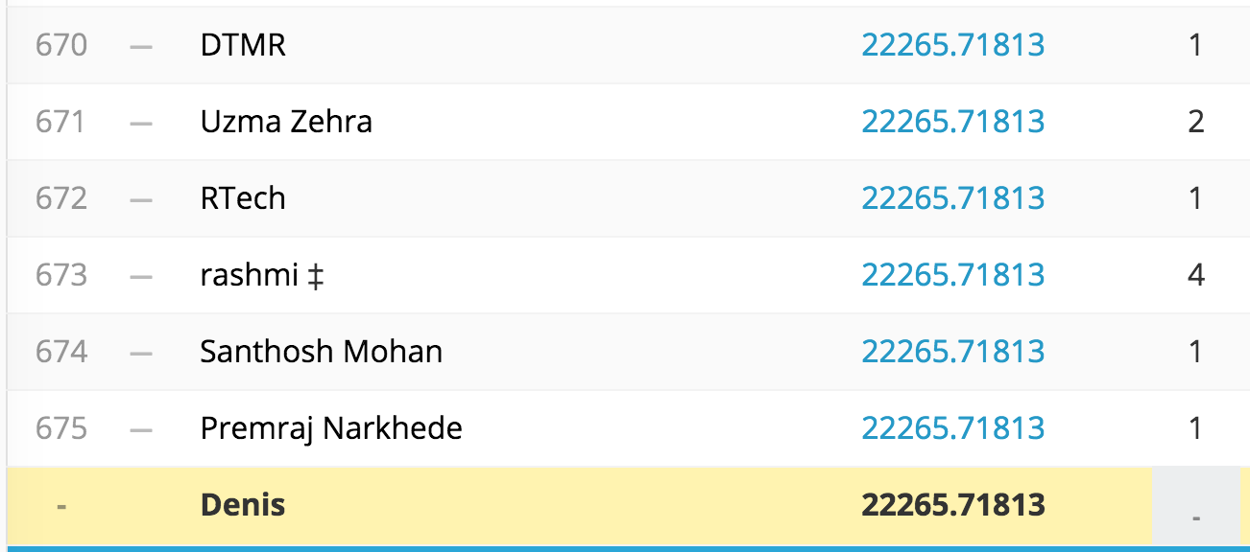
Submitting An Empty File
What is the worst score?

Slide 10
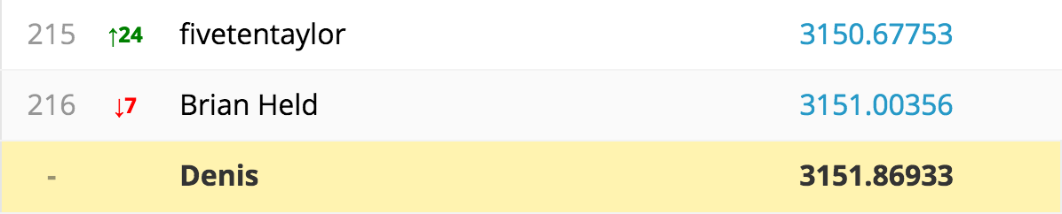
TSLM
tslm is used to fit linear models to time series including trend and seasonality components
It allows variables "trend" and "season" which are created on the fly from the time series characteristics of the data. The variable "trend" is a simple time trend and "season" is a factor indicating the season

Slide 11
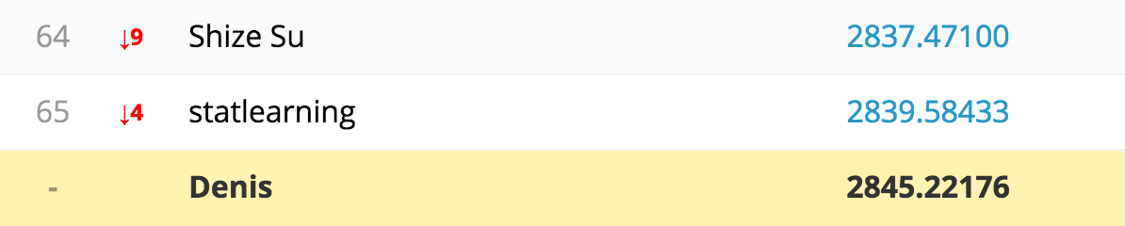
ARIMA
These models are fitted to time series data to better understand the data or to predict future points in the series
X[t] = a[1]X[t-1] + ... + a[p]X[t-p] + e[t] + b[1]e[t-1] + ... + b[q]e[t-q]

Slide 12
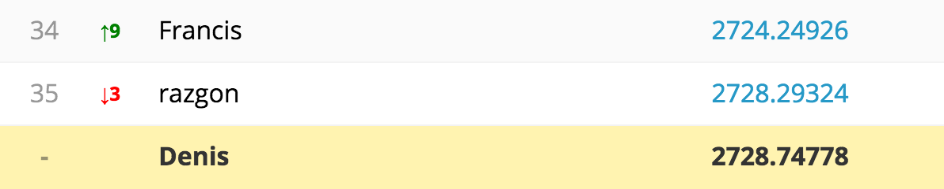
STLF
Forecasts of STL objects are obtained by applying a non-seasonal forecasting method to the seasonally adjusted data and re-seasonalizing using the last year of the seasonal component
stlf applies an STL decomposition, models the seasonally adjusted data, reseasonalizes, and returns the forecasts

Slide 13
Future Work
Run other algorithms and combine them
Incorporate features.csv
Unemployment, CPI, fuel prices, temperature may affect sales
Shifting weeks to accommodate for partial weeks during holidays

