Slide 1
Data Structures and Algorithms
in Hoffman
Brent Baccala

Slide 2
Data Structures and Algorithms in Hoffman
Introduction
Why use retrograde analysis?
Retrograde – the basic algorithm
Futurebases and pruning – enhanced algorithm
State of the Art
Hoffman
Multi-threading
Handling large working sets
Experience with C++11
Seven-piece tablebases?

Slide 3
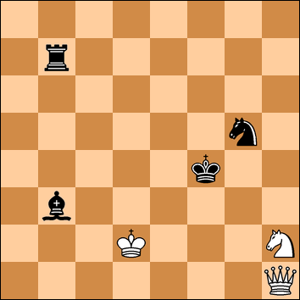
Longest Known Mate – 524 Moves

Slide 4
Indexing
A table is built with one entry for every possible chess position with a given configuration of pieces, plus a side-to-move flag.
Ex: a white king, a black king, a white queen, and a black rook
A (naïve) indexing scheme would require 2²⁵ entries.

Slide 5
Improved Indexing
Illegal positions (two pieces on the same square)
Duplicate positions
Board symmetry
Color symmetry
King restrictions (they can never be adjacent)
A naïve 7-piece indexing scheme would require 2⁴³ entries!

Slide 6
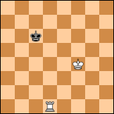
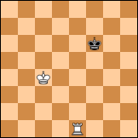
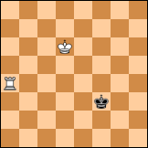
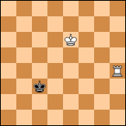
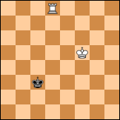
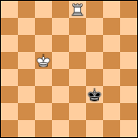
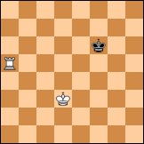
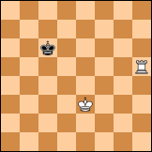
Board Symmetry

Slide 7
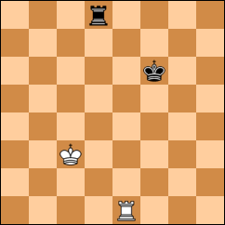
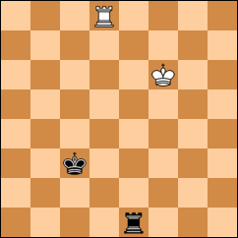
Color Symmetry

Slide 8
Basic Retrograde Algorithm - Initialization
foreach legal position do:
if PNTM king can be captured:
Flag position as PTM wins
else:
Count (and record) number of possible moves

Slide 9
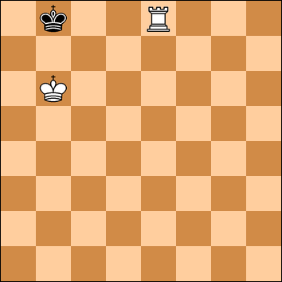
Basic Retrograde Algorithm – Checkmate

Slide 10
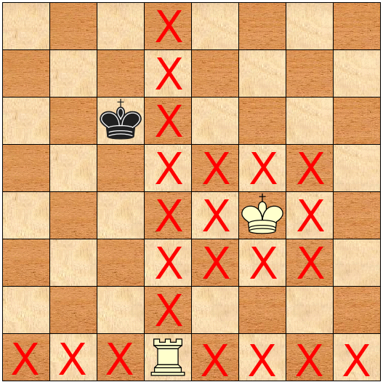
Basic Retrograde Algorithm – Move Counting

Slide 11
Basic Retrograde Algorithm – Main Loop
foreach unprocessed PTM wins position:
foreach position reached by a backwards move:
Decrement move count
if move count == 0:
Flag position as PNTM wins (unprocessed)
Flag position as processed

Slide 12
Basic Retrograde Algorithm – PTM wins

Slide 13
Basic Retrograde Algorithm – Main Loop
foreach unprocessed PNTM wins position:
foreach position reached by a backwards move:
Flag position as PTM wins (unprocessed)
Flag position as processed
Repeat both loops until all won positions processed

Slide 14
Basic Retrograde Algorithm – PNTM wins

Slide 15
Futurebases
Captures and pawn promotions require pre-computation
of tablebases with different configurations
Ex: krkr requires krk
Ex: kpk requires kqk, krk, kbk and knk

Slide 16
Futurebases
After initialization pass, made a pass through futurebases,
backing out captures and promotions
Use same basic PTM/PNTM algorithm
Each position is assigned a bit vector during initialization
indicating which “futuremoves” are possible from that position
Bits are cleared as each futuremove is handled

Slide 17
Futurebases (krk into krqk)

Slide 18
Pruning
It is possible to simplify a retrograde analysis
by discarding moves, at the cost of some loss of accurary.
You can discard your moves, if you never make them.
You can discard your opponents moves, if you concede them.

Slide 19
State of the Art
Nalimov (2005) – 6 piece tablebases
Lomonosov (2012) – 7 piece tablebases
Freezer (2005) – piece restrictions
Finalgen (2012) – better pawn handling
Hoffman

Slide 20
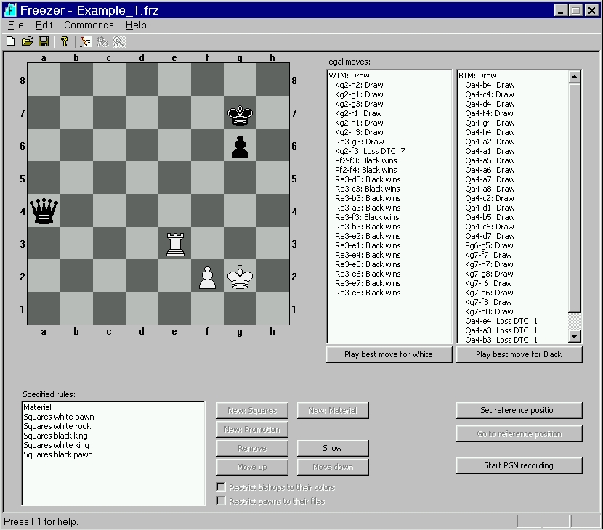
Freezer

Slide 21
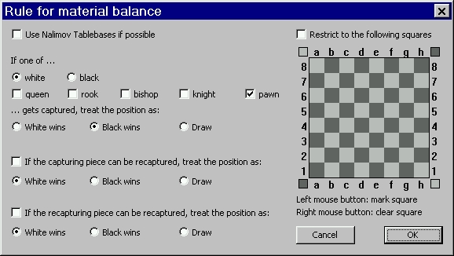
Freezer

Slide 22
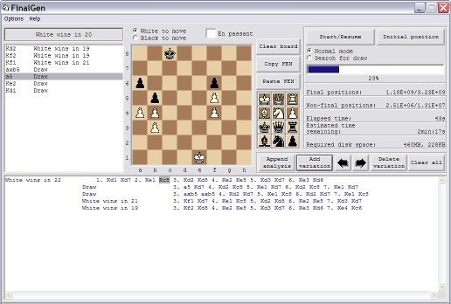
Finalgen

Slide 23
Hoffman
Under development since 2006
Originally intended for correspondence chess
C++11
XML based configuration

Slide 24
Hoffman XML – kqkq.xml
<?xml version="1.0"?>
<!DOCTYPE tablebase SYSTEM "http://www.freesoft.org/software/hoffman/tablebase.dtd">
<!-- Created by genctlfile.pl -->
<tablebase>
<dtm/>
<piece color="white" type="king"/>
<piece color="black" type="king"/>
<piece color="white" type="queen"/>
<piece color="black" type="queen"/>
<futurebase filename="kqk.htb" colors="invert"/>
<futurebase filename="kqk.htb"/>
<output filename ="kqkq.htb"/>
</tablebase>

Slide 25
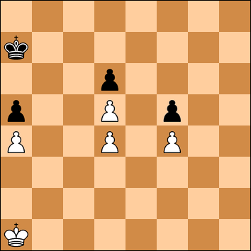
Lasker (1901)

Slide 26
Hoffman XML – lasker1901.xml
<?xml version="1.0"?>
<!DOCTYPE tablebase SYSTEM "http://www.freesoft.org/software/hoffman/tablebase.dtd">
<!-- Problem position 8/k7/3p4/p2P1p2/P2P1P2/8/8/K7 w -->
<tablebase>
<prune-enable color="white" type="concede"/>
<prune-enable color="black" type="concede"/>
<piece color="white" type="king"/>
<piece color="black" type="king"/>
<piece color="white" type="pawn" location="a4"/>
<piece color="white" type="pawn" location="d4"/>
<piece color="white" type="pawn" location="f4"/>
<piece color="white" type="pawn" location="d5"/>
<piece color="black" type="pawn" location="a5"/>
<piece color="black" type="pawn" location="f5"/>
<piece color="black" type="pawn" location="d6"/>
<prune color="white" move="KxP" type="concede"/>
<prune color="black" move="KxP" type="concede"/>
<output filename="lasker1901.htb"/>
</tablebase>

Slide 27
Hoffman - Probing
Hoffman $Revision: 1.896 $ $Locker: $
Loading 'lasker1901.htb'
Index or FEN? 8/k7/3p4/p2P1p2/P2P1P2/8/8/K7 w
Index 177642 (lasker1901.htb)
White wins in 14
Ka1b1 (177745) White wins in 14
Ka1a2 (178463) Draw
Ka1b2 (178559) Draw
8 | . . . . . . . .
7 | k . . . . . . .
6 | . . . p . . . .
5 | p . . P . p . .
4 | P . . P . P . .
3 | . . . . . . . .
2 | . . . . . . . .
1 | K . . . . . . .
+----------------
a b c d e f g h
FEN 8/k7/3p4/p2P1p2/P2P1P2/8/8/K7 w - -
Index, FEN or move?

Slide 28
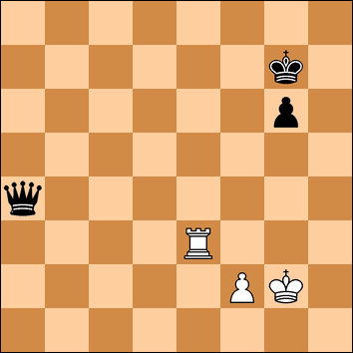
Fortress Example (from Freezer)

Slide 29
Fortress Example - XML
<?xml version="1.0"?>
<!DOCTYPE tablebase SYSTEM "http://www.freesoft.org/software/hoffman/tablebase.dtd">
<!-- Problem position 8/6k1/6p1/8/q7/4R3/5PK1/8 w -->
<tablebase>
<prune-enable color="white" type="discard"/>
<prune-enable color="black" type="concede"/>
<dtm/>
<piece color="white" type="king" location="e1 f1 g1 h1 e2 f2 g2 h2 e3 f3 g3 h3"/>
<piece color="black" type="king"/>
<piece color="white" type="rook" location="e3 g3"/>
<piece color="black" type="queen"/>
<piece color="white" type="pawn" location="f2"/>
<piece color="black" type="pawn" location="g6 g5 g4 g3"/>
<futurebase filename="kqkrp.htb"/>
<futurebase filename="krpkp.htb" colors="invert"/>
<futurebase filename="kqpkr.htb"/>
<futurebase filename="kqpkp.htb"/>
<prune color="black" move="P*" type="concede"/>
<prune color="white" move="P*" type="discard"/>
<prune color="white" move="R*" type="discard"/>
<prune color="white" move="K*" type="discard"/>
<output filename="fortress.htb"/>
</tablebase>

Slide 30
Hoffman – Design Features
Sophisticated indexing schemes
Sophisticated pruning controls
Futuremove tracking
Handles suicide variant
Can generate bitbases
Multi-threaded operation
Handles very large tablebases

Slide 31
Hoffman – combinadic4 encoding
Kings encoded with a dedicated table
2/4/8-way board symmetry
Omits side-to-move flag on color symmetric positions
“Semilegal” piece groups
Combinatorial numbers used to encode piece groups
“Plus” pawns
Nested piece groups

Slide 32
Combinatorial Numbers
A numbering scheme for k-combinations
k numbers chosen from a set of N without ordering and without replacement
The number corresponding to (ck, c2, c1) is

Slide 33
Combinatorial Numbers
0 | {1,0}
1 | {2,0}
2 | {2,1}
3 | {3,0}
4 | {3,1}
5 | {3,2}
6 | {4,0}
7 | {4,1}
8 | {4,2}
9 | {4,3}

Slide 34
Combinatorial Numbers - Encoding
Example:
The number corresponding to (27, 13) is

Slide 35
Combinatorial Numbers - Decoding
Binary search on a table:

Slide 36
Multithreading
Locks
  Spinlocks or std::mutex?
  Granularity
Compare and exchange
Memory ordering
Cache lines
Debugging

Slide 37
Compare and Exchange
/* MemoryEntriesTable - an EntriesTable held completely in memory */
class MemoryEntriesTable: public EntriesTable {
atomic_entry * entries;
atomic_entry & operator[](index_t index) {
return entries[index];
}
};
/* a discard; just decrement movecnt */
nonatomic_entry expected = entriesTable[index];
nonatomic_entry desired;
if (expected.is_normal_movecnt()) {
do {
desired = expected;
desired.set_movecnt(desired.get_movecnt() - movecnt);
} while (!entriesTable[index].compare_exchange_weak(expected, desired));
}

Slide 38
atomic_entry / nonatomic_entry
typedef entry<std::atomic<entry_t>, true> atomic_entry;
typedef entry<entry_t, false> nonatomic_entry;
template <typename T, bool isAtomic> class entry {
T e;
/* nonatomic_entry needs to expose 'e' to atomic_entry */
friend atomic_entry;
public:
/* atomic_entry can be implicitly converted to nonatomic_entry (when we read the array), and a
* nonatomic_entry can be atomically assigned to an atomic_entry (when we write the array). A
* third possibility, for atomic_entry only, is compare_exchange_weak().
*/
template <bool A=isAtomic, typename = typename std::enable_if<A>::type>
operator nonatomic_entry () { return nonatomic_entry(e); }
template <bool A=isAtomic, typename = typename std::enable_if<A>::type>
atomic_entry & operator=(const nonatomic_entry &val) {
e = val.e;
return *this;
}
template <bool A=isAtomic, typename = typename std::enable_if<A>::type>
bool compare_exchange_weak(nonatomic_entry & expected, nonatomic_entry desired) {
return e.compare_exchange_weak(expected.e, desired.e);
}

Slide 39
atomic_entry / nonatomic_entry
/* Bitfields can be accessed for both types. Atomic access requires a bit more work, though. */
unsigned int get_unsigned_bitfield(int offset, int bitmask) {
return (e >> offset) & bitmask;
}
template <bool A=isAtomic>
typename std::enable_if<!A, void>::type set_unsigned_bitfield(int offset, int bitmask, unsigned int val) {
e &= ~(bitmask << offset);
e |= (val & bitmask) << offset;
}
template <bool A=isAtomic>
typename std::enable_if<A, void>::type set_unsigned_bitfield(int offset, int bitmask, unsigned int val) {
entry_t expected = e;
entry_t desired;
do {
desired = expected;
desired &= ~(bitmask << offset);
desired |= (val & bitmask) << offset;
} while (! e.compare_exchange_weak(expected, desired));
}

Slide 40
atomic_entry / nonatomic_entry
void set_raw_DTM(int dtm) {
set_signed_bitfield(dtm_offset, dtm_bitmask, dtm);
}
int get_raw_DTM(void) {
return get_signed_bitfield(dtm_offset, dtm_bitmask);
}
void set_movecnt(unsigned int movecnt) {
set_unsigned_bitfield(movecnt_offset, movecnt_bitmask, movecnt);
}
unsigned int get_movecnt(void) {
return get_unsigned_bitfield(movecnt_offset, movecnt_bitmask);
}

Slide 41
Q: How do you update a table that can't fit in RAM?

Slide 42
Q: How do you update a table that can't fit in RAM?
A: Use an intermediate data structure

Slide 43
Proptables

Slide 44
Proptables

Slide 45
Proptables

Slide 46
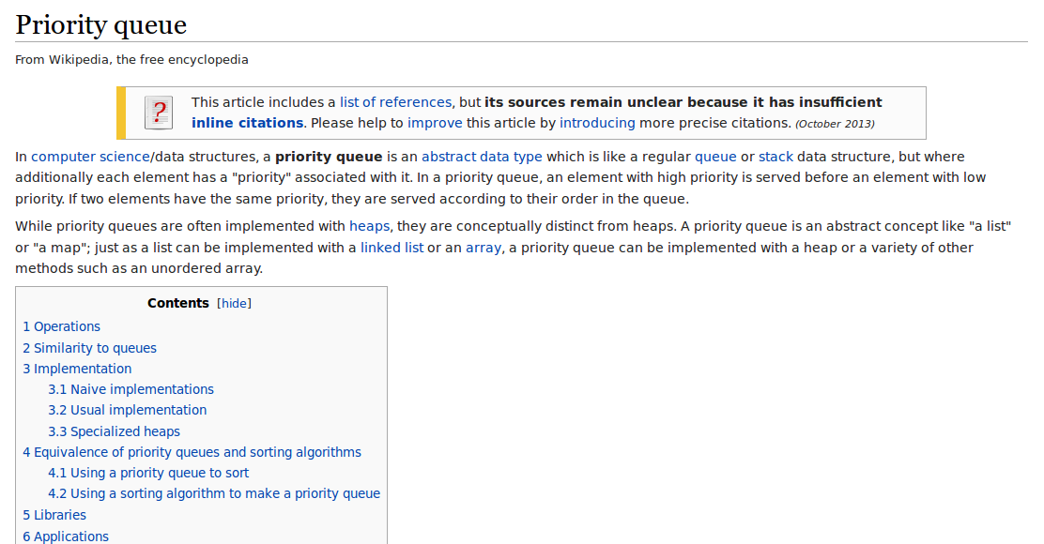
Priority Queue

Slide 47
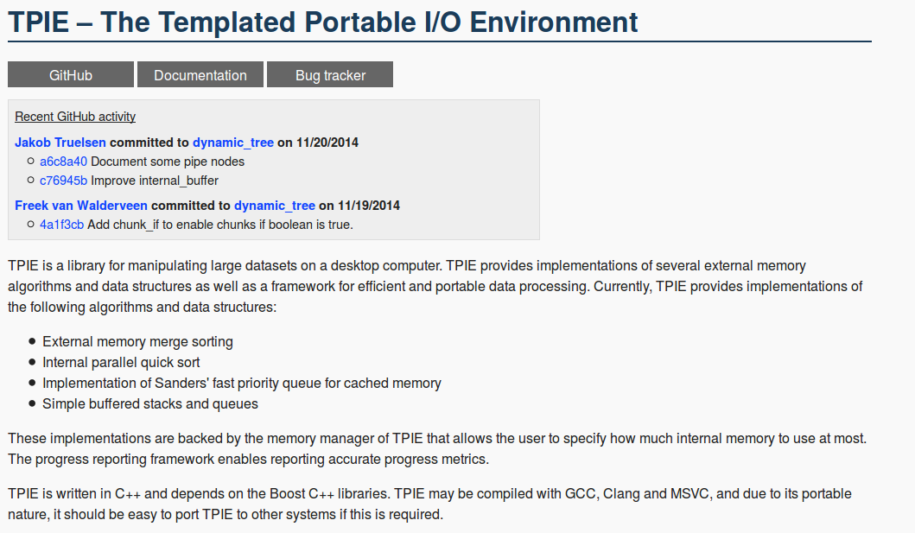
TPIE

Slide 48
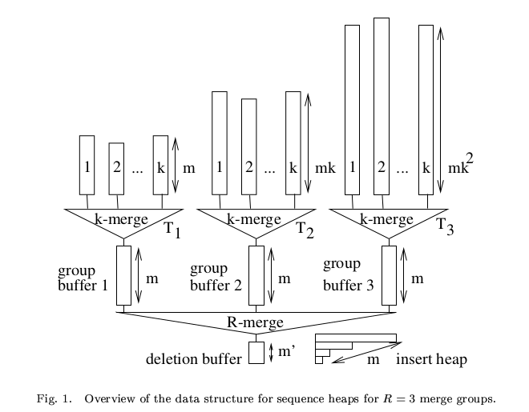
Sander's Priority Queue

Slide 49
Knuth's Merging Tree
/* A sorting network.
*
* We're reading from a container of pointers to subcontainers. Each subcontainer is itself sorted,
* but now we impose a total sort on all of them. We do this by maintaining a binary tree (the
* sorting network), with the subcontainers 'feeding' the leaves and each non-leaf being the
* less-than comparison of the two nodes below it. We also track which subcontainer each entry came
* from originally. Once initialized, we just read the root of the tree to get the next entry, then
* refill whichever leaf we got the entry from (that's why we track subcontainers for each entry),
* and run back up the tree from that leaf only, recomputing the comparisons. It's laid out in
* memory as an array, like this (in this example, highbit is 4):
*
* -4
* /
* /-2--5
* 1
* \-3--6
* \
* -7
*
* so that we can run that last step (backing up the tree, from right to left, in the diagram), just
* by right shifting the index. I got this idea from Knuth.
*/

Slide 50
Test Suite
# Open a non-existent tablebase
92512a58a45a635b99123de0b18943d5 1 doesNotExist.htb
# Probe an index
80ffb5db2bcfd5e9cf437958c63b9a43 258856\\nc1xd2 kqkq.htb kqk.htb
# attempt to probe an index larger than the valid range (tests 1.812)
27cc4a87b20e7b6a1db3d678c14f761f 5677889 kqkq.htb kqk.htb
# Some basic probes
0f56531789bae988ab35ce39d58be26c 8/8/K6k/8/3pP3/8/8/8\ w kpkp.htb kpk.htb kqk.htb
3e668b9c57c8b82f54210058e9ee51a9 8/8/K6k/8/4Q3/8/8/8\ w kqk.htb
# Probe an en passant position and capture
3bfd755a85246c8394e7cf59c4e07707 8/8/K6k/8/3pP3/8/8/8\ b\ -\ e3\\nd4xe3 kpkp.htb kpk.htb

Slide 51
C++11 move semantics
C++ had copy constructors and copy assignment:
Type(Type & source);
Type & operator=(Type & source);
C++11 introduces move constructors and move assignment:
Type(Type && source);
Type & operator=(Type && source);

Slide 52
C++11 move semantics
typedef struct tablebase {
/* I want an xmlpp::DomParser instance variable, to hold the tablebase's associated XML
* structures, like this:
*
* xmlpp::DomParser parser;
*
* Unfortunately, xmlpp::DomParser is NonCopyable and libxml++ 2.6 doesn't implement C++11 move
* semantics, so this would make tablebase objects non-movable and non-copyable, creating
* problems putting them in an array.
*
* I use a unique_ptr to get around this. It's ugly, but the net result is a xmlpp::DomParser
* that is attached to each tablebase, movable, and cleanly destroyed.
*/
std::unique_ptr<xmlpp::DomParser> parser = std::unique_ptr<xmlpp::DomParser>(new xmlpp::DomParser);
xmlpp::Document * xml;

Slide 53
To Do List
Add DTC and DTR metrics
Improved pawn handling
Ability to back propagate from Nalimov tablebases
GUI
Random access to tablebases
General speed improvements
Hadoop port

Slide 54
Seven-piece tablebases?
Lomosonov tablebases are reportedly 110 TB
Amazon's S3 storage: $0.0290 per GB·mo
  110 TB is $3,200/mo
Transmitting from Amazon to the Internet: $0.070 per GB
  Transmitting 110 TB from Amazon to Internet: $7,700
CPU time to generate?

Slide 55
That's it!
(hope you liked it)

