Slide 1

TenurIT Offerte & installatieplan
Gent Groep 06

Slide 2

TenurIT
Gent
ICT-infrastructuur
In-house datacenter

Slide 3
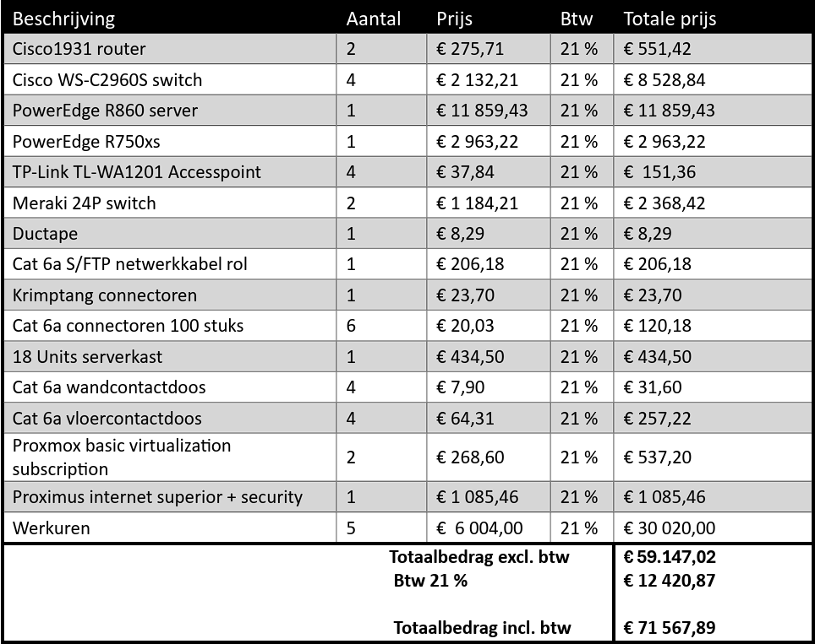
Offerte

Slide 4
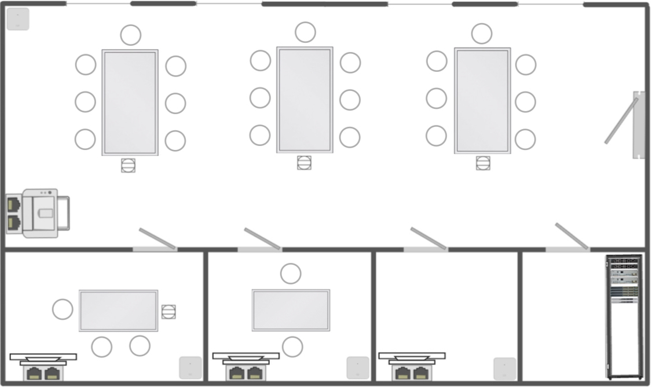
Installatieplan

Slide 5
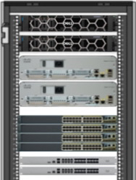
Installatieplan
Inhoud
- 2 servers
PowerEdge R860 server
PowerEdge R750xsz
- 2 Cisco1931 routers
- 4 Cisco WS-C2960S switches met 48 poorten
- 2 Meraki switches

