Slide 1

DATA-303 BOOK PRESENTATION
SHERISE IMMANUELA
FACTFULNESS
BY HANS, OLA, AND ANNA ROSLING (2018)

Slide 2
THE FACTFULNESS QUIZ
01
IN THE LAST 20 YEARS, THE PROPORTION OF THE WORLD POPULATION LIVING IN EXTREME POVERTY HAS . . .
A. Almost doubled
B. Remained more or less the same
C. Almost halved
How accurate is your view of the world?

Slide 3
THE FACTFULNESS QUIZ
02
HOW MANY OF THE WORLD’S 1-YEAR-OLD CHILDREN TODAY HAVE BEEN VACCINATED AGAINST SOME DISEASE?
A. 20%
B. 50%
C. 80%
How accurate is your view of the world?

Slide 4
THE FACTFULNESS QUIZ
03
IN 1996, TIGERS, GIANT PANDAS, AND BLACK RHINOS WERE ALL LISTED AS ENDANGERED. HOW MANY OF THESE THREE SPECIES ARE MORE CRITICALLY ENDANGERED TODAY?
How accurate is your view of the world?
A. Two of them
B. One of them
C. None

Slide 5
01
IN THE LAST 20 YEARS, THE PROPORTION OF THE WORLD POPULATION LIVING IN EXTREME POVERTY HAS . . .
03
IN 1996, TIGERS, GIANT PANDAS, AND BLACK RHINOS WERE ALL LISTED AS ENDANGERED. HOW MANY OF THESE THREE SPECIES ARE MORE CRITICALLY ENDANGERED TODAY?
A. Almost doubled
B. Remained more or less the same
C. Almost halved
A. Two of them
B. One of them
02
HOW MANY OF THE WORLD’S 1-YEAR-OLD CHILDREN TODAY HAVE BEEN VACCINATED AGAINST SOME DISEASE?
C. None
A. 20%
B. 50%
C. 80%

Slide 6
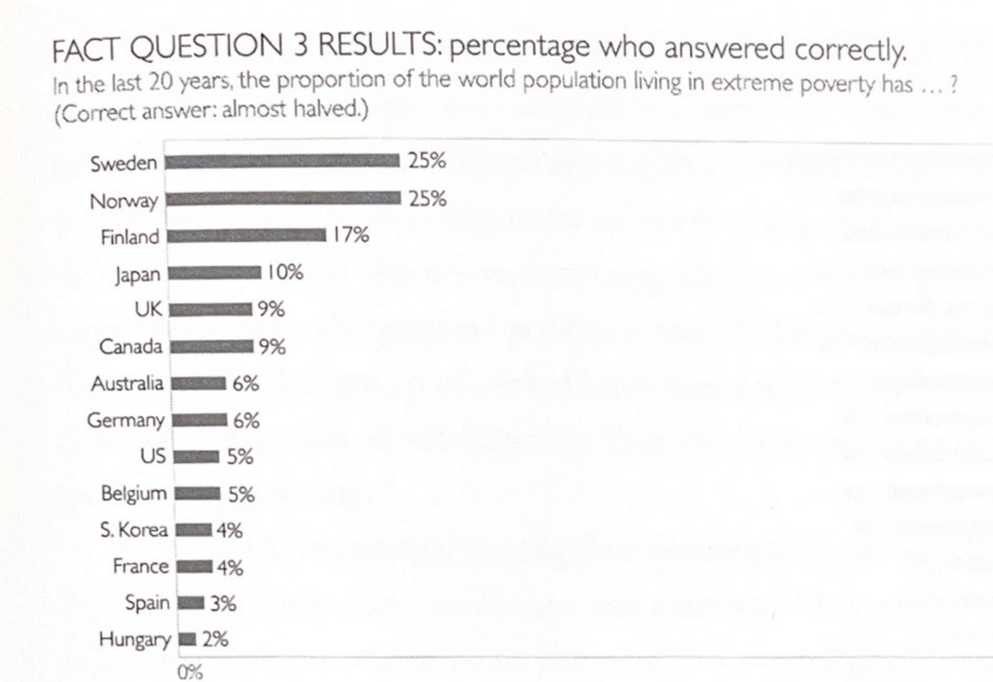
On average only 7% in the most educated countries get it right.
People guess worse than a random choice (1 out of 3)

Slide 7

WORLD POPULATION (BILLION) BY FOUR INCOME LEVELS
$2/day
$8/day
$32/day
L2
L3
L4
L1
Low Income
(Extreme Poverty)
High Income
Middle Income

Slide 8
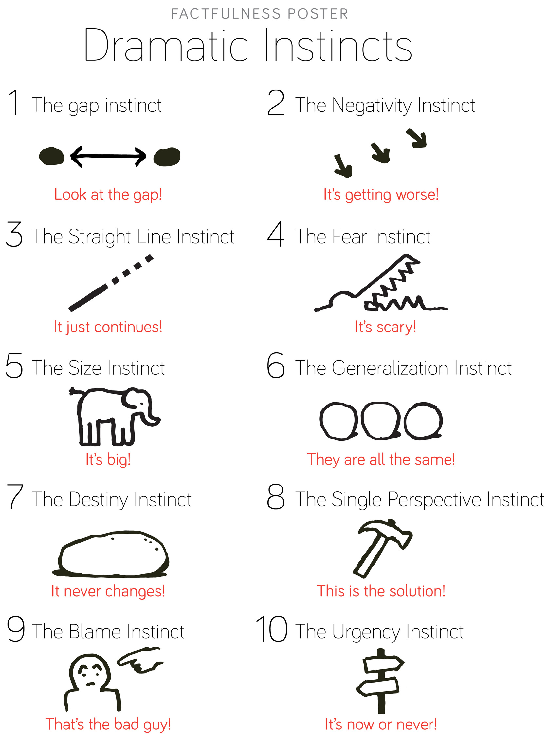

Slide 10

KEY TAKEWAYS & RECOMMENDATION
The world is improving in many ways, but our perception of it is often overly negative and pessimistic.
Data is essential for developing a fact-based worldview.
The media can distort our perceptions of the world, and it's important to seek out balanced sources of information.
Highly recommended: challenges readers to rethink their perceptions of the world

