Slide 1
OpenTelemetry

Slide 2
What is Distributed Tracing?
Distributed tracing is the capability for a tracing solution to track and observe service request as they flow through distributed systems by collecting data as the requests go from one service to another

Slide 3
What is OpenTelemetry?
OpenTelemetry is a collection of tools, APIs and SDKs that are deigned for the creation and management of telemetry data such as traces, metrics and logs.
A single, vendor-agnostic instrumentation library per language with support for both automatic and manual instrumentation
An end-end implementation to generate, emit, collect, process and export telemetry data
Open-standard semantic conventions to ensure vendor-agnostic data collection
Trace - A trace is a collection of operations that represents a unique transaction handled by an application and its constituent services
Span - A span is a single operation within trace
Span contains the following information: Method name, service name, operation name, start time of the operation, end duration of the operation, name and ip address of the service

Slide 4
OpenTelemetry Advantage
Backed by major cloud vendors :OpenTelemetry is an open-source project under Cloud Native Computing Foundation backed by major cloud providers like Microsoft and Google. As such, it has a wide community support as well as support by most APM and observability vendors.A single, vendor-agnostic instrumentation library per language with support for both automatic and manual instrumentation
Reduced overhead for telemetry data: OpenTelemetry reduces overhead from your application to create and manage telemetry data. Your application is decoupled from OpenTelemetry implementation as OpenTelemetry provides an API to interact with. Telemetry is collected by otel-collectors which can receive, process and export data in multiple data formats.
OpenTelemetry Tracing API is stable: OpenTelemetry has stable tracing API release in Java, .NET, Javascript, Python, and Erlang.
Vendor-agnostic data formats :OpenTelemetry provides an otel-collector that can be used to receive trace data in multiple formats. Otel-collector also provides processors and exporters using which you can choose to export the collected data in your required format.Span - A span is a single operation within trace
Easy set-up and implementation : OpenTelemetry libraries come with default support for tracing. You just need to configure OpenTelemetry collectors via a config file to collect traces data in the format you prefer.

Slide 5
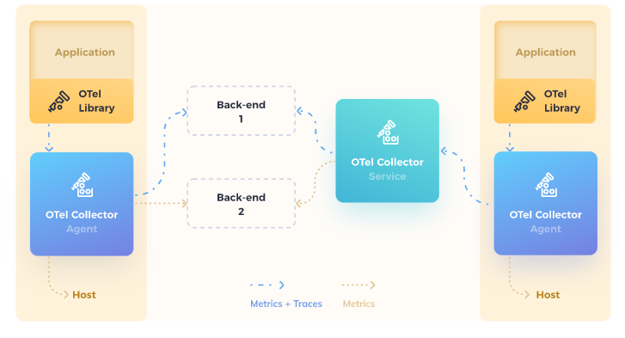
Architecture
Opentelemtry collector (OTel Collector/Agent) should be deployed as an agent on each host and configured to send telemetry data to the backend.
Opentelemtry instrumentation libraries (OTel Library) should be added to each application
The collector supports many popular open-source wire formats including Jaeger, Prometheus, and Fluent Bit.
Opentelemtry is flexible and extensible to support a board range of open-source and commercial solutions

Slide 6
What OpenTelemetry is not?
Opentelemetry is not an observability back-end like Jaeger/prometheus.
Instead, it supports exporting data to a variety of open-source and commercial back-ends

Slide 7
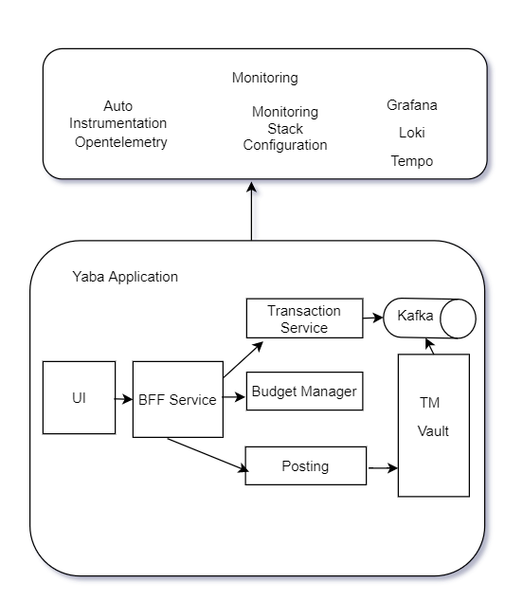
Automatic Instrumentation - Java Apps
file: '%clr(%d{yyyy-MM-dd HH:mm:ss.SSS}){faint} %clr(%5p) %clr([${spring.application.name},%X{trace_id},%X{span_id}]) %clr(${PID:- }){magenta} %clr(---){faint} %clr([%15.15t]){faint} %clr(%-40.40logger{39}){cyan} %clr(:){faint} %m %n%wEx’
- JAVA_OPTS=-javaagent:./opentelemetry-javaagent-all.jar -Dotel.traces.exporter=jaeger -Dotel.exporter.jaeger.endpoint=http://tempo:14250 -Dotel.metrics.exporter=none -Dotel.resource.attributes=\"service.name=tm-core-bucket-manager\" -Dotel.javaagent.debug=false
No code change
Instrumentation after post compilation
Pass OTEL agent and attributes as JAVA_OPTS
Opentelemetry Configuration/Monitoring Stack
isolated rom the application
Support for major Languages. Java, Ruby, Python Javascript, Golang etc
Automatically capture traces for build in libraries HTTP Clients, HTTP Servers and Frameworks and Database Clients.

Slide 8
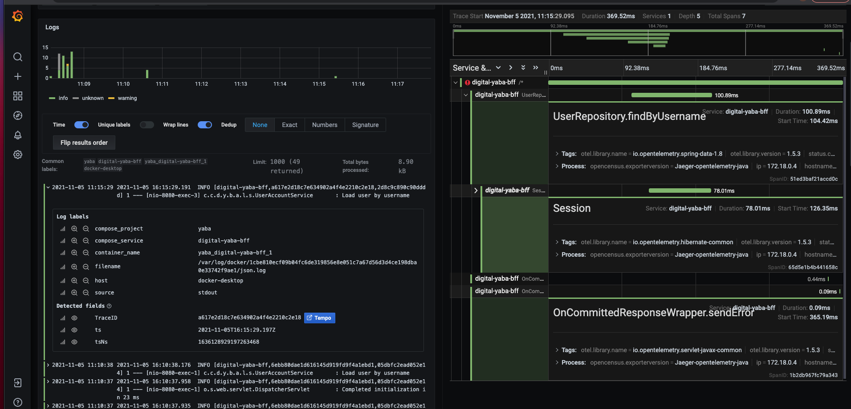
Automatic Instrumentation - Java Apps

Slide 9
Performance Impact
Auto instrumentation significantly decreases the barrier to adopting observability. But it adds additional overhead to program execution.
Benchmark the application with auto-tracing enabled vs auto-tracing disabled.
OpenTelemetry api’s follows the two key principles to minimize the performance overhead.
Opentelemetry api’s not blocking end-user application by default
Not consuming unbounded memory resources

Slide 10
Manual Instrumentation - Java
Pom file
<dependency>
<groupId>io.opentelemetry</groupId>
<artifactId>opentelemetry-api</artifactId>
<version>1.2.0</version>
</dependency>
<dependency>
<groupId>io.opentelemetry</groupId>
<artifactId>opentelemetry-extension-annotations</artifactId>
<version>1.2.0</version>
</dependency>
public UserDetails loadUserByUsername(String username) throws UsernameNotFoundException {
log.info("Load user by username " );
User account = userRepository.findByUsername(username);
if (account == null) {
throw new UsernameNotFoundException("Could not find account with username $username!");
}
log.info("Add Roles to the user " + username);
addUserRoles();
. . .
. . .
}
@WithSpan
public void addUserRoles() {
log.info("Adding roles to the user");
Span span = Span.current();
span.setAttribute("template.a2", "user Adding roles to the user span");
span.addEvent("Adding roles to the user started", atttributes("321"));
try {
Thread.sleep(2000);
}
catch (InterruptedException e) {}
span.addEvent("Adding roles to the user End", atttributes("321"));
}
Add OTEL dependencies in pom file
Create new spans using WithSpan Annotation
Add event/attribute/logs to the new span.
Adding new Span

Slide 11
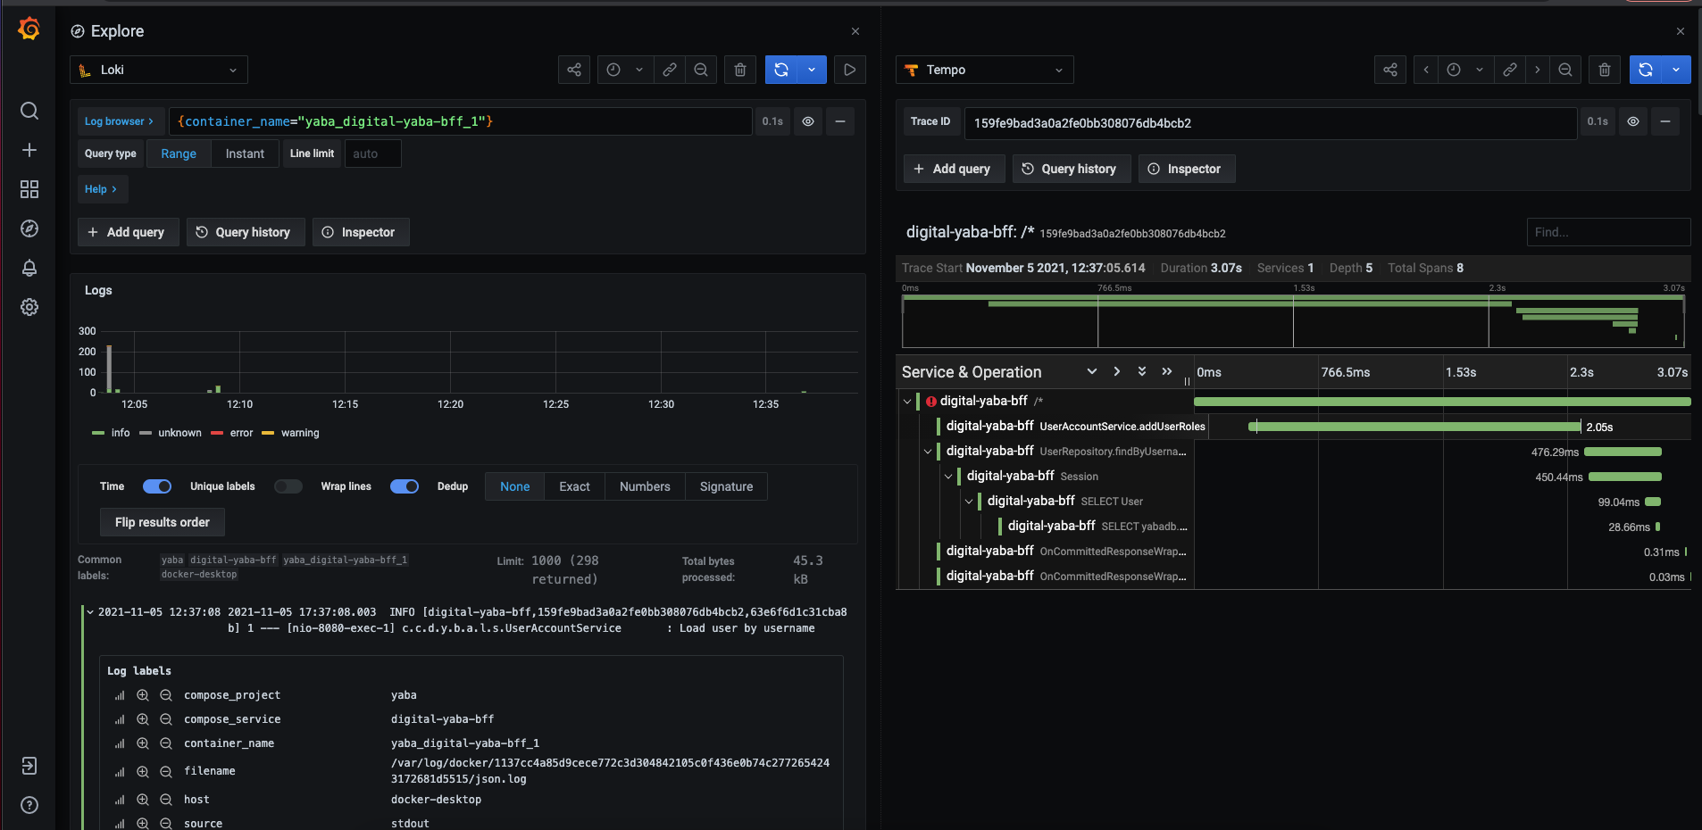
Manual Instrumentation - Java

Slide 12
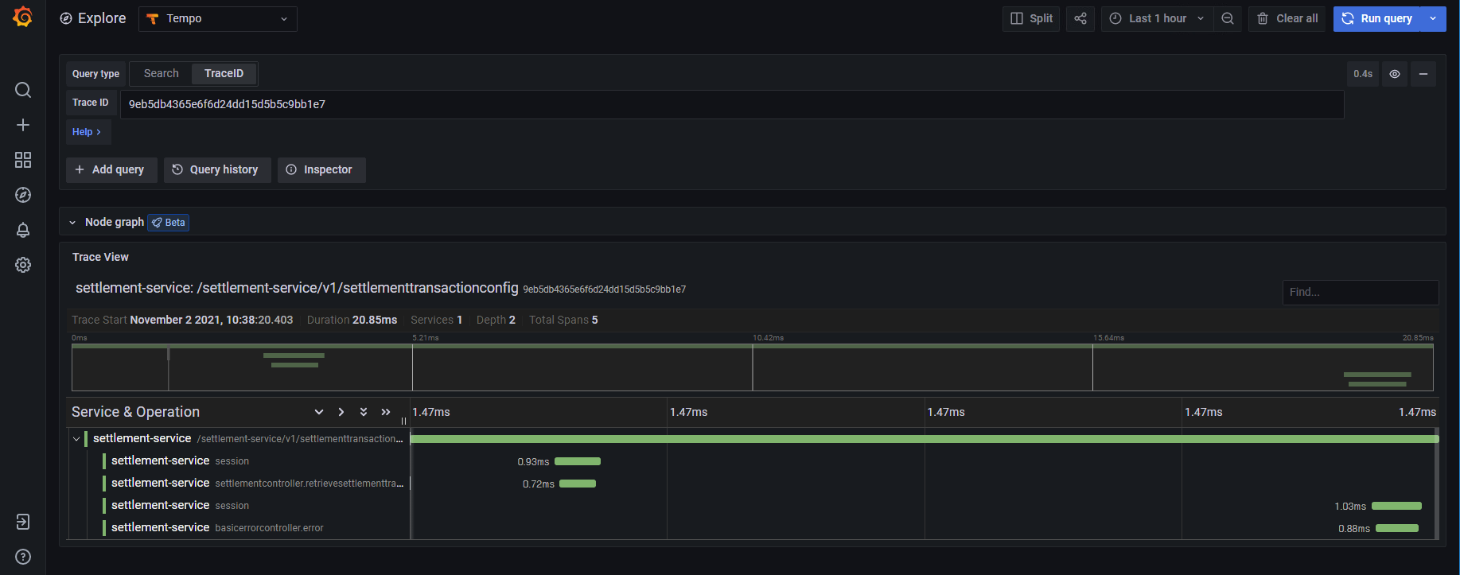
Photon Zipkin - Open Telemetry Tracing
Remove any code and configs/logs related to Zipkin tracing in the code
Add opentelmetry auto instrumentation. (Post compilation, Pass OTEL agent and attributes as JAVA_OPTS)
Photon-Settlement Service - Instrumented with Otel (no code change and post compilation

