Slide 1
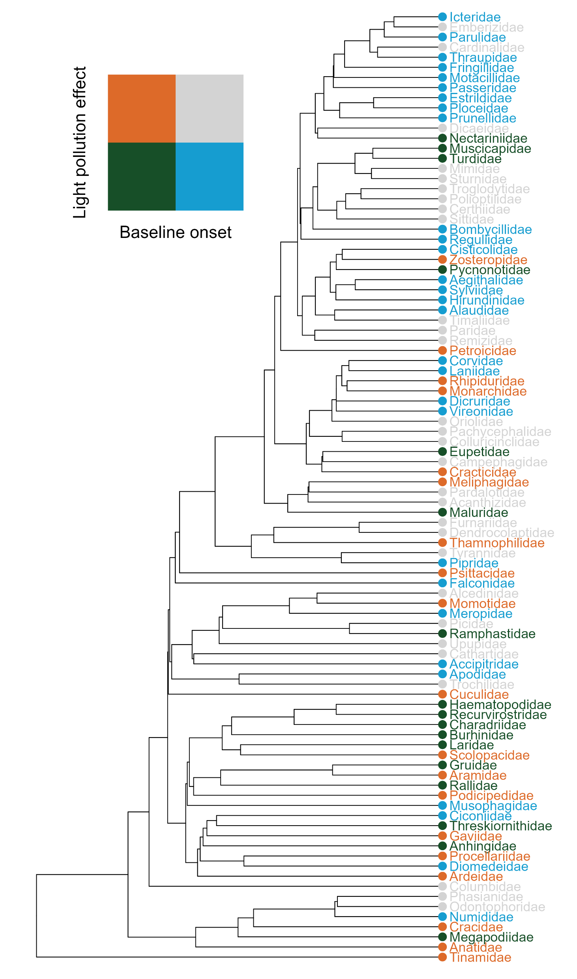
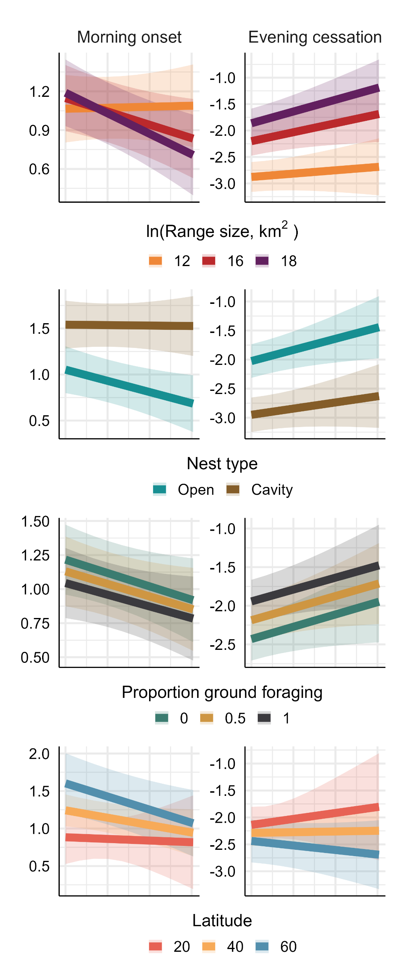
(A)
(B)
delay
delay
Light pollution effect
Light pollution effect
advance
advance
Baseline onset
Baseline onset
after
sunrise
before
sunrise
after
sunrise
before
sunrise
(C)
Time (hr) relative to sunrise or sunset
(D)
(E)

