Slide 1

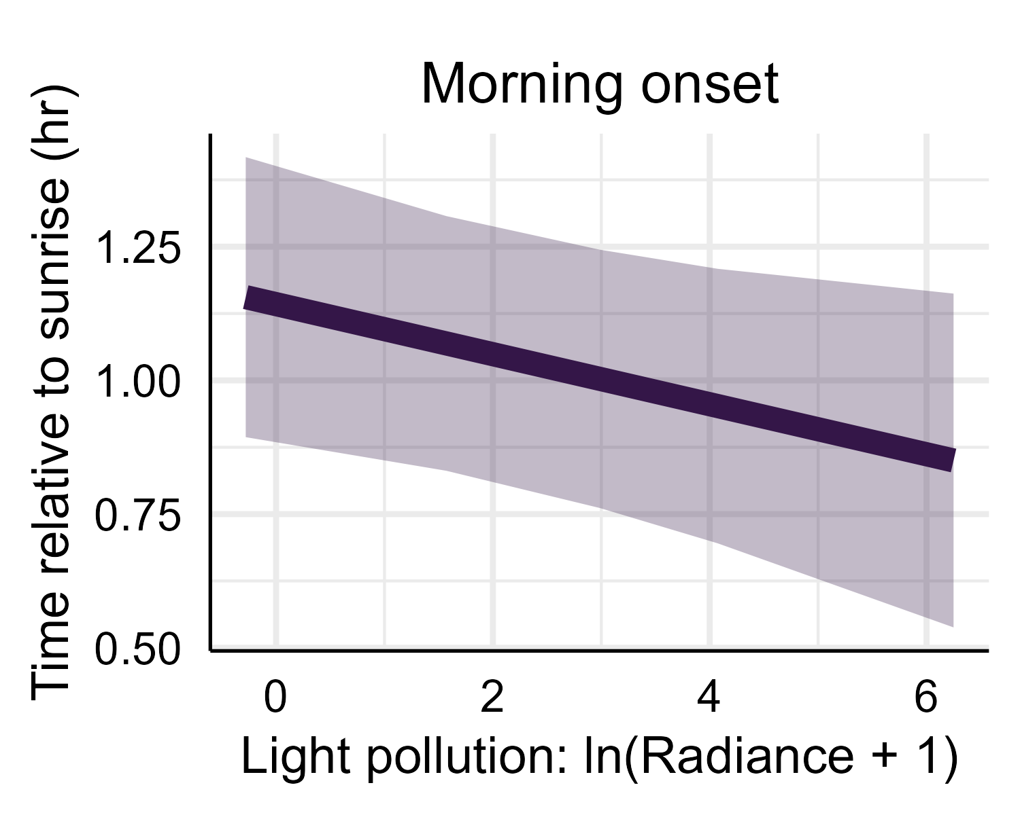
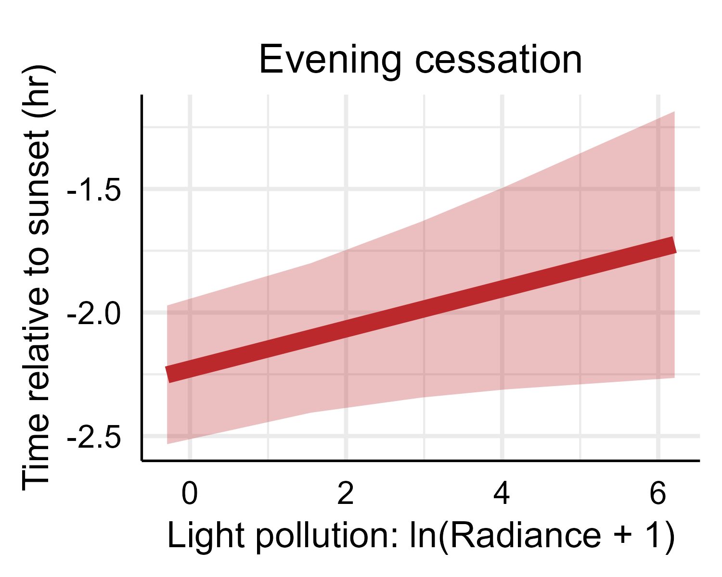
(a)
Amount of vocalization
cessation of vocalization extended 32 min
onset of vocalization advances 18 min
dark landscapes
bright landscapes
Time of day
(b)
(c)

